Slide 1
Platon Solutions GmbH

Slide 2
PLATON Solutions GmbH Grindelallee 176 20144 Hamburg

Slide 3
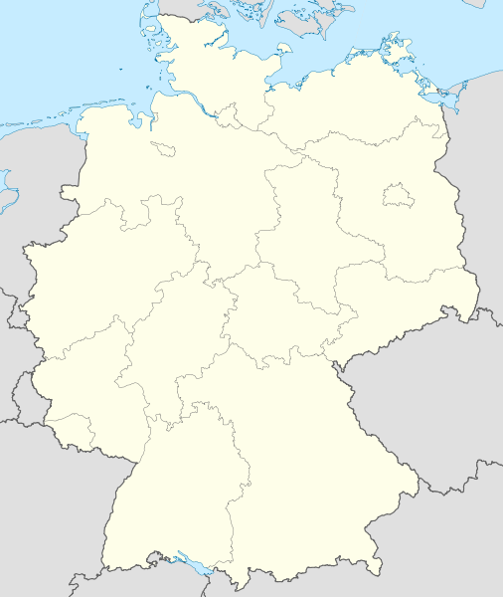
Hamburg

Slide 4
The goal
is to produce bioplastics from non-edible parts of the plant
The basics: biomass that contains lignin and cellulose, different sugars and Poly Lactic Acid (PLA)
Its processing is less energy consuming than that of conventional plastics.
It offers big advantages for the environment and the climate.
It values highly a sustainable eco-balance.
It reduces the carbon footprint and takes responsibility for the environment and future generations.

Slide 5
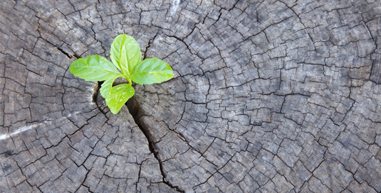
Plastics from renewable resources
substitute fossil resources like oil and gas
made from:
1. Different sugars
Sugars are extracted from starch, for example:
maize, wheat, beet root, sugar

Slide 6
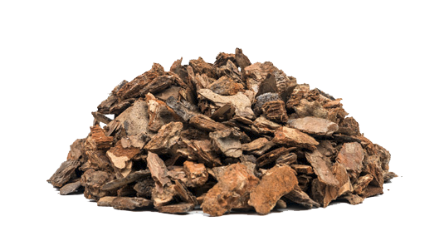
Residual biomass
2. Wood
huge reserves
forestry sector or the wood-processing industries
lignin and cellulose are taken from straw, rice and grain husks and wood

Slide 7
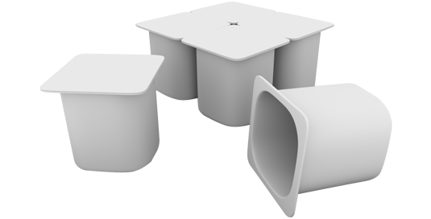
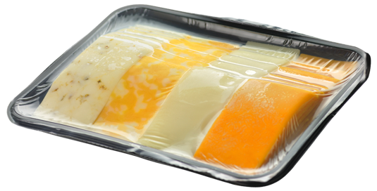
3. Biobased Poly Lactic Acid (PLA)
PLA is made of Lactic Acid Monomers.
PLA has the advantage of being suitable as a transparent packaging material as well as demonstrating a high degree of stability.

Slide 8
process innovation

Slide 9
Innovation
Technological company partner is GREEN SUGAR AG
Patents on this technology
With the multi-phase hydrochloric acid hydrolysis the company wins lignocellulosic biomass which they use for bio-based plastic products.

Slide 10
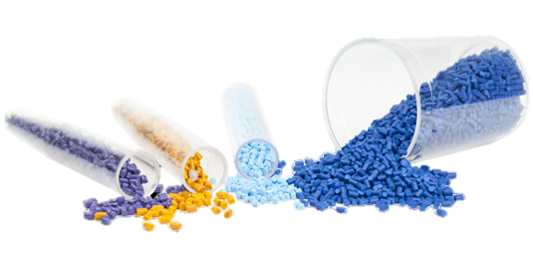
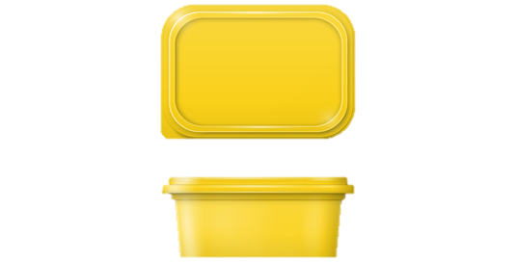
Bioplastic Products
The bioplastic granulats out of lignincellulose, different sugars and/or PLA can be used for many different packagings. This can be transparent packaging material like film as well as packaging of a high degree of stability.

Slide 11
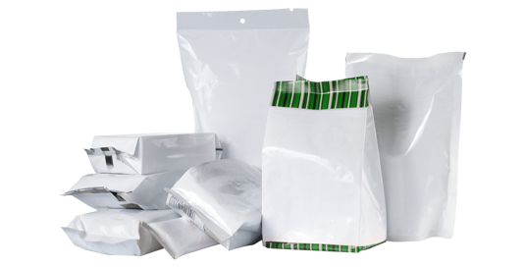
The Platon Solutions GmbH and the Green Sugar AG offer a solution to their clients to substitute their use of conventional plastics with environmentally friendly plastics that are non-conflicting with food.

Slide 12
Another Company:
MOSCA GMBH
Gerd-Mosca-Straße 1,
69429 Waldbrunn/Germany
Phone: +49 62 74 / 9 32 - 122
Fax: + 49 62 74 / 9 32 - 400 122
E-Mail: strap@mosca.com
Internet: www.mosca.com

Slide 13
SUSTAINABILITY
Muckental 2015
Sustainability is secured anchored in Mosca’s corporate philosophy as “Responsible Production” policy.
Innovative technologies, machinery and straps from Waldbrunn ensure energy efficient and safe operation of Mosca’s own and its customers’ processes worldwide, meeting the highest quality requirements.

Slide 14
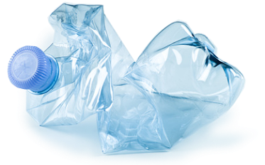
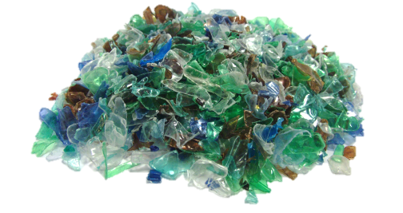
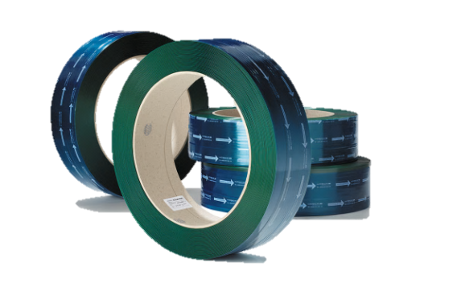
SUSTAINABLE MATERIALS
PET straps are completely made of recycled PET-bottles.
So 85 percent CO₂ emissions can be reduced compared to the use of virgin PET. This number corresponds to savings of 2,5 tons CO₂ per ton of produced material.
9% of any waste PET strapping can be recycled yet again and used, along with recycled bottle flakes to make further PET straps.
“bottle flakes“

Slide 15
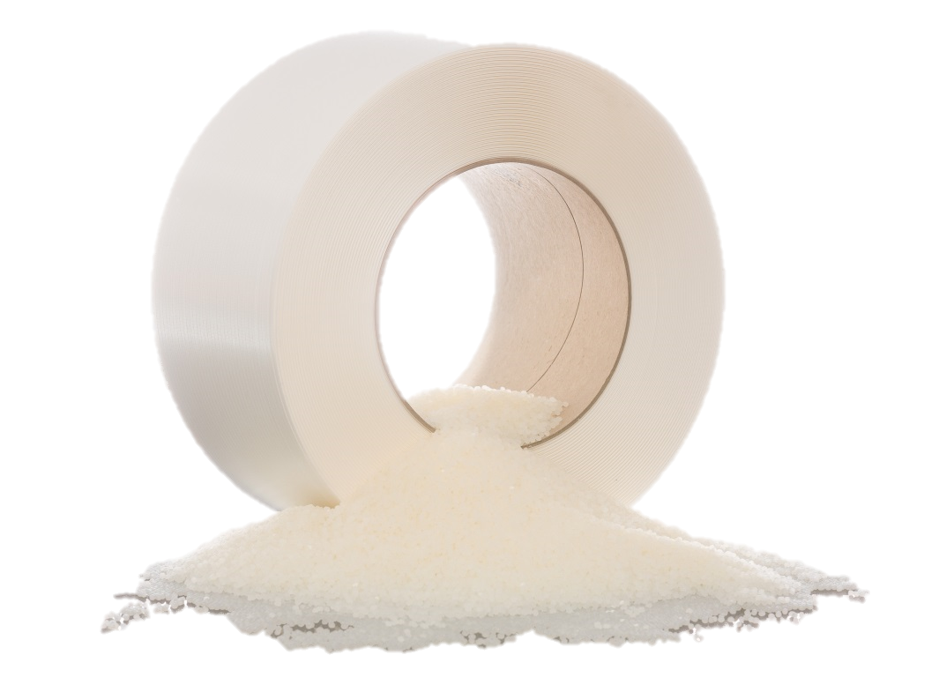
SUSTAINABLE MATERIALS
The future of strapping technology has already started at Mosca!
Plastic straps, developed of renewable raw material “polylactic acid” (PLA) are largely compounded of L-Lactic acid.
Within short time, PLA straps can easily be composted industrially to 100 percent after use.
Thus the PLA strap is biocompatible and environmentally friendly by producing from renewable raw materials.

Slide 16
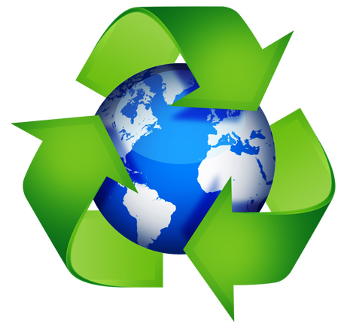
SUSTAINABLE MATERIALS
The future of strapping technology has already started at Mosca!
corn
lactid acid
biomass
“ECO-STRAP“
PLA
With “ECO-STRAP“ Mosca closes the cycle from renewable resources to the complete degradation of the packaging straps.

Slide 17
Thank you for your attention!

