Slide 1
GERMANY – second part

Slide 2
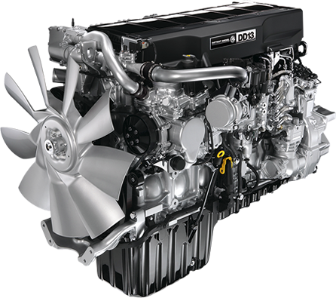
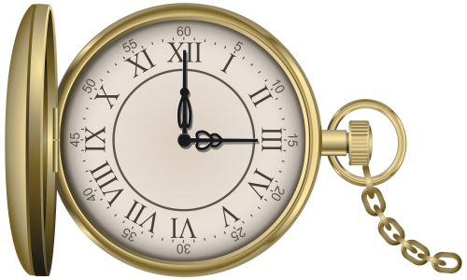
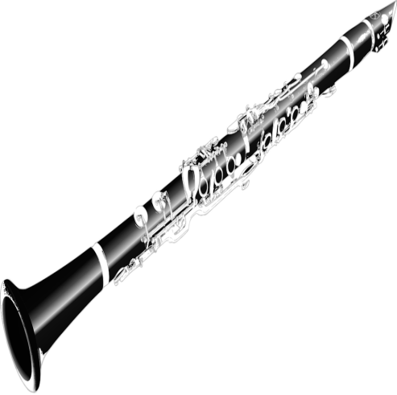
#6
Germany boasts some of world's most famous inventions – you can thank the Germans for the light bulb, the automated calculator.
That's not all – the Germans are also credited for the the invention of the clarinet, the pocket watch, television (partly), paraffin, petrol/gasoline & Diesel engines, the automobile engine, differential gear and other important devices, the motorcycle, the LCD screen and the Walkman.

Slide 3
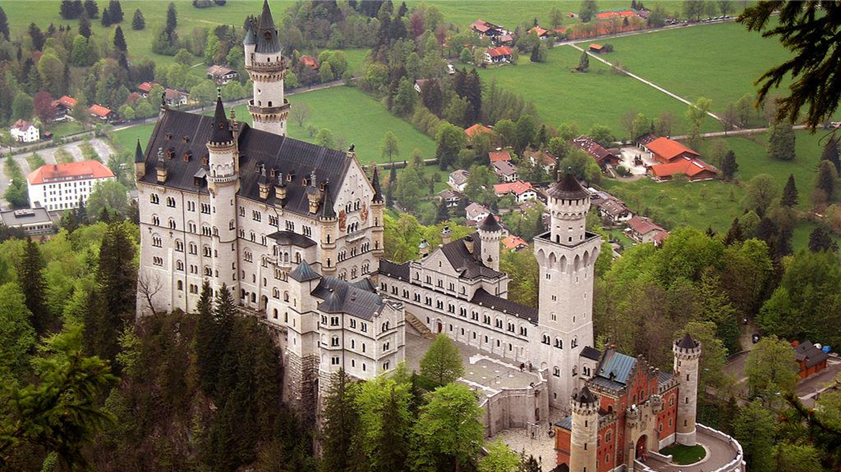
#7
Schloss sNeuschwanstein
The palace was commissioned by King Ludwig II of Bavaria a a refuge and a tribute to Richard Wagner. The palace wanted to be a personal refuge of the retired king, but it was opened to the paying public immediately after his death in 1886.

Slide 4
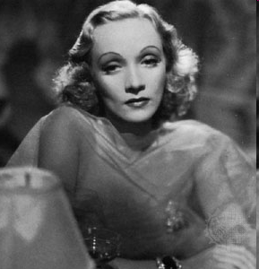
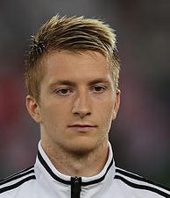
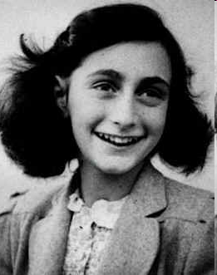
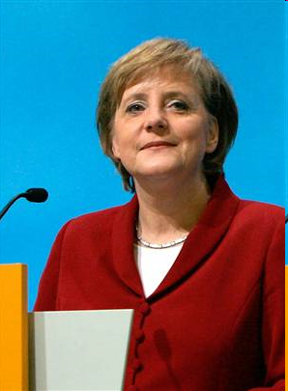
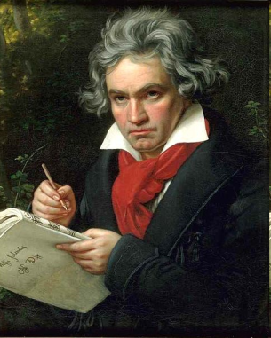
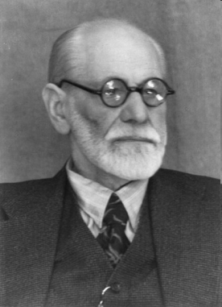
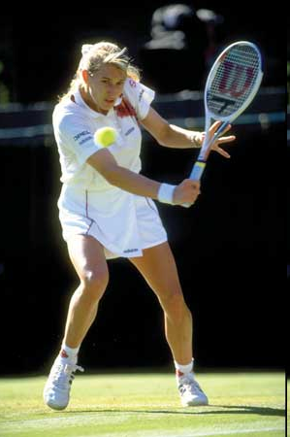
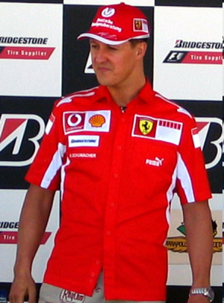
The famous Germans
A) Albert Einstein - theoretical physicist
B) Angela Merkel
C) Marlene Dietrich - actress and singer
D) Ludwig van Beethoven
E) Anne Frank- German-born diarist
F) Michael Schumacher – a racing driver
G) Steffi Graf - professional tennis player
H) Sigmund Freud - the founder of psychoanalysis
I) Marco Reus - professional footballer
J) Heidi Klum - model
A.
C.
I.
E.
B.
D.
H.
G.
F.
J.

Slide 5
Holidays
Christmas
New Year’s Eve
Easter
Mother’s Day

Slide 6
German Traditions

Slide 7
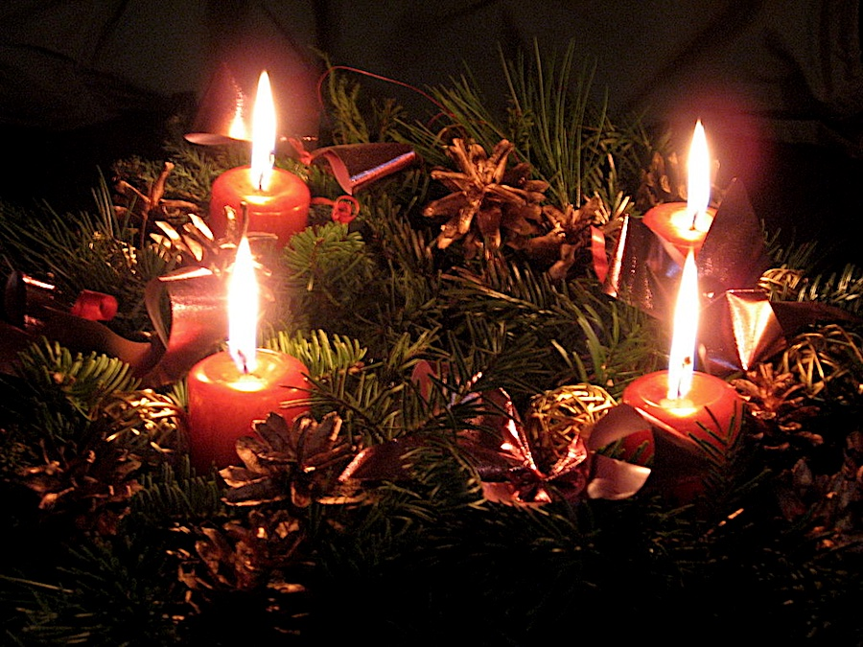
Christmas Time & Traditions in Germany
During the four weeks before Christmas, Germans celebrate Advent, a romantic and delightful time of the year, which is strongly linked to traditional Christmas markets in wonderful settings. You'll find plenty of hand-crafted Christmas decorations, cute little incense burners, wooden-carved toys and nativity scenes to place at the heart of your Christmas display. Germany's first Christmas market was recorded in 1393, and today there are thousands of them all over the country.

Slide 8
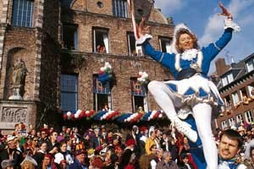
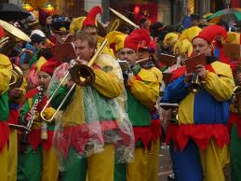
Karneval: Mardi Gras' German Cousin
Many of Germany's visitors remember this event. It happens about six weeks before Easter, or one week to 10 days leading up to the beginning of Lent. It starts with Cologne's two-and-half hour Rose Monday parade and includes huge "Karneval" floats bearing dozens of citizens dressed up in costumes. They toss fistfuls of candies to the noisy crowds on the sidewalks, exactly the way New Orleans's Mardi Gras crews toss plastic-beaded necklaces and coins.

Slide 9
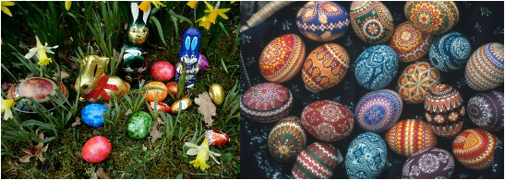
The Easter Bunny & the Tale of the Eggs
From the name to the bunny, it's all German. The name Easter was first appropriated by the Christian calendar. First it was the pagan festival Ostara, celebrated on the vernal equinox, around March 21 in the Northern hemisphere. Ostara was named for the pagan goddess of spring, Eostre. According to legend, she once saved a bird whose wings had frozen during the winter by turning it into a rabbit. Because the rabbit had once been a bird, it could lay eggs. And so it became the Easter Bunny.

Slide 10
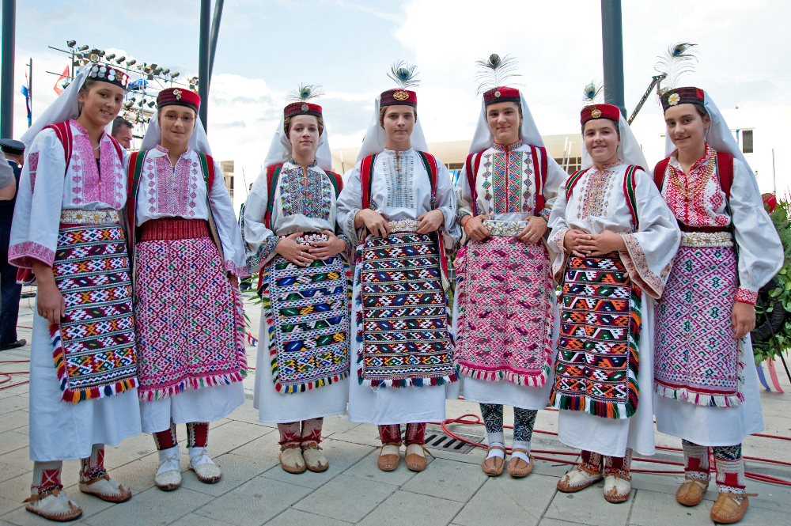
German vintage fashion

Slide 11
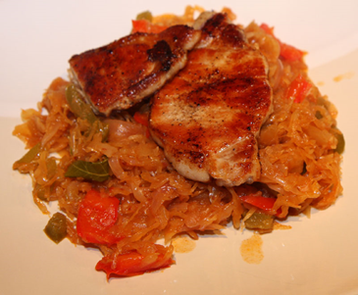
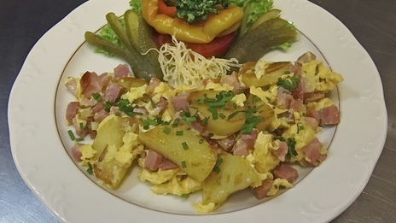
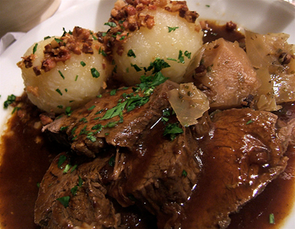
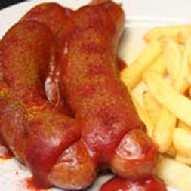
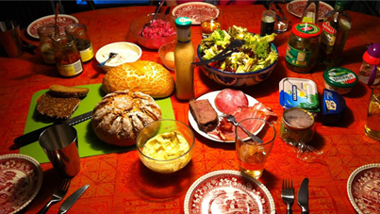
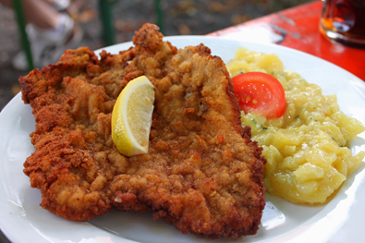
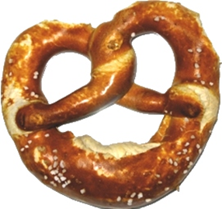
German cuisine
Very diverse usually a lot of potatoes
It varies depending on the region

Slide 12
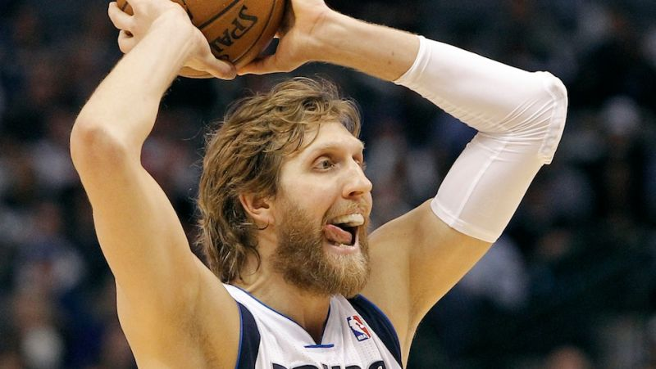
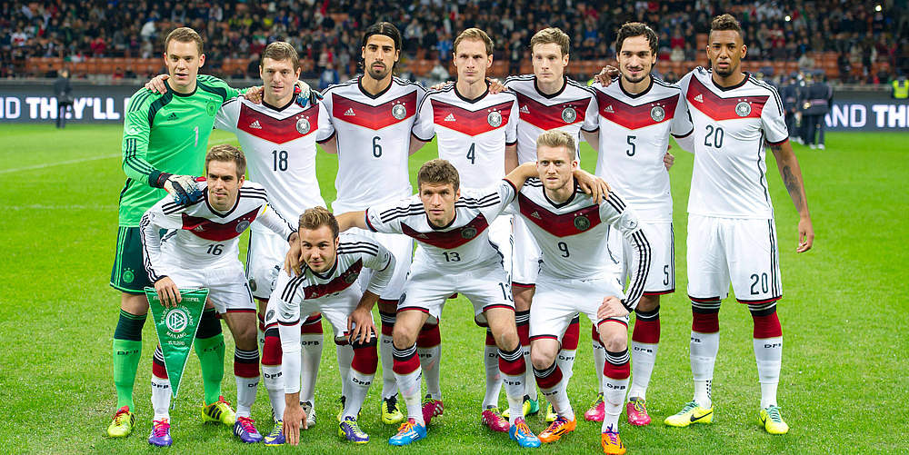
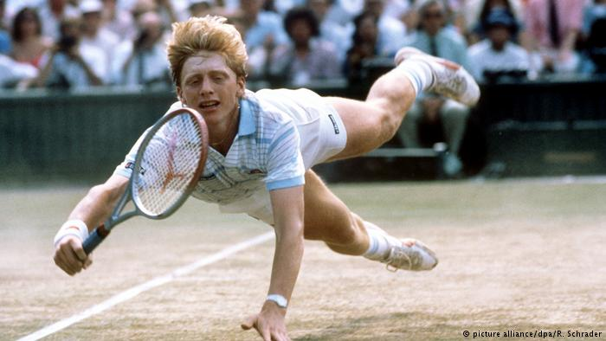
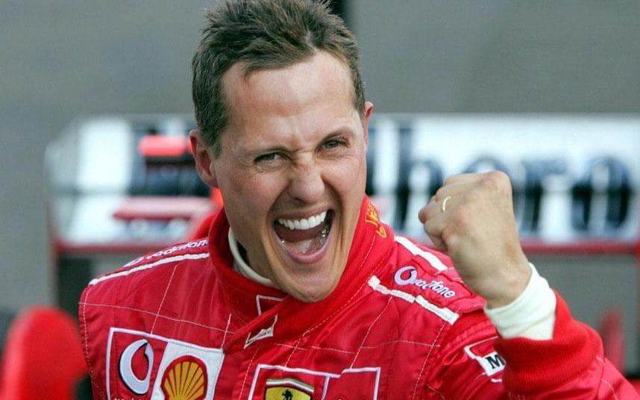
German sports
Germany national football team holds 4 World Cup titles.
Formula 1- Michael Schumacher and Sebastian Vettel hold together 11 World Champion titles
While Boris Becker was the youngest player to ever win the title at Wimbledon, Steffi Graf was on the top spot of female tennis players for years.
Dirk Nowitzki is by far the most famous German basketball player. After his Rookie season in 1998 he quickly became the best player on his team, the Dallas Mavericks. Quickly dubbed “German Wunderkind” Dirk Nowitzki won the NBA championship in 2011, his career highlight.

Slide 13
Funny German Expressions
If you don’t know a person well enough to forgo formalities, you can tell them that you have “not yet kept pigs together” by saying Wir haben zusammen noch keine Schweine gehütet!
A very artful way of saying that you don’t care at all: Das ist mir Wurst. (That’s sausage to me.)
In Germany, saying someone has a bird is the equivalent of calling them insane. Sie hat einen Vogel. (Literally, “She has a bird.”)
Ich verstehe nur Bahnhof. (I only understand “train station.”)This idiom comes in handy when you don’t really understand something

Slide 14
Thank you for your attention!

