Slide 1
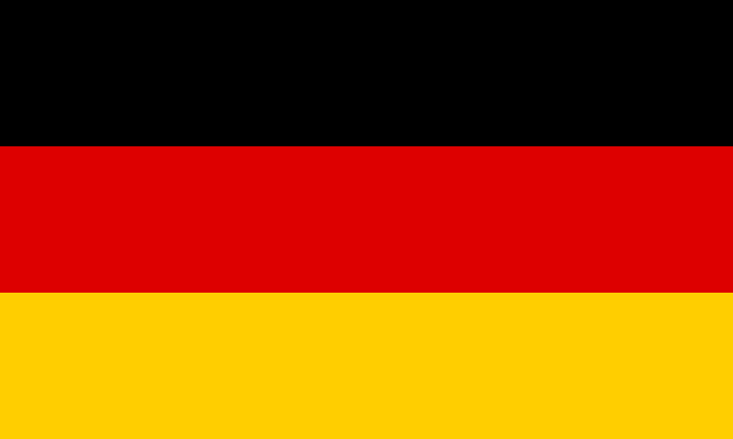
Germany
By Theodor Nichifor

Slide 2
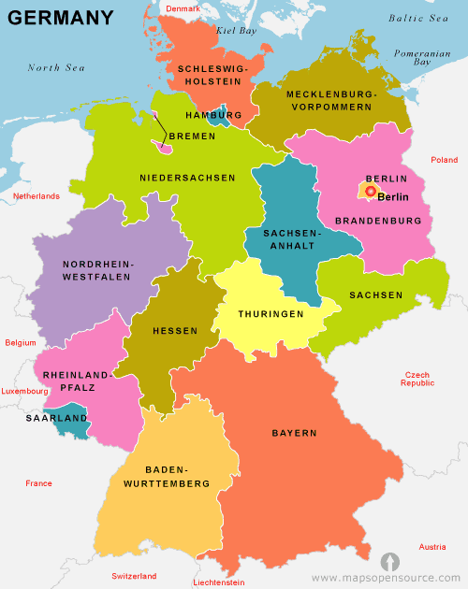
The country is Europe's second most populous after Russia, with more than 81 million people, according to the World Factbook. The German economy is the largest on the continent and the fifth largest in the world.
Germans place a high priority on structure, privacy and punctuality. The German people embrace the values of thriftiness, hard work and industriousness and there is great emphasis on making sure that "the trains run on time."

Slide 3
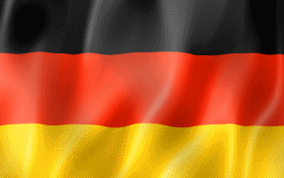
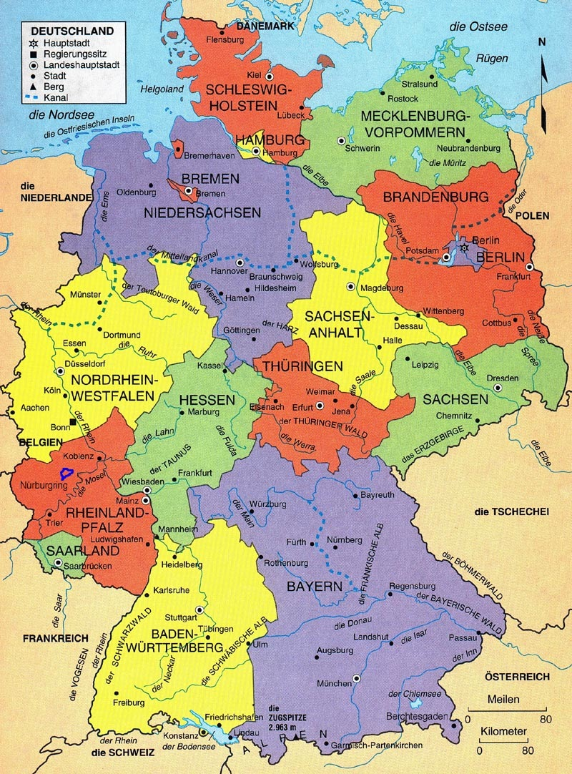
GERMANY
Consists of 16 parts and the capitol is Berlin and it’s official name is Bundesrepublik Deutschland.
The Flag of Germany is Black, Red, gold horizontal stripes (bottom-right). The flag can be hung vertically, but must be on a horizontal flagpole with the black facing furthest from the building. (bottom-left)
The estimated population is 82,425,000, Germany actually ranks in at 62 in land mass according to a size chart of the largest areas.
The Major religions are Protestant, Roman Catholic, und Rei Evangelishe Kirche.
The national currency is the euro, and the main exports are: Automobiles, Chemicals, Electronics, Foodstuffs, Machinery and Equipment, metals, textiles.

Slide 5
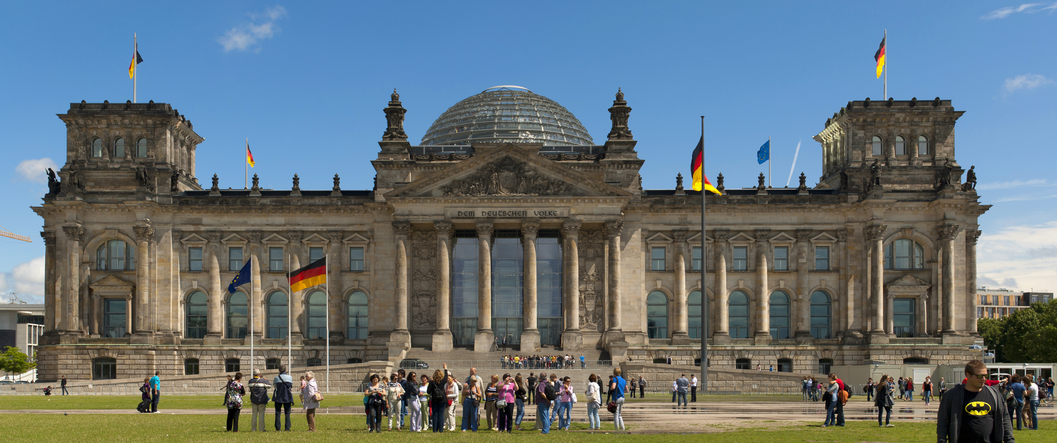
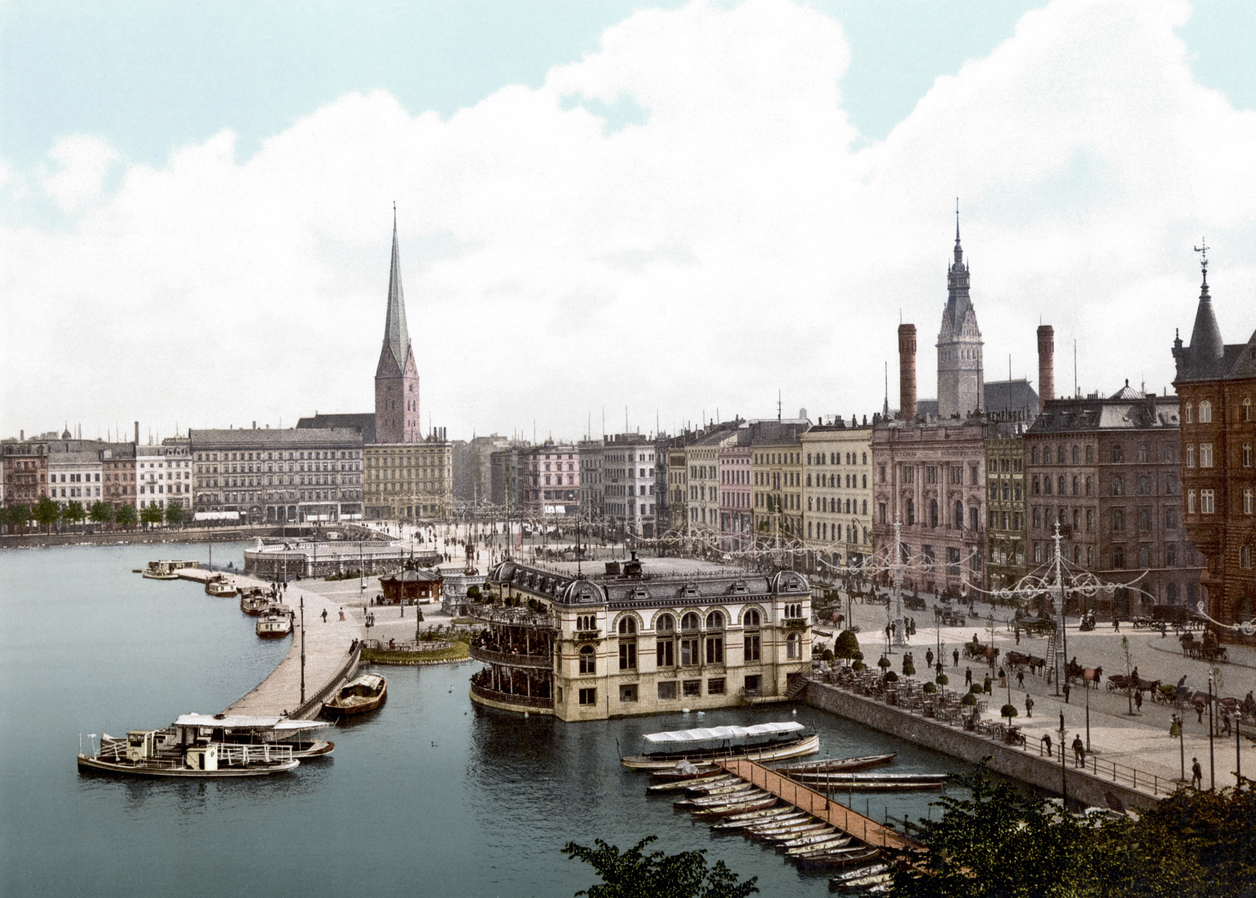
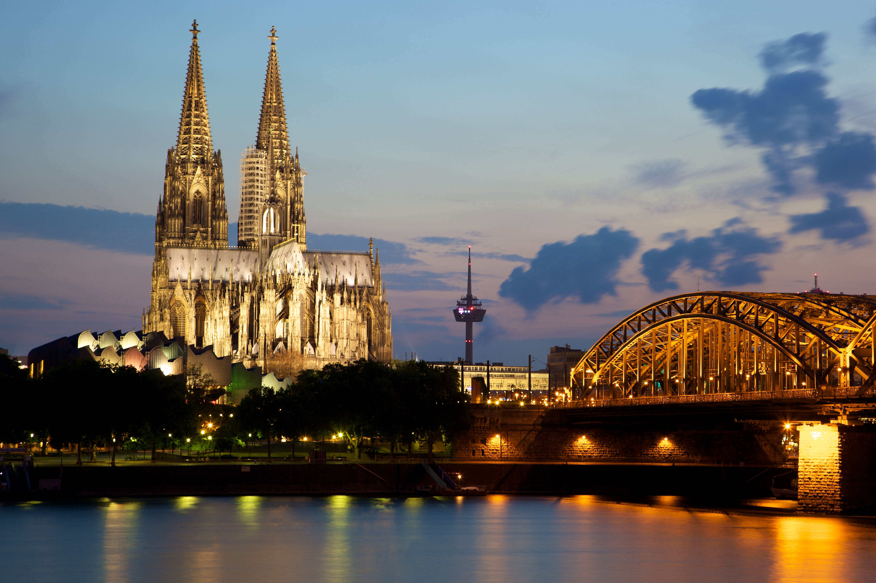
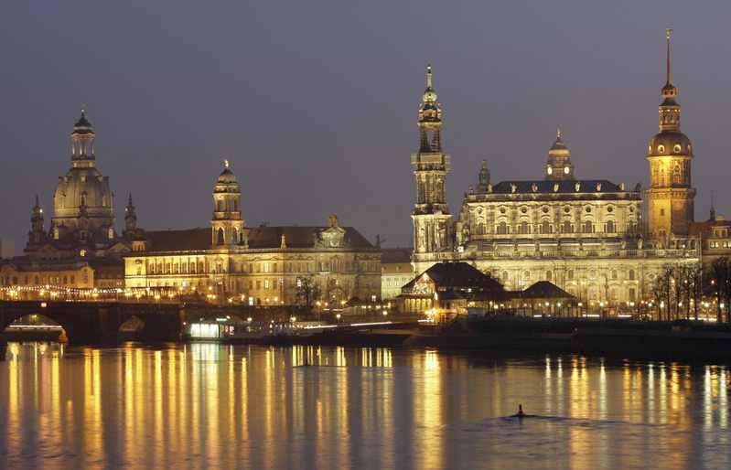
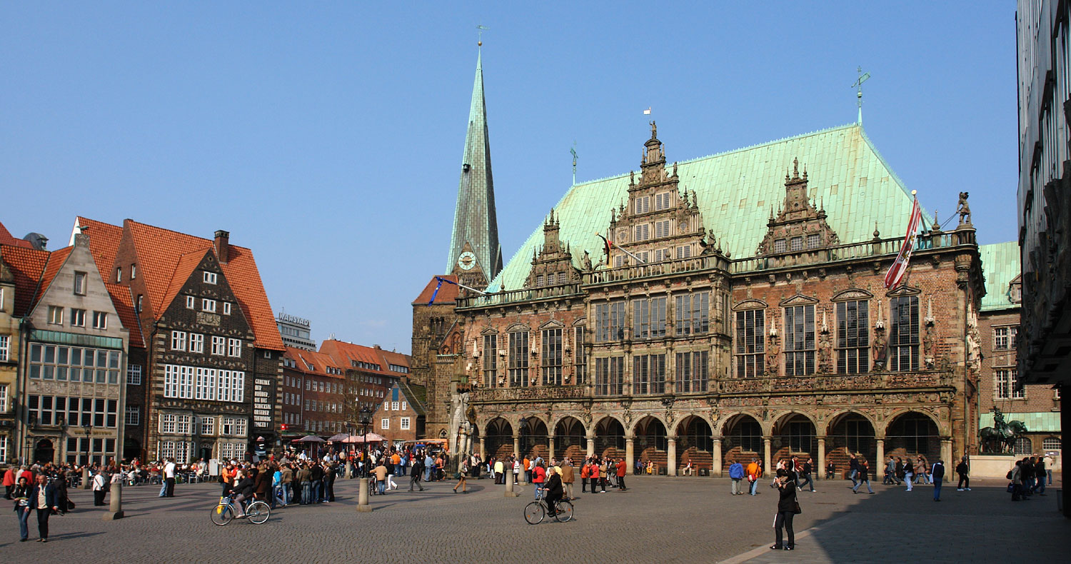
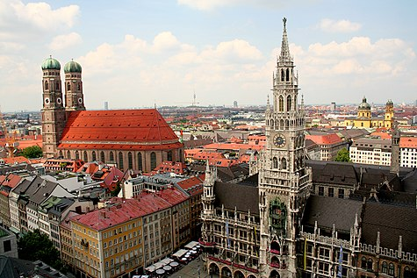
Biggest cities:
1.
1.Berlin
2.Hamburg
3.Cologne
2.
3.
4.
4.Dresden
5.Bremen
6.Munich
5.
6.

Slide 7
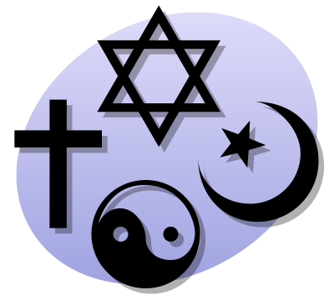
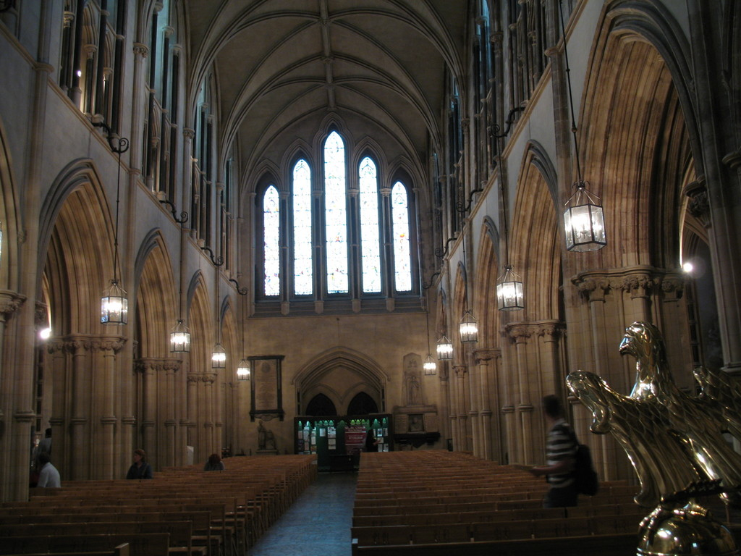
Religion In Germany
In Germany Religion is something that is considered to be personal. Very few Germans will engage in a religious conversation, and actually try to avoid the subject all together.
Germany does not have a strict separation of state and Church, not only that, but 12 of the 15 legal German holidays are Christian feast days.
Some of the religions of Germany are Lutheran, Roman Catholic, Protestant, Rei Evangelishe Kirche, etc..

Slide 8
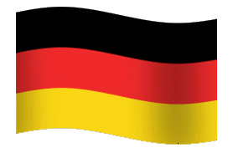
7 things you didn’t know about Germany

Slide 9
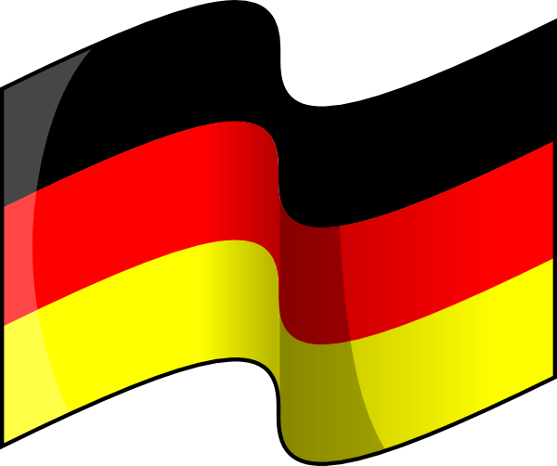
#1
Germany was the first country in the world to adopt Daylight saving time – DST, also known as summer time. This occured in 1916 in the midst of WWI and was put in place to conserve energy.

Slide 10
#2
Germany's capital centre has shifted seven times – these cities have all at one time or another been capitals of modern-day German territory: Aachen (during the Carolingian Empire), Regensburg, Frankfurt-am-Main, Nuremberg, Berlin, Weimar (unofficially, during unrest in Berlin), Bonn (and East Berlin), and, since 1990, Berlin again.

Slide 11
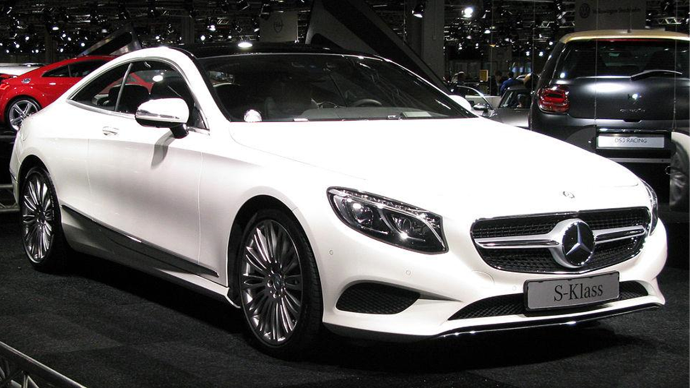
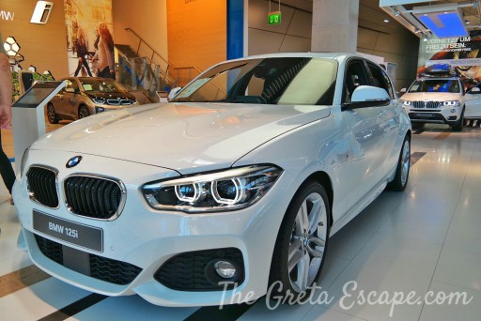
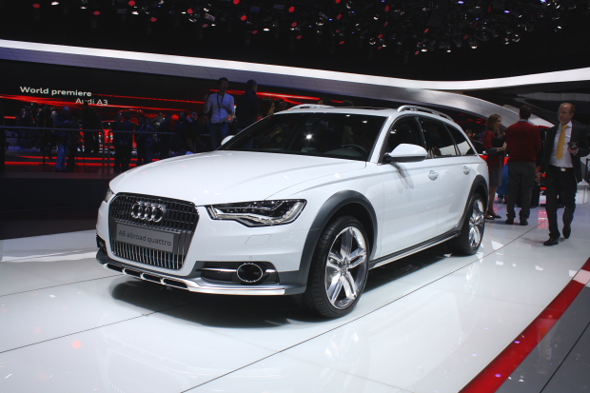
#3
Germany is one of the world’s largest car producers – selling 5.9 million cars in 2011. VW’s Golf is one of the best selling cars of all time: in 2012 it year it sold more than 430,000 Golfs around Europe (125,000 ahead of its nearest rival). In 2013, the top-selling car brands in Germany were Volkswagen, Mercedes, Audi and BMW.

Slide 12
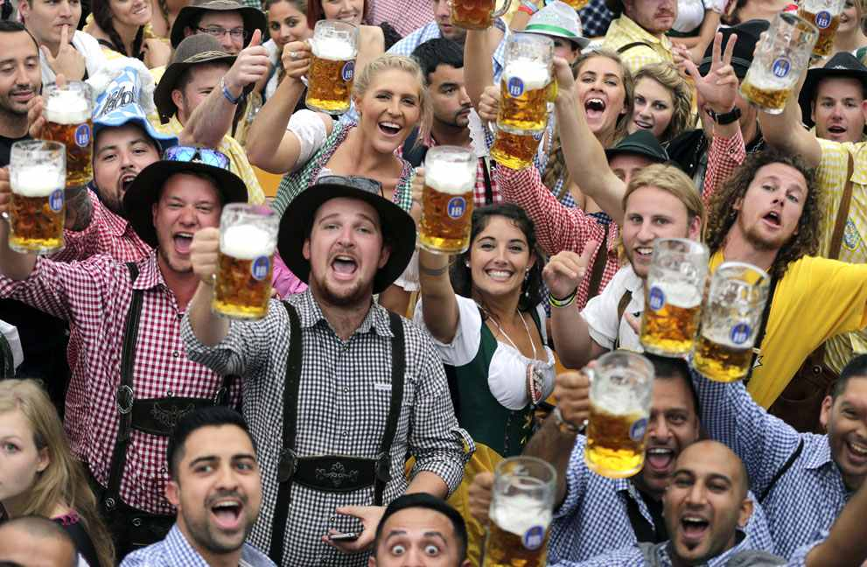
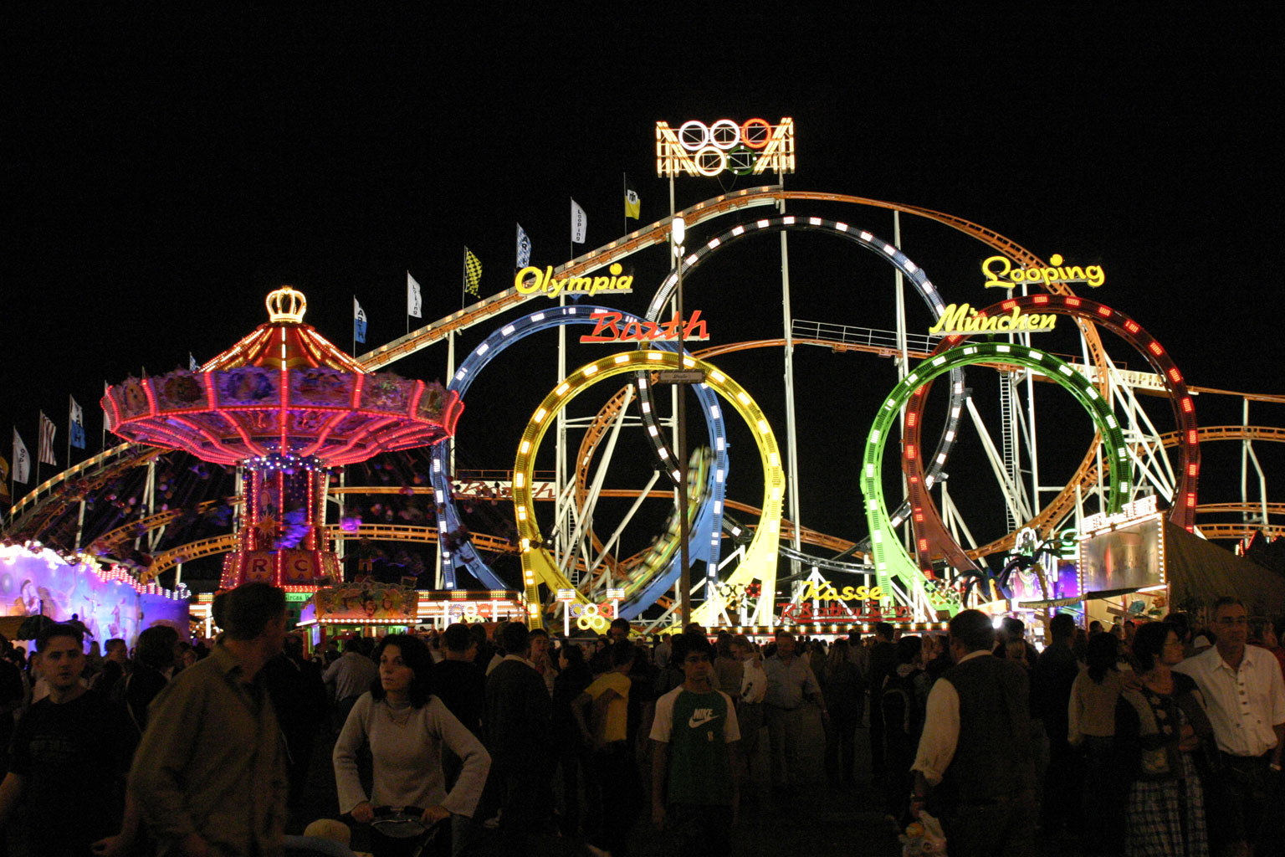
#4
The biggest Beer Festival in the world is of course the Oktoberfest in Munich, Bavaria, where the size of the beer glass is not 500ml but a whole liter!

Slide 13
#5
Germany is a leader in climate and energy policies – it made a decision in 2011 to decommission all nuclear power stations (then producing around 18 percent of electricity consumed) by 2022 and to replace them with renewable energies and new storage for green electricity. At least a third of Germany is now also powered by renewable energy.

