Slide 1
Cryptography
Art and Math

Slide 2
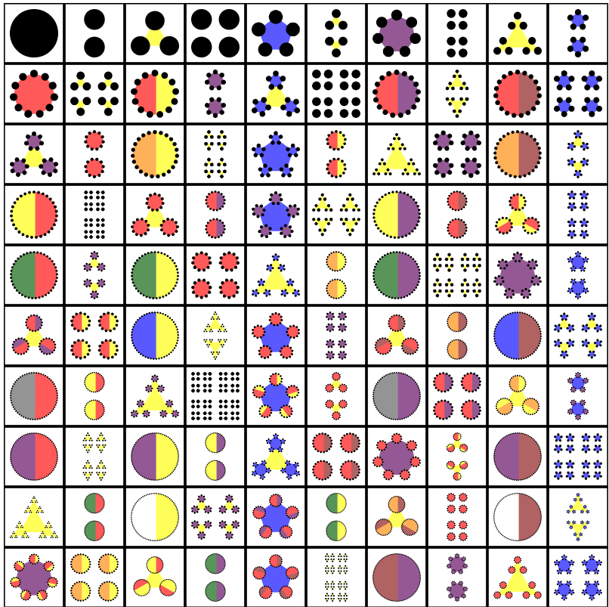

Slide 4
Merry Christmas and a happy new year
M=77 E=69 R=82 R=82 Y=89
A=65 N=78 D=68
A=65
H=72 A=65 P=80 P=80 Y=89
N=78 E=69 W=87
Y=89 E=69 A=65 R=82
A.M.E.
A=65 .=46 M=77 .=46 E=69 .=46

Slide 5
GeoGebra link
An example of Cryptography and ART using the above idea
https://ggbm.at/bmksbbhy

