Slide 1
stars
Presentation by Students of PGU Unna

Slide 2
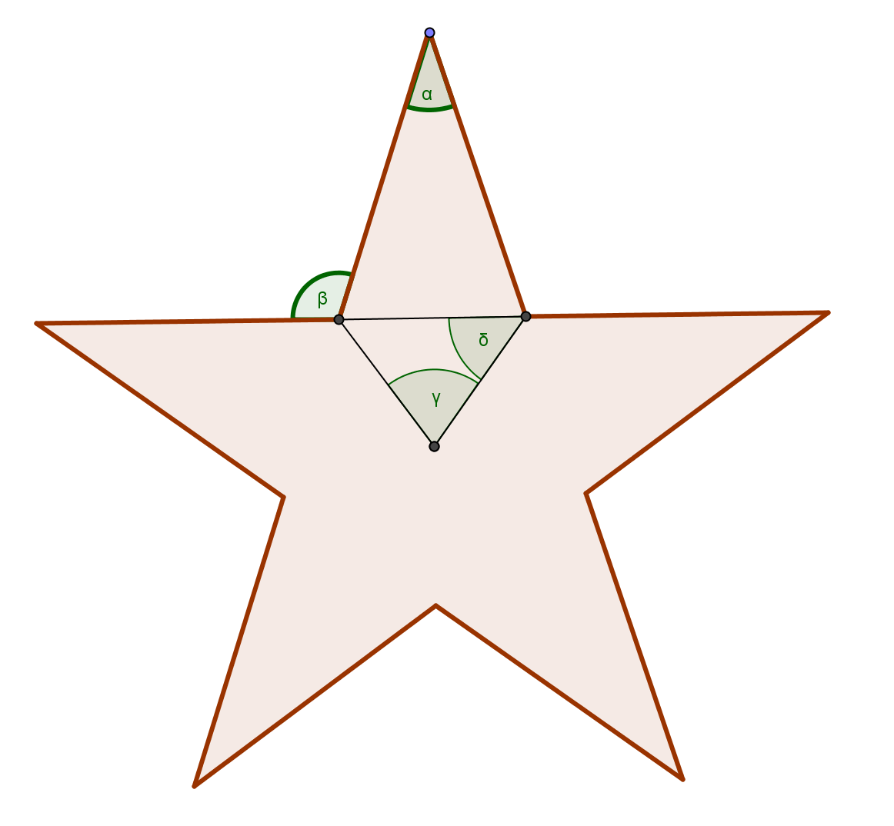
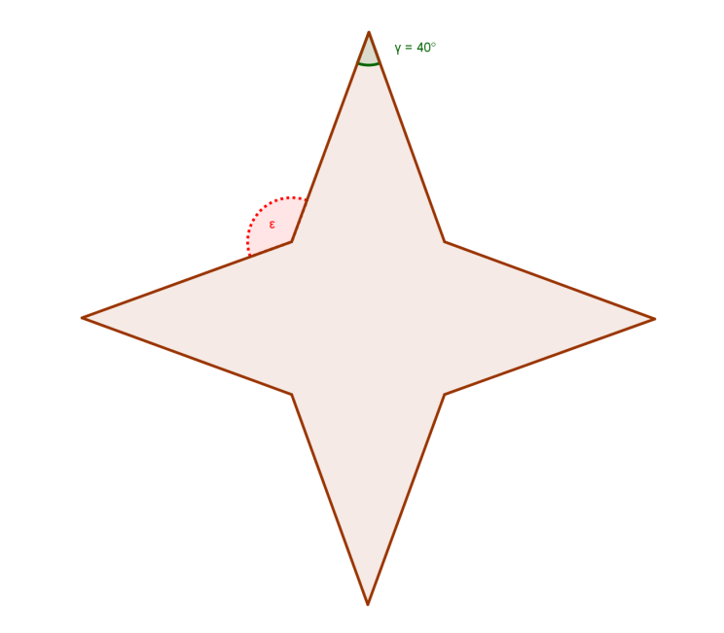
I. Stars: detective of angles
What about sum of the angles inside the star?
What about the size of ε?

Slide 3
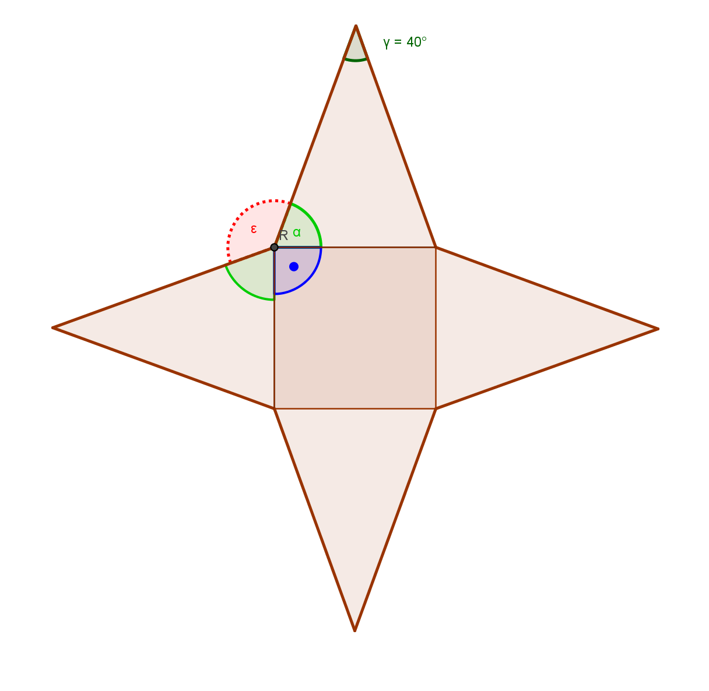
I. Stars: detective of angles - solution 1
green angles:
(180° - 40°):2= 70°
ε =360 –(70°+70°+90°) = 130°
Sum of all angles inside the star:
160° + 4*130°= 680°

Slide 4
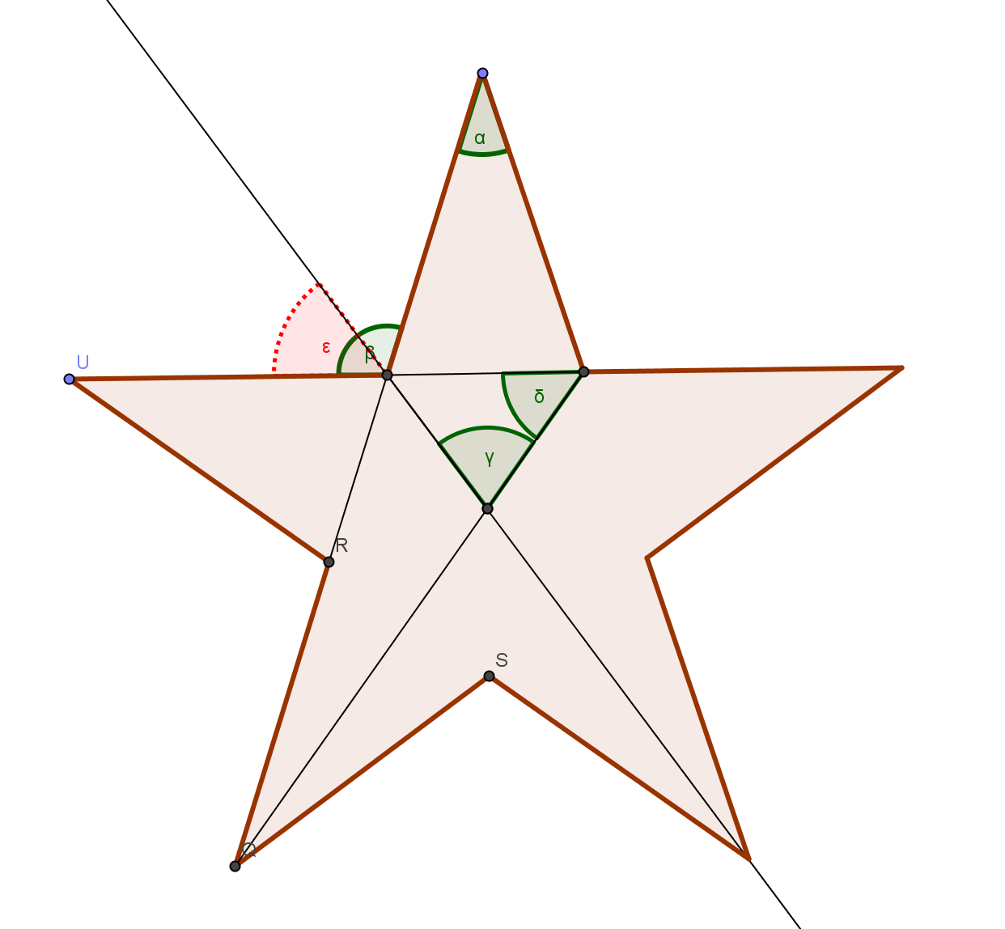
I.Stars: detective of angles -Solution 2
= 72 °
= (180° -72°):2 = 54 °
= 54°
= 2* ε =108°
α =(180° - 72°):2 = 36°

Slide 5
II) Stars with GeoGebra
There are different ways to construct stars.
We did it with GeoGebra.
We will show you now two simple ways how to do it.

Slide 6
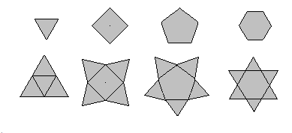
II. Stars with Geogebra: 1st Way

Slide 7
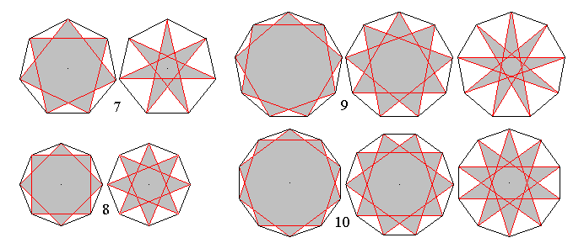
II. Stars with Geogebra: 2nd way

Slide 8
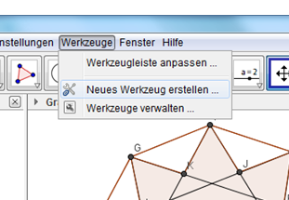
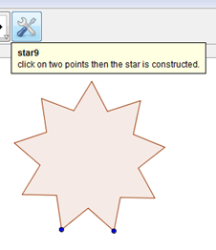
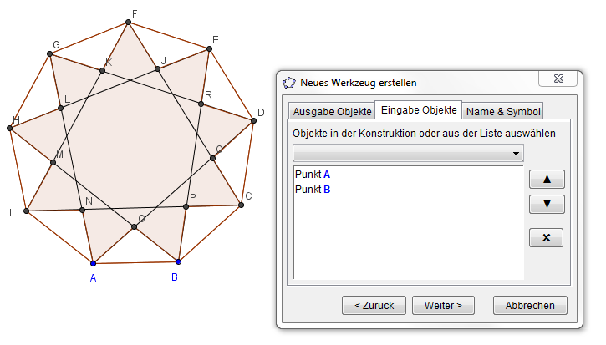
III. GEOGEBRA Tools: easy construction
1
3
2

Slide 9
Have a nice winter time!
picture

