Slide 1
PRIMARY SCHOOL RAJIĆ
CROATIA

Slide 2
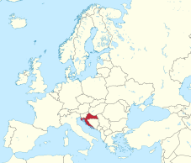
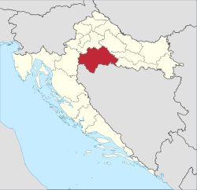
location
Rajic is in Sisak Moslavina County.
Sisak-Moslavina County (Croatian: Sisačko-moslavačka županija) is a Croatian county in eastern Central Croatia and southwestern Slavonia. It is named after the city of Sisak and the region Moslavina just across the river Sava. According to 2011 census it is inhabited by 172,000 people.
RAJIĆ

Slide 3
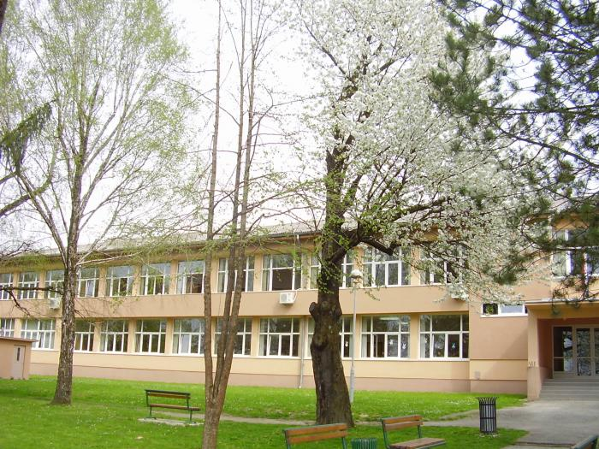
rajić - history
The first records of this area date back to 1334.
In the 15th century during the Turkish wars Rajic was a "famous city" and a strategic point of defense from the Turks.
In 1780, a pupil school was opened in Rajić, making Rajić a central place with all the spiritual and secular functions of the authorities.

Slide 4
Primary school
Today, we have 168 students in eight grades.
Through the education we develop digital competence for lifelong learning.
Rajić Elementary School students deal with various aspects of extracurricular activities such as dramatic-recitative, literary group, , small and large choir, ecological group and through School sports club Rajić realize all activities related to sports competitions.

Slide 5
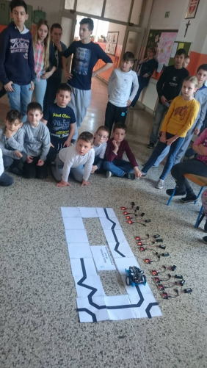
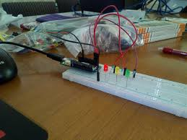
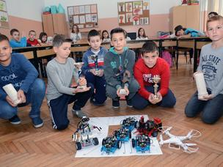
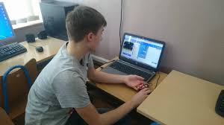
ARDUINO
ROBOTICS
MICRO:BIT

Slide 6
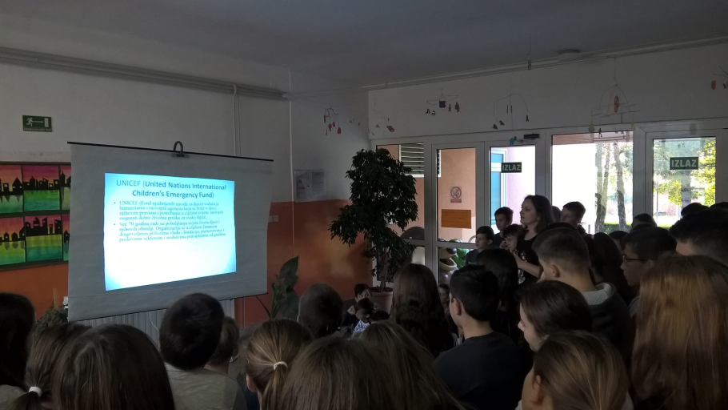
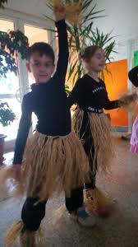
WE ARE PARTICIPANT IN THE PROJECT SCHOOL FOR AFRIKA

Slide 7
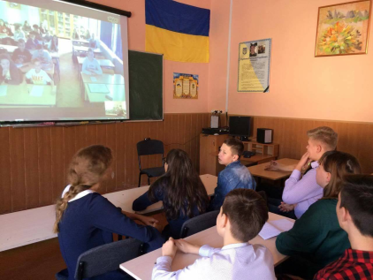
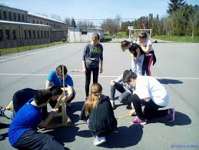
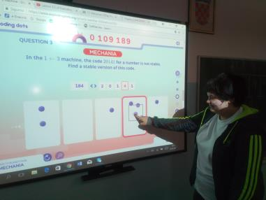
EUROPEAN LANGUAGE DAY
Eratosthenes EXPERIMENT
GLOBAL MATH WEEK

Slide 8
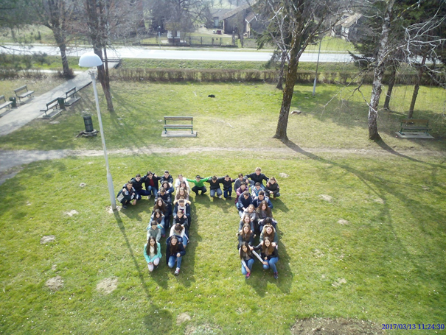
PI DAY

Slide 9
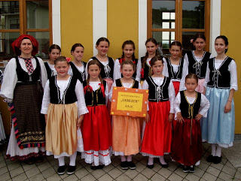
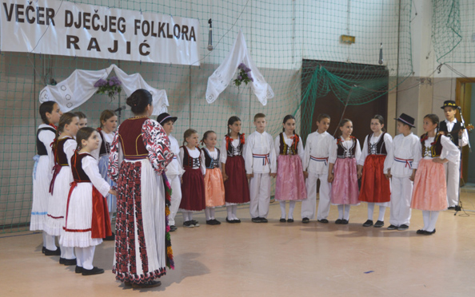
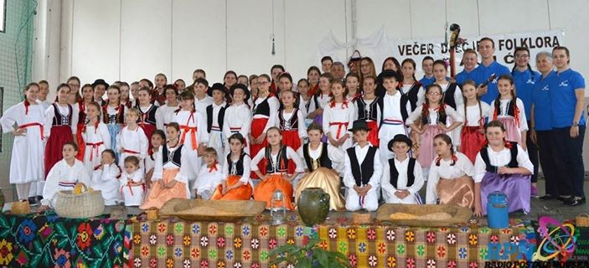
FOLKLORE

Slide 10
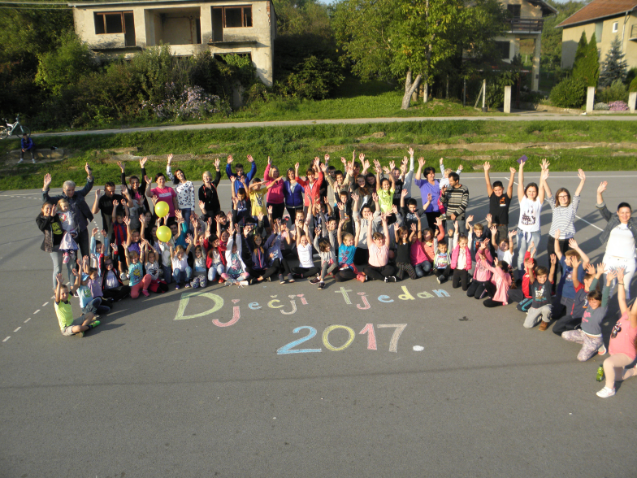
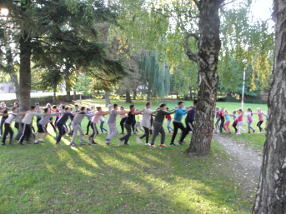
CHILDREN WEEK
MOTTO OF WEEK: LOVE CHILDREN BEFORE ALL

Slide 11
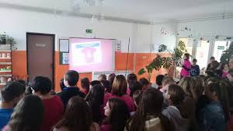
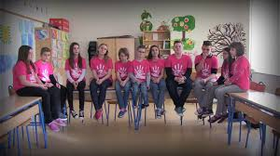
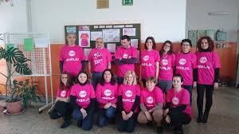
THE PINK SHIRT DAY

Slide 12
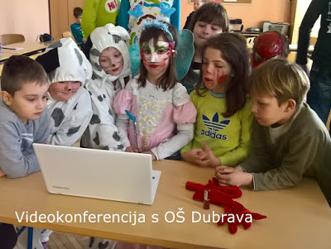
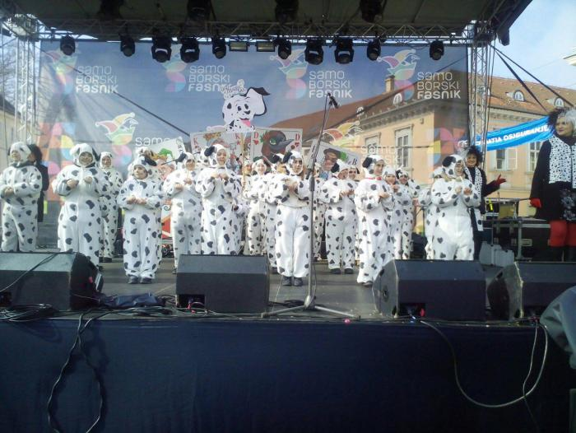
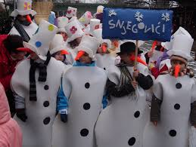
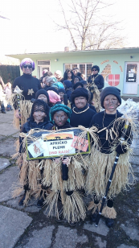
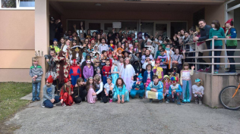
CARNIVAL

Slide 13
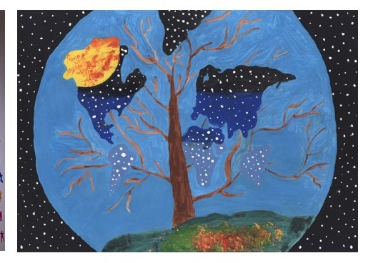
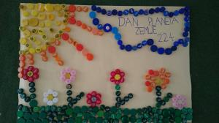
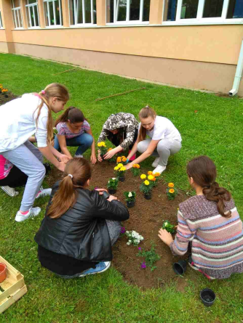
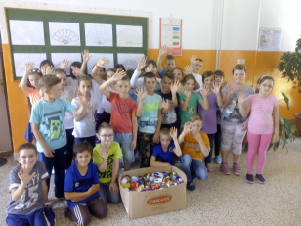
WE CARE…
…AND WE RECYCLES

Slide 14
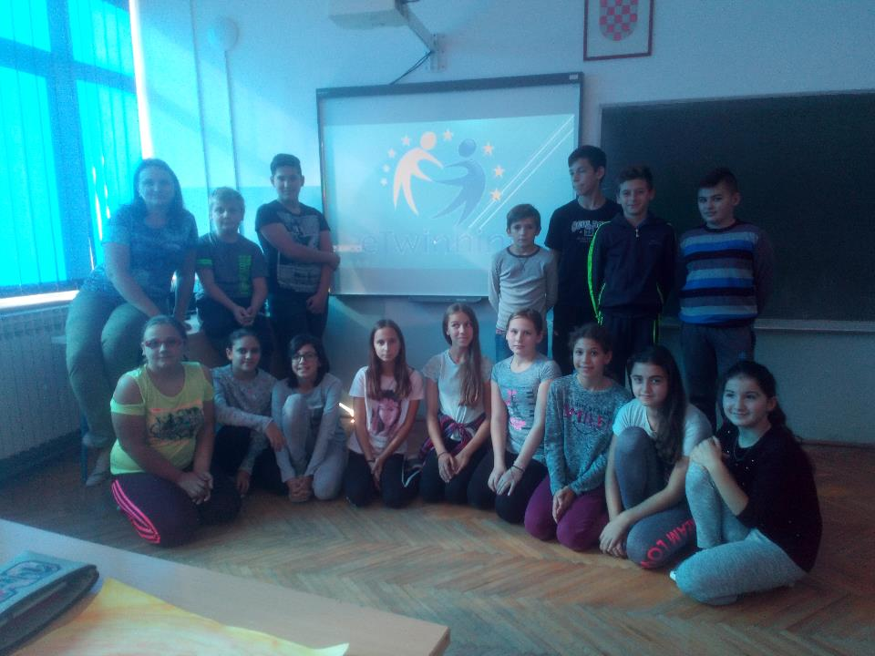
Someone once said in our school: "This is a small school but your kids and people have a big and warm heart!"

