Slide 1
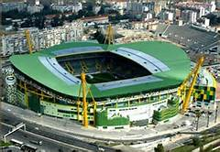
José Alvalade Stadium
Work done by: João Leal; Gabriel Lima e Miguel Soqueiro

Slide 2
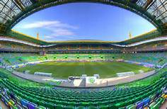
José Alvalade Stadium
The José Alvalade stadium is located in the Alvalade XXI complex at Professor Fernando da Fonseca street in Lisbon.

Slide 3
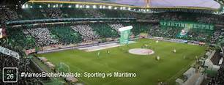
José Alvalade Stadium
It belongs to Sporting Clube de Portugal and was inaugurated on August 6, 2003.

Slide 4
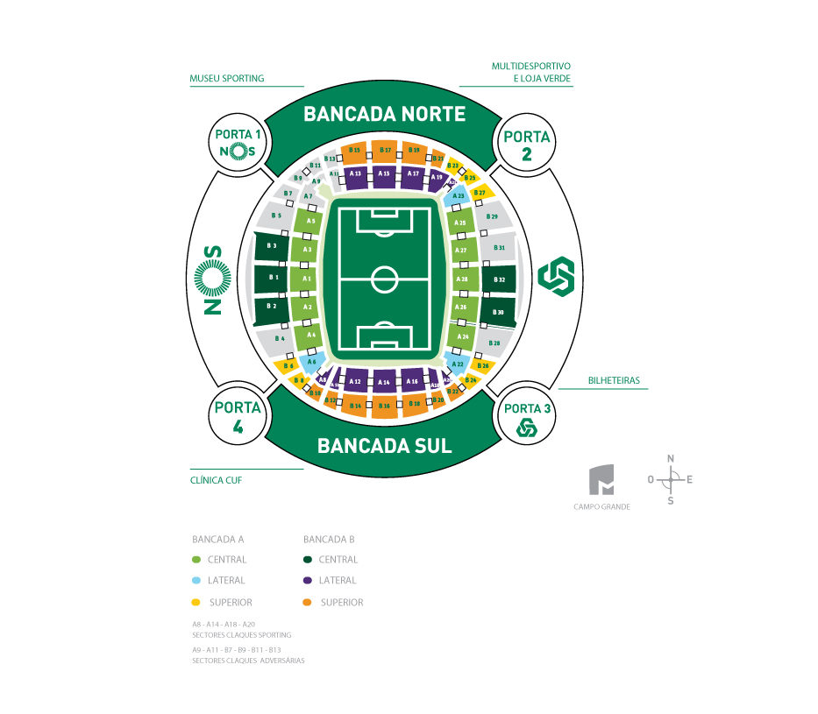
José Alvalade Stadium
His architect was Tomás Taveira and has a capacity for fifty thousand people.

