Slide 1
Measurement of energy produced from photovoltaic modules
Physics laboratory

Slide 2
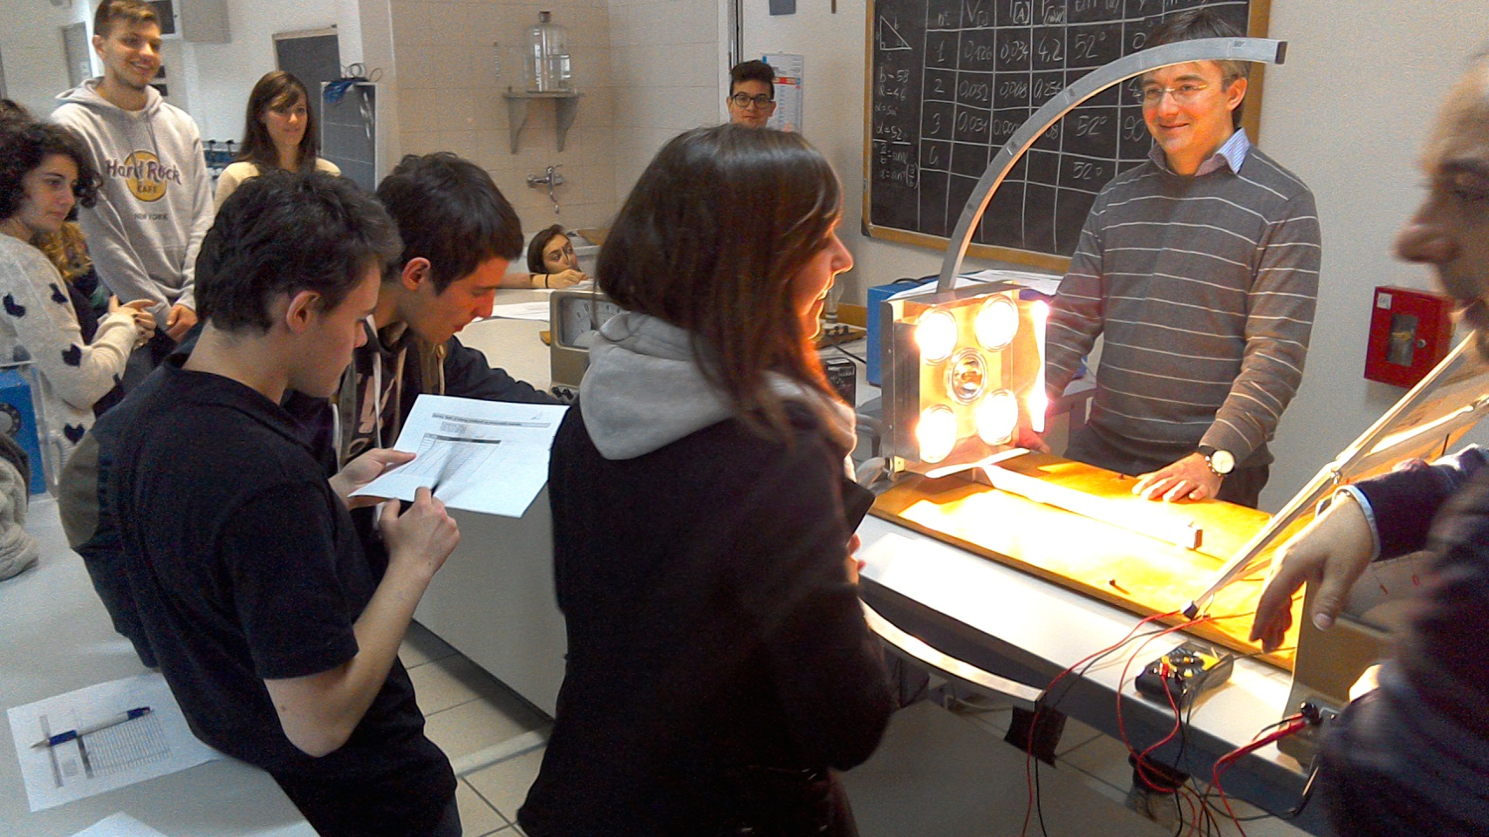
In the physics lab
We have used a module of 11 Watt and we have misured the product power changing the tilt angle and azimut angle.

Slide 3
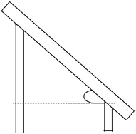
TILT ANGLE
The tilt angle is the angle of the panel to the horizontal axis .
When the angle of incidence of solar radiation tends to be normal to the panel, the reflected component will be lower and therefore the production of the panel will be greater .
30°
Geographical area |  | Tilt angle
Italia |  | 30 – 35°
• | Bolzano | 35°
• | Siracusa | 30°
Polo Nord |  | 90°
Equatore |  | 0°

Slide 4
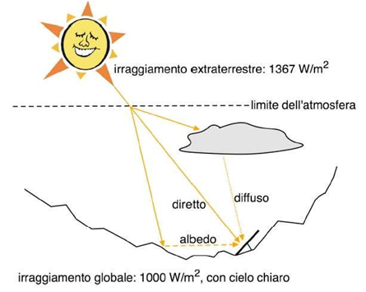
Azimut angle
Azimuth angle is the deviation than the south . The orientation of the panel should be as possible to the south .
ORIENTATION
South = 0° e Est/West = 90°
0°
15°
30°
45°
60°
75°
90°

Slide 5
With the misures we have made graphics to know the best power performance of the module changing the angle.
So the best power performance is with a tilt angle of about thirty degrees, and an azimut angle of 0.

Slide 6
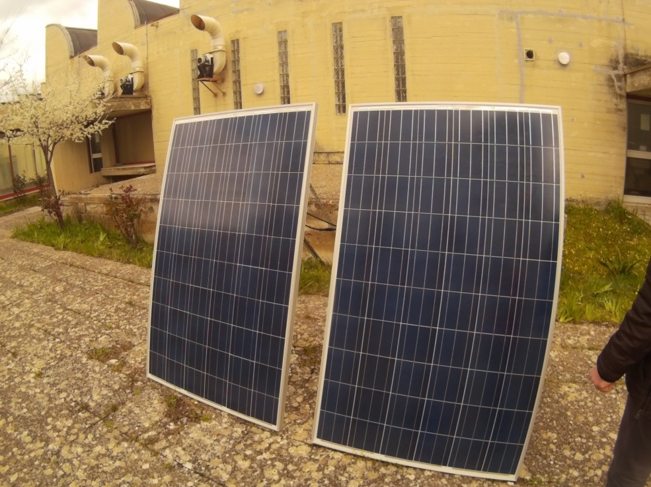
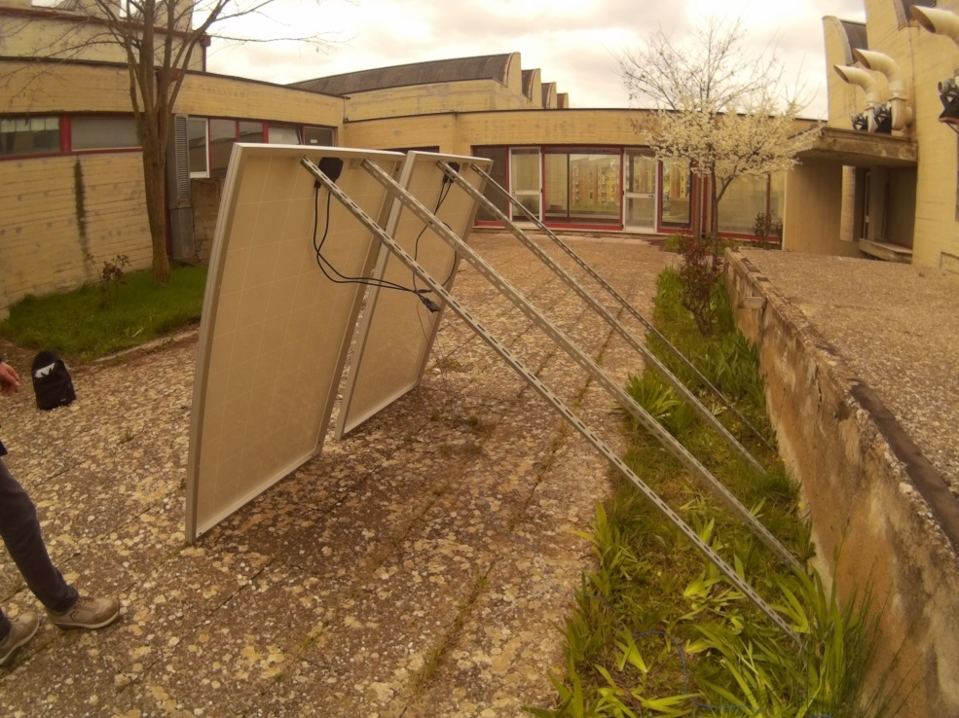
The experience outside
We have used two modules of 250W in serial connection.

Slide 7
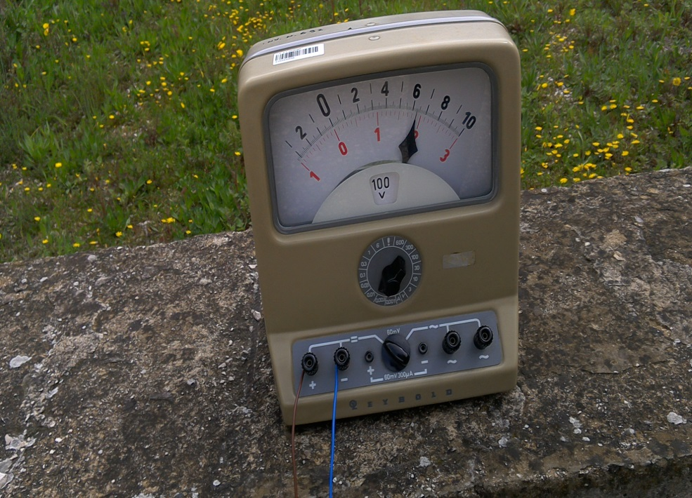
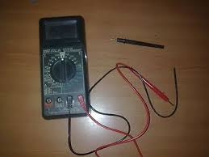
We have done the measures with an analogical and digital instrument called multimeter .

Slide 8
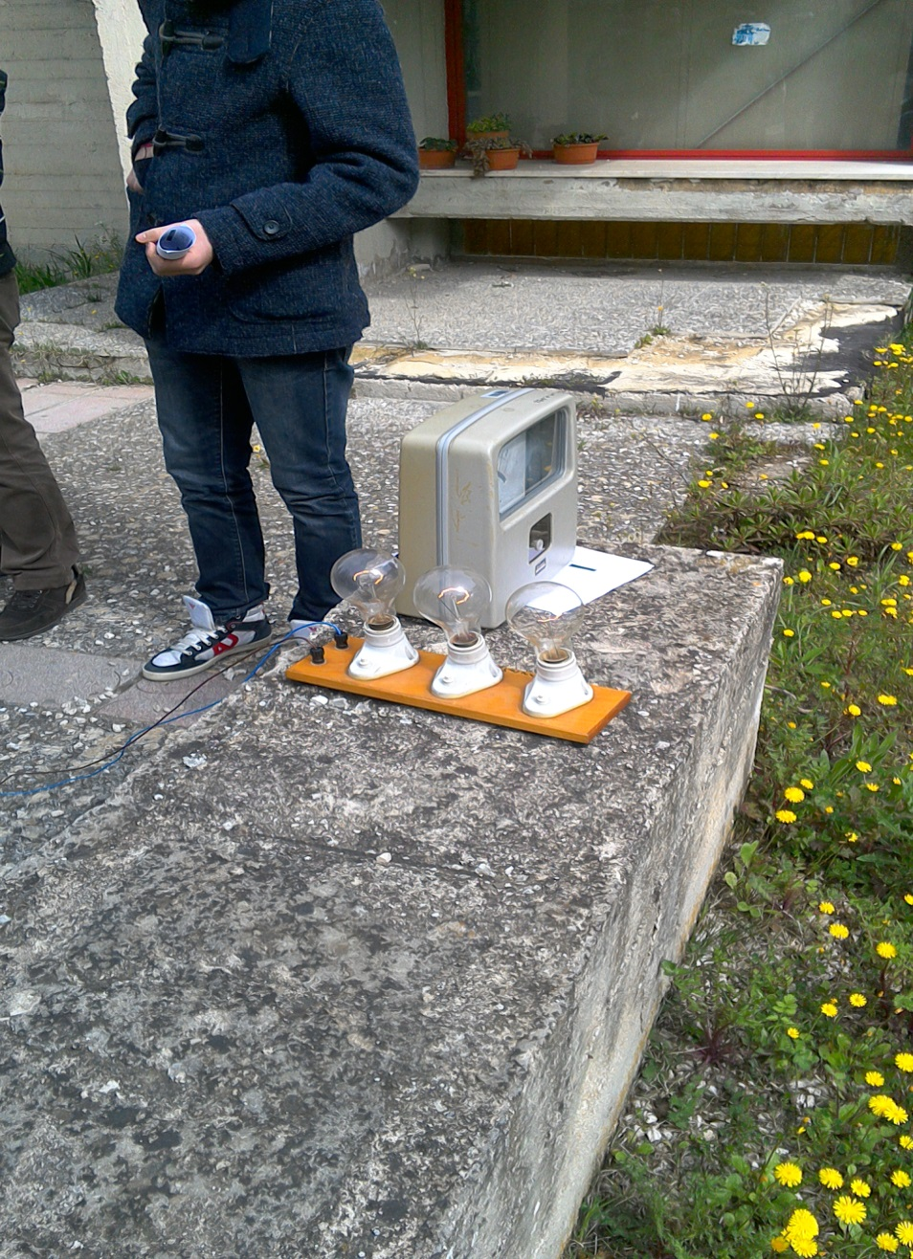
With the power produced we took on three lamps each of 200W.

Slide 9
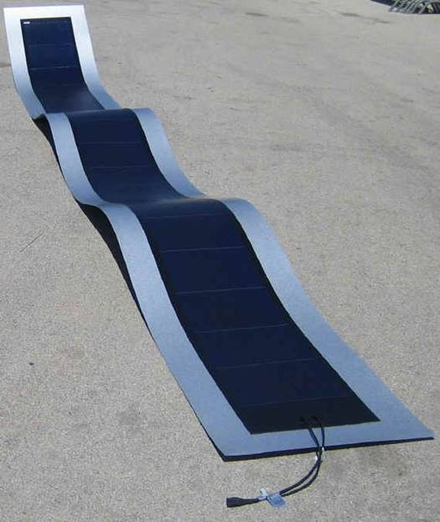
The application on the electric car
We can use a module with a thin film
The problem is how can we put the module on the car and that the power of the panel is not sufficient for the car but they give to the car a great help.

