Slide 1
Electricity and Magnetism
-DANIELE COTRUFO
-SONER MUSTAFOV -THIBAULT GUERARD

Slide 2
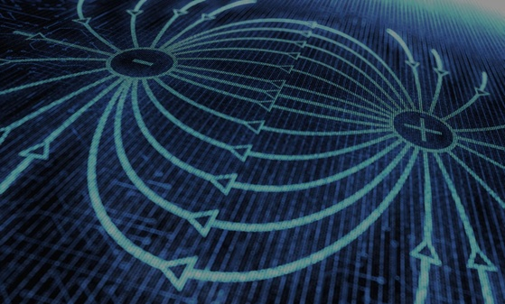
INTRODUCTION
Electromagnetism is the result of the union between electricity and magnetism.
Electric and magnetic fields, considering Maxwell’s theory, very similar, so they can be considered as an only element: the electromagnetic field.

Slide 3
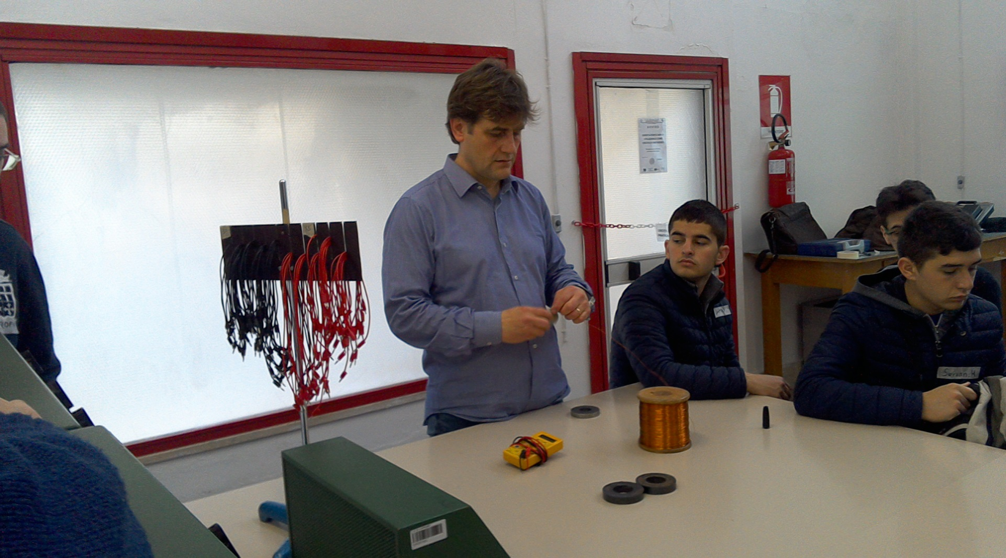
In this experience we have seen how the magnetics fields work.
First of all we have made an experiment with two magnets, a copper cable and a power generator.

Slide 4
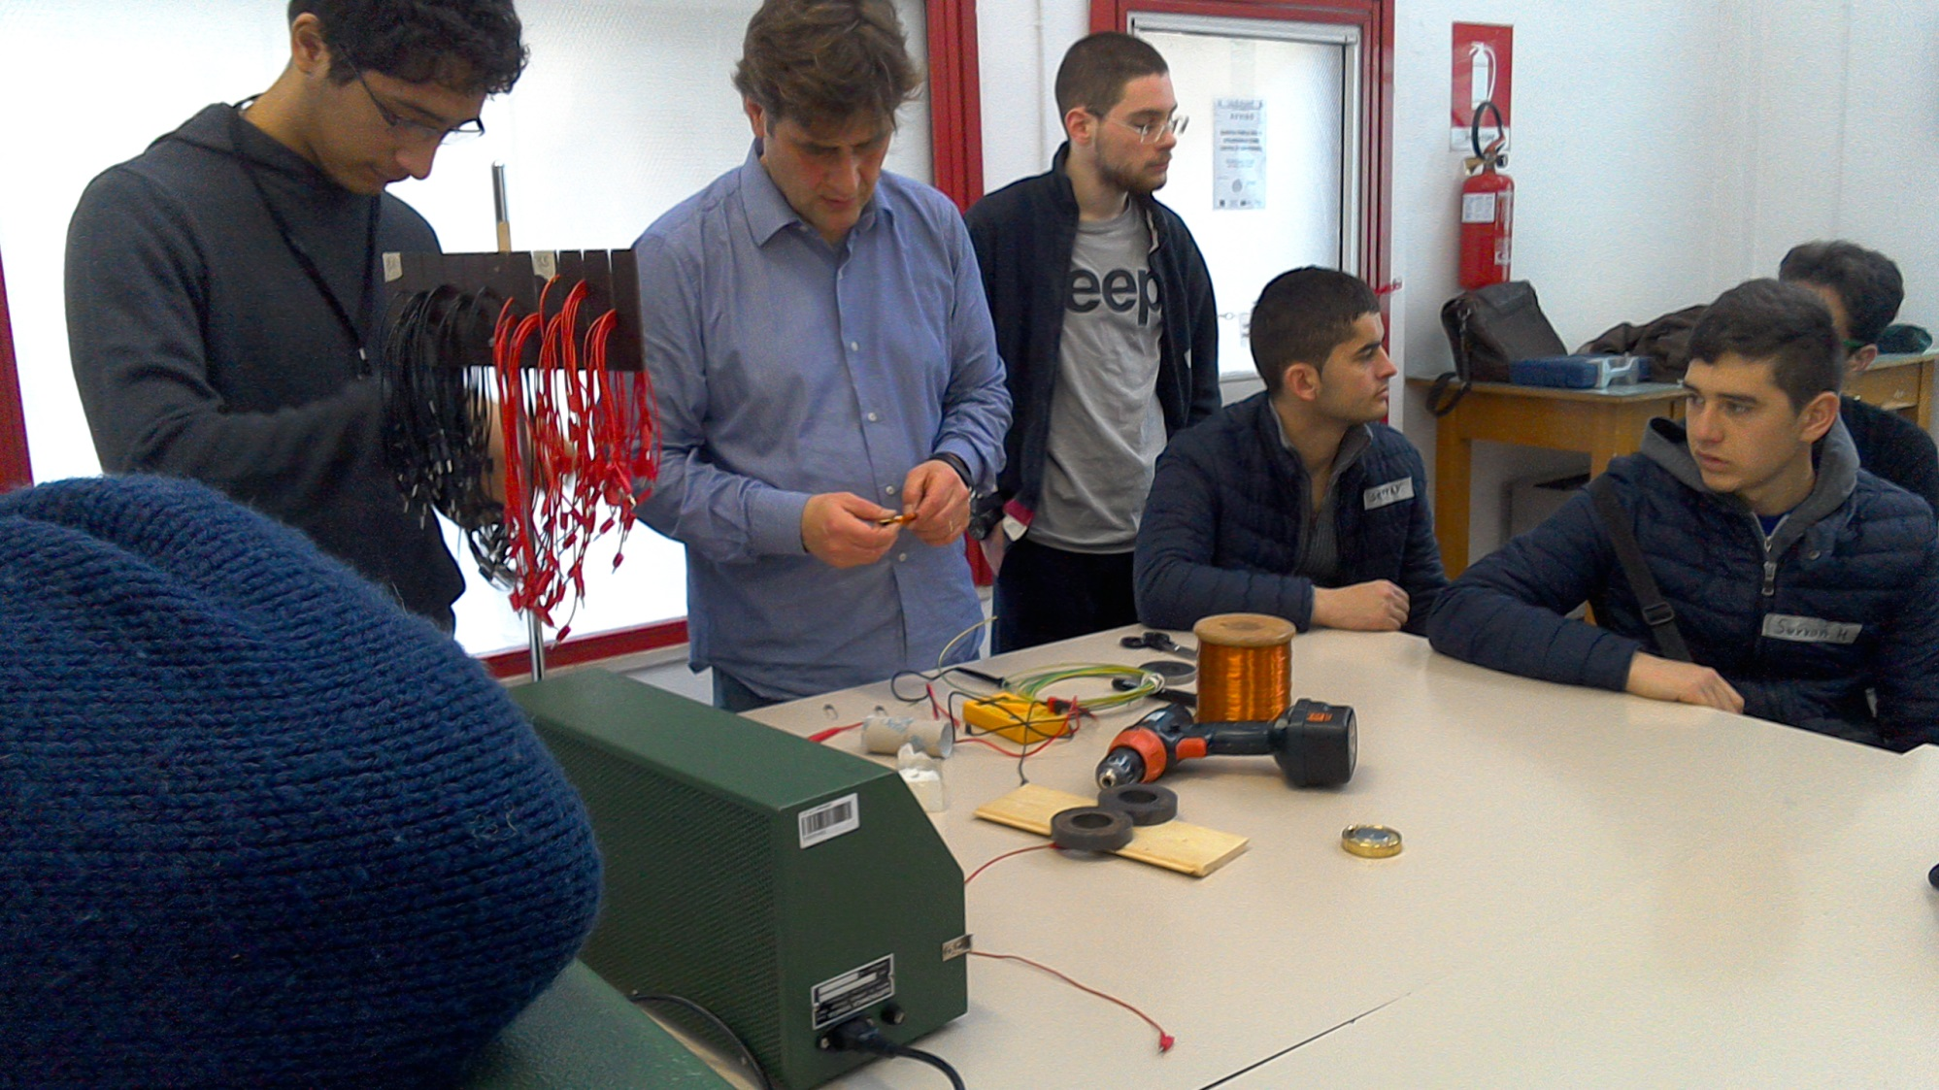
We twisted the cable to do a copper coil, that we put over the magnets as a particular structure.

Slide 5
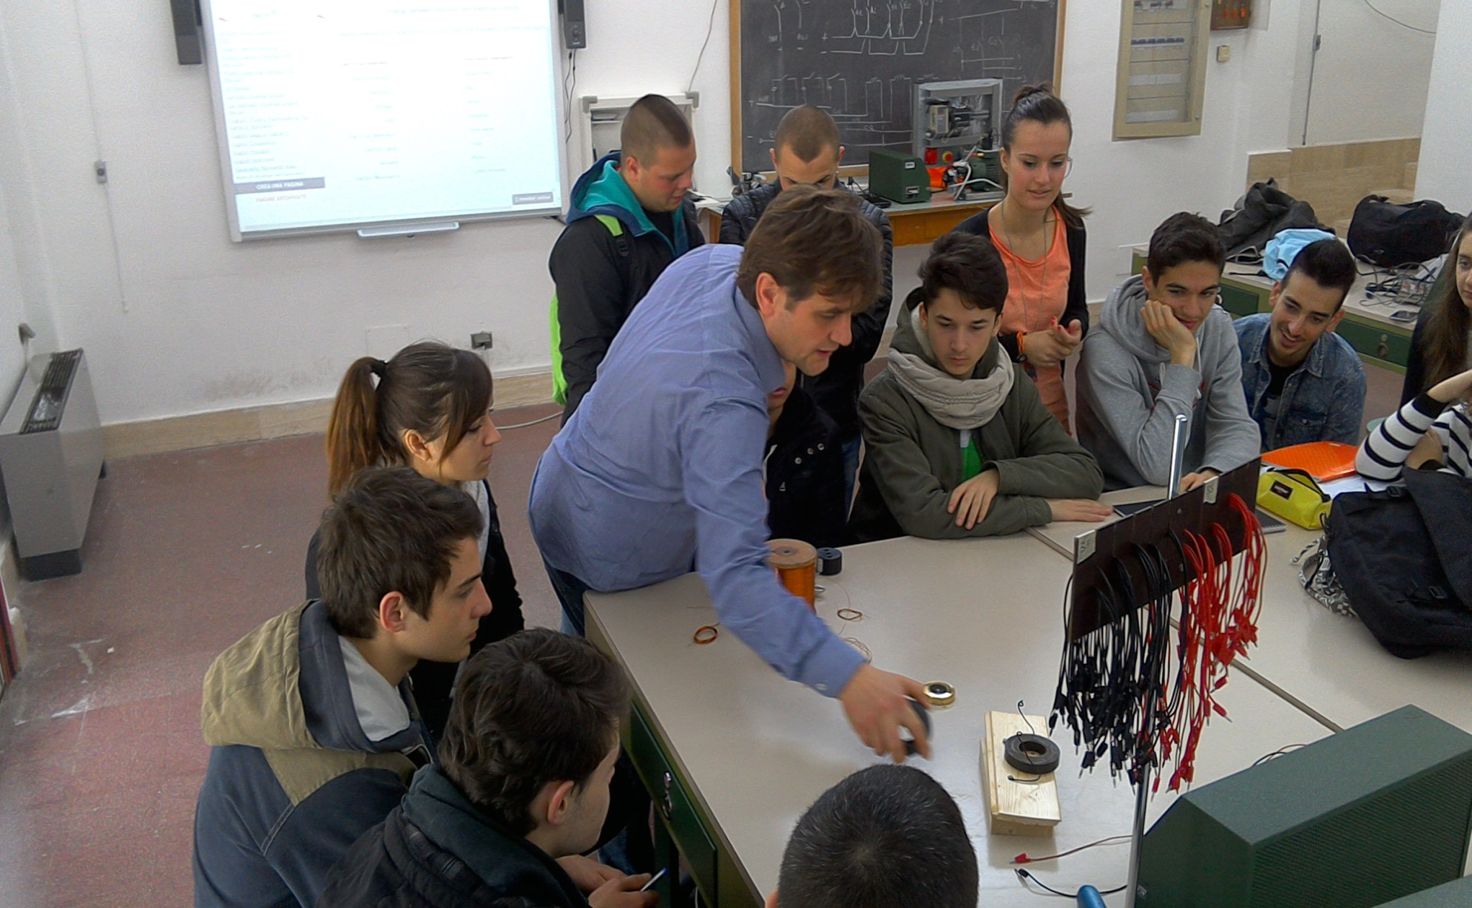

Slide 6
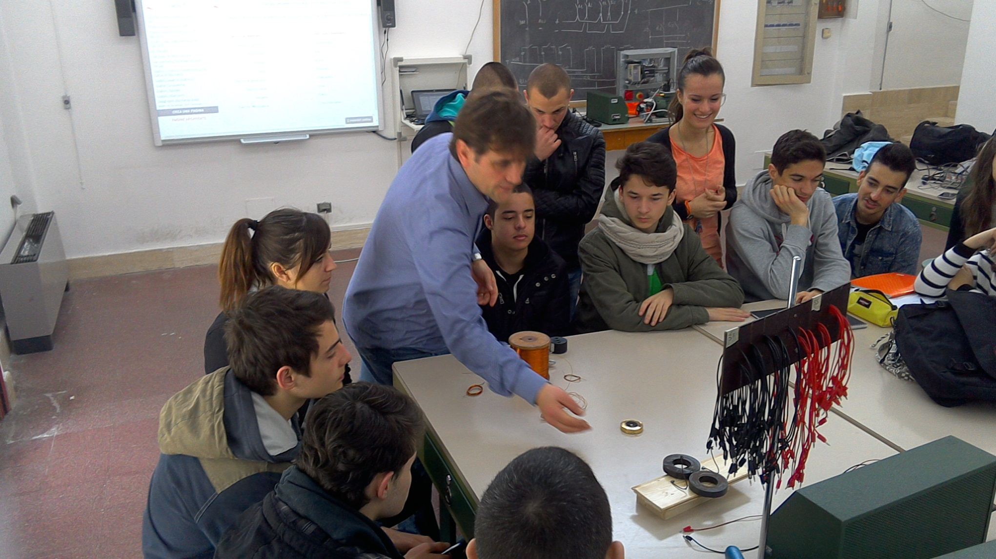

Slide 7
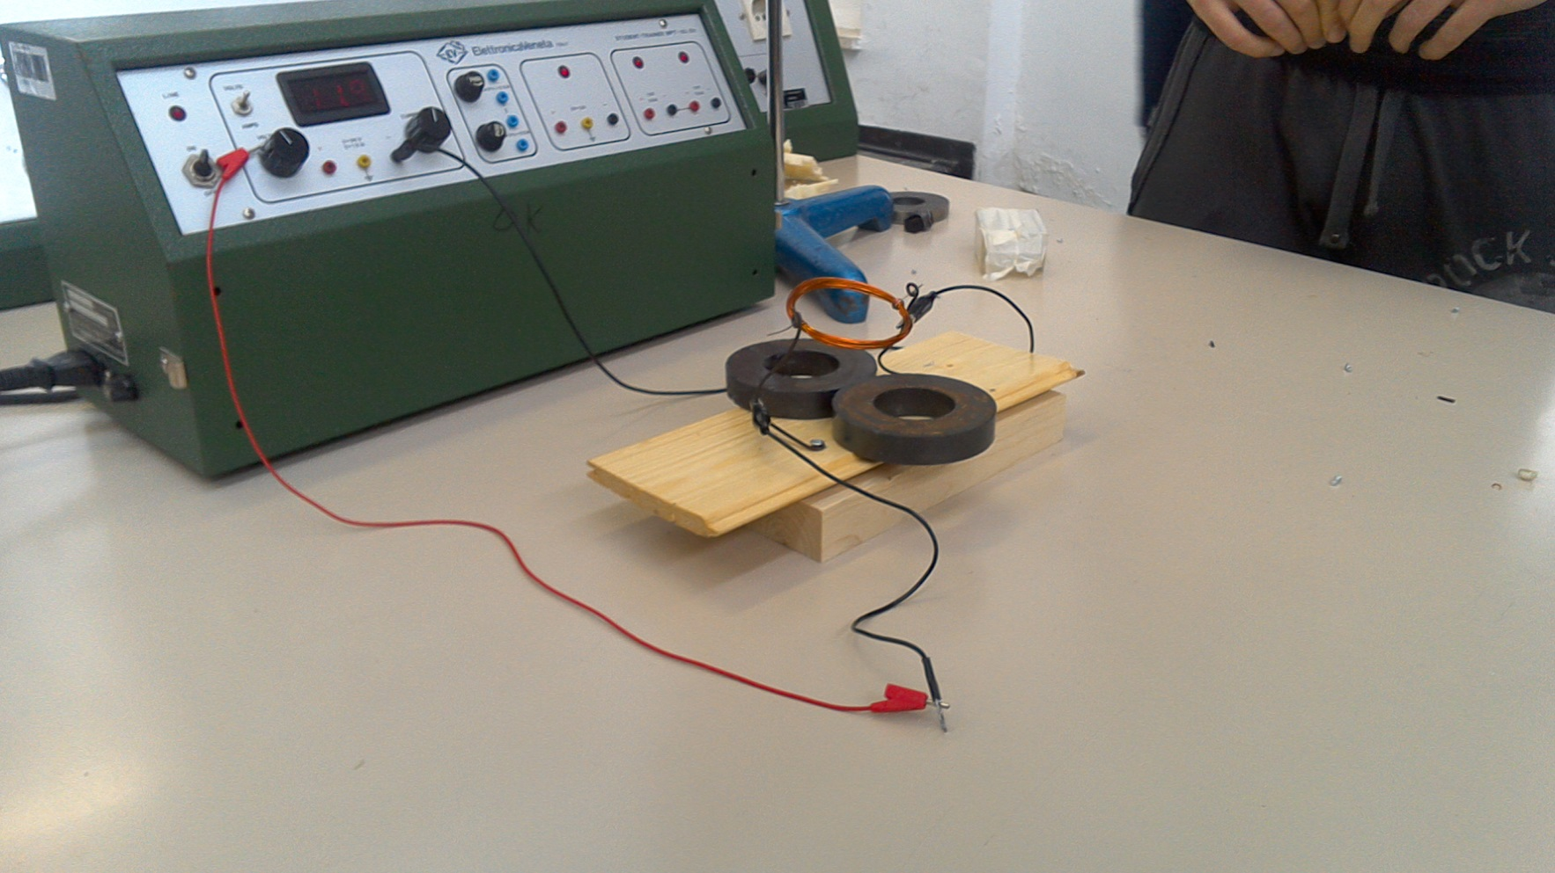
When the generator’s current flowed in the copper coil, this one started to spin, because there was an interaction between the magnets’ field and the copper coil’s one.

Slide 8
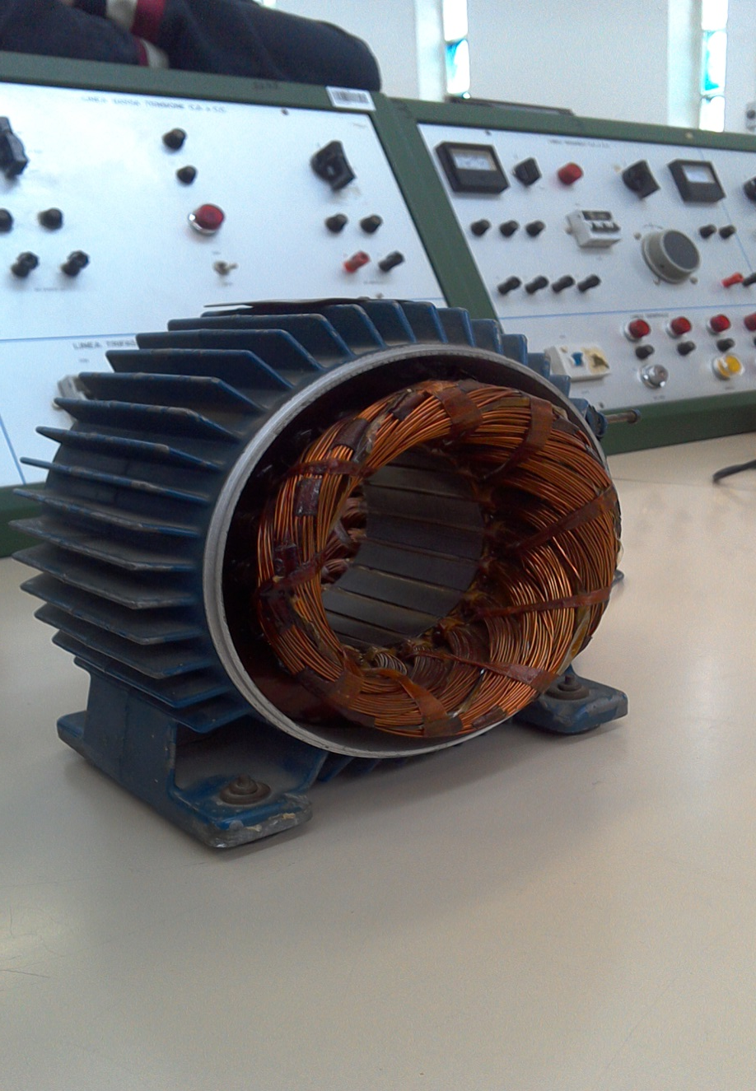
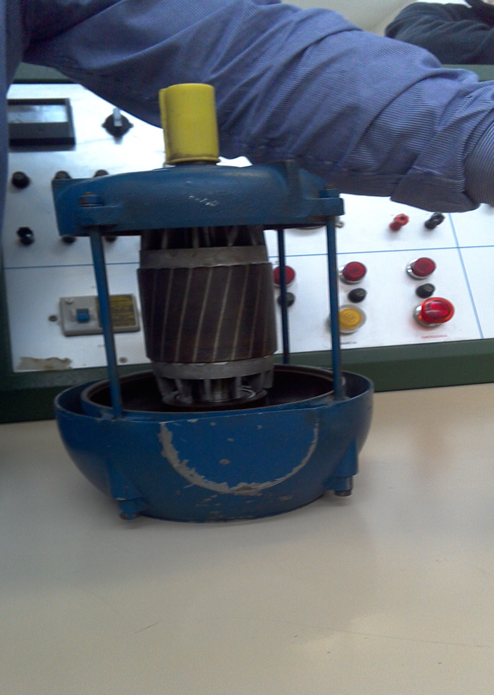
After that we saw how engines, that are based on this.

Slide 9
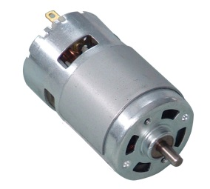
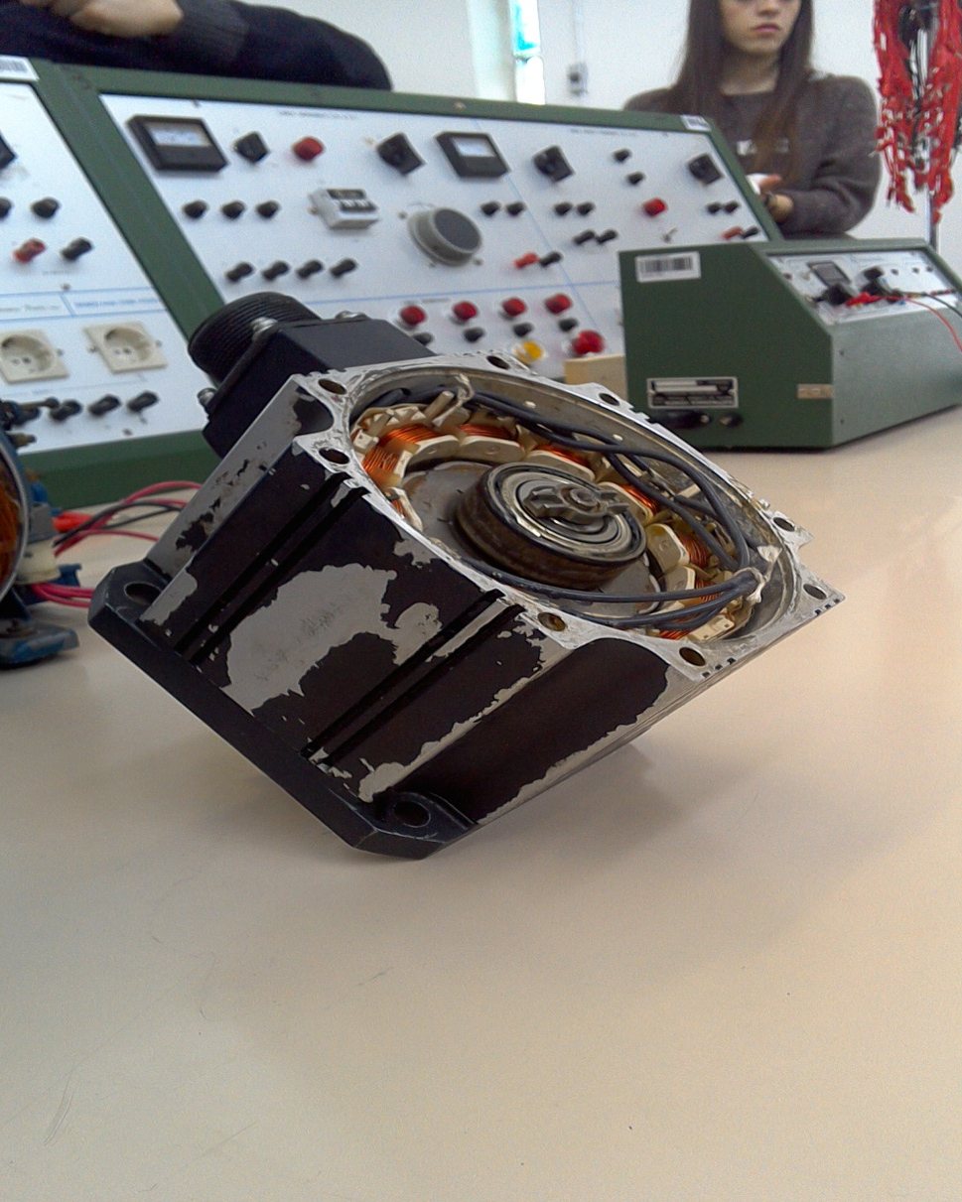
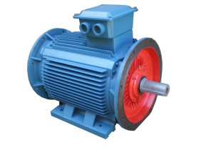
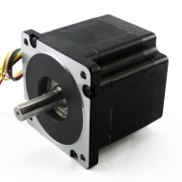
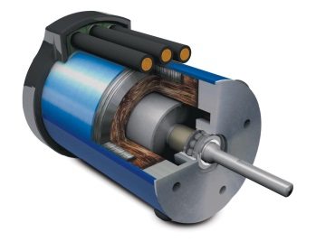
We have different kind of motors:
DC Motor
AC Motor
Stepper Motor
Brushless Motor

Slide 10
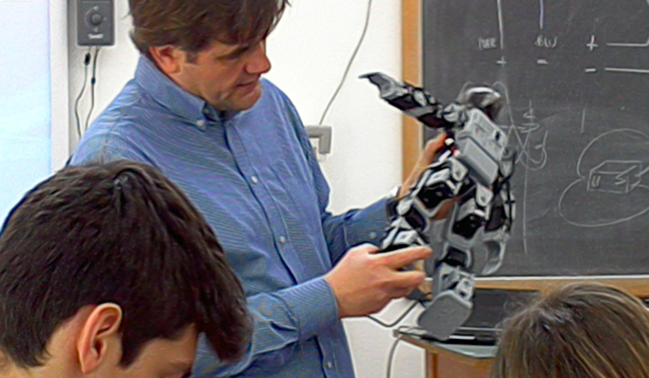
Finally we have seen the BIOLOID ROBOT, that his composed by 8 engines.

Slide 11
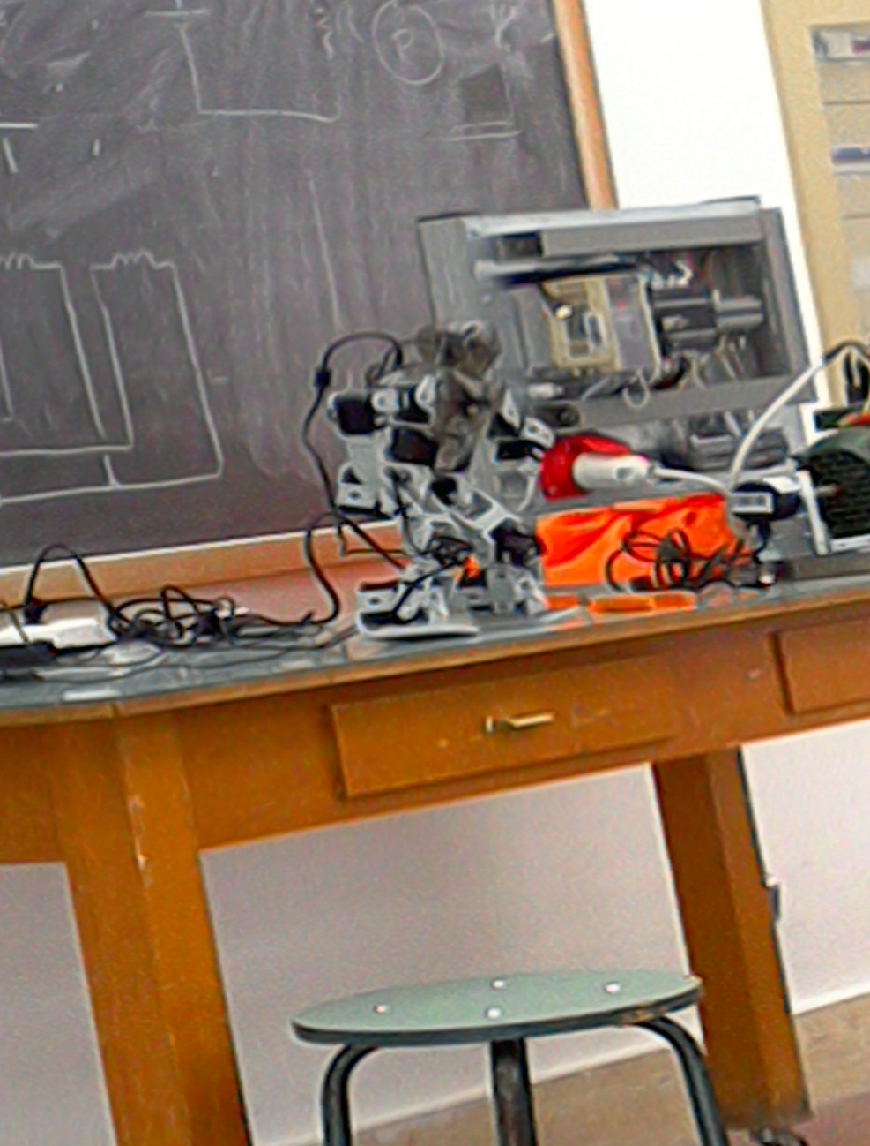
THE END

