Slide 1
Valentine’s day

Slide 2
Valentine's Day is a holiday celebrated on February 14 by the Catholic and Church of England . On that date, lovers express their love for each other by sending greeting cards, candy hearts. It is customary to give flowers.

Slide 3
The holiday... is
The name of the festival comes from one of the two Christian martyrs named Valentine who lived in the 3rd century . Originally an old Roman Catholic holiday, it became associated with romantic love in the Middle Ages .

Slide 4
On this day back in the 14th century becomes a tradition to exchange love messages in the form of so-called " valentines “.

Slide 5
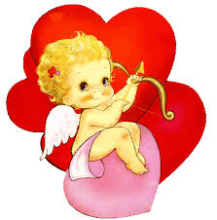
Modern symbols of love are now the heart and the image of the winged Cupid .

Slide 6
According to the tradition of the English court in the early 17th century, Valentine's young men and women exchanged rings and candy. Any woman can go and ask the man she likes, to become her husband.
The important thing is that the man has no right to refuse a lady. But if still his heart is already taken, he should give her silk dress.

Slide 7
The relationship between Valentine and romantic love is not mentioned in any early historical document, and is considered merely a legend. First Valentine's Day is named in commemoration of February 14 by Pope Gelasius I.

Slide 8
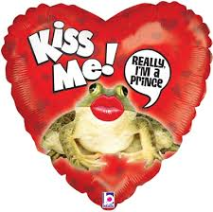

Slide 9
The presentation was made by Sava Savov Xv class. applause please!

