Slide 1
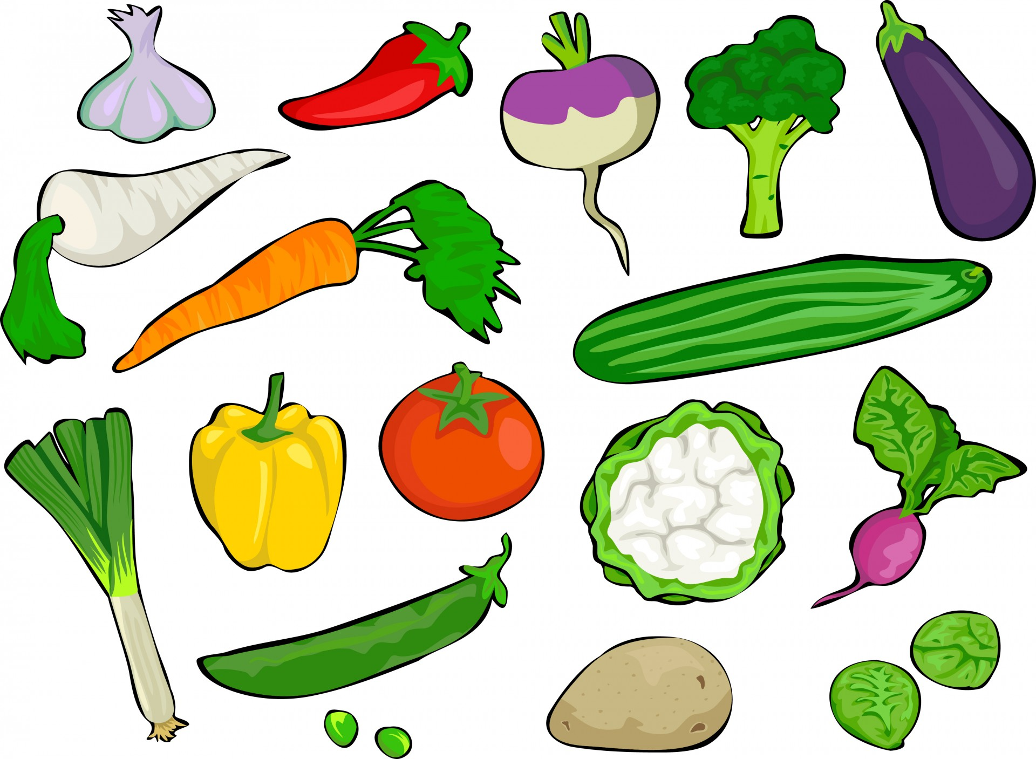
VEGETABLES
Kasia Mackiewicz
Zuzia Łotysz
II C

Slide 2
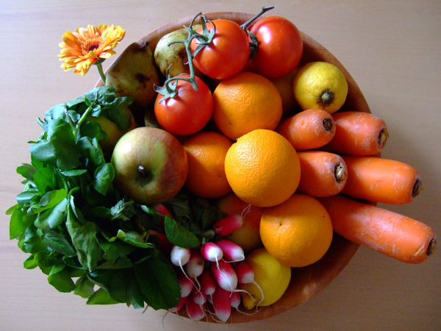
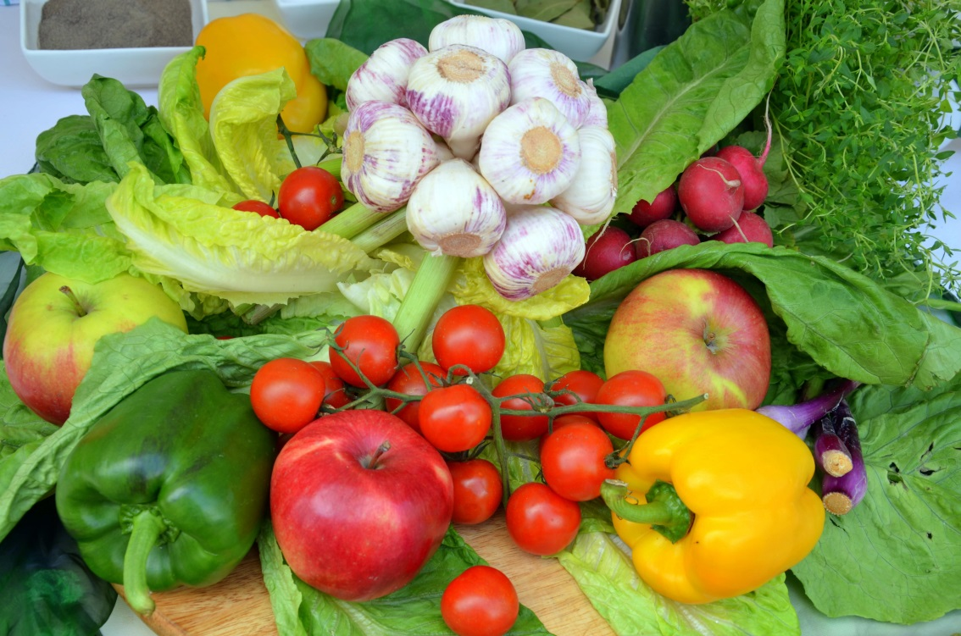
Vegetables
In everyday usage, a vegetable is any part of a plant that is consumed by humans as food as part of a meal. The term vegetable is somewhat arbitrary, and largely defined through culinary and cultural tradition. It normally excludes other food derived from plants such as fruits, nuts, and cereal grains, but includes seeds such as pulses. The original meaning of the word vegetable, still used in biology, was to describe all types of plant, as in the terms "vegetable kingdom" and "vegetable matter".

Slide 3
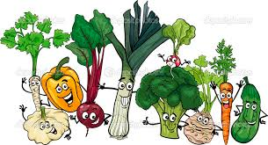
Why should we eat vegetables ?
You need to eat vegetables everyday because you simply cannot find another food group that is as perfectly matched to our everyday human needs as vegetables! Vegetables fit us like a glove. From so many different perspectives, the nature of vegetables and the nature of human health are matched up in a way that simply cannot be duplicated by other food groups, including fruits, legumes, nuts and seeds, grains, seafoods, or poultry and meats.

Slide 4
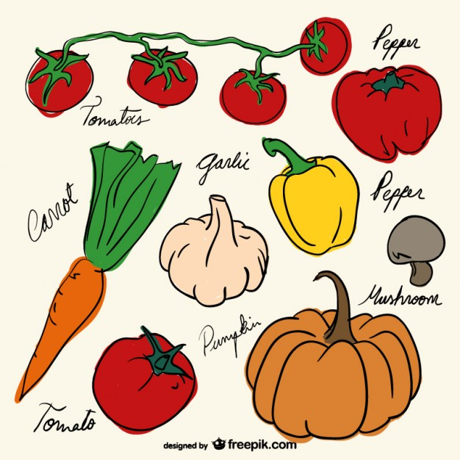
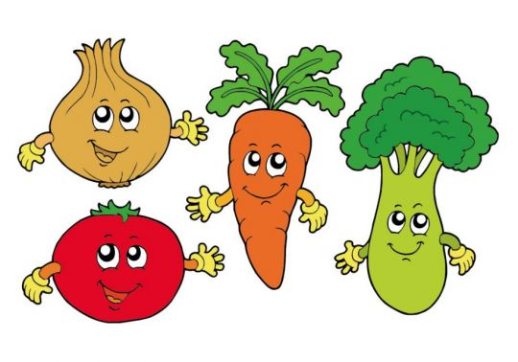
What can we find in Vegetables ?
Vegetables should be an important part of your daily diet. They are naturally good and contain vitamins and minerals that can help to keep you healthy. They can also help protect against some diseases.

Slide 5
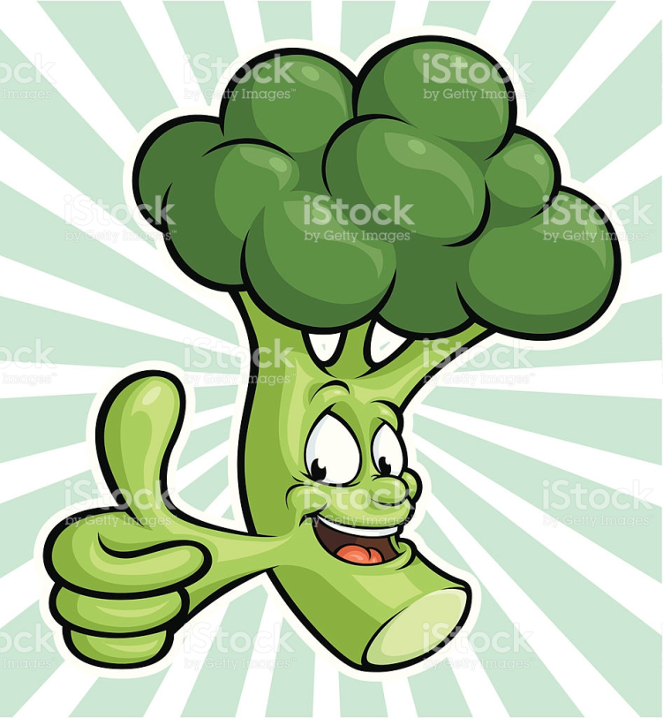
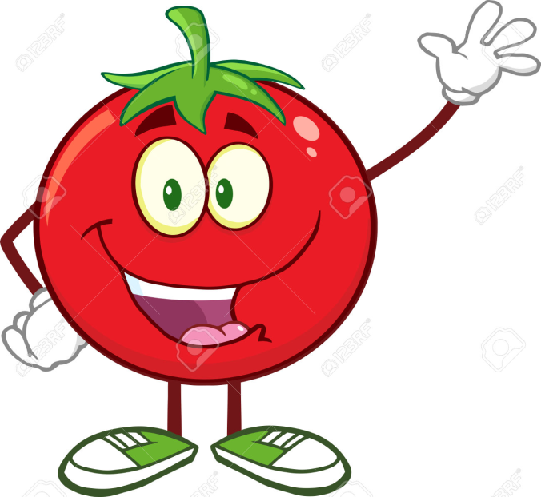
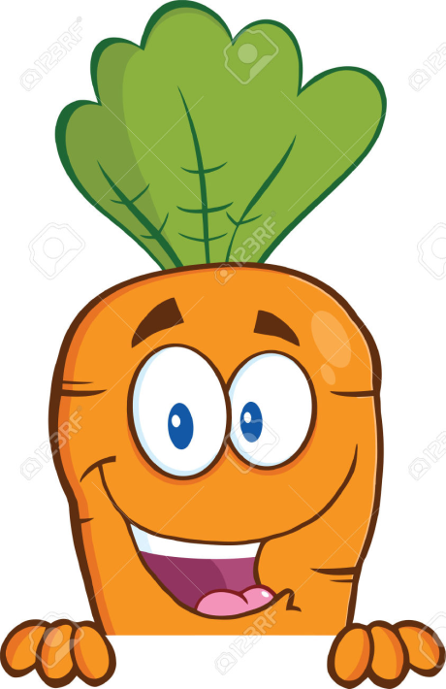
Let’s eat Vegetables
Tomato
Broccoli
Carrot

Slide 6
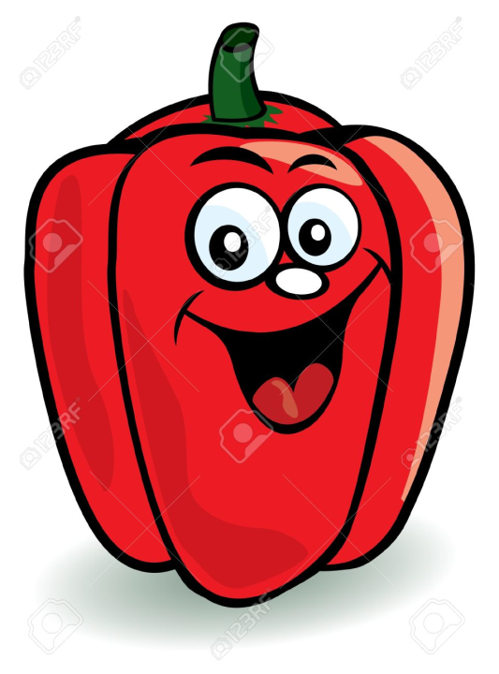
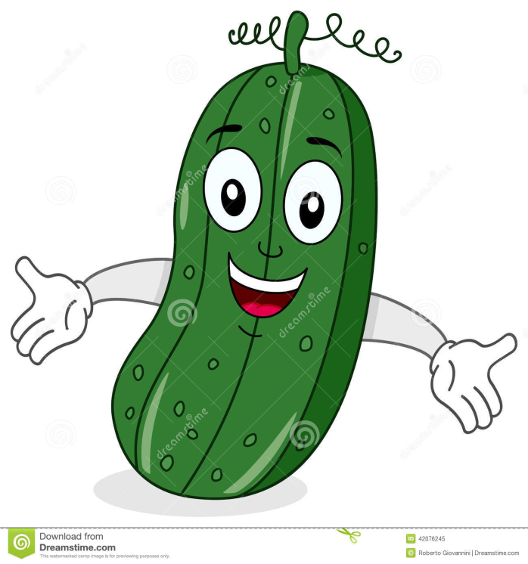
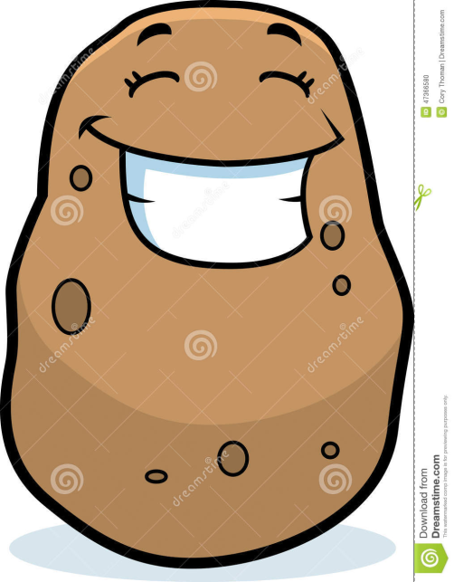
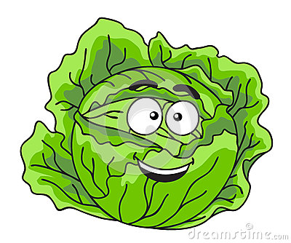
Pepper
Onion
Cucumber
Cabbage
Potato

Slide 7
The End
Thanks for watching

