Slide 1
EUROPE

Slide 2
CLIMATE IN EUROPE

Slide 3
CLIMATE IN EUROPE
ATLANTIC
-
MEDITERRANEAN
ARCTIC
SUB-ARCTIC
4 seasons;
hot and dry summers;
mild winters.
4 seasons;
cold winters;
hot summers with low humidity;
strong temperature range.
Scarce precipitation;
long and harsh winters;
short or cool summers.
Long periods of frost and short periods of thaw;
long and harsh winters;
short summers.

Slide 4
TERRITORY
OF
EUROPE

Slide 5
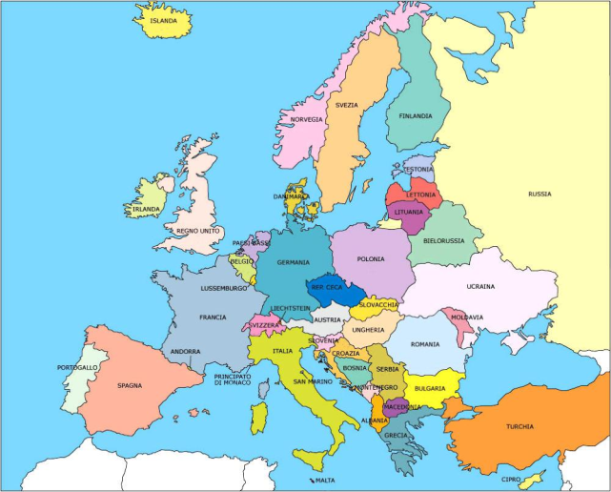
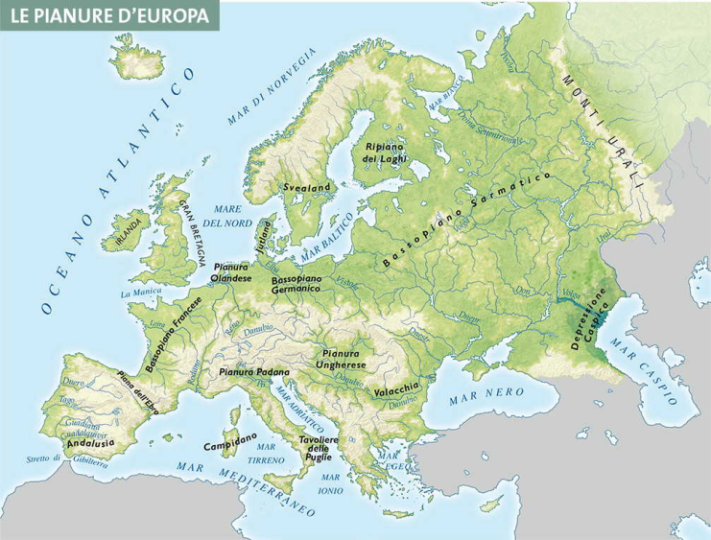
STATES AND TERRITORY IN EUROPE
STATES
TERRITORY
According to most of the criteria adopted in the geographic literature, the States of Europe are 47.
In Europe the mountain ranges are not very extensive, while the lowlands and flood plains prevail.
The plains occupy about 2/3 of the continent's surface .

Slide 6
MIGRATION IN EUROPE

Slide 7
MIGRATION IN EUROPE
IMMIGRATION IN EUROPE
WHO?
WHERE DO THEY USUALLY LAND?
FROM WHERE?
WHY?
People from 146 countries such as:
Syria-12%
Iraq-8%
Eritrea-20%
Africa-36%
Tunisia-22%
Men-72%
Underage-12%
Women-16%
They escape from:
Dictatoriship
ISIS
Religious wars
Persecutions
Terrorism
Political and social crisis
They usually land in:
Italy
France
Germany
United Kingdom
Sweden

Slide 8
ETHNIC GROUPS IN EUROPE

Slide 9
ETHNIC GROUPS IN EUROPE
RELIGIONS
POPULATION
LANGUEGES

Slide 10
Work made by:
Giulia
Alessandra
Andrea
Lorenzo
Riccardo

