Slide 1
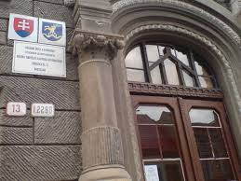
Elementary and High School with Hungarian Teaching Language Dunajská 13 , Bratislava

Slide 2
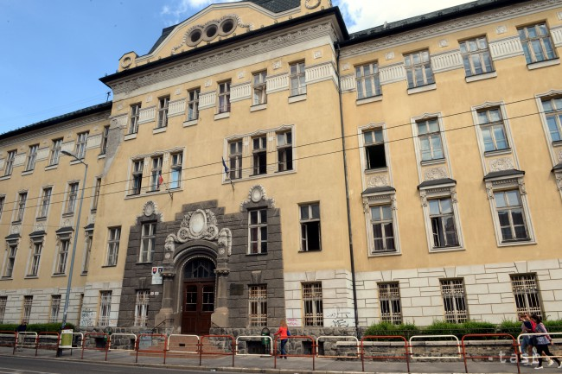
Location
Our school is located in the capital city of Slovakia, in Bratislava in city district called Old town on Dunajská street. It’s a big, beautiful old building. This school is visited by kids with Hungarian nationality, so we learn everything in Hungarian language. Beside the Hungarian language we have English, German and Slovak of course.

Slide 3
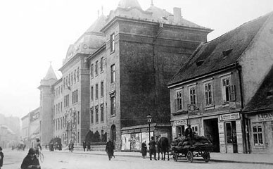
History
Name of the street Duna utca (Danubia street) is more than 500 years old.
Building of the school has a pretty good history, too.
Before the building of the school, there was house of Kempelen-family, (member of this family was Hungarian inventor Kempelen Farkas). In this rococo building was estabilished girls school in 1875 until 1883. From this year, there was governmental girls boarding school.
After renovovations and additions, the building got his nowadays look in 1910.
During the I. WW there was field hospital.
Our school is here from 1950.
First director was Sandtner Józsa.

Slide 4
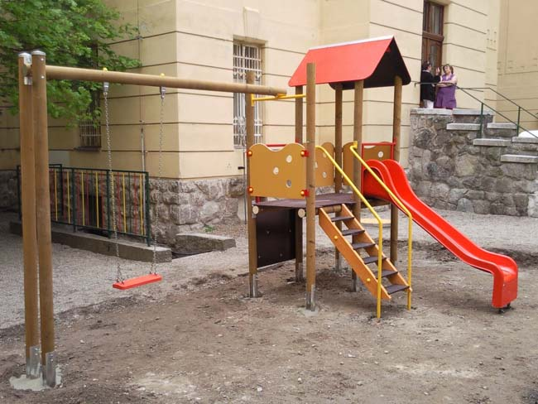
Equipments
Gym
Fitness
Schoolyard with playground
Canteen
Language lab
Science lab
About 20 ordinary classrooms
Snack bar

Slide 5
Some of our school policy
Students mustn´t eat during the lesson.
Students mustn´t use mobile phones during the lessons.
Students mustn´t gamble.
Students must stand up when the teacher comes in the class.
Students needn´t wear uniforms.
Ipod, MP3 player or other electronic devices are not allowed during
lessons.
Students have to greet teachers according to time of day.
Students are obligated to appear with clean, well-groomed, cultivated
look in school.
Students are obligated to wear exchange shoes in the building.

Slide 6
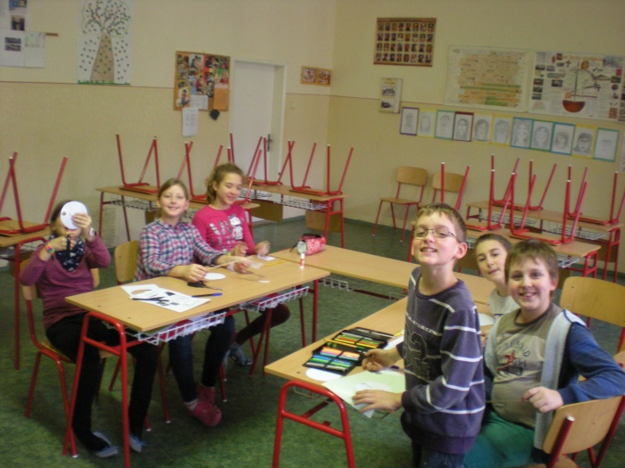
Elementary school
Children start when they are 6 years old
Children finish when they are 15 years old
Classes: 1- 9
Elementary school has two parts: lower grade (1-4) and higher grade(5-9)
Subjects in 1st and 2nd class: reeding, writing, P.E., art, maths, Slovak, English, music education, I.T.
Subjects in 3rd and 4th class: maths, English, Slovak, Hungarian, P.E., art, easy biology, easy geography, music education, I.T
Subjects from 5th to 9th class: maths, English, Slovak, Hungarian, German, history, physics, science, biology, geography, P.E., art, music education, I.T

Slide 7
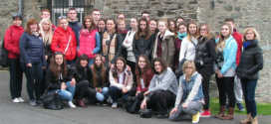
High school
Students start when they are 16 years old
Students finish when they are 19 years old
Classes: 1-4
Subjects in 1st nad 2nd class: maths, science, biology, physics, geography, English, Slovak, Hungarian, German/Russian, history, P.E., I.T., art
In 3rd and 4th class the students have to choose which subjects they want to do the final exams from, except Hungarian, Slovak and English (because from these they must do it). They can choose 1-3 extra subject.
From the chosen subject than the students have more lessons, so they can prepare for the final exams in 4th class.
Final exams (maturitas) : tests the students have to pass if they want to finish the high school. If they pass, they get the leaving certificate which they need to get to college.

Slide 8
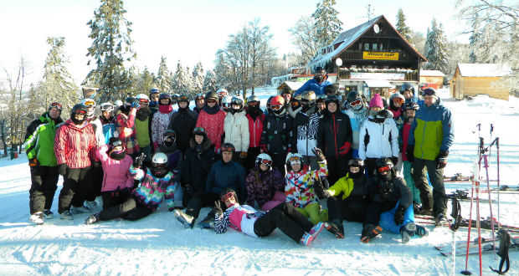
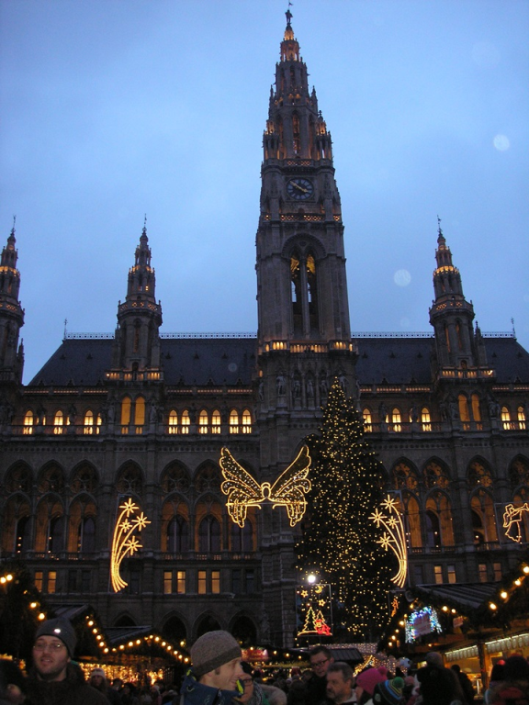
Trips and excursions
Ski camp
Swimming camp
International excursions :
Busapest
Vienna
Krakkow
Prague

Slide 9
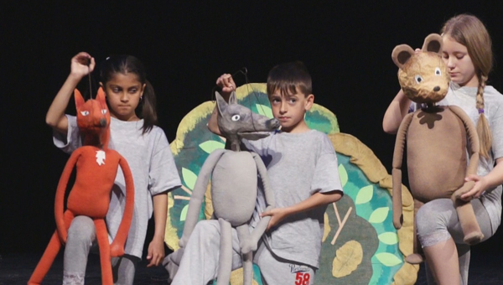
The school’s puppet theatre club
The school’s puppet theatre club started 10 years ago, when a great teacher Mrs. Farkas created it. At first, they just had a small play on the Chrismas show, then they became more and more popular and student joined them. After 2-3 years they started competing in the biggest event for puppet theatres in Hungarian language in Slovakia and since then they always get great ranking, they even ranked first several times.

Slide 10
Recitating and essay writing competition of Tibor Kulcsár
Our school organises an event called recitating and essay writing competition of Tibor Kulcsár. It’s in a small theatre and the whole comppetition ends there they give there prices for the participants. It is very interesting.

Slide 11
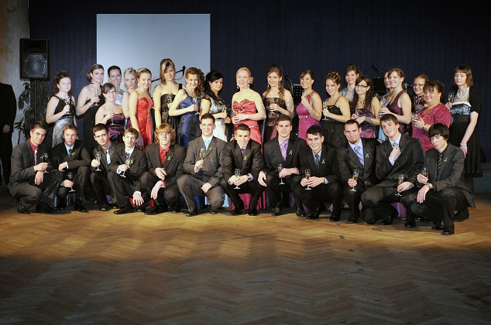
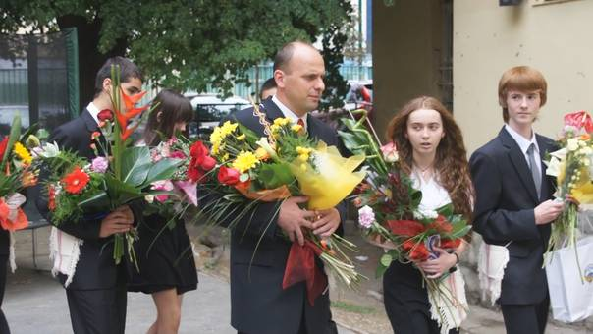
Nice customs ☺
The oldest students who are finishing the elementary or high school have a big party with their classmates, teachers and family. For the elementary school it is called „koszorúcska“ . The students have to show their parents and teachers what they learnt on dance classes before the ball.
For the high school it is called „szalagavató“ when the students get green ribbons from their class teacher. The student wear the ribbons to show the people they are almost grown ups and ready for the life.
When the students are finishing the elementary or high school the students of lower classes decorate the coridors and the finisher´s classes with flowers. Then the finishing students walk around the school singing songs for good bye. The ceremony ends with the director´s intercession on the schoolyard. The students get a lot of flowers and chocolates.

Slide 12
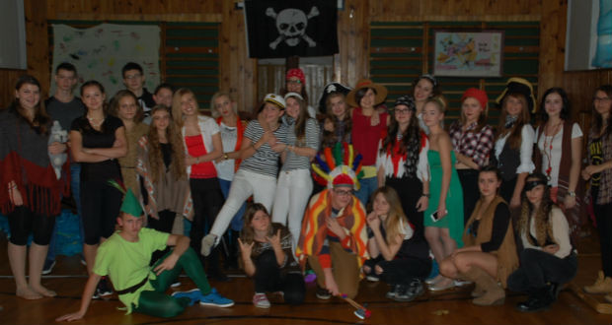
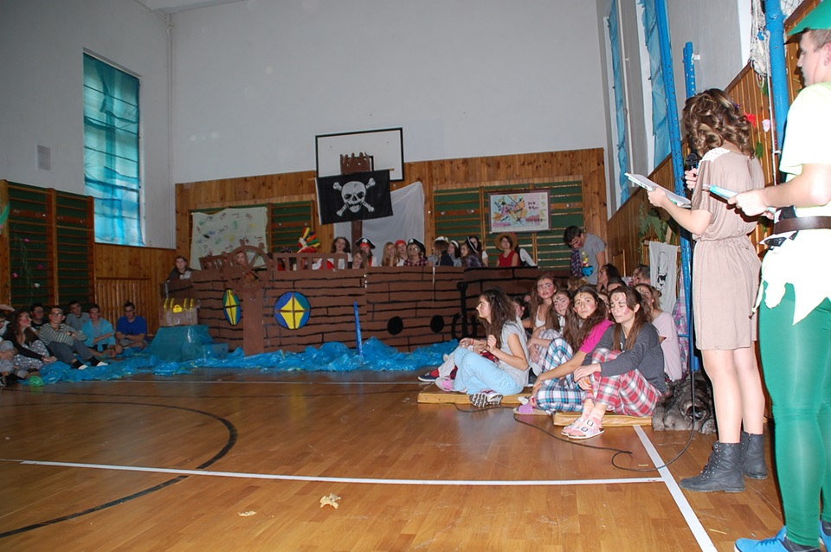
Consecration of the beginners:
Every year the students of the second class consecrate the new „greenhors“. They decorate the gym and think of some challenges for the beginners, which they have to complete.

Slide 13
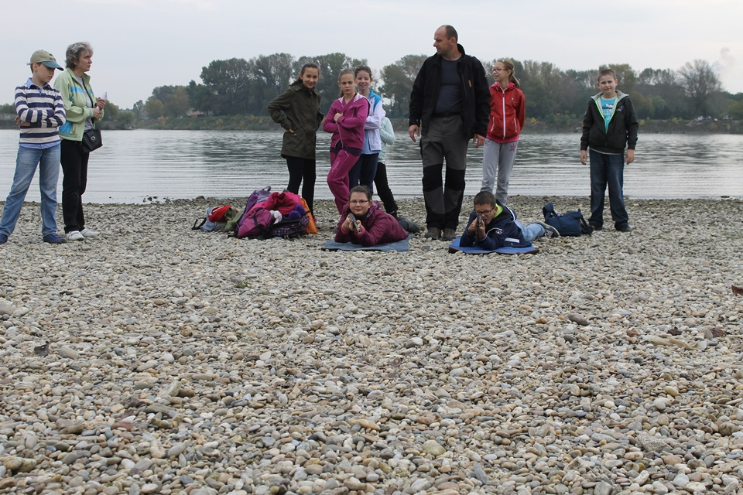
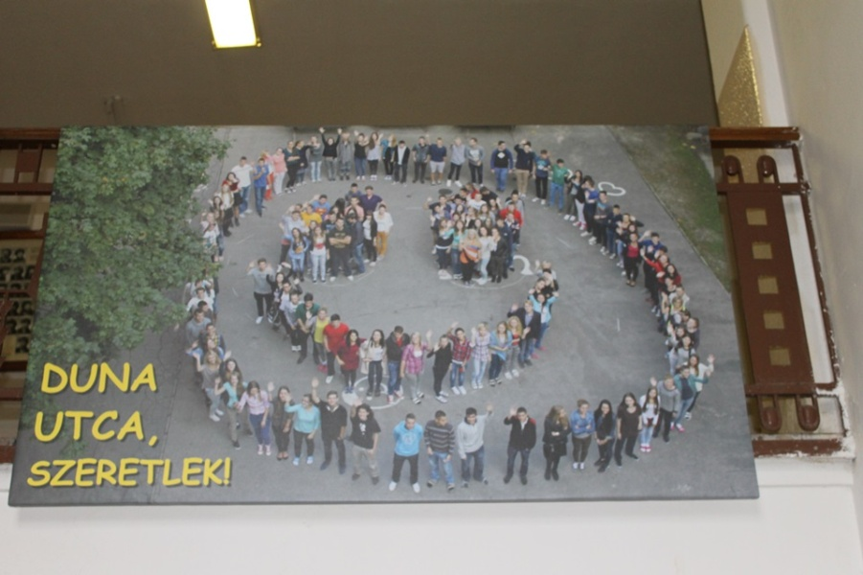
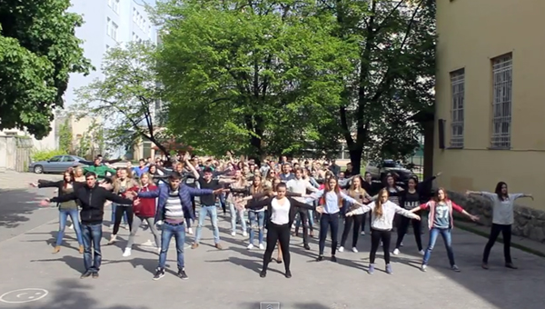
Some projects
Our school organizes a lot of interesting programs and projects. Here are some of them:
Flash mob
Enviromental days
Open doors´s day
The day of the smile

Slide 14
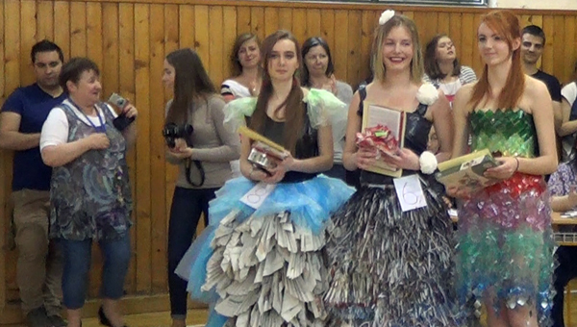
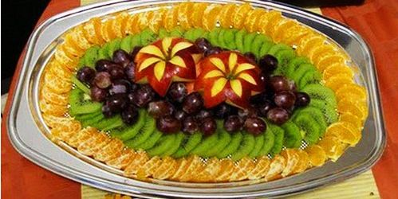
Enviro days
Every year our school organises three days of activities called The days of environment. There is a contest in nature photography, each year there’s a different theme, for example animals in water.
One day is about presentations about health, medicine, biology… Students can do own research and give presentations to professors and other students. It’s very interesting.
There is also an exhibition of fruit and vegetable statues and animals.
The biggest, most exciting thing is the fashion show: the dresses are from used paper and plastic. There are judges, models and creators.
The whole event ends with an expedition to see a cave or a forest, for example.

Slide 15
Thank you for your attention!

