Slide 1
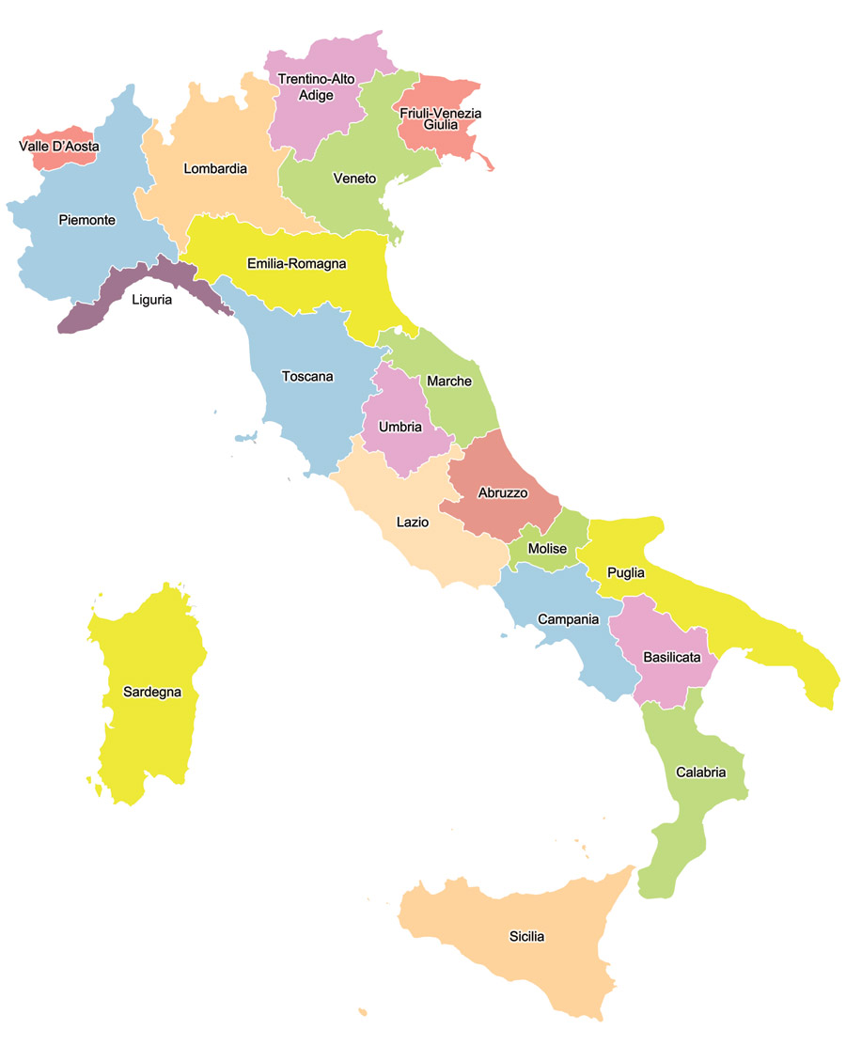
WE ARE HERE!!!

Slide 2
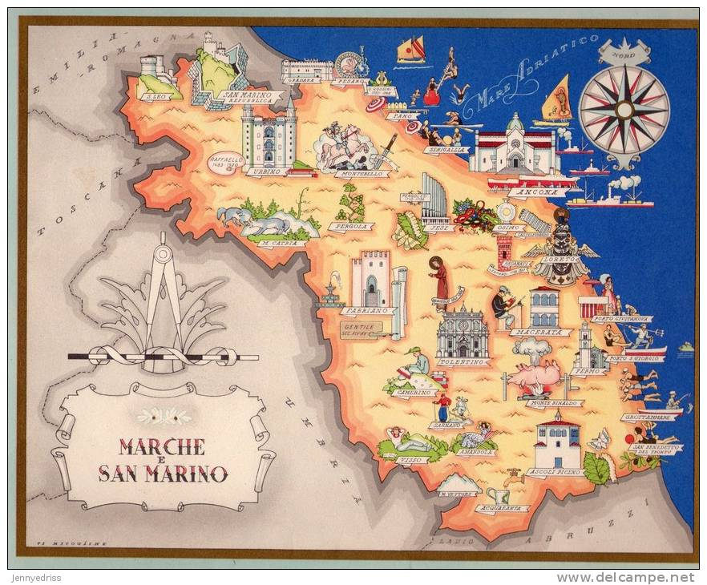
Marches
Marche is one of the twenty regions of Italy. The name of the region, the only one which is plural, derives from the plural name of marca, coming from the German name :mark (border). The region is divided into five provinces: the fifth province , Fermo was estalished in 2009, the other provinces are Ascoli Piceno, Ancona, Macerata,Pesaro e Urbino.

Slide 3
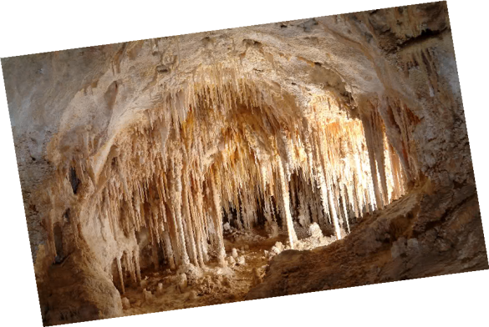
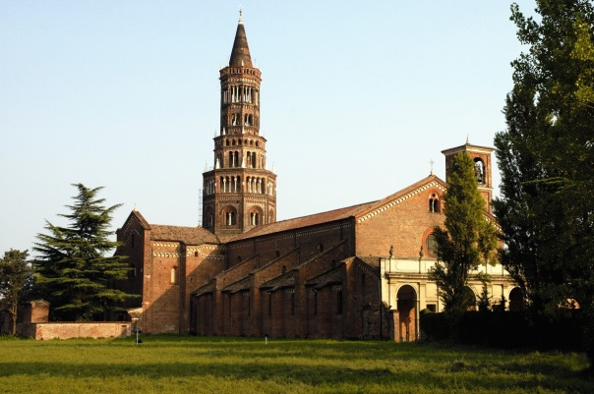
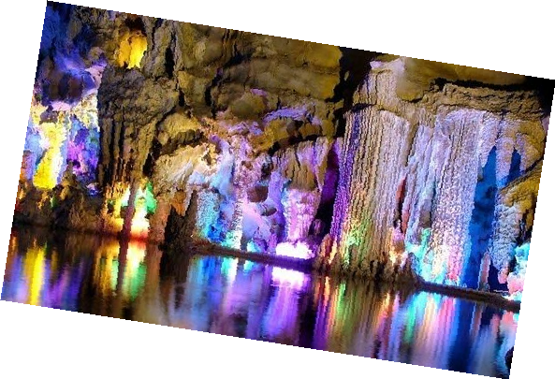
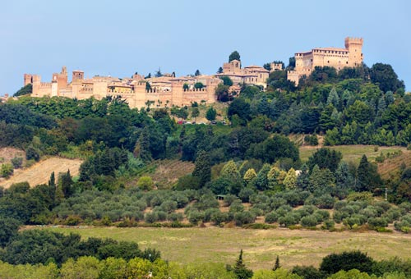
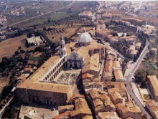
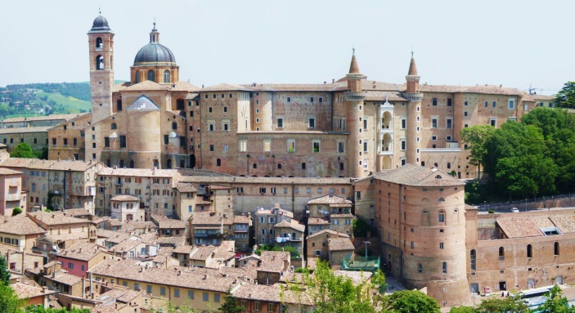
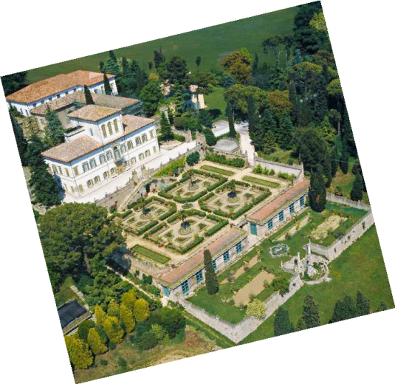
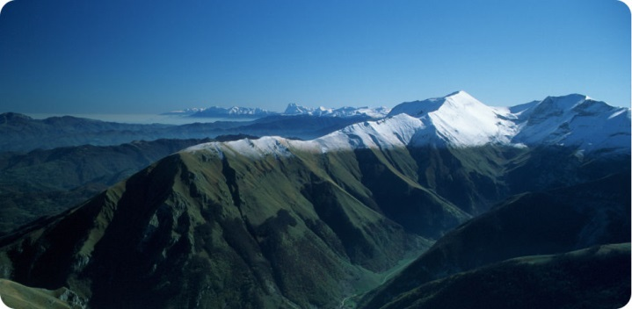
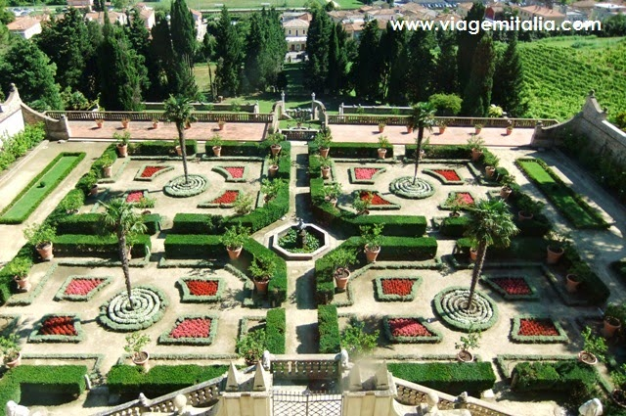
Frasassi caves
Chiaravalle’s abbey
Gradara
Loreto
Urbino
Villa Caprile
Sibillini Mountains
Notes:
3

Slide 4
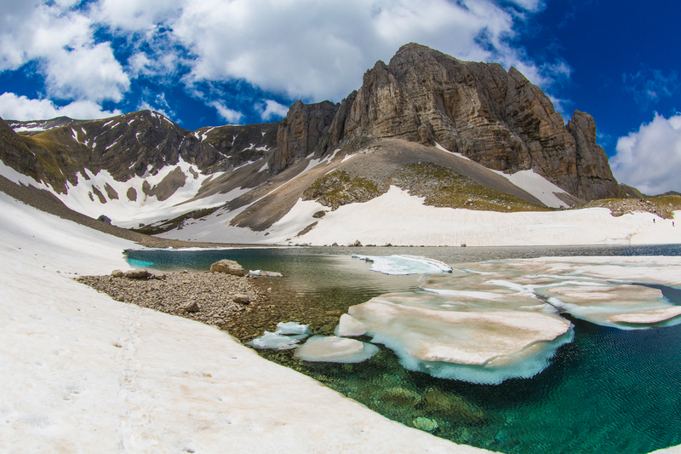
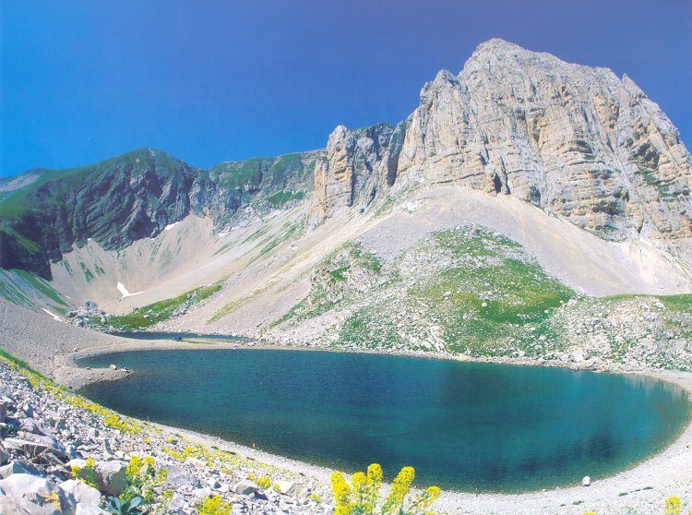
The Mountains
Marche region geographically occupies the eastern side and the territory and it is essentially mountainous and hilly.
The Apennine ridge, which develops along a North South line, is parallel to the coast, with reliefs which present increasing heights towards the South, and end in the southern part of the Region, with the Sibillini Mountains ,with the homonymous national Park; their highest peak is Mount Vettore (2,476 m), which also represents the highest elevation of the whole region.
Sibilla legend
The legend tells about “Sibilla”, a witch Eland, who had been exiled in a horrible point of Sibillini exactly at the mouth of hell, and she was unable to die until Final Judgement because she had rebelled against God.

Slide 5
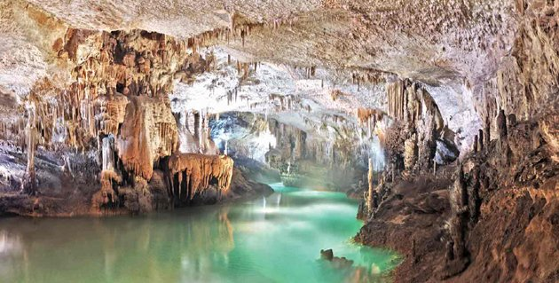
Grotte Frassassi
Frasassi caves are underground caves that are located within the Regional Natural Park of Gola della Rossa and Frasassi , at Genga in Ancona Province. The complex is formed by a series of caves with wonderful stalagtites and stalagmites. The biggest one is so high that could contain Milan Cathedral.
The discovery of Frasassi caves dates back to September 25, 1971. CAI Speleological Group of Ancona led by Giancarlo Cappanera found them by chance.
In July 1971 a group of seven explorers was attracted by a strong current of air coming from a small hole. After expanding the size of the passage in order to pass through it, the explorers discovered an incredible network of galleries, tunnels, columns and caves along an area of about 5 km.

Slide 6
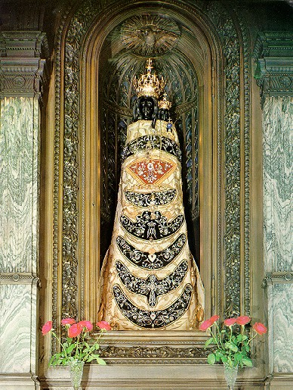
Loreto
The statue of “black Madonna" discovered in a house near a laurel grove (in Loreto) in 1294; The house was said to be the Holy House of Mary transported from Nazareth by angels to Italy in 1294. The statue was accidentaly destroyed by fire and replaced in 1921 by a new standing figure, three feet high, carved from the wood of a cedar grown in Vatican.

Slide 7
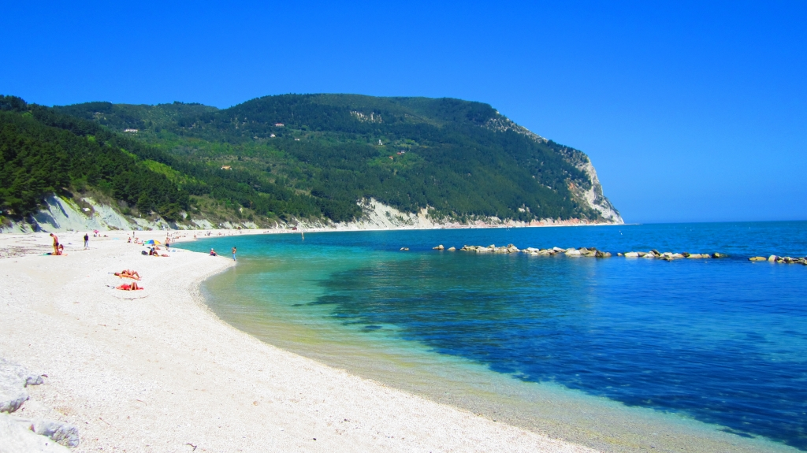
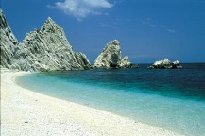
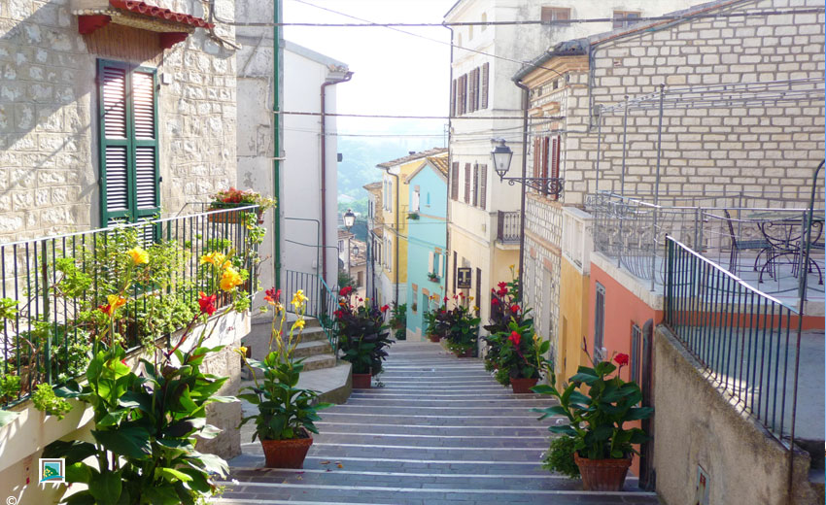
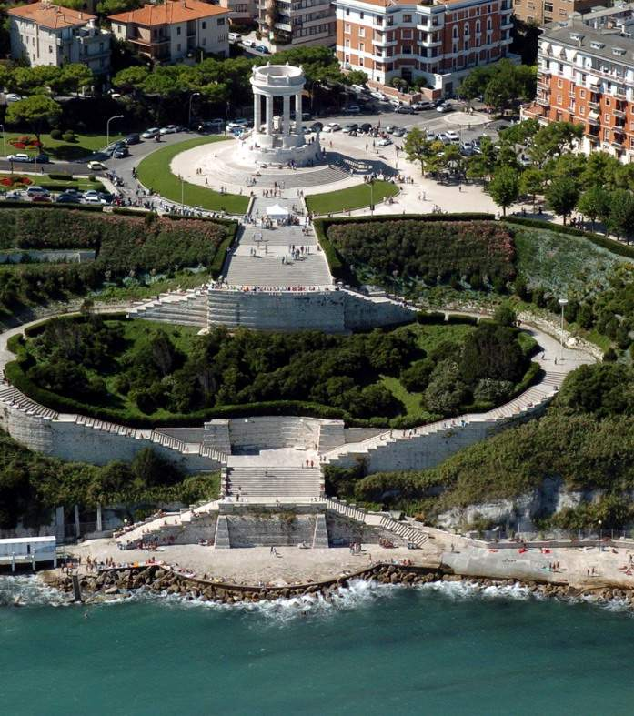
Riviera del Conero
The” two sisters”
“Passetto” Ancona
Numana’s centre

Slide 8
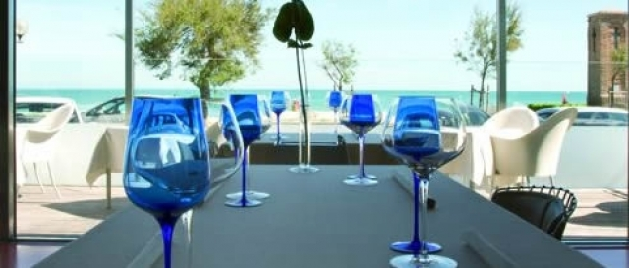
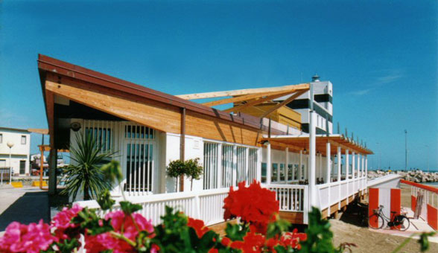
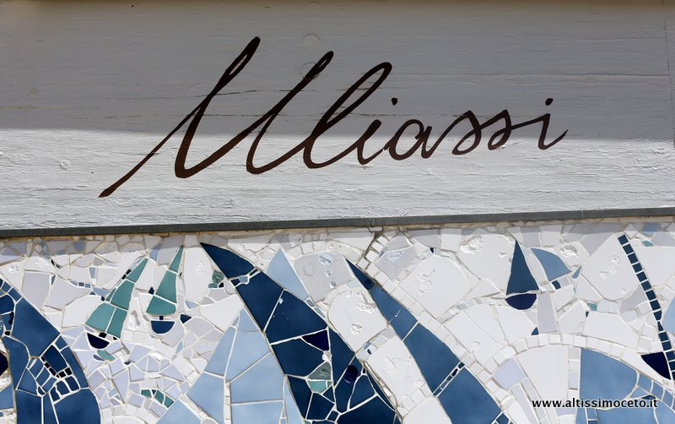
Where to eat something…

Slide 9
Restaurants, bars, pizzerias
There are many restaurants in Senigallia as it is a seaside resort…
You can choose a luxury restaurant with wonderful seafood, good restaurants in town or one of the many bars along the seafront.

Slide 10
Culture
Giacomo Leopardi
Gioacchino Rossini
L’infinito, A Silvia
Il barbiere di Siviglia, Guglielmo Tell
Giacomo Leopardi, a poet famous worldwide, was of noble birth. He was born in Recanati, near Macerata, in 1798,under the papacy
Gioacchino Rossini, composer, was born in Pesaro, under the papacy, on 29 February 1792. His father was a musician and his mother had singing gift.

