Slide 1
You do not know where to go on holiday? Try to visit

Slide 2
SLOVAKIA

Slide 3
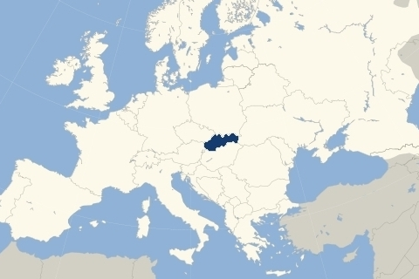
P O S I T I O N

Slide 4
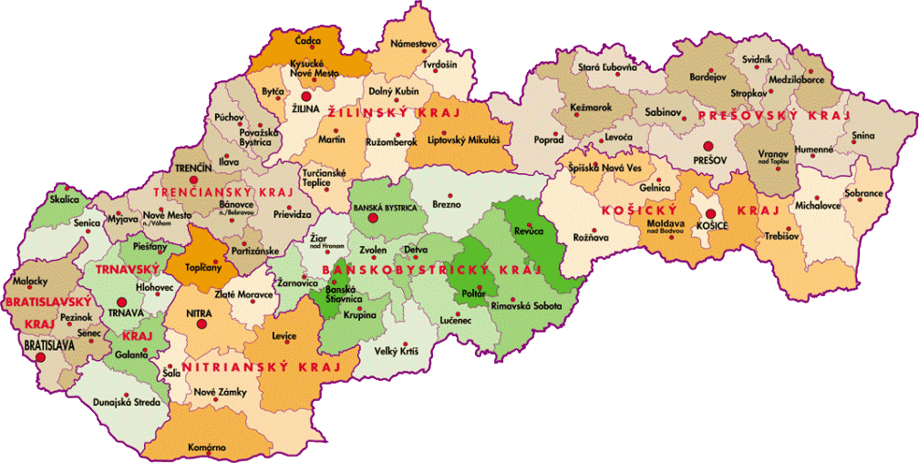
Slovakia

Slide 5
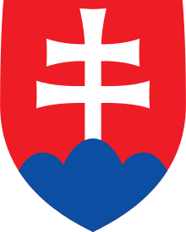
BASIC FACTS
Slovakia is a little country in the middle of Europe.
It has a population of over five million people and an area of about 49,000 km²
.
Slovakia is bordered by the Czech Republic and Austria to the west, Poland to the north, Ukraine to the east and Hungary to the south.
The largest city is the capital, Bratislava, and the second largest is Kosice.
Slovkia is a member state of the European Union, NATO, United Nations, OECD,
and WTO among others.
The official language is Slovak, a member of the Slavic language family.

Slide 6
Nature in Slovakia
Over 40% of Slovakia is covered by forests, more than in Switzerland or Norway
Villages are tranquil places with a very slow pace of life, still using horses and sythes for farming, a way of life, that is disappearing.
Slovakia is a wonderful place for walking, bird watching and fishing.

Slide 7
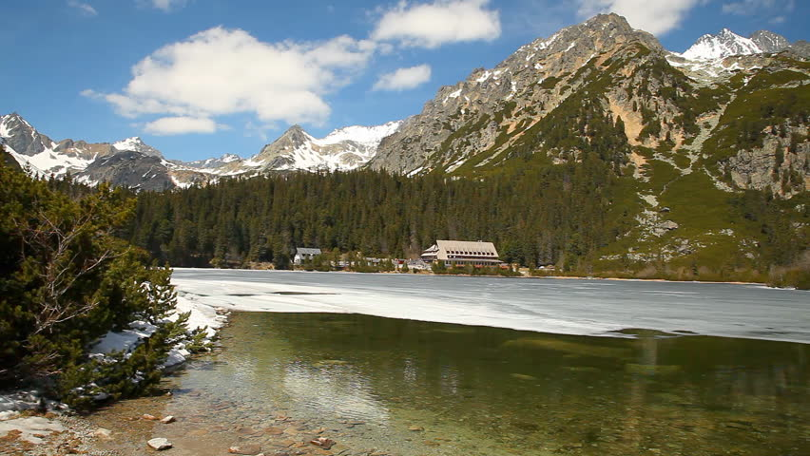
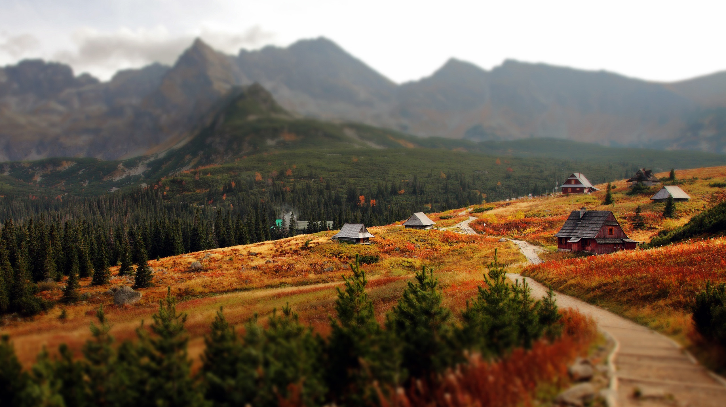
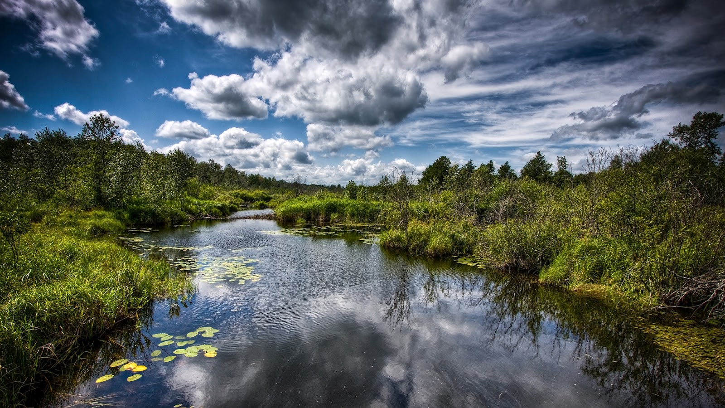
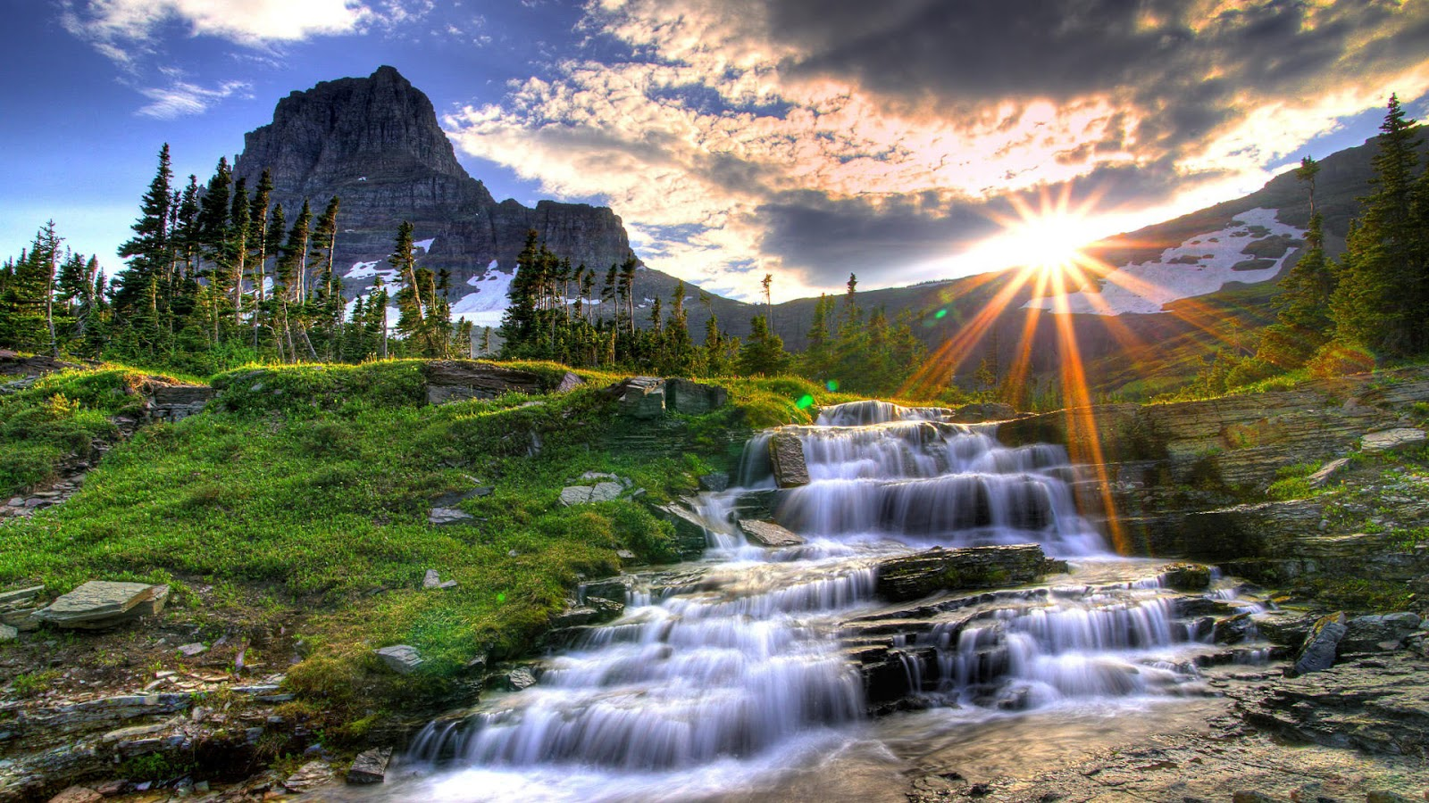
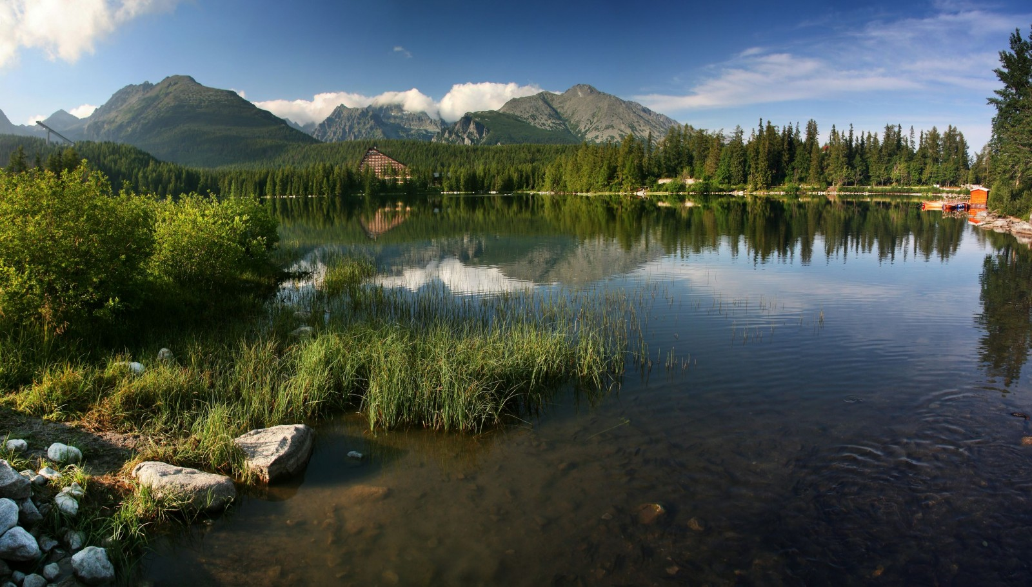
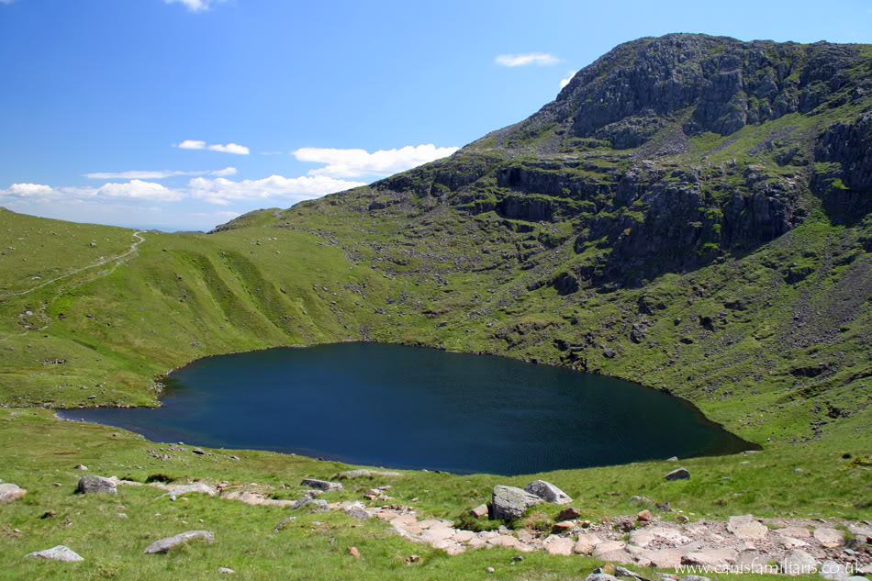
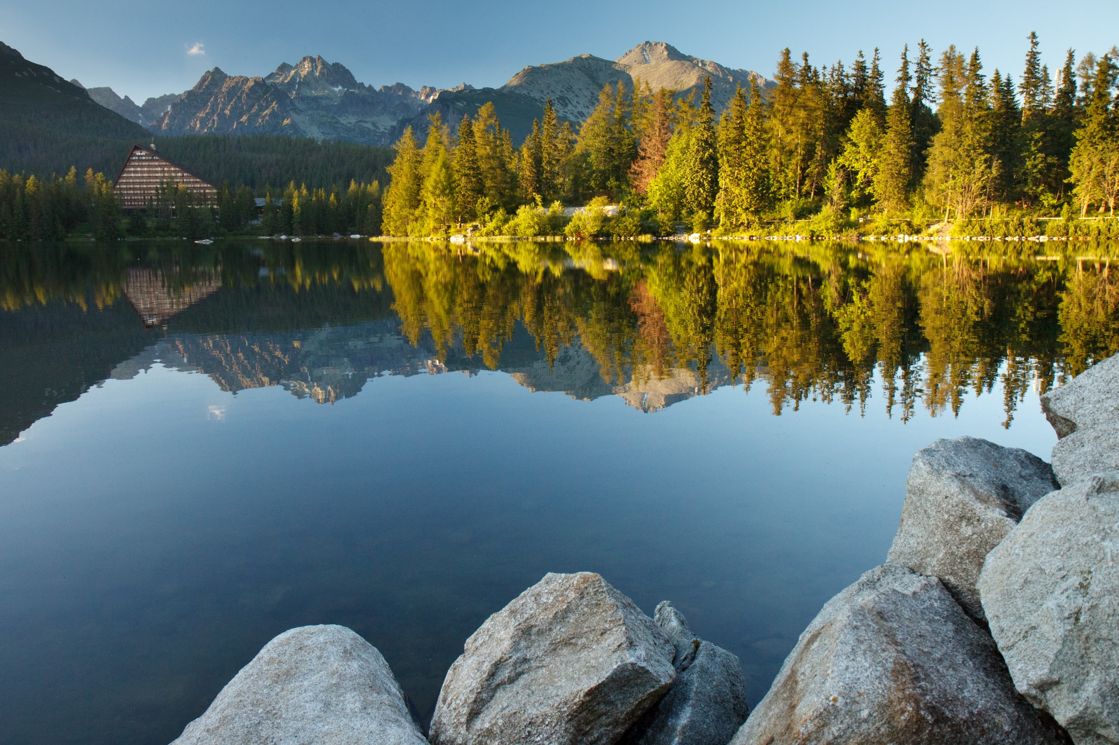
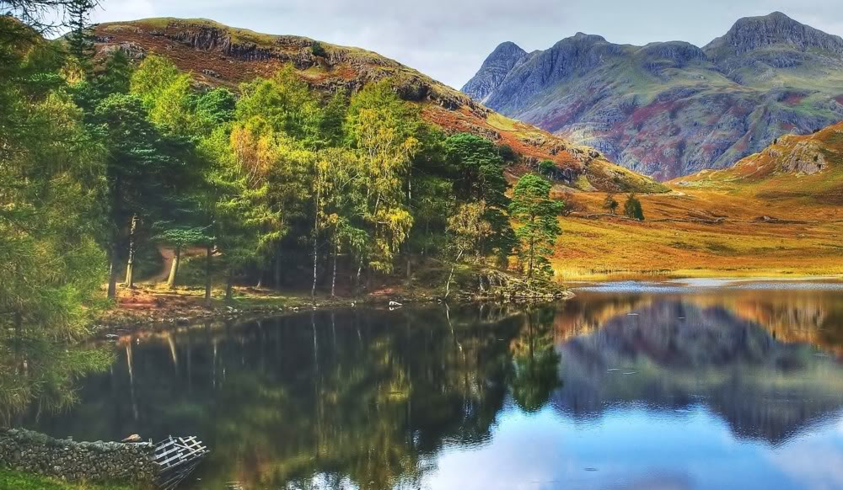
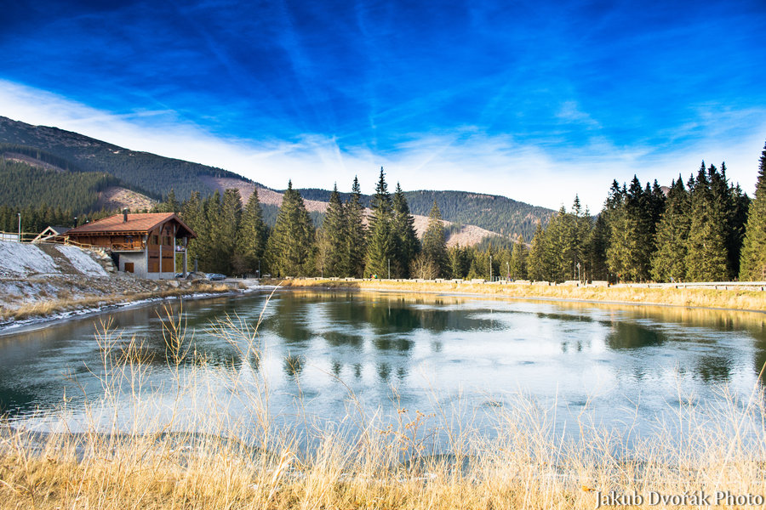
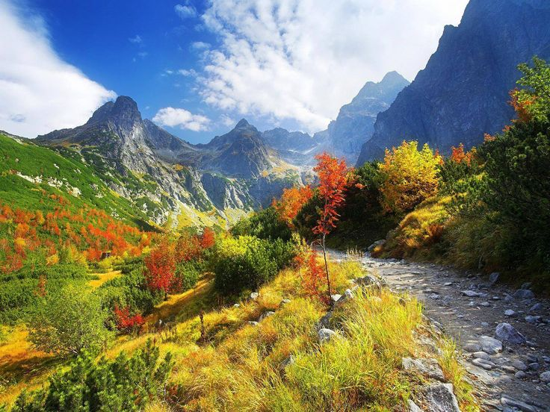
Here are some examples of our beautiful nature:

Slide 8
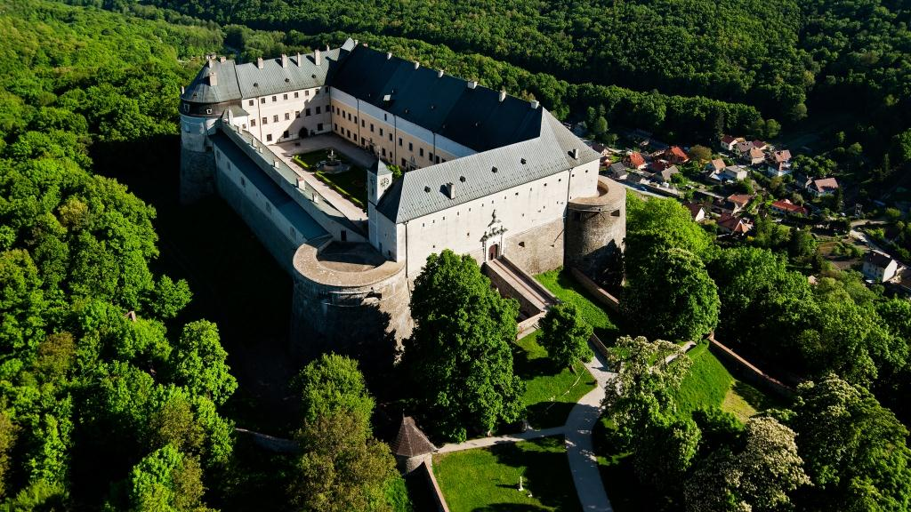
Slovakia is a country full of castles, restored palaces as well as ruins

Slide 9
The main castle of Slovakia’s capital. Rectangular form with four towers. Many legends are connected with this castle.
Bratislava castle

Slide 10
Ruins of Spis castle
The largest castle in
Central Europe(41 426km²)
Included in the UNESCO list
of world heritages sites

Slide 11
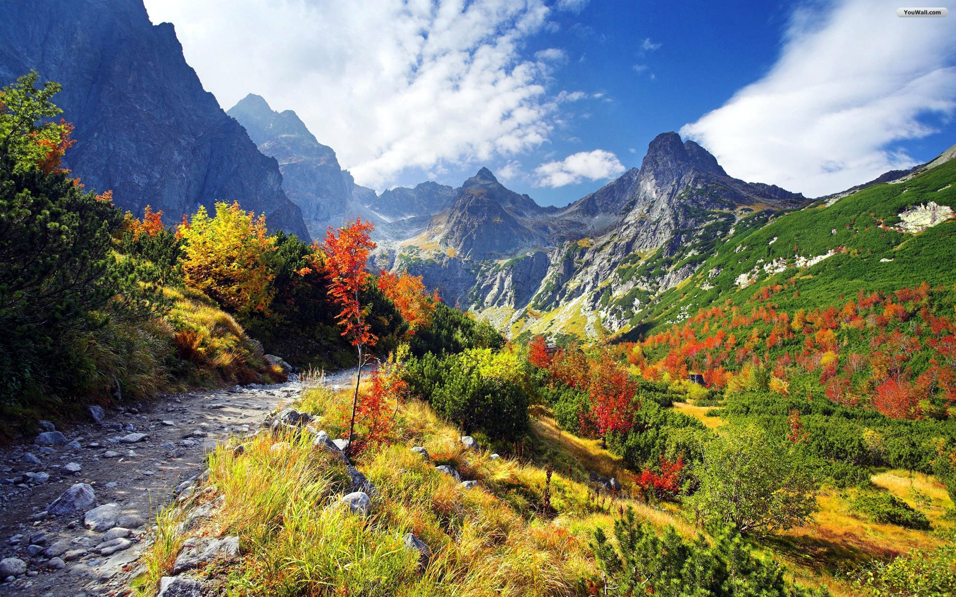
Spectacles of Slovakia
Caves, National Parks, Mountains

Slide 12
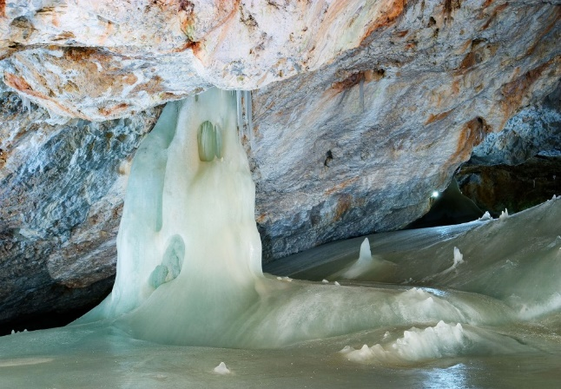
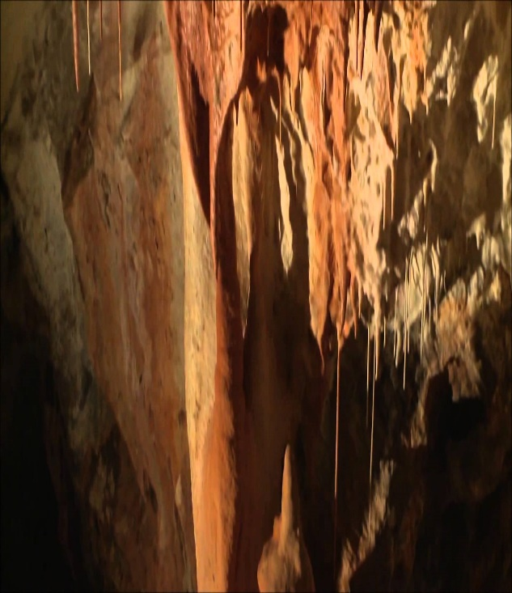
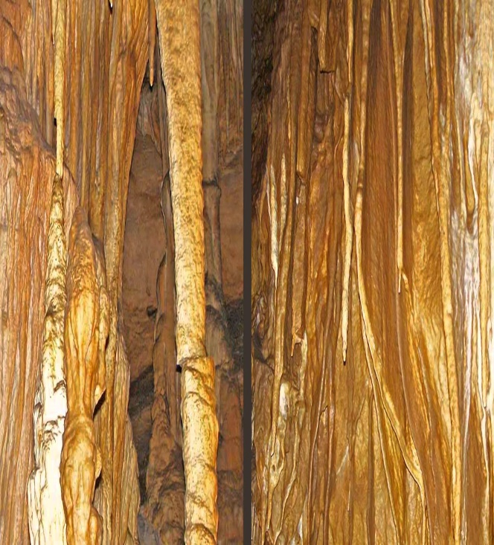
Belianska Cave Dobšinská Ice Cave Gombasecská Cave Jasovská Cave

Slide 13
Our country is full of majestic limestone and dripstone caves
Slovakia has more than 4000 caves
Only 12 are open to the public
Dobšinská Ice Cave and the Dobšinská Dripstone Cave near Slovak Paradise are the most visited ones of them all
Caves served as shelters for people in the past in order to hide from their enemies, today they are only tourist attractions
The Ice cave is approximately 9 thousand years old ( it was called ´Ice hole´ by the locals)
- it was discovered in 1870
- it was the first cave in Europe illuminated by electric light
- they are both listed on the UNESCO list
Belianska Cave is also one of the World´s Heritage
- it is a dripstone cave full of interesting stone formations
- it is situated near Starý Smokovec
Ochtinská Cave is the most unusual of Slovakia´s caves
- there are only three aragonite caves in the world
- the cave was formed deep in the earth
- aragonite is a mineral that is not stable at normal surfaces temperatures and pressures
- the cave has dramatic shapes: needles, spirals, spiky clusters resembling flowers
Jasovská Cave and Gombasecska Cave are also visited by many tourists

Slide 14
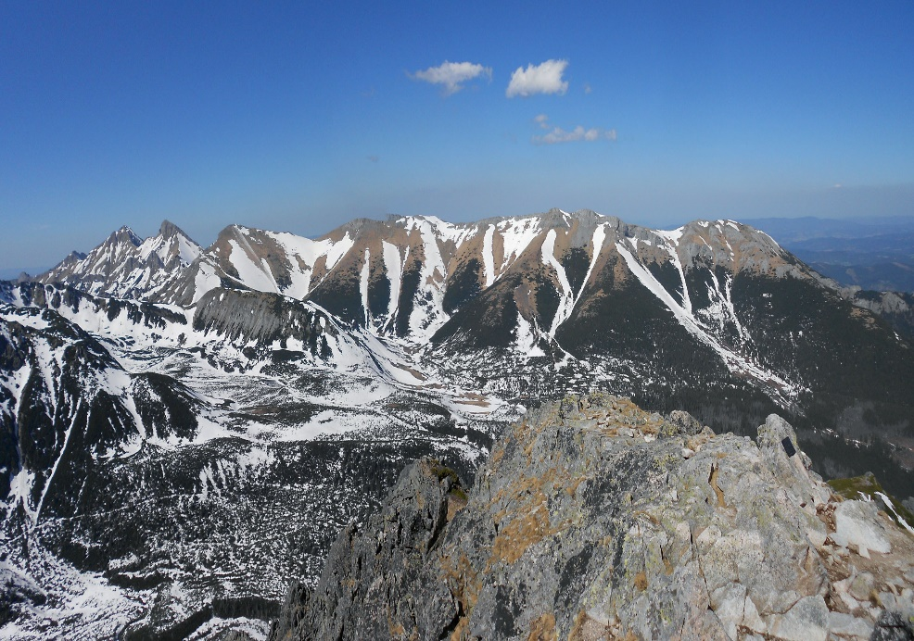
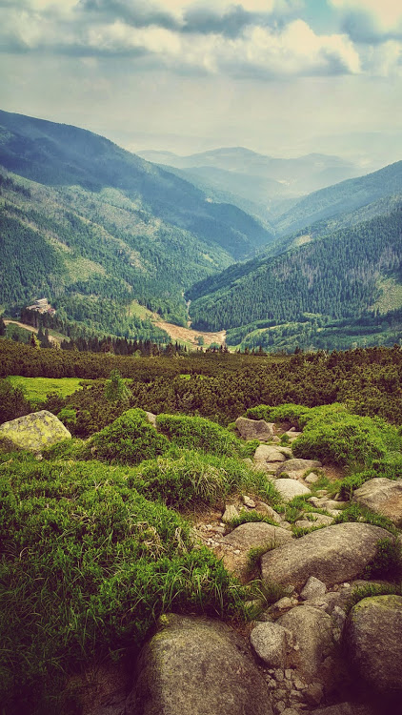
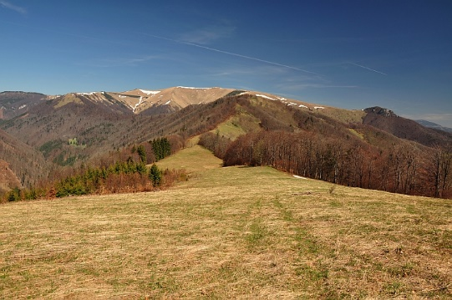
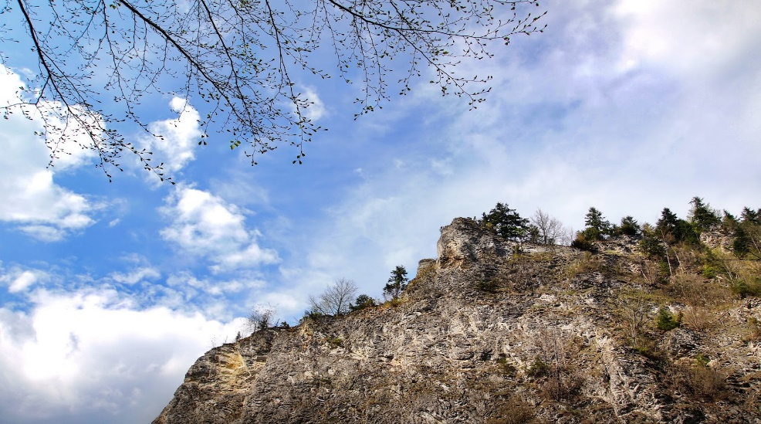
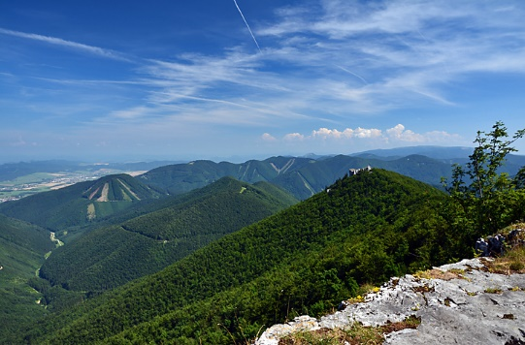
High Tatras Belianske Tatras Low Tatras
Greater Fatra Lesser Fatra Pieniny

Slide 15
Mountains and National Parks
Over 40 per cent of the territory of Slovakia is forests. Numerous mountain ranges attract still more and more visitors. The most imposing national park is the High Tatras, the smallest of the highest mountains in Europe. The most important centres of tourism in the High Tatras are Štrbské Pleso, Tatranská Lomnica and Starý Smokovec. The largest national park is the Low Tatras. The most visited centres of the Low Tatras are Jasná and Tále. The Pieniny national park is well- known for its valley of the Dunajec River. Further national parks with specific country relief, fauna and flora are the Malá Fatra, Muránska Planina and Poloniny.

Slide 16
You can find a lot of spa centres in Slovakia where you can rest
Health Spa Piešťany - Paradise for body and soul
Natural healing sources – thermal mineral water and unique sulphuric mud - are the cornerstones of the Piešťany spa which has become worldfamous thanks to its modern methods of treating rheumatism and other disorders of motion. Spa Piešťany is located on the beautiful Spa Island which has a luxurious park, rich cultural and social life and numerous possibilities for active relaxation.

Slide 17
Bojnice Spa
Bojnice Spa in the heart of Slovakia is a peaceful resort that thanks to its geographic location, climate and water composition provides ideal conditions for the curative tratmen processes, regeneratin and the reast of its guests.

Slide 18
Interesting cities

Slide 19
Bratislava
It‘s not just the political, but is also the cultural and sporting capital of Slovakia. Bratislava boasts numerous theatres, museums, galleries, concert halls, cinemas, film clubs, large malls and foreign cultural institutions. It also has the country‘s biggest football and ice hockey teams.
What to see:
Slavín War Memorial
Devín Castle
Danubiana Meulensteen Art Museum
St. Martin‘s Cathedral
The New Bridge

Slide 20
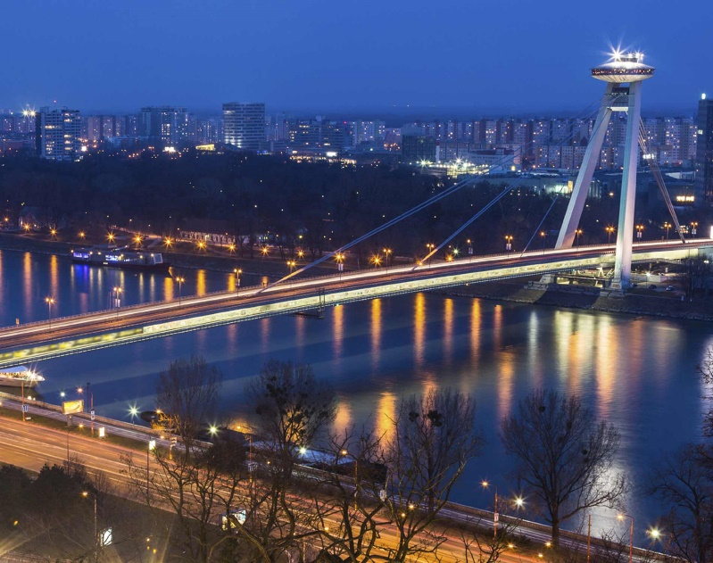
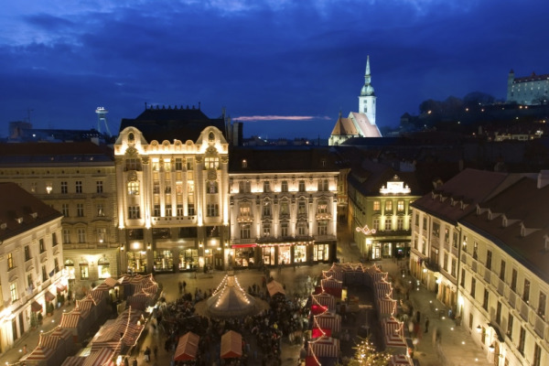
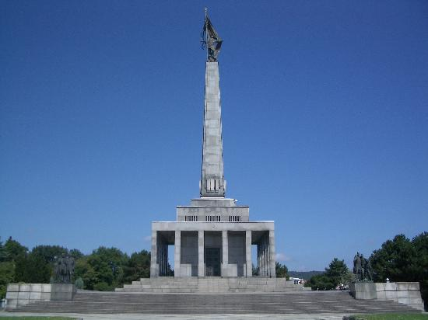
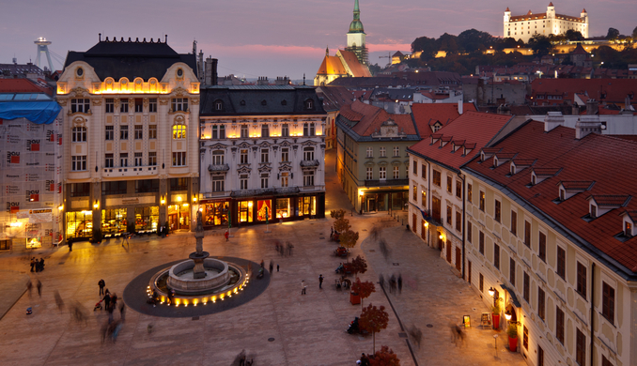
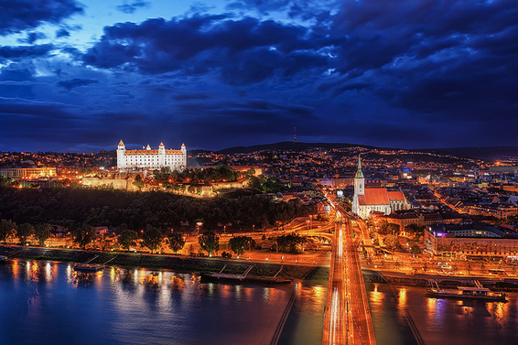

Slide 21
Košice
In terms of its size and importance in the Slovak Republic, the city of Košice ranks right after the capital Bratislava. It lies in the eastern part of Slovakia, not far from the borders with Hungary, Ukraine and Poland. Košice has an existing railway junction and airport with international status.
What to see:
The Slovak Technical Museum
St. Elisabeth Cathedral (Slovakia‘s biggest church)

Slide 22
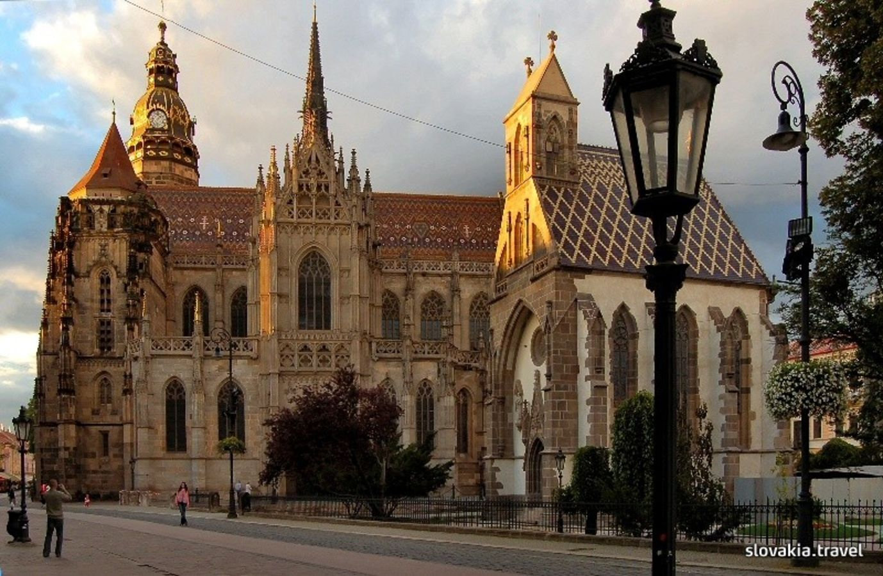
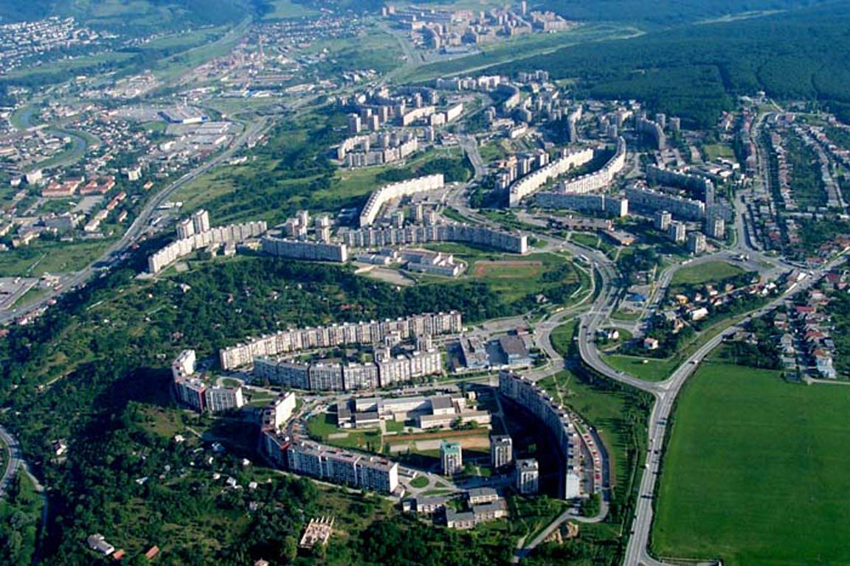
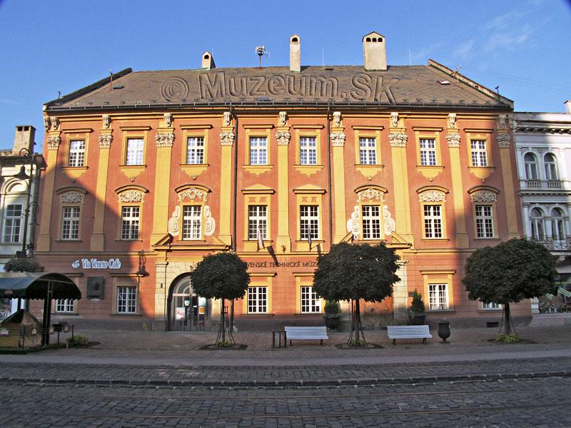
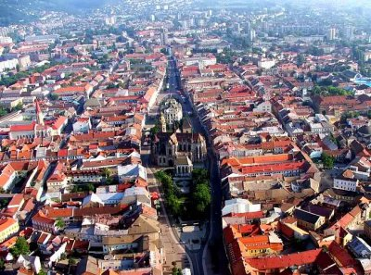
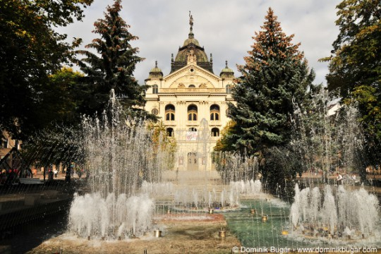
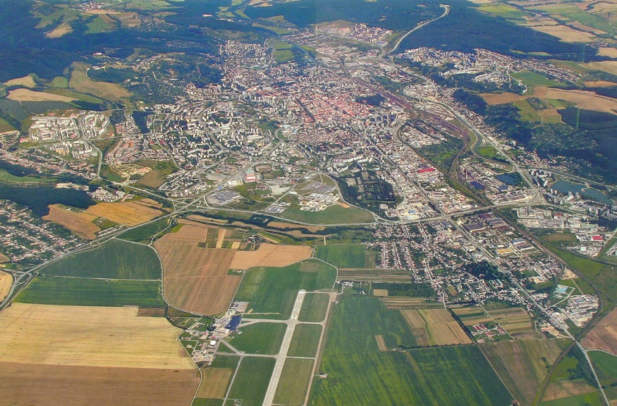

Slide 23
Prešov
Prešov is a city in eastern Slovakia and it is the third largest city in Slovakia. After 1948, during the Communist era in Czechoslovakia, Prešov became an industrial center. The population started growing fast. Prešov has the oldest football team in Slovakia.
What to see:
St. Nicholaus Church
Torysa riverbank
Neptune‘s fountain

Slide 24
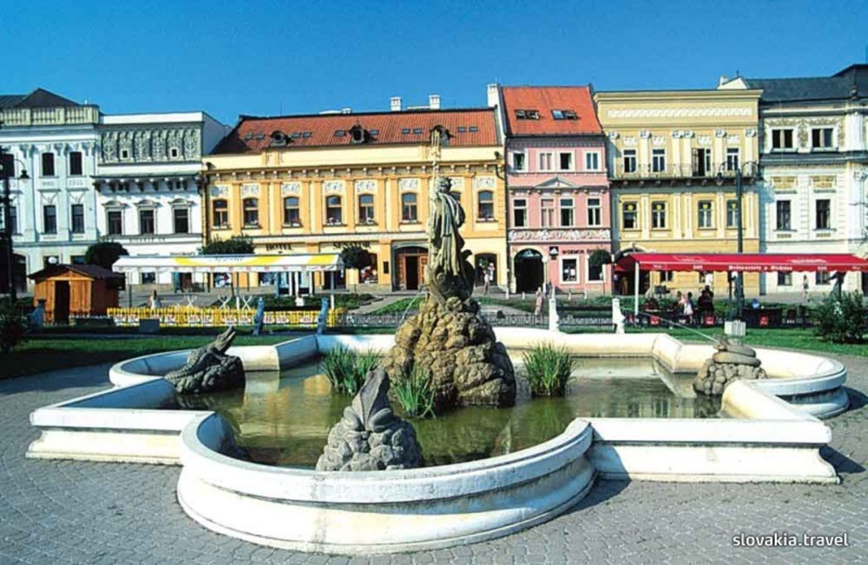
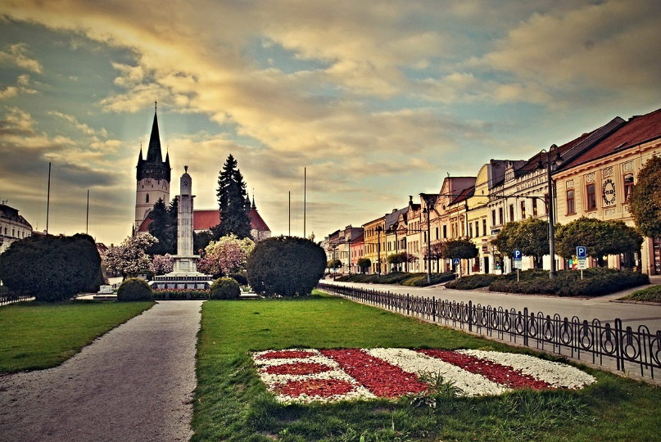
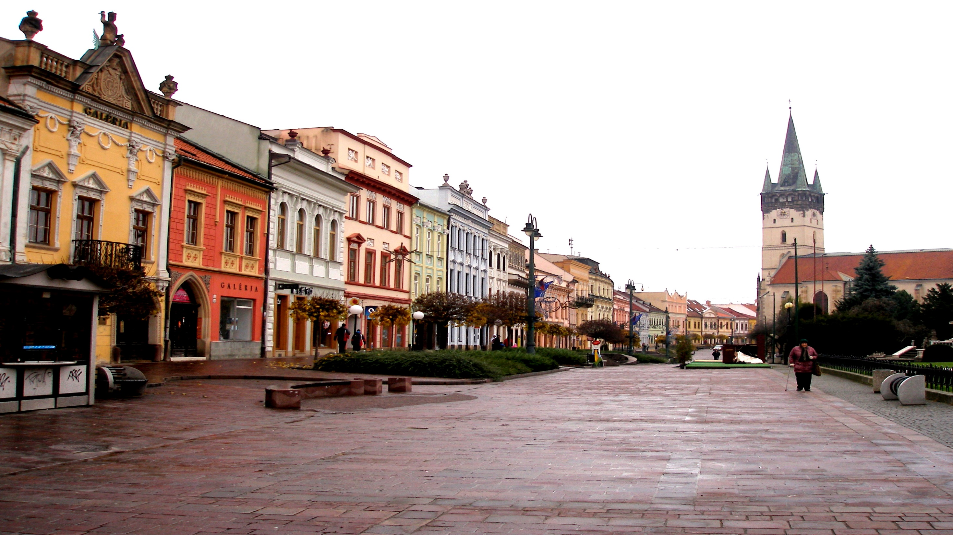

Slide 25
Now you know what Slovakia is. Do you like it? If yes, there are also another beautiful places in Slovakia, that are waiting just for you! So do not hesitate, common and enjoy!☺
Thank you for watching ☺
Editors: Gabi Világi Péter Csonga Dominik Lelkes Gergely Horváth
Norbert Haják
Karin Frühwald

