Slide 1
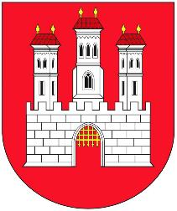
Bratislava

Slide 3
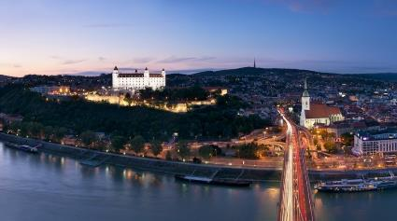
General information
The biggest and also the capital city of Slovakia
Population: about 500.000
River Danube, River Morava
5 districts
Population: -Slovak: 90%
-Hungarian: 3,4%
-Czech: 1,3%

Slide 4
History
200 BC- Celtics
1st-4th century AD- Romans
10th century- Bratislava became a part of the Kingdom of Hungary
1291- King Andrew III. gave to Bratislava town privileges
1405- King Sigismund- free royal town
1465-Matthias Corvinus, Academia Istropolitana
1526- the Battle of Mohács, the Ottomans damaged Bratislava

Slide 5
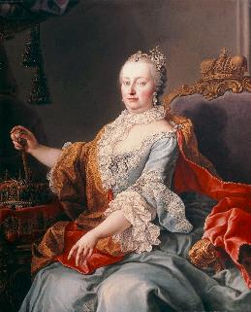
1536-1830- eleven Hungarian kings were crowned here at St. Martin’s Cathedral
17th century- fighting against the Turks, plague, anti-Habsburg uprisings
18th century- Queen Maria Theresa
1848- revolution, Ferdinand V. signed the April laws
1918- Bratislava became a part of Czechoslovakia, later the fascistic First Slovak Republic
1993- Bratislava finally became the part of Slovakia

Slide 6
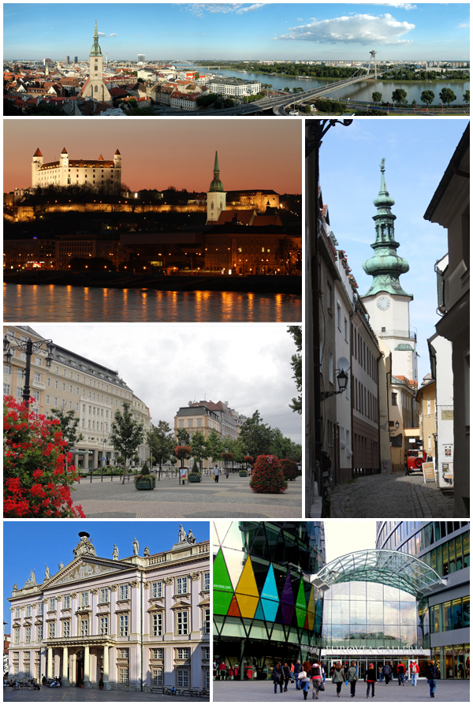
Sightseeing
It has several museums, galleries and of other educational, cultural and economic institutions.

Slide 7
Bratislava Castle

Slide 8
Castle of Pressburg
The castle in the past
The castle nowadays

Slide 9
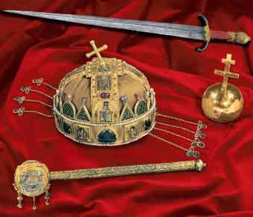
mixture of Gothic, Renaissance and Baroque styles
Four gates: Vienna, Leopold, Nicholas, Sigismund
16th century- home of the Hungarian crowning jewells
Now museum and touristic attraction

Slide 10
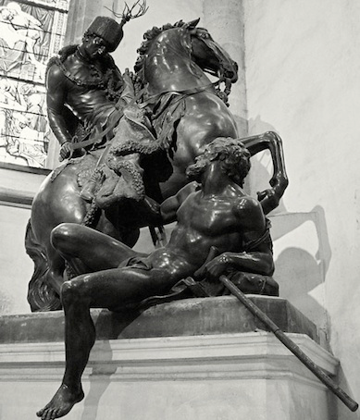
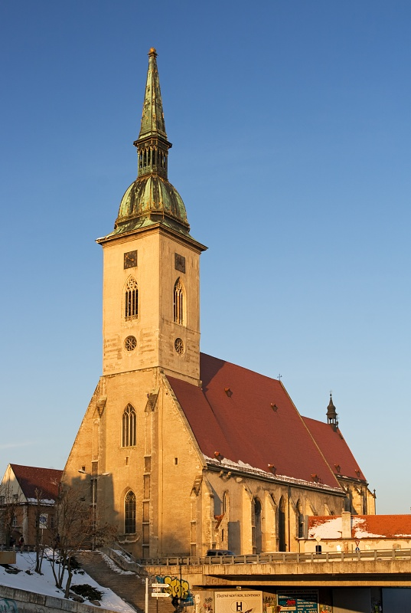
St. Martin’s Cathedral

Slide 11
It is the largest and one of the oldest churches in Bratislava, built in 1221
Roman catholic church
Also known as coronation church
On the tower there is a replica of the Hungarian crown on a golden pillow
Statue of St. Martin by Georg Raphael Donner
Under the main altar there is the crypt of the Pálffy family

Slide 12
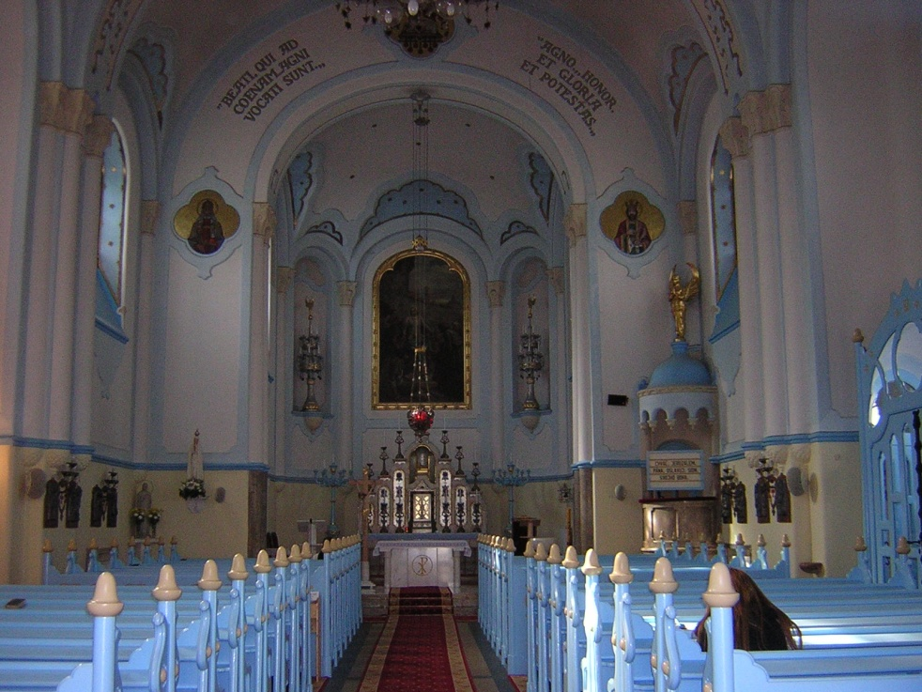
Blue church

Slide 13
The ground floor of the church is oval.
In the foreground there is a 36.8 metre high cylindrical church tower.
The barrel vault topped by a hip roof.
The roof is covered with glazed bricks with decoration.

Slide 14
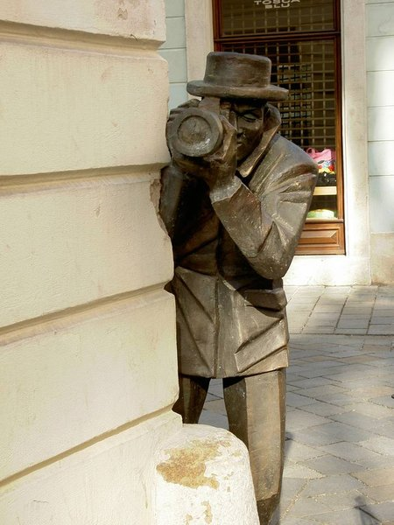
Quirky street statues around Bratislava

Slide 15
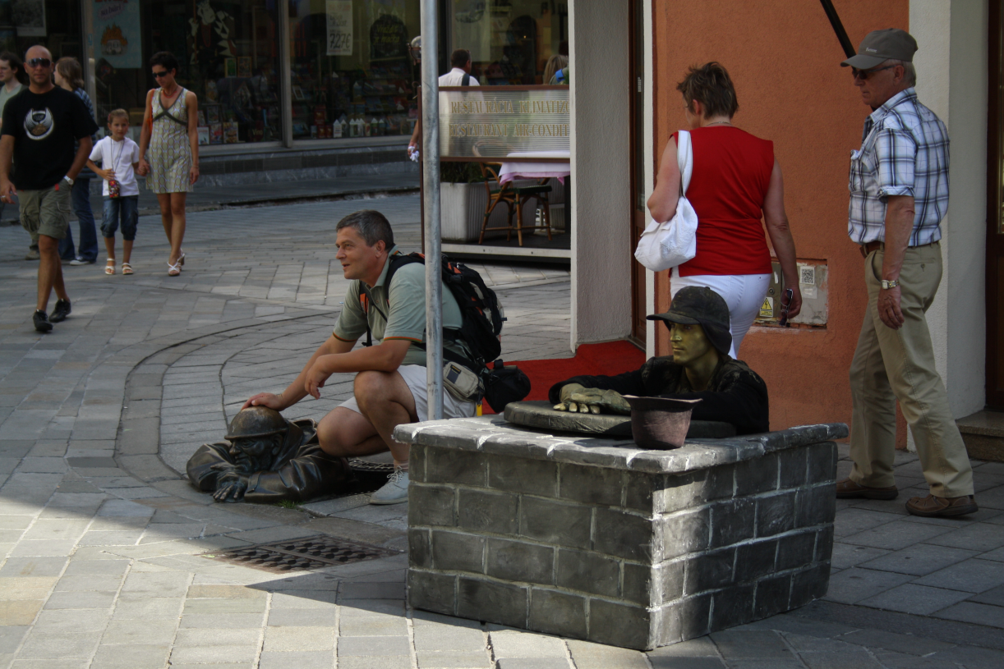
Man at work

Slide 16
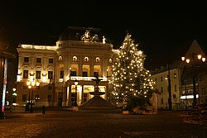
Slovak national theatre

Slide 17
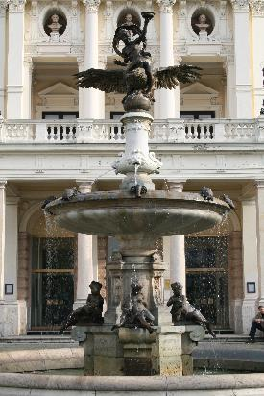
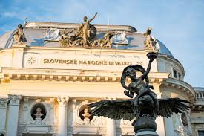
3 ensembles: drama, opera, ballet
It was opened in 1886, the first opera performed here was the Bánk bán from Erkel Ferenc
In front of the theatre there is a fountain by Victor Tilgner, the fountain of Ganymede.

Slide 18
ufo

Slide 19
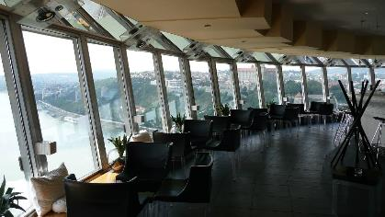
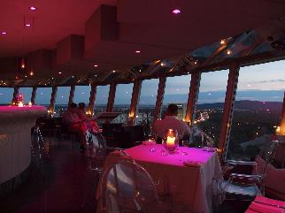
UFO is a restaurant in central Bratislava, Slovakia
It is located on top of the Most SNP bridge over the river Danube
The restaurant received the Restaurant of the Year award in 2011
The name "UFO" comes from the restaurant's shape, resembling a flying saucer
The Most SNP bridge and the UFO restaurant on top of it are one of Bratislava's most famous and most prominent landmarks

Slide 20
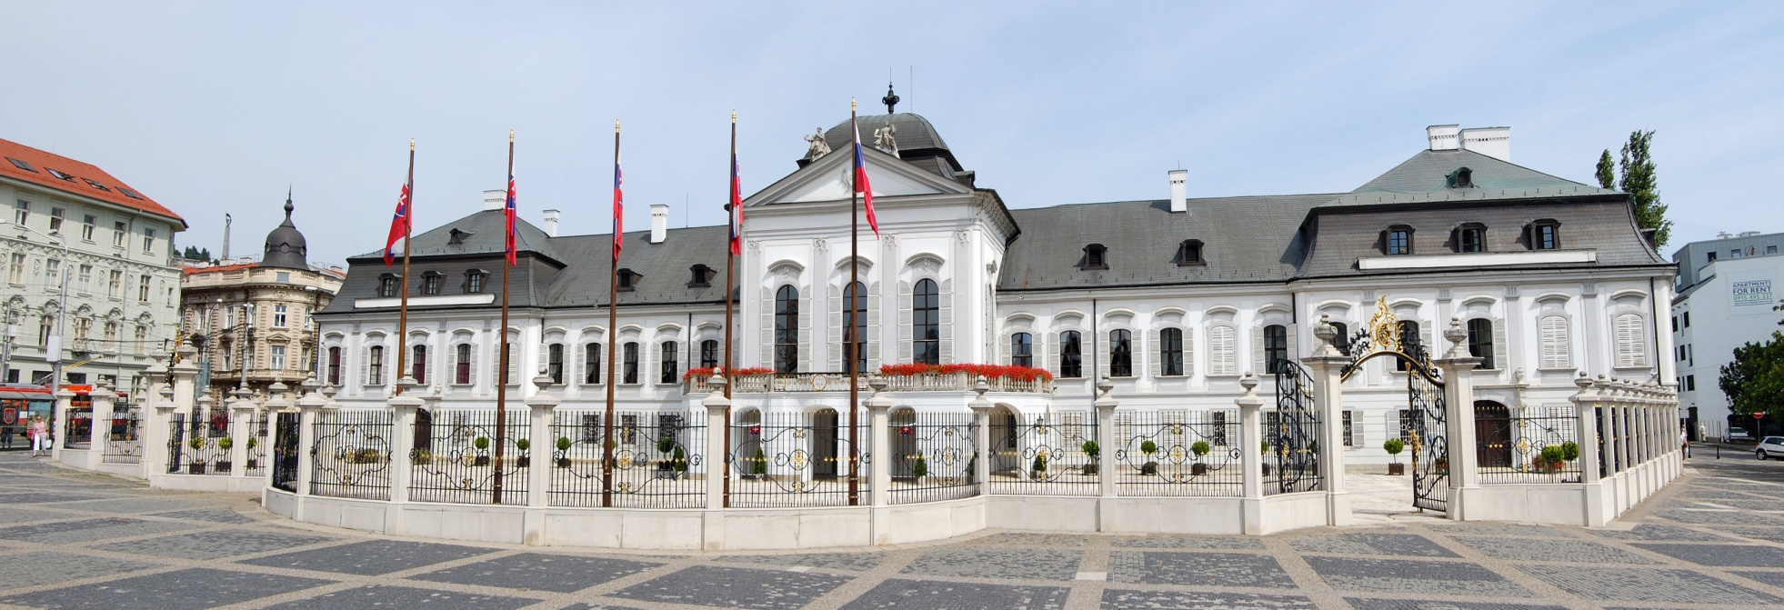
Grassalkovich palace

Slide 21
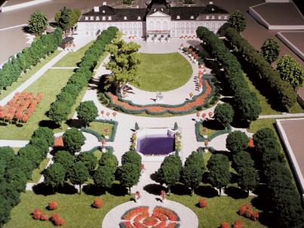
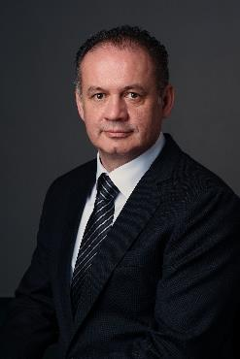
It was built in 1760 in Baroque style with a French garden
Originally built for a Hungarian aristocrat, Antal Grassalkovich, one of the closest friends of Maria Theresa
During the 1939-45 period it was the residence of the president of the fascistic First Slovak Republic
1950- Klement Gottwald turned it into the House of Pioneers and Youth during the Communism
The garden is opened for public
It is the residence of the president, Andrej Kiska

Slide 22
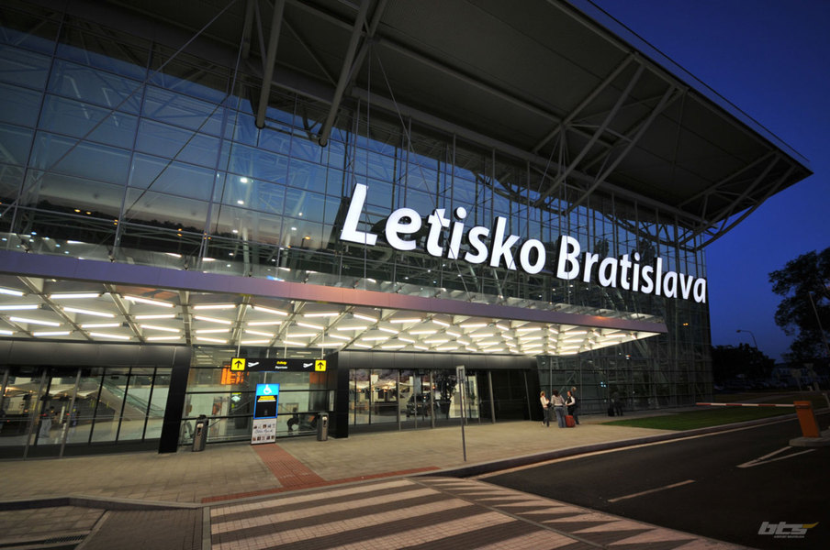
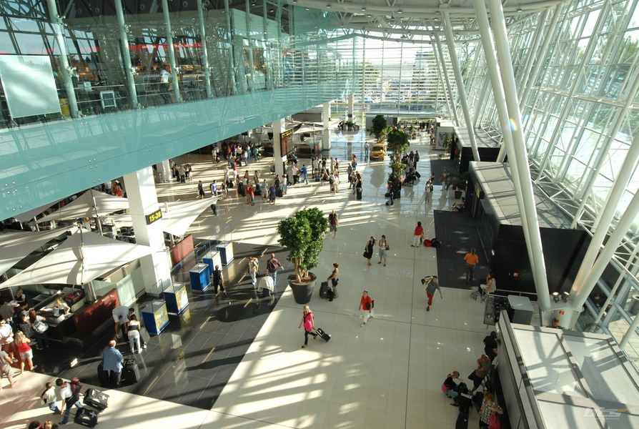
Bratislava airport

Slide 23
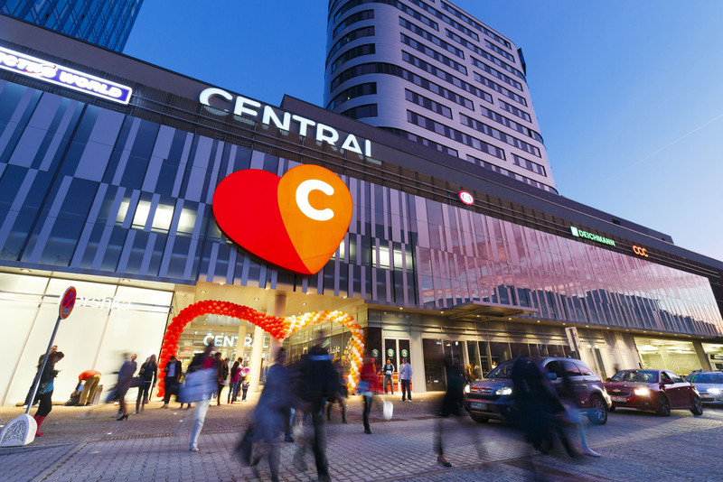
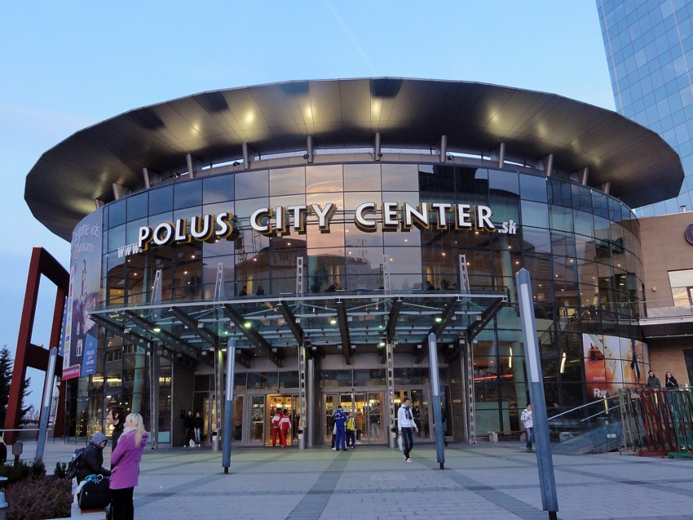
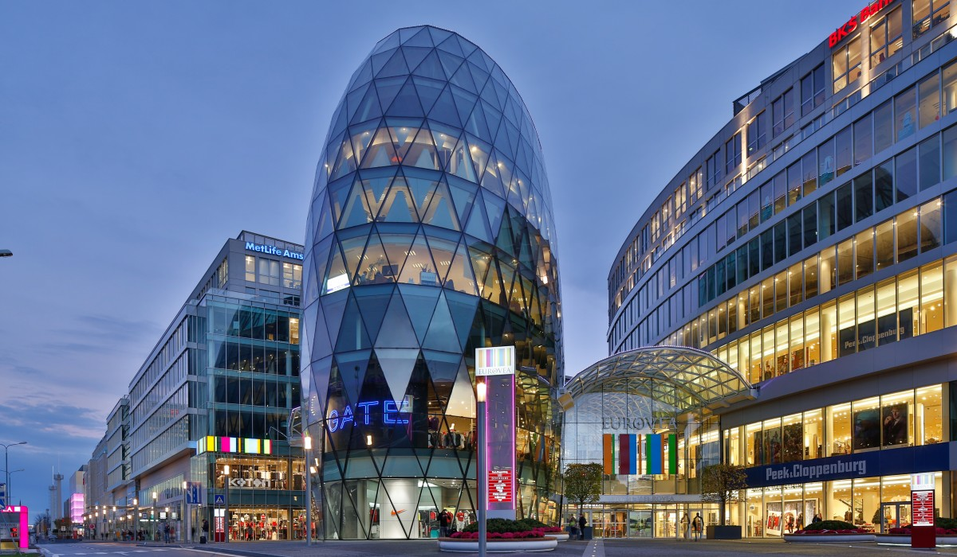
Shopping centres

Slide 24
