Slide 1
2016/2017
1st WORKSHOP
for teachers
about “Burnout”
AGRUPAMENTO DE ESCOLAS DE RESENDE
ERASMUS +: Projeto “Take a Chance”

Slide 3
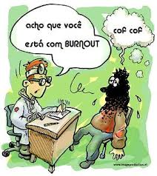
BURNOUT: definition
It's an answer to chronic work stress, integrated by negative attitudes and feelings towards the people with whom one works and their own professional role, as well as feeling emotionally exhausted. .
(Maslack & Jackson, 1981)

Slide 4
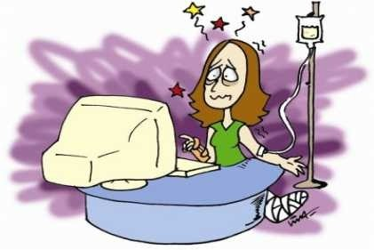
Burnout syndrome
Burnout syndrome results from the interaction between the individual and the harmful conditions at work.
It is usual to consider that the individual is not suitable for work, instead of questioning what is possible to change in the conditions or characteristics of work, in order to provide wellbeing and fulfillment to professionals.

Slide 5
Components of Burnout Syndrome
The syndrome involves three components, which may appear associated, but they are independent:
Emotional exhaustion – lack of energy associated to the feelings of emotional exhaustion. The practioner feels that cannot expend more energy to develop his activities.
Depersonalization – indifference to daily work activities, presence of negative attitudes and behaviours of cynicism and pretending affectivity by socializing with people, treating them as objects.
lack of involvement in the work or low professional achievement – sensation of inadequacy, low self-esteem, demotivation and unhappiness at work, affecting even skill and dexetry.

Slide 6
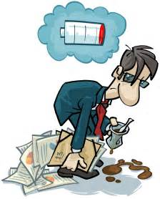
Signals/ symptoms of the Burnout syndrome
It reveals itself through four symptomatological dimensions: physical, psychic; behavioural and emotional.
The main symbols: emotional exhaustion, depersonalization, reduced professional achievement; tiredness; pain; immunodeficiency; sexual dysfunctions; distrust; irritability; loss of initiative and trend to be isolated.
Signs of advanced disease: migraines, insomnia, gastritis and ulcer; diarrhea; asthma attacks; palpitations; hypertension; muscle pain; allergies and infections, depression, increased consumption of coffee, alcohol, barbiturates and cigarettes.

Slide 7
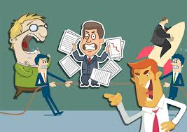
Burnout syndrome: education professionals
The Burnout of teachers is closely related to demotivating conditions at work, which in most cases affects the performance of the professional. The lack of motivational factors leads to professional stress, causing the professional to quit his job, or, when he maintains in it, he works without much attachment or care.

Slide 8
Results analysis
Results of a study carried out with teachers who decided not to take up positions in classrooms at the beginning of the school year in Virginia, United States, and with 244 teachers of students with irregular or undisciplined behaviour.
These are, in descending order, the causes of stress in those teachers:
inappropriate school policies for cases of indiscipline;
attitude and behaviour of managers;
evaluation of managers and supervisors;
attitude and behaviour of other teachers and professionals;
excessive work load;
uninteresting career opportunities;
low status of the profession of teacher;
lack of recognition for a good lesson or for teaching well;
noisy students;
dealing with parents.

Slide 9
Effects of stress
In the research work, the effects of stress are identified as:
feeling of exhaustion;
feeling of frustration;
feeling of incapacity;
load stress home;
feeling guilty for not doing enough;
irritability;

Slide 10
Strategies to deal with stress
The strategies used by teachers to cope with stress are:
perform relaxation activities;
organize time and decide priorities;
maintain a balanced diet and exercise;
discuss the problems of work with colleagues;
take the day off;
seek professional help in conventional medicine or alternative therapies.

Slide 11
Conclusion
Activities to develop:
Fill in an online questionnaire about burnout;
Analysis of the results of the previous questionnaire;
Questionnaire 2 (each teacher will check their burnout rate);
Activities to diminish / eliminate the existing burnout.

Slide 12
Good job!
Thank you for your cooperation!
The team involved:
António Miranda de Carvalho (Grupo 620)
Eduardo Pinto (Grupo 500)
Fátima Cardoso (Psicóloga do AER)
Francisco Magalhães (Grupo 300)
Isolina Tuna (Grupo 330)

