Slide 1
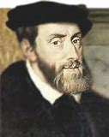
Carlos I de España y V de Alemania.
He was born in 24th February of 1500.
He died in 21st September of 1558.
He was the King of Spain and Germany.

