Slide 1
Joaquín Sorolla
He was born in 27th february of 1863
He worked as a painter
He died in 10th august 1923
He made these pictures:

Slide 2
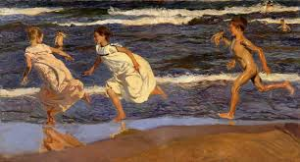
The paints of Joaquín Sorolla

Slide 3
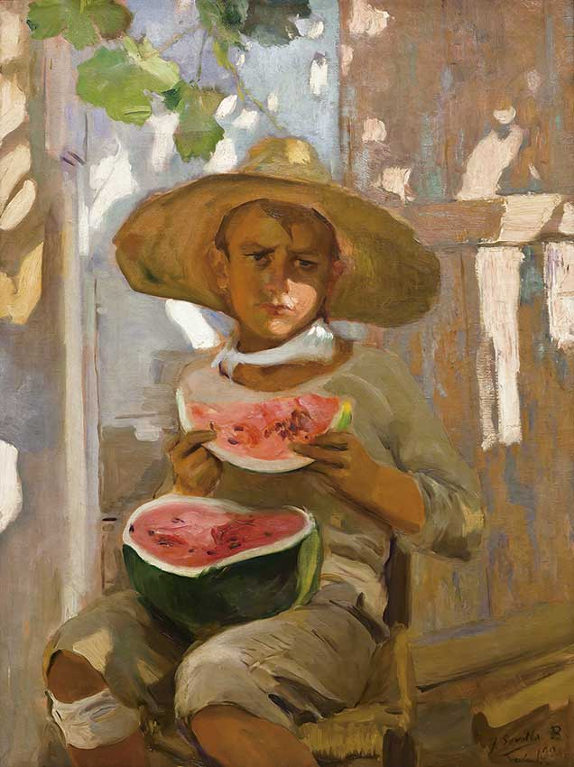
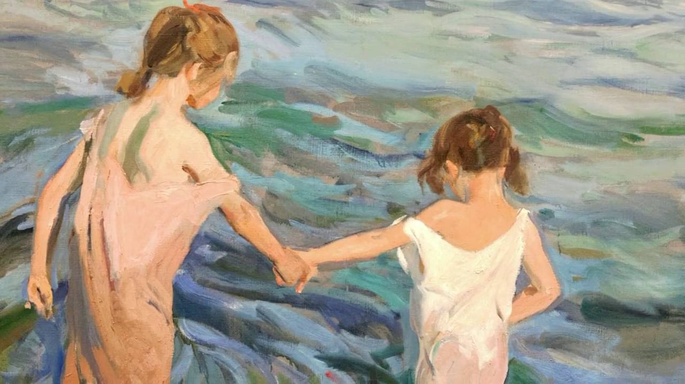
Others

