Slide 1
Ida Eide

Slide 2
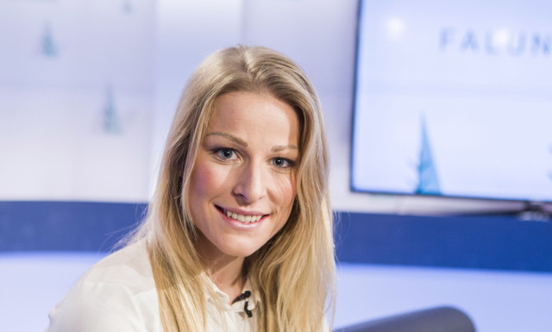
Her death
She was an earlier Cross Country Skier.
She died the 03/09/2018.
And she was only 30 years old when she died.
she died in a road races because her heart stopped.

Slide 3
About Ida
Her sister is Mari Eide, also a Cross Country Skier.
She had a famous Boyfriend, named Nils- Ingar Aande.
He was a comedian.
She was born 3/april/1988.
EIDE

Slide 4
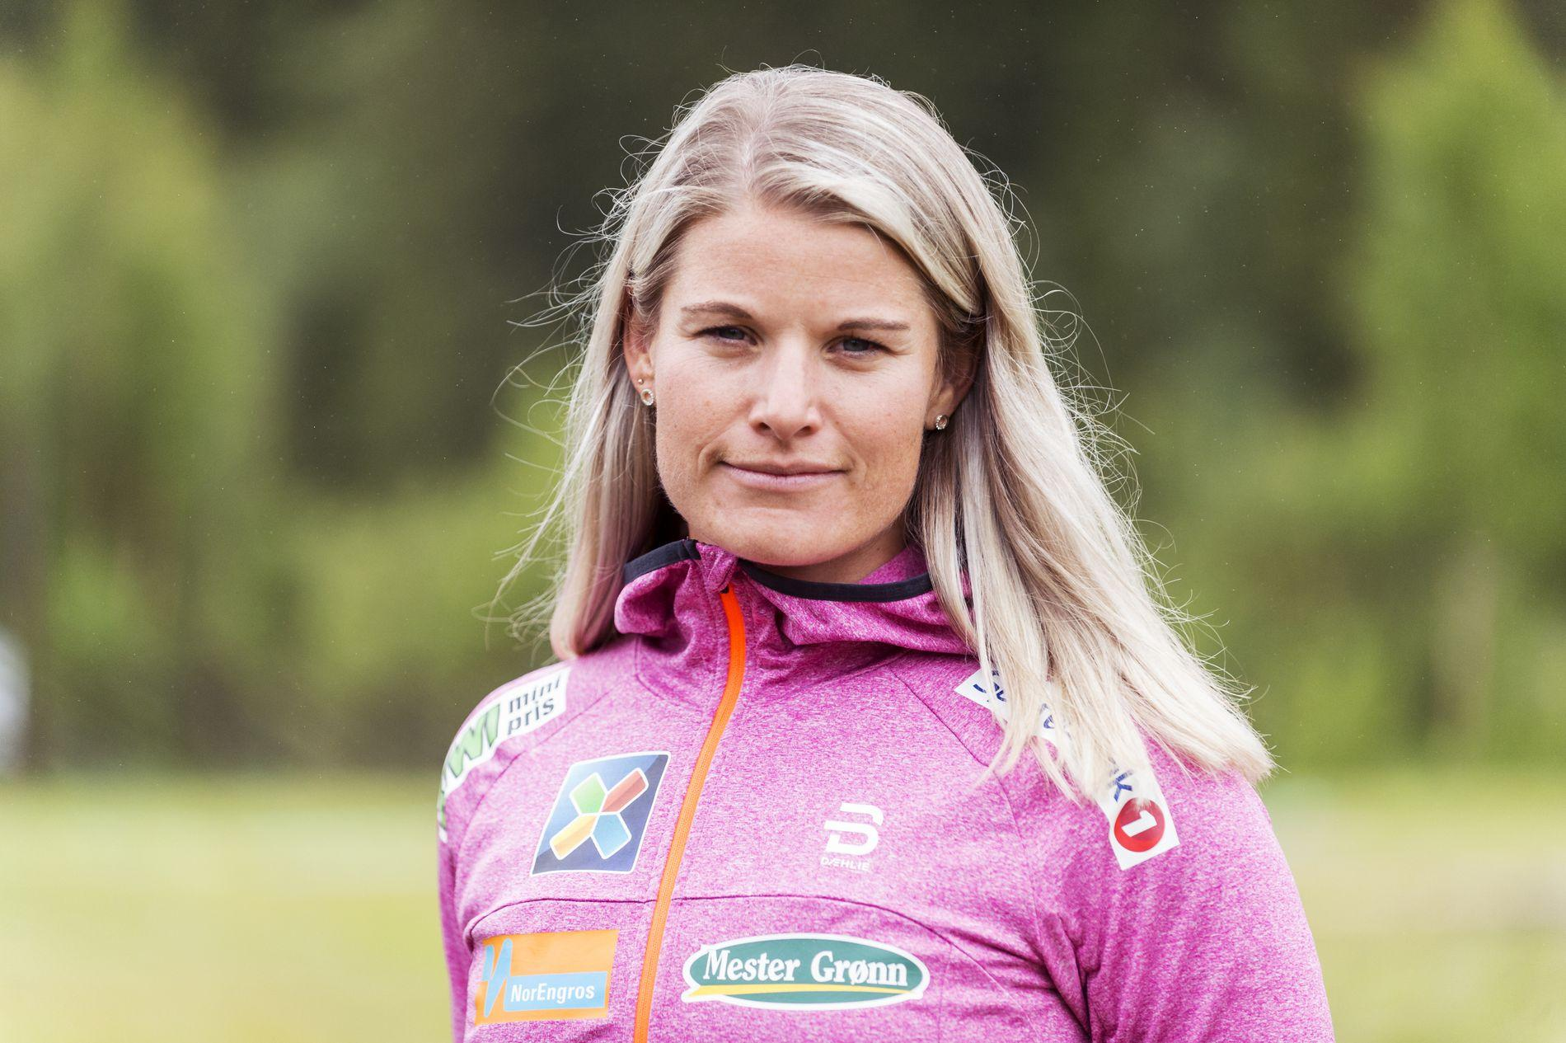
About her
One of her best friends was Therese Johaug and she is the best Cross Country Skier in the world.
Ida won a bronze medal in junior NM in 2007.
Ida worked in Norsk Hydro.

Slide 5
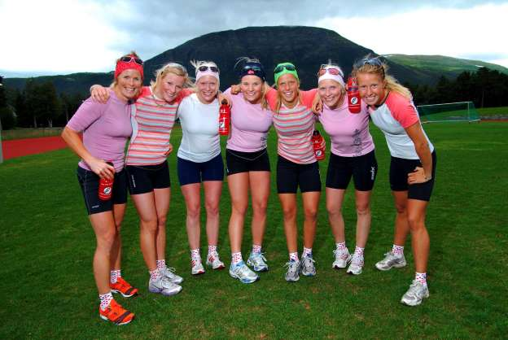
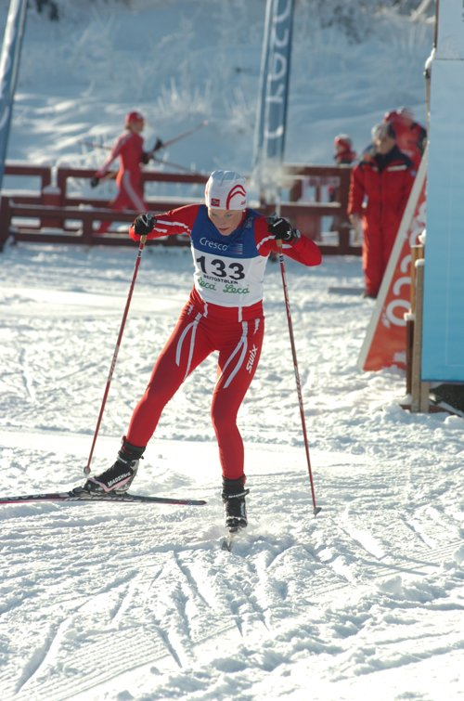
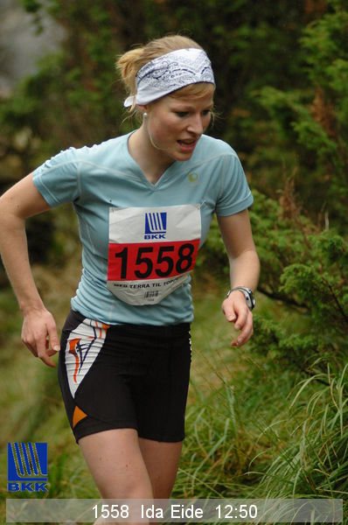
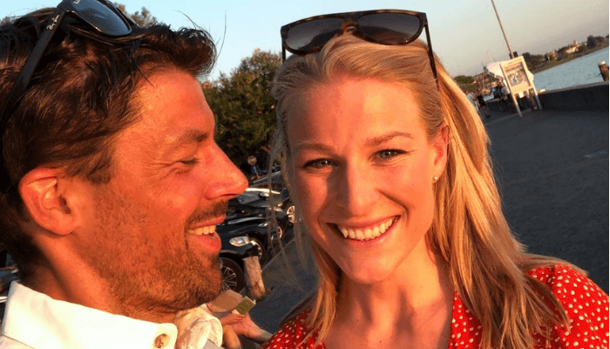
Some pictures of Ida Eide

Slide 6
Thanks for me♡♡♡

