Slide 1
Jorge manrique
The same as Villamanrique a
Village of my country

Slide 2
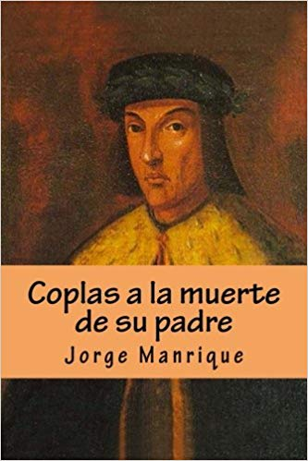
He was a famous writer and soldier.
He was born in 1440.
He died the 27th of march of 1479, because he had a war´s wound
And he wrote “Coplas a la muerte de mi padre”.

