Slide 1
from

Slide 2
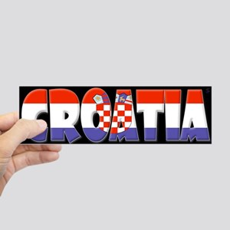
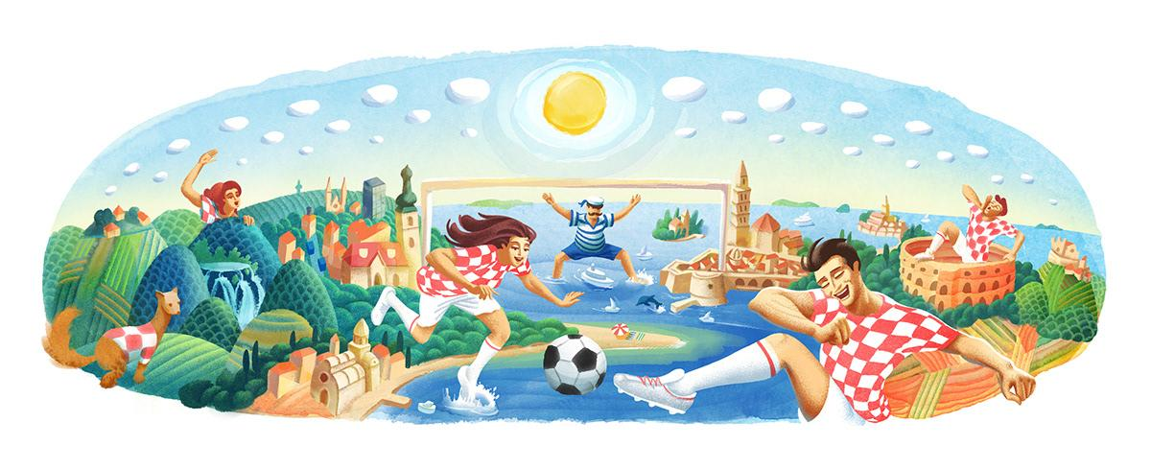

Slide 3
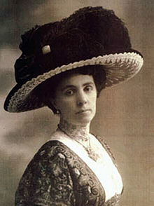
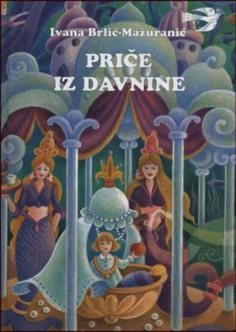
Ivana Brlić Mažuranić
She was a famous Croatian author for children. She wrote novels and fairy tales.
Ivana was born in 1874 in Ogulin and
she died in 1938 in Zagreb.
She was nominated 4 times
for a Nobel Prise for the literature.
Ivana had 8 children.

Slide 4
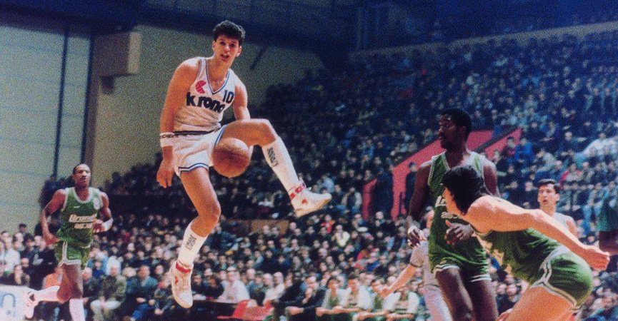
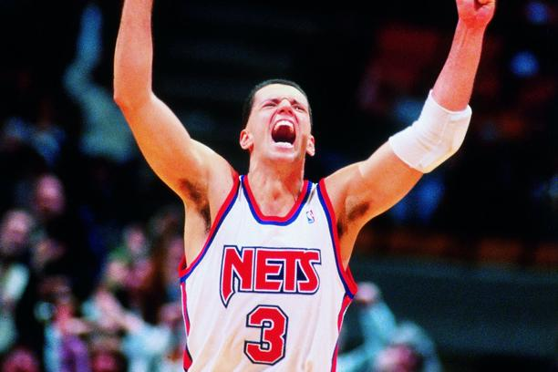
Dražen Petrović
Dražen was born October 22, 1964 in Šibenik, Croatia and died in a car accident June 7, 1993 in Germany
He was the best Croatian basketball player of all time
He won a sliver Olympic medal with Croatian national basketball team in 1992
The press called him „Basketball Mozart”

Slide 5
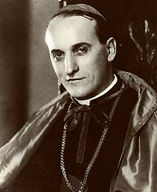
Alojzije Stepinac
He was Croatian, Zagreb’s archbishop and cardinal
He was born May 8, 1898 in Brezarići and died February 10 , 1960
He faught for Croatian Catholicism
He held his last mass 3 days before he died

Slide 6
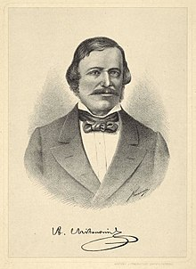
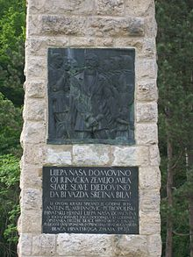
Antun Mihanović
He was born in Zagreb 1796 and he died November 14, 1861
He was a poet
He wrote a poem called Horvatska domovina which became Croatian national anthem at the end of 19. century

Slide 7
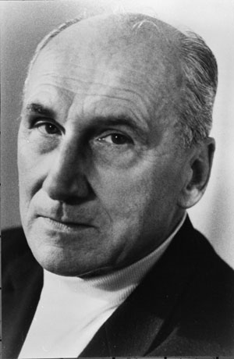
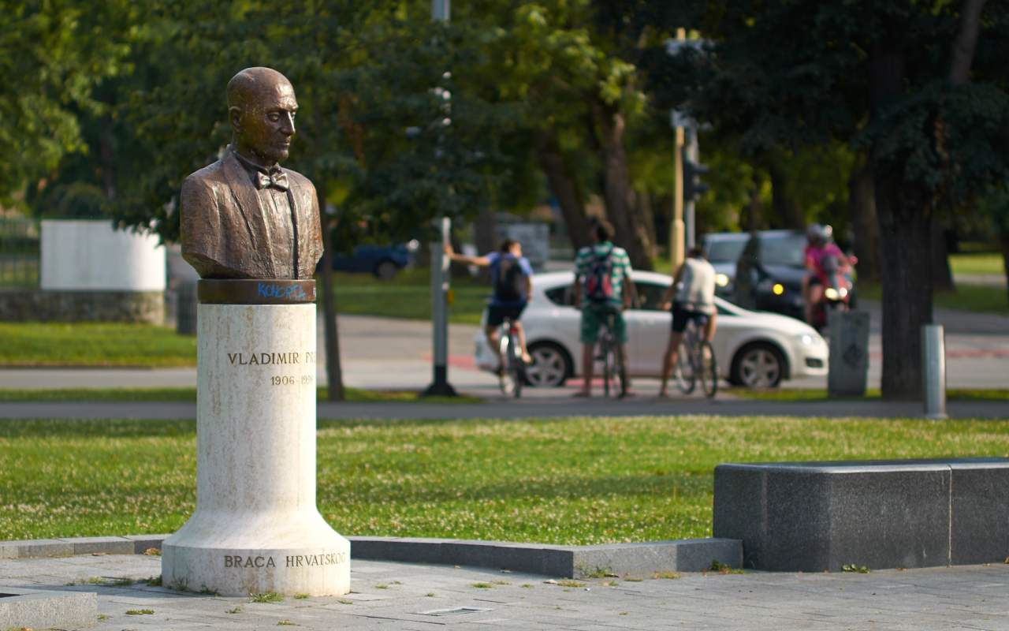
Vladimir Prelog
He was born in Sarajevo July 23, 1906 and lived in Osijek
Vladimir was Croatian chemist
He got a Nobel prize in 1975
He died in Zurich , January 7 , 1998

Slide 8
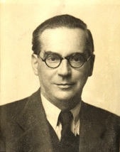
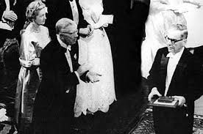
Ivo Andrić
He was born in Docu on Lašvi on October 9, 1892 and died March 13, 1975
He was ambassador of the Kingdom of Yugoslavia in Germany in 1939 and a famous writter
He won a Nobel prize in 1961 for his novel „Na Drini ćuprija”

Slide 9
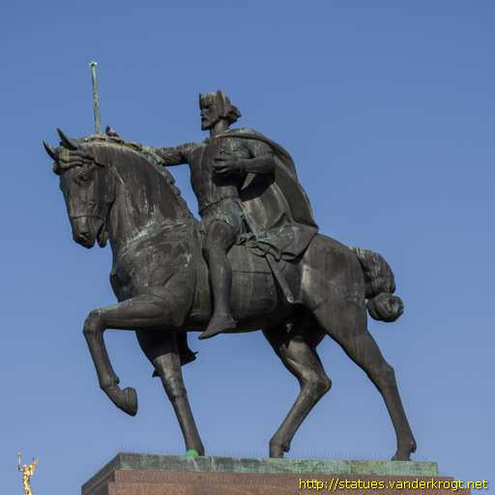
King Tomislav
King Tomislav was the first Croatian King
He was elevated to kingship in 925 and reigned until 928
He was one of the best emperors of Croatia

Slide 10
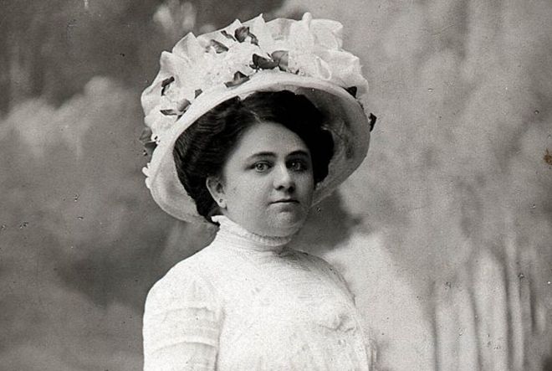
Marija Jurić Zagorka
Born on March 2, 1873.
She was first female journalist and in the beginning Marija wrote under male alias
Marija fought for women's rights and against discrimination
She wrote novels and some of them are dramatized and screened (The Witch from the Grič, Daughter of Lotrščak etc.)

Slide 11
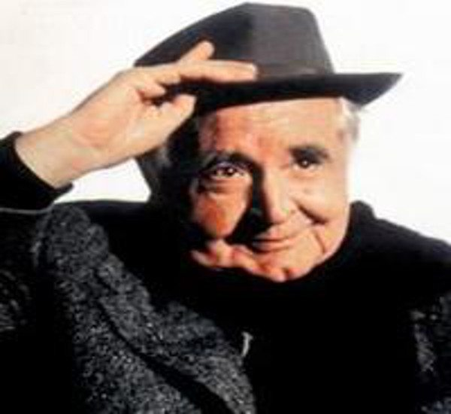
Miroslav Krleža
He was born in July 7, 1893 and died December 29, 1981
He was famous Croatian writer and poet
He was a prominent figure in cultural life

Slide 12
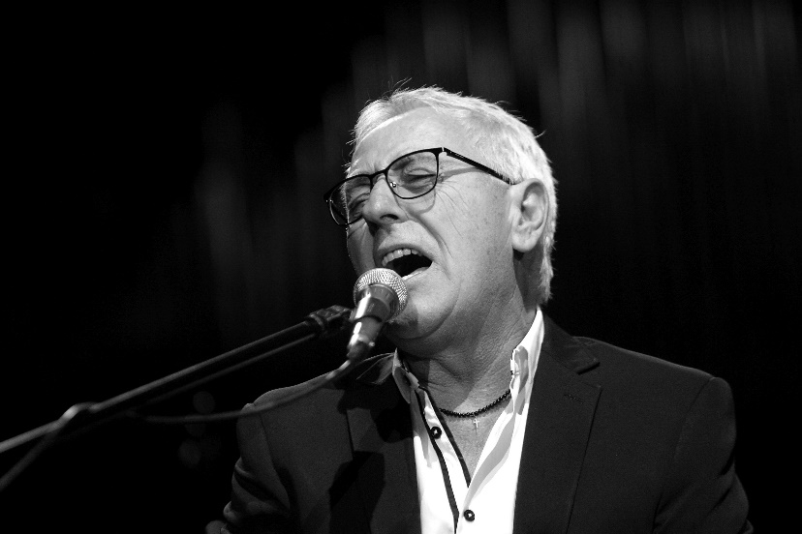
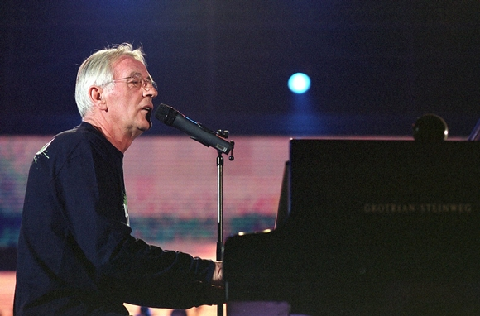
OLIVER DRAGOJEVIC
He was born in Split (Croatia) December 7 , 1974
He was a Croatian recording artist
His most popular songs were ”Cesarica” and ”Moj galebe”
He died from illness July 29, 2018

Slide 13
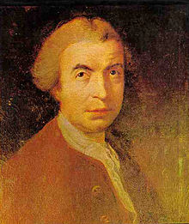
Ruđer Bošković
He was Croatian mathematician, astronomer, geodesist, physicist and philosophe.
He was born in Dubrovnik on May 18,1711 and he died in Milano on February 13, 1787
His most important ideas were those about atomic structures.

Slide 14
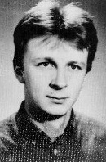
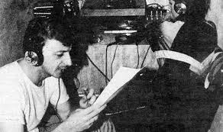
Siniša Glavašević
He was born in Vukovar November 4,1960
He was a prose writer, a librarian, a journalist and a war reporter
He wrote „Stories from Vukovar”
He was killed during the battle for Vukovar in 1991

Slide 15
Slavoljub Eduard Penkala
Eduard Penkala was born in Liptószentmiklós
He then moved with his wife to Zagreb in 1900
He constructed first pen
Among his patented inventions were:
a hot water bottle - his first patented invention, the "Termofor"
a type of bluing detergent
a rail-car brake
an anode battery

Slide 16
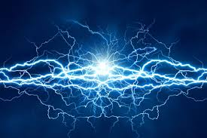
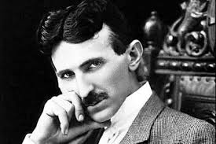
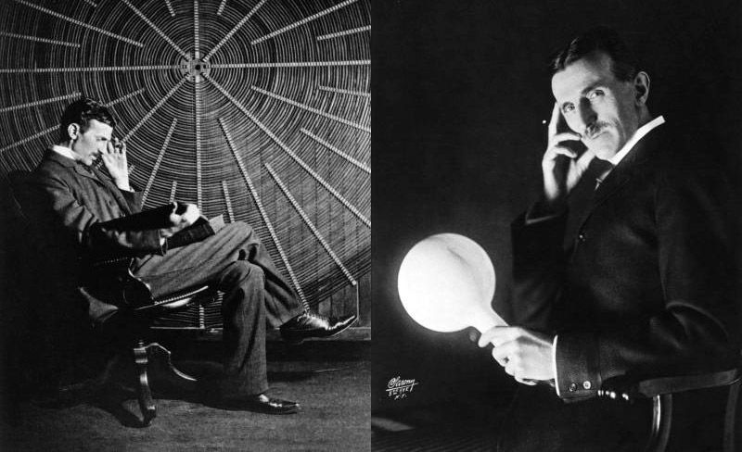
NIKOLA TESLA
He was born in Smljan, Croatia on July 10, 1856
He won a Nobel Prize but he did not want to share it with Thomas Alva Edison
He was an inventor, electrical engeneer, mechanical engeneer and futurist.
He invented Tesla coil, wireless lightning, magnifying transmitter, Tesla turbine, shadowgraphs, neon lamps, radio, induction motor and many other great pioneering inventions.

Slide 17
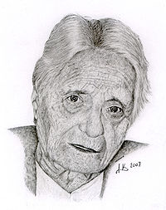
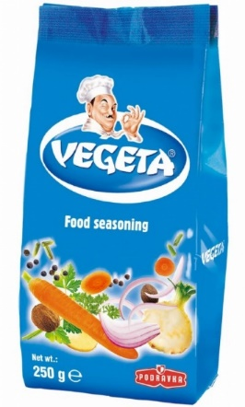
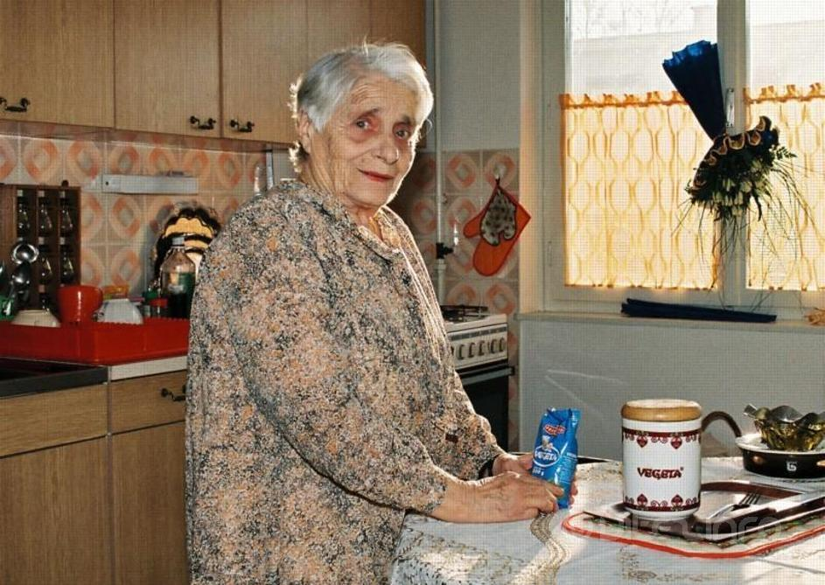
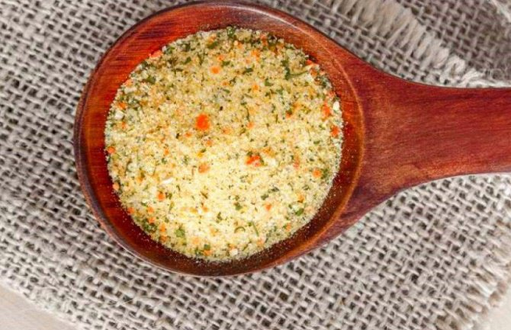
ZLATA BARTL, ”Aunt Vegeta”
She was born on February 20, 1920
in Bosnia and Herzegovina(Dolac)
After she gradauted, she moved to Zagreb
(Croatia),where she graduated from
the Faculty of Natural Sciences with
chemistry, physics, mathematics,
mineralogy
In 1955 she went to Koprivnica
(Croatia) and started her scientific
work in 1959 in Podravka and invented a spice
called Vegeta and with it Podravka
hit the world market
She died on July 30, 2008 in Zagreb

Slide 18
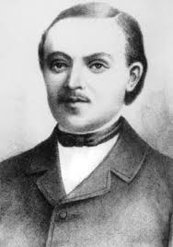
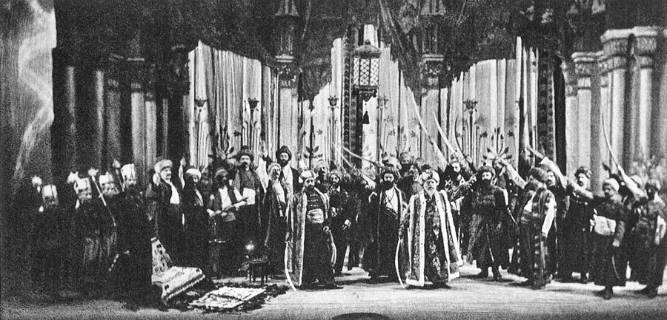
Vatroslav Lisinski
He was born in Zagreb in 1819.
He became a succesful composer.
He died young and poor, at age of 35.
A famous concert hall called Vatroslav Lisinski was named after him.

Slide 19
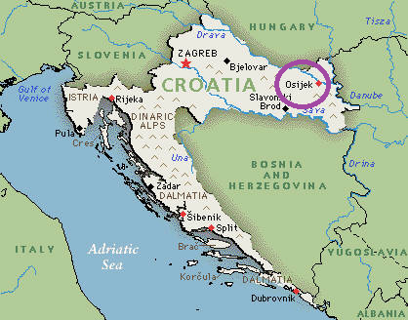
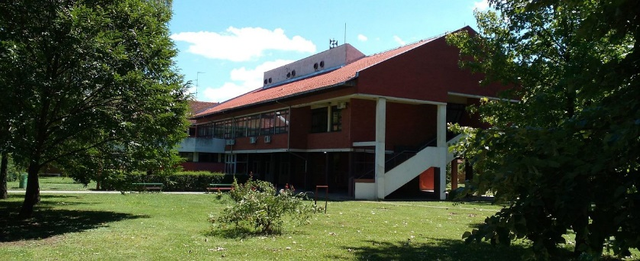
Thank you for your attention!
We are 7th grade students (13 years old) from primary school „Retfala” in Osijek (east Croatia).

