Slide 1
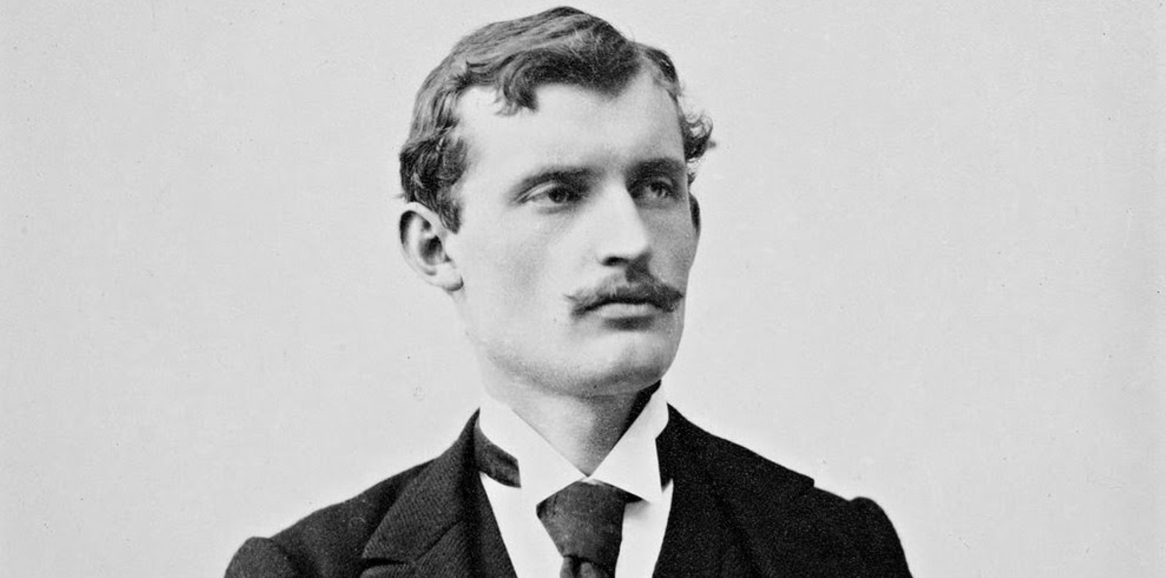
Edvard Munch

Slide 2
Life
He was borned at the 12th Desember 1863, in Løten
He died in Oslo at the Age of 80 years on 23rd January 1944.
He had no kids.
His mother and sister died when he was very young.

Slide 3
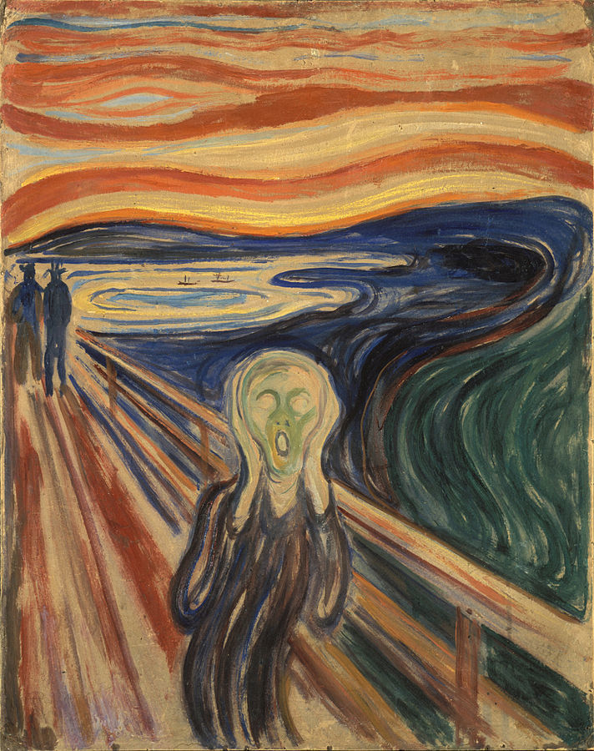
Career
Munch participated in a competition called Thaylows, and started to paint professionally in 1883 and painted “Morning”
His most famous painting is Scream
In his youth he painted a lot of nude pictures, which he continued with in his 50/60

Slide 4
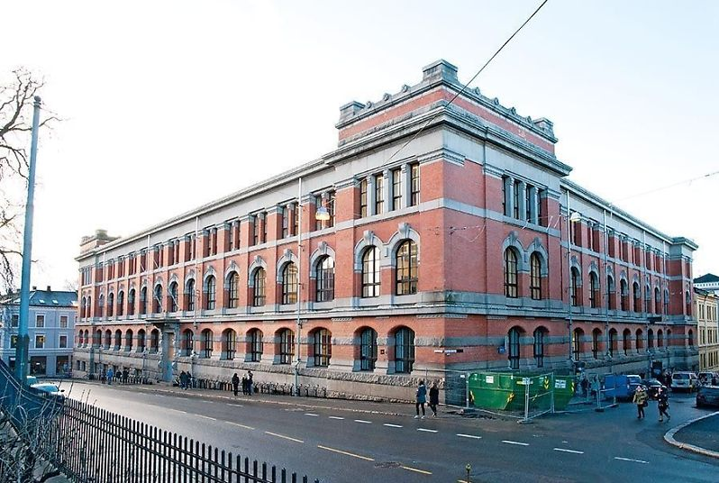
Facts
He was a painter and printmaker, and he has a school and a museum in Oslo named after him.
His father got disappointed when he started a carrier as a painter.

Slide 5
Scources
SNL
Meta floss
Wikipedia
Google images

