Slide 1
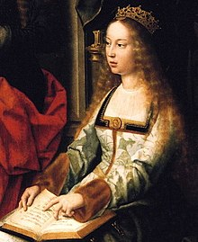
ISABEL I OF CASTILLA
SHE WAS BORN ON 22ND APRIL 1451.
SHE WAS THE QUEEN OF SPAIN.
SHE HELPED COLON TO DISCOVER AMERICA.
SHE DIED ON 26TH NOVEMBER 1504 IN MEDINA DEL CAMPO.

