Slide 1
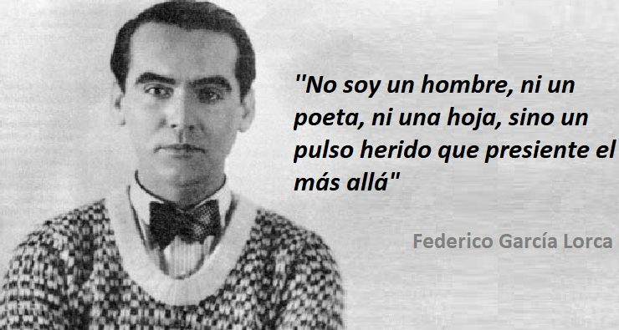
This job has been made by manuel jesús. 6º a
This job has been made for manuel jesús.
6º a
Federico García Lorca was born the fifth of June of 1898 in Fuente Vaqueros, Granada.
His job was poet and dramatist (playwright).
His principal works were: “Blood of weddings”, “The Bernarda Alba’s house”, “Gipsy ballad” and “Poet in New York”.

Slide 2
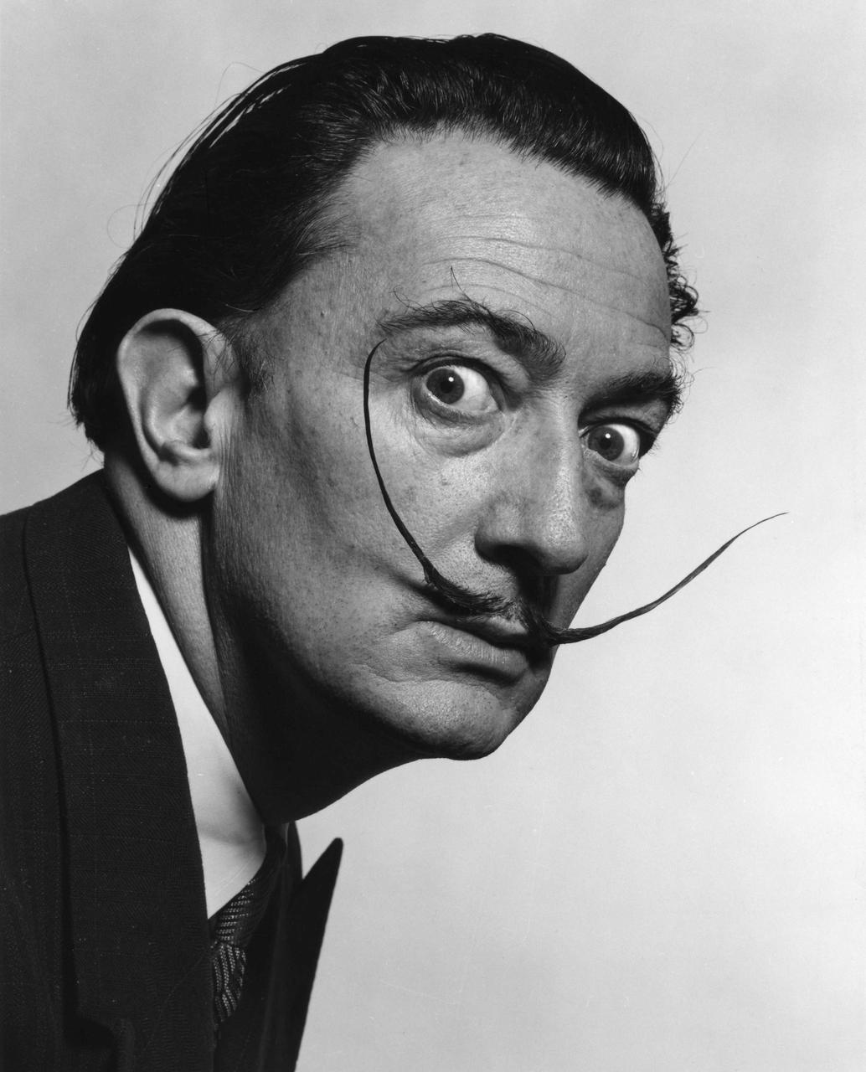
This job has been made by manuel jesús. 6º a
Salvador Felipe Jacinto Dalí i Domènech
This job has been made for manuel jesús.
6º a
Salvador Dalí was born the eleventh of May of 1904 in Figueras, Girona.
His job was painter and sculptor.
His principal works were: “The memory persistence” and “Saint Anthony tentations”.

