Slide 1
Edvard Grieg

Slide 2
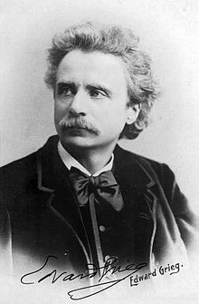
Edvard grieg
He was born in 15. june 1843 in bergen
He was a composer and a pianist
Edvard was raised in a musical family. His mother was his first piano teacher and taught him to play at the age of six

Slide 3
More Edvard grieg
Edvard debuted as a concert pianist in Karlshamn , Sweden. In 1862
he got married in June 1867
Edvard died at the Municipal Hospital in Bergen 1907 at age 64

Slide 4
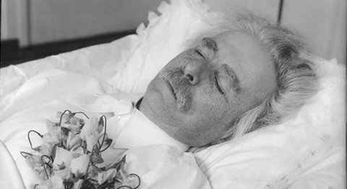
More Edvard grieg
There were 30 000 and 40 000 in the streets of his home town to honor him
His last words were Well it must be so

