Slide 1
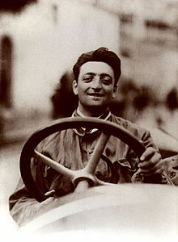
ENZO FERRARI
NAME: Enzo Anselmo Giuseppe Maria Ferrari
He was born in Modena on the 20th February of 1898.
He died on the 19th August of the 1988
He was an enterpreneur, a sports manager, a F1 pilot and the founder of the Ferrari Team
He won 9 world championship of pilots

