Slide 1
Erasmus
Presented by the Dutch students

Slide 2
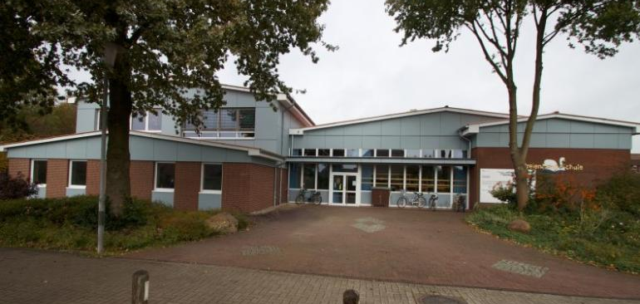
Germany school
8:30 – 15:00 monday-friday
Lessons take 80 minutes
7 years
Extra subjects
No school uniforms
Online lessons because of corona
Notes:
A normal school day for the German pupils starts at 8.30 and ends at 15.20. The lessons take 80 minutes each. The pupils go to school for 7 years. At the school there are a lot of extra subjects in which the pupils can participate like sports and languages. At the beginning of the year, they can choose what sport they want to do, they can choose between volleyball, basketball, dance, fitness, badminton, and a lot of other sports. They don't have to wear school uniforms. Because of corona virus Germany is in lockdown and the schools are closed. The students follow online lessons every day.

Slide 3
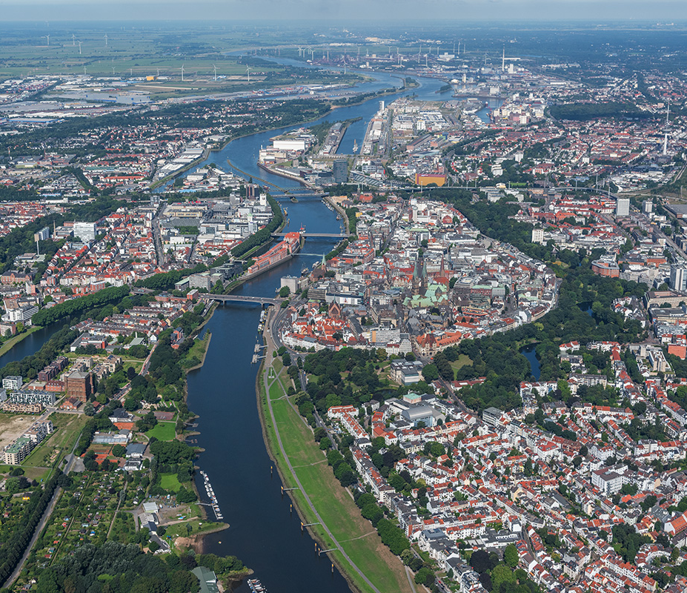
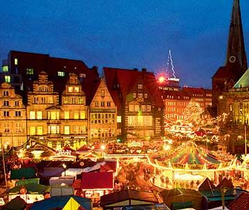
Germany neighborhood
Bremen
Seaside
Big city (500.000 people)
Tourists
Christmas market
Friendly people
Old buildings
Shops
Weser river
Notes:
The school is close to Bremen which is a big city in the north of Germany and it's also close to the seaside. There live 500.000 people and there are a lot of tourists. Every year there is a very big Christmas market which attract many people. Last year it was canceled because of corona. The city is very cozy and the people are very friendly. There are a lot old buildings and shops. There is a river called Weser, if I pronounce it the right, which runs through the middle of the city.

