Slide 1
Erasmus
Presented by the Dutch students

Slide 2
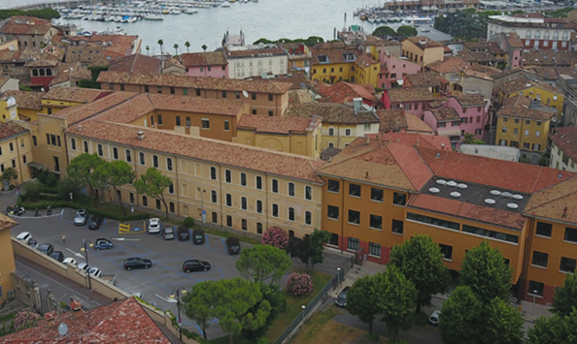
Italy school
Classic, linguistic and scientific high schools
Lot of projects
Ochestra and theatre
8.00-13.00 monday-saturday
Online school
Notes:
High school Bagatta is an old school, established in 1792 and at this moment there are around the 900 pupils in there. In Italy, the schools are divided into linguistic, scientific, and classic high schools. High School Bagatta is a scientific one. The students perform many projects, which results in a nice interaction between them. There are a lot of activities next to the regular school programme. The ochestra and theatre are the most popular activities. The biggest difference with the ochter schools is that the Italian pupils go to school from monday 'till saterday, from 8 am 'till 1 pm (the other schools have longer school-days, but don't have lessons on saturday). The corona virus hit hard in Italy, so that's why the Italien students have gone to school for only 2 month since february. They folowed online lessons the rest of the time.

Slide 3
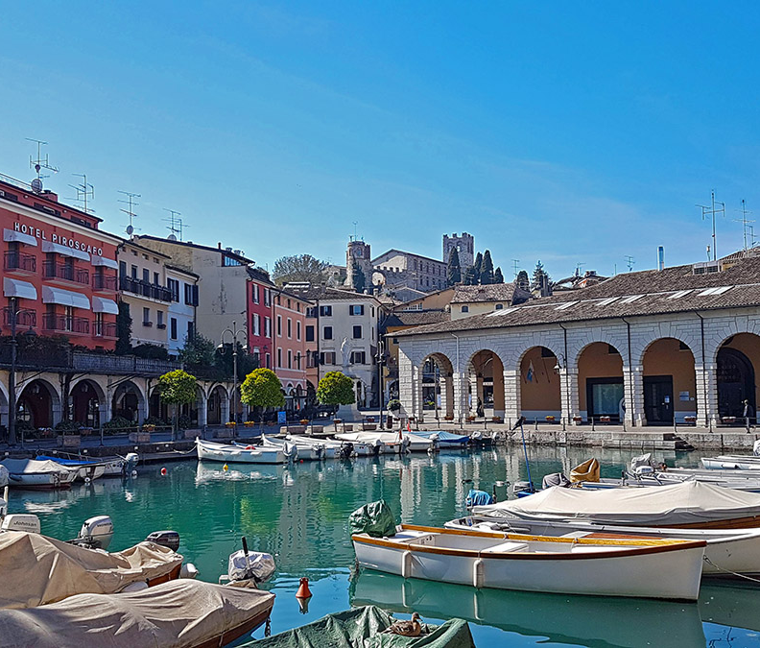
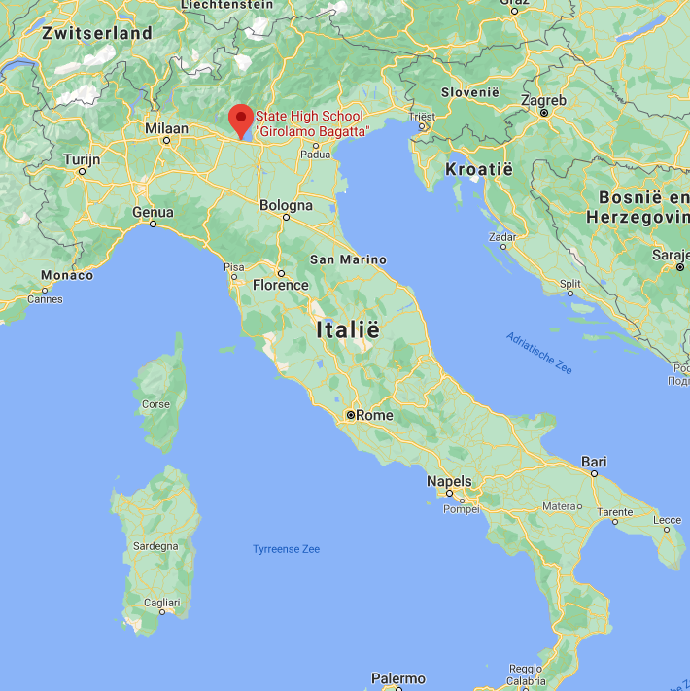
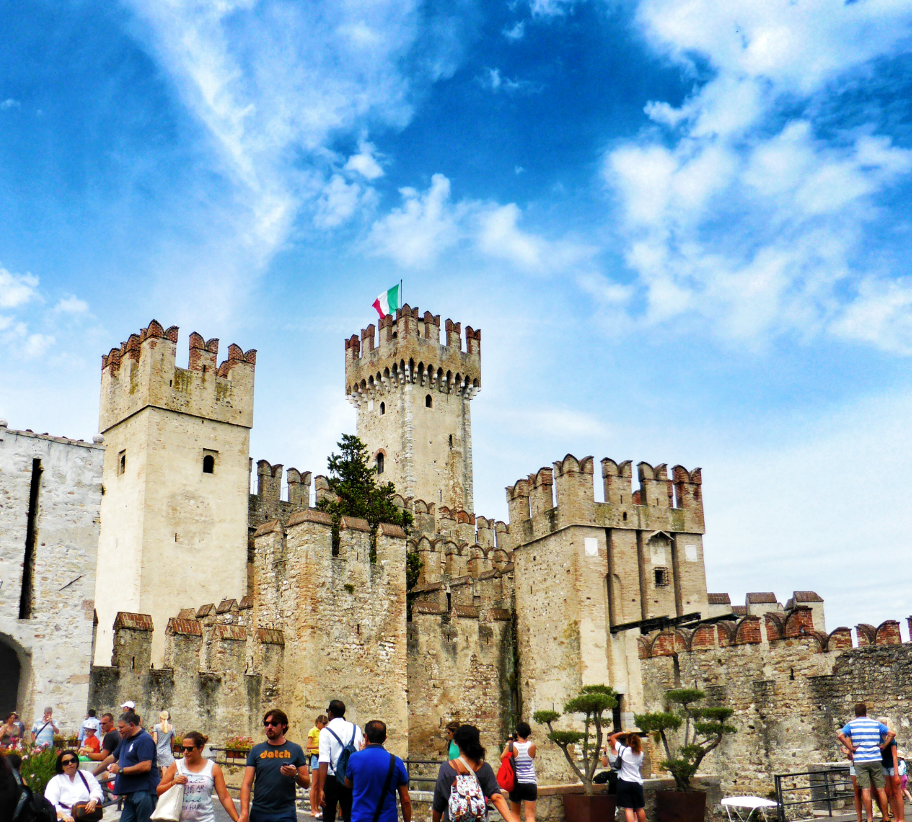
Italy neighborhood
Different cultures
Desenzano del Garda
Lake and castle
Lockdown
Notes:
Italy is best know for the food (the pasta, pizza and risotto), the old Roman cities and the beautiful nature. But the wide variety of cultures charactarises Italy too. So there are big differences in food, habits and dialects between different regions. Especialy the difference between North and South-Italy is pretty big, but this is becaming much more normal now. High School Bagatta is located in the city 'Desenzano del Garda' next to a big lake called Garda, which attracts many tourists in the summer. The big 'castello di Desenzano' is a popular attraction for tourists too. As you probaly know, the coronavirus has spread really fast in the North of Italy. That's why the Italiens had to go in lockdown many times. The lockdown from mid-februari 'till the beginning of May was very strict; They couldn't visit family or sport outside. Hopefully that won't be necessary anymore.

