Slide 1
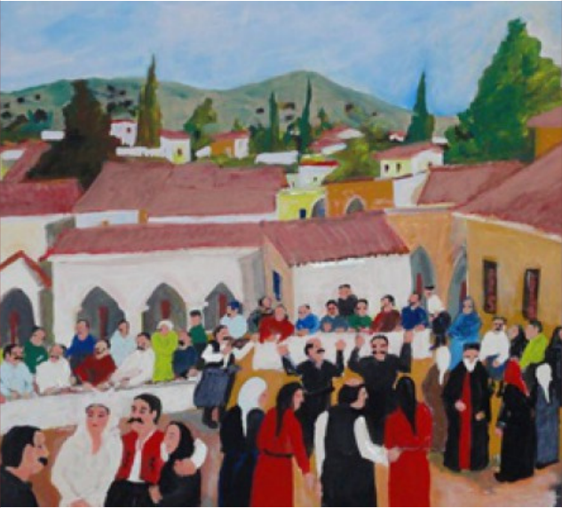
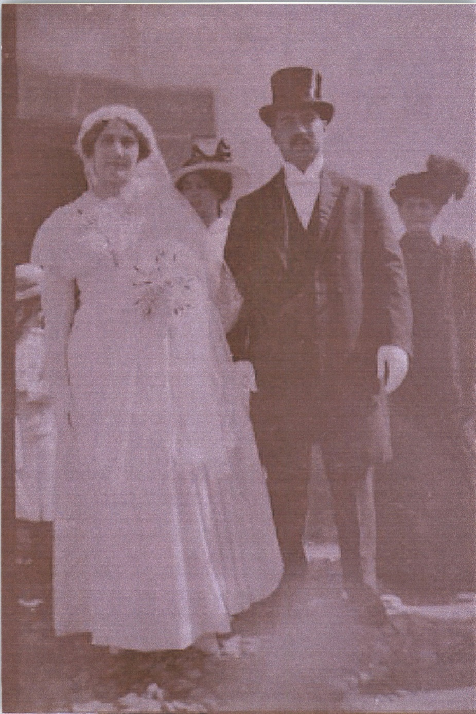
Cyprus traditional wedding customs

Slide 2
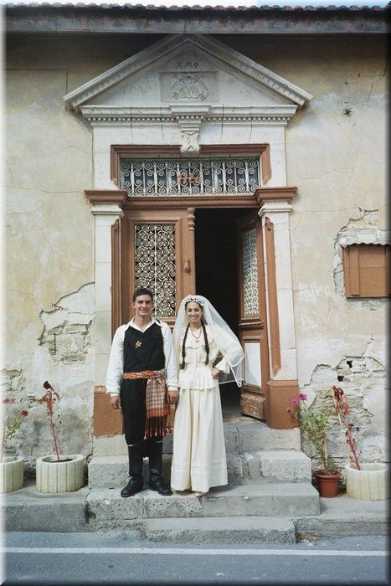
Customs of traditional weddings are kept alive throughout the centuries.
New couples, their families and friends incorporate wedding traditions and customs into their wedding day celebrations even today.
They are also kept alive by the musicians and singers of traditional music and other individuals who actively participate in carrying out the traditional wedding customs.
Folklore societies, traditional dance groups and other cultural groups also play a very important role in keeping the tradition alive, contributing to the promotion and preservation of wedding customs.

Slide 3
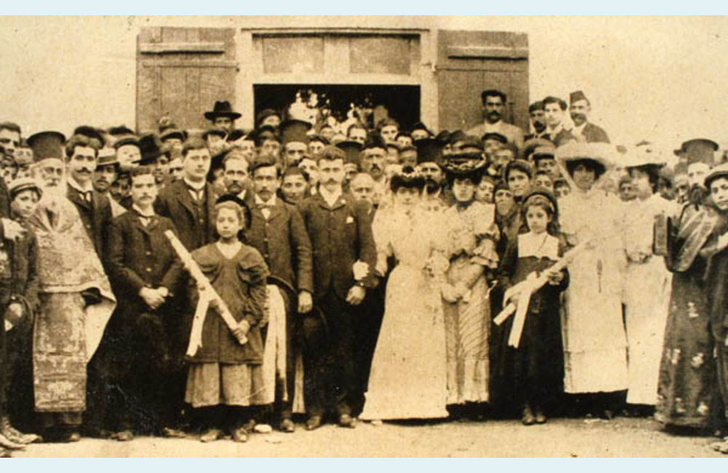
In the past, there used to be a greater variety of wedding traditions and customs celebrated, however with time many have been abandoned for a variety of reasons. Today, the main customs preserved and celebrated throughout Cyprus are associated with the rituals of separation, that symbolize the disunion of the couple to be married from their families.

Slide 4
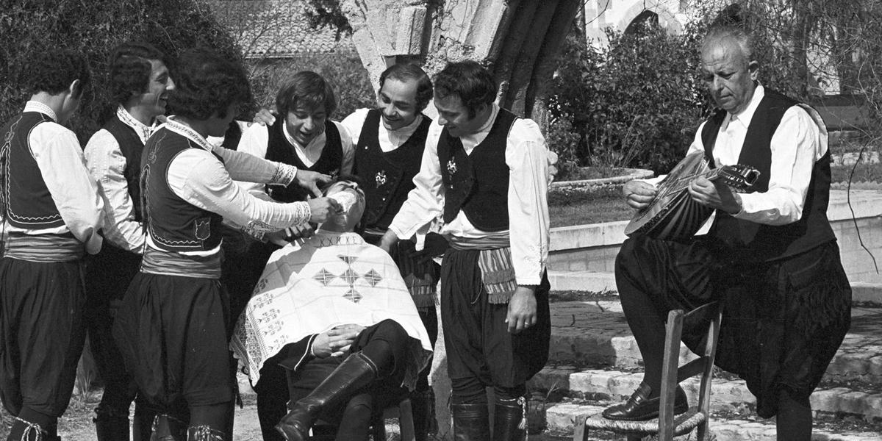
Wedding traditions and customs
These are:
The shaving of the groom
The “dance of the wedding clothes”
The dressing of the bride and groom
The ’zosimo’ ritual (the tying and untying of a red kerchief around the waist of the bride and groom)
The ’kapnisma’ ritual (holy smoke) for protection from the evil eye.
Also, specifically linked with village weddings in the Paphos district, a mixture of meat and wheat named ‘Resi’ dish is served.

Slide 5
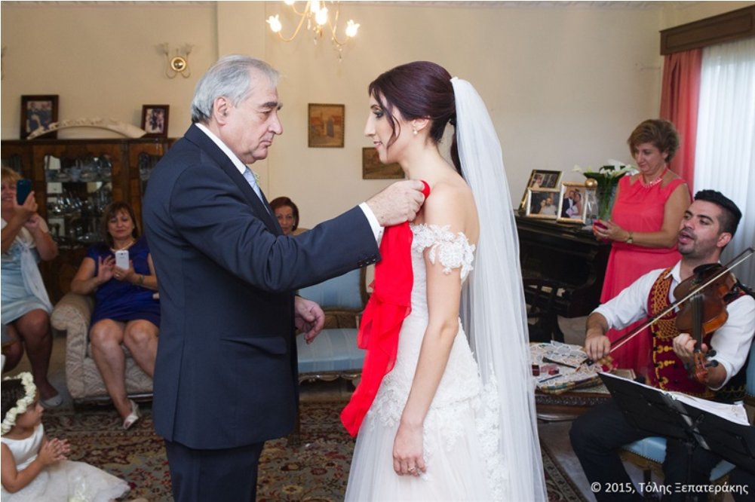
The aforementioned rituals and customs take place at the childhood homes of the bride and groom to be, before the wedding ceremony at the church takes place.
In the old days, the bride and groom would sit on a chair with an embroidered pillow, under which they placed a straw mat. The best man and maid of honour, with all due formality, would help the bride and groom to get ready, which is why they are always by their side. The dressing of the bride and groom is accompanied by traditional musicians (violin and lute players), who perform music and songs,many of which embody the customary way of carrying out these rituals.

Slide 6
Festivities after the wedding ceremony
Bibliography:
www.unesco.org.cy
www.pio.gov.cy
Archive of CVAR museum

Slide 7
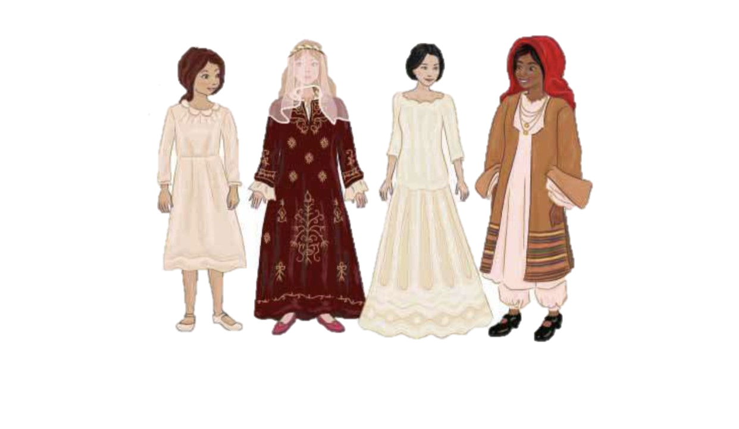
The objects… “speak” The Wedding Gowns by Natasa Charalambous illustrations: Anna Stylianidou
AN EDUCATIONAL APPROACH BY CVAR MUSEUM

Slide 8
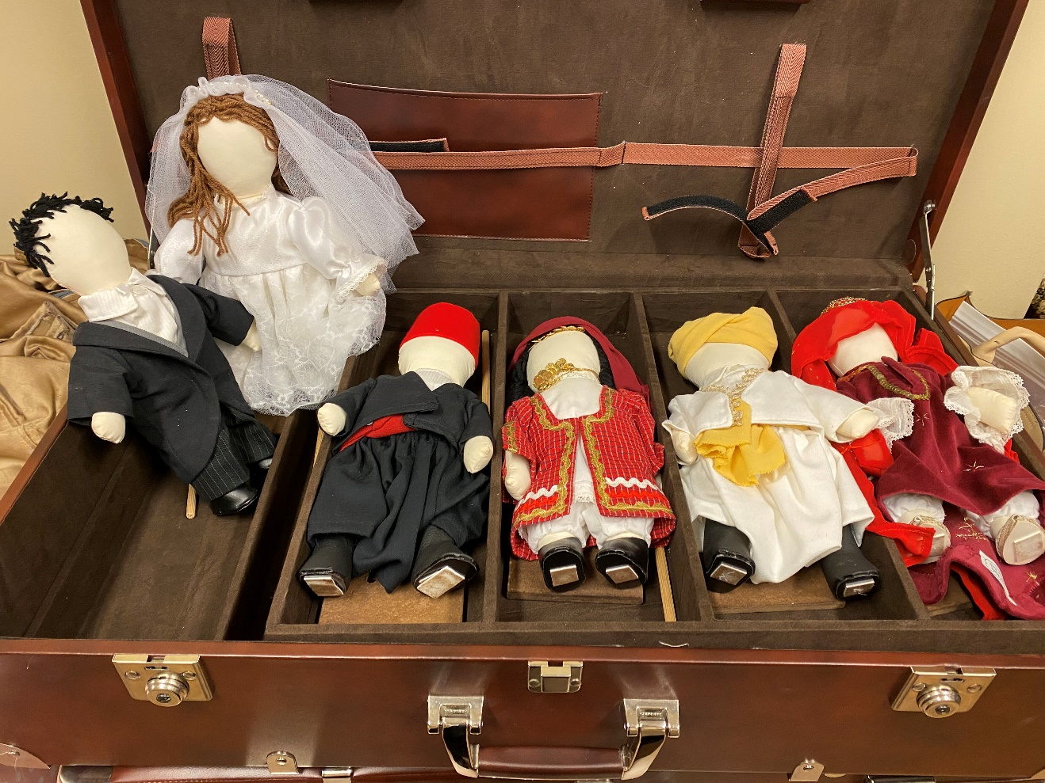
The museum comes to the school…
at the size of a small bag…
The bag includes:
A book (the objects come to life and speak)
Dolls, specially made wearing traditional wedding cloths.
Red scarf for “zosimo” ( the couple is blessed with a red scarf three times by each parent)
A card game (matching the object with its use)
Puzzles (old pictures)
Real size paper clothes

Slide 9
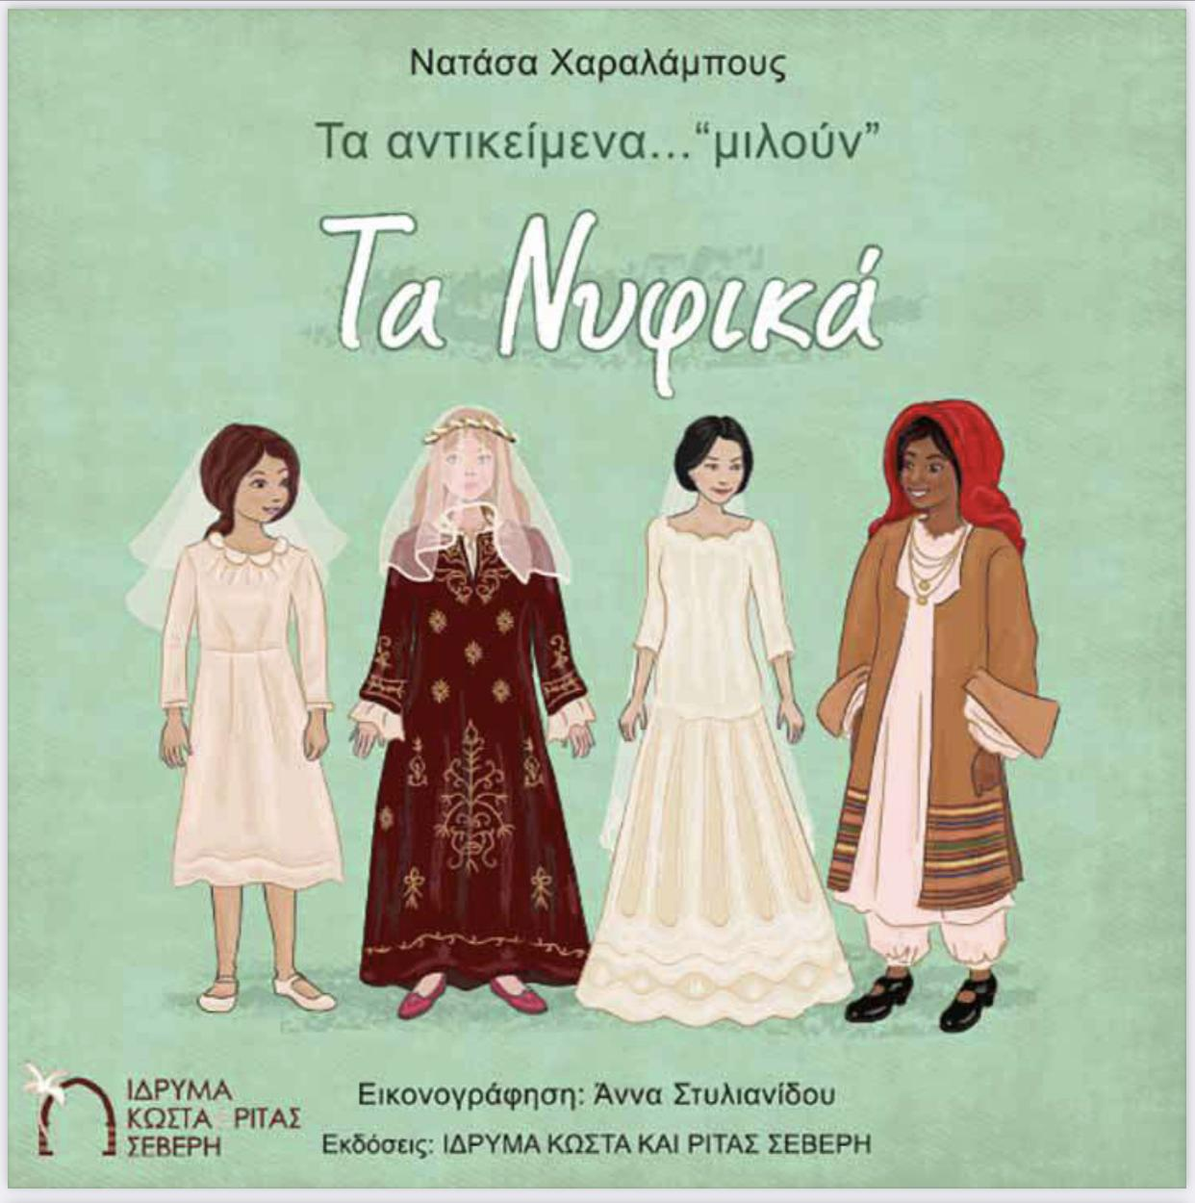
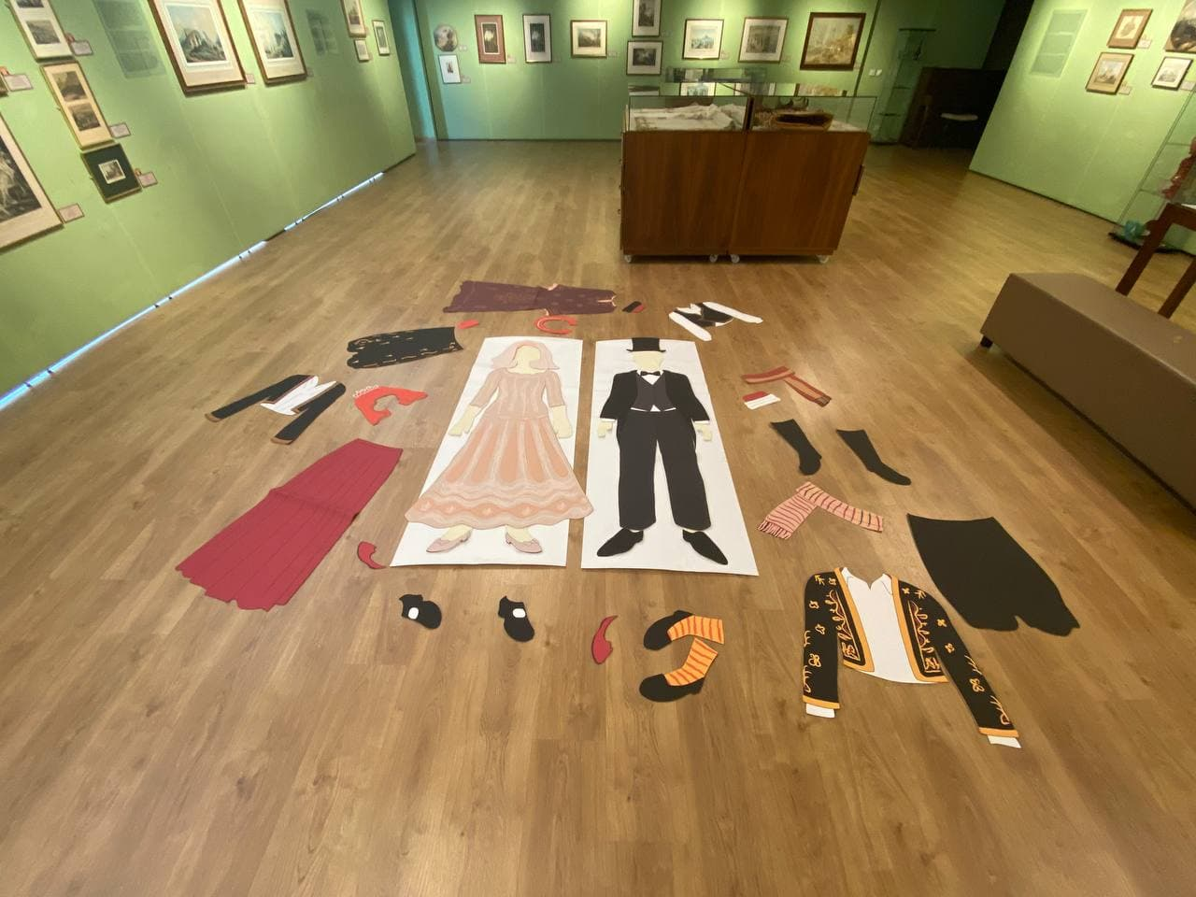
The book
Real size paper clothes

Slide 10
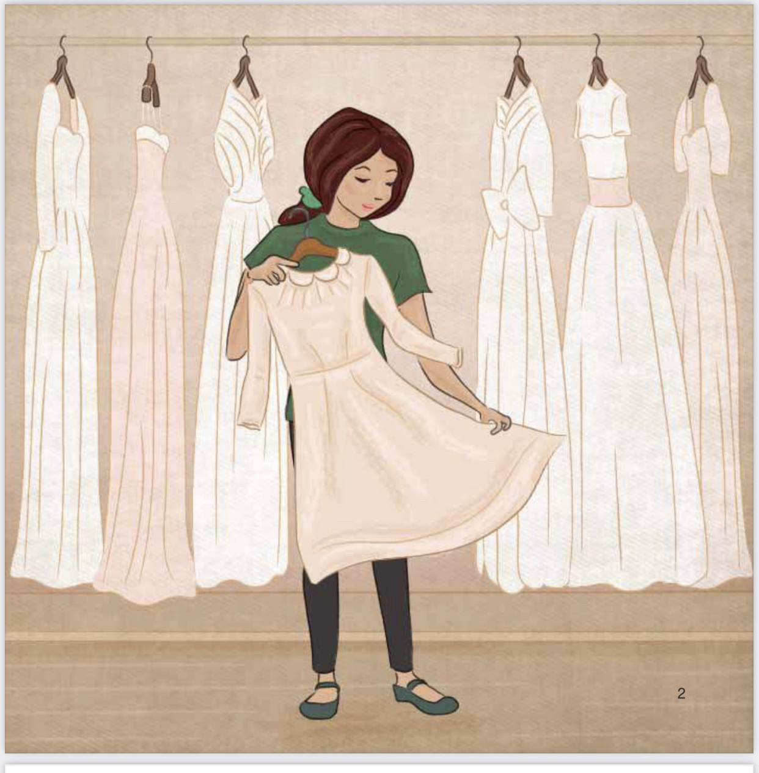
Ariadne is a 15 year old girl taking part in a fashion show exhibiting traditional wedding gowns.
She is going to wear a beige wedding gown which she is extremely excited about.

Slide 11
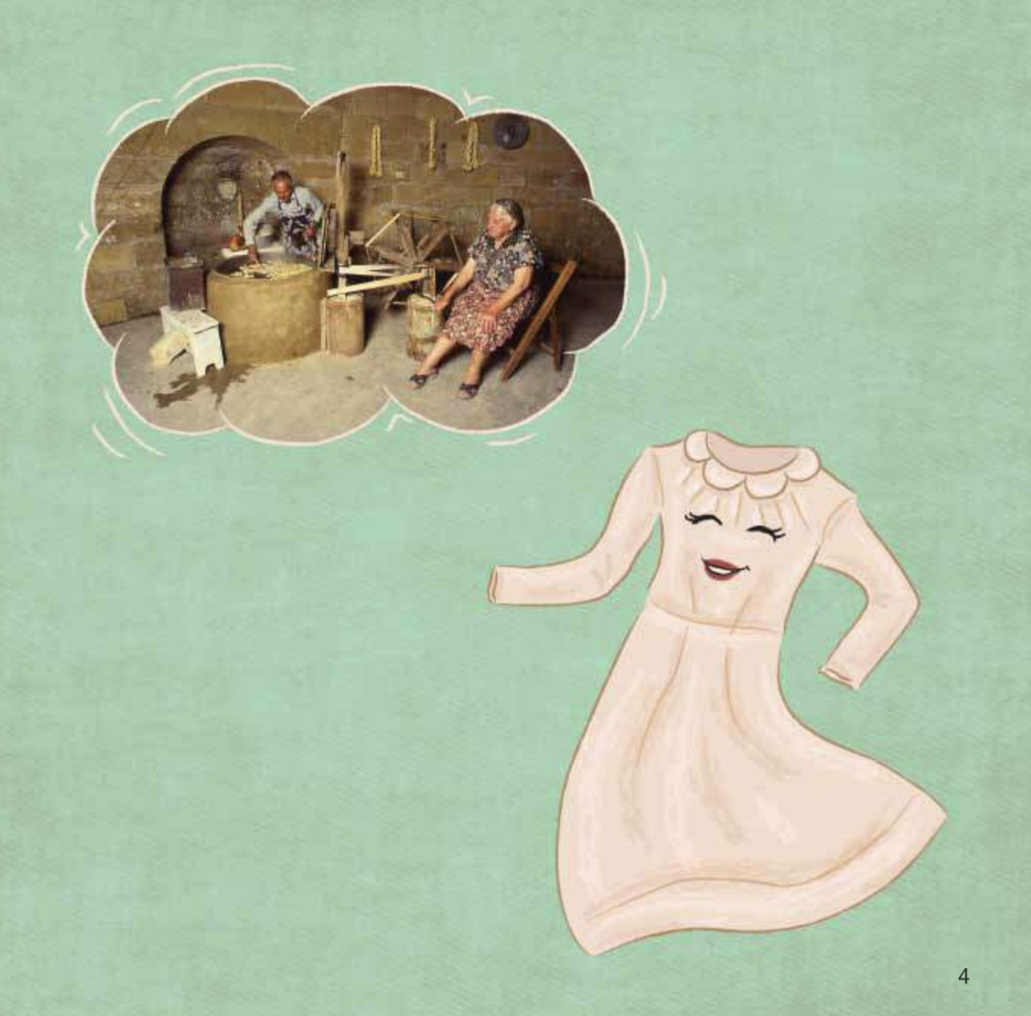
The wedding gowns come to life…
The wedding gowns start a conversation exchanging information about their story.
Areti’s wedding
The Beige Gown (Maronite community - Catholics)
It was made by the Iosifi family in Kormakitis village (inhabited mostly by the Maronite community and now occupied illegally by the Turkish troops). The gown was made of silk. The Iosifi family made it from scratch producing even the silk thread from silkworms bred in their yard. It was made using a loom with special care and it was embroidered in hand with much detail. The wedding of Areti was a great event, even though Areti was only a 12 year old girl.

Slide 12
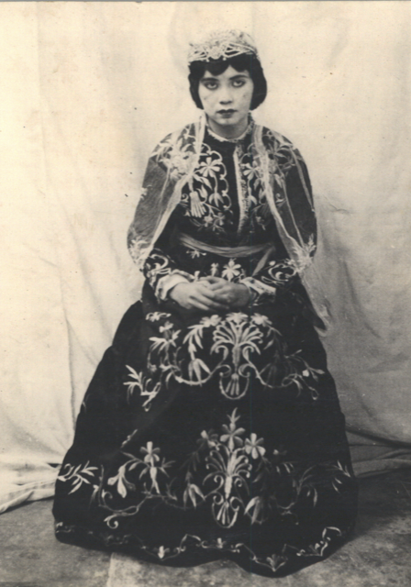
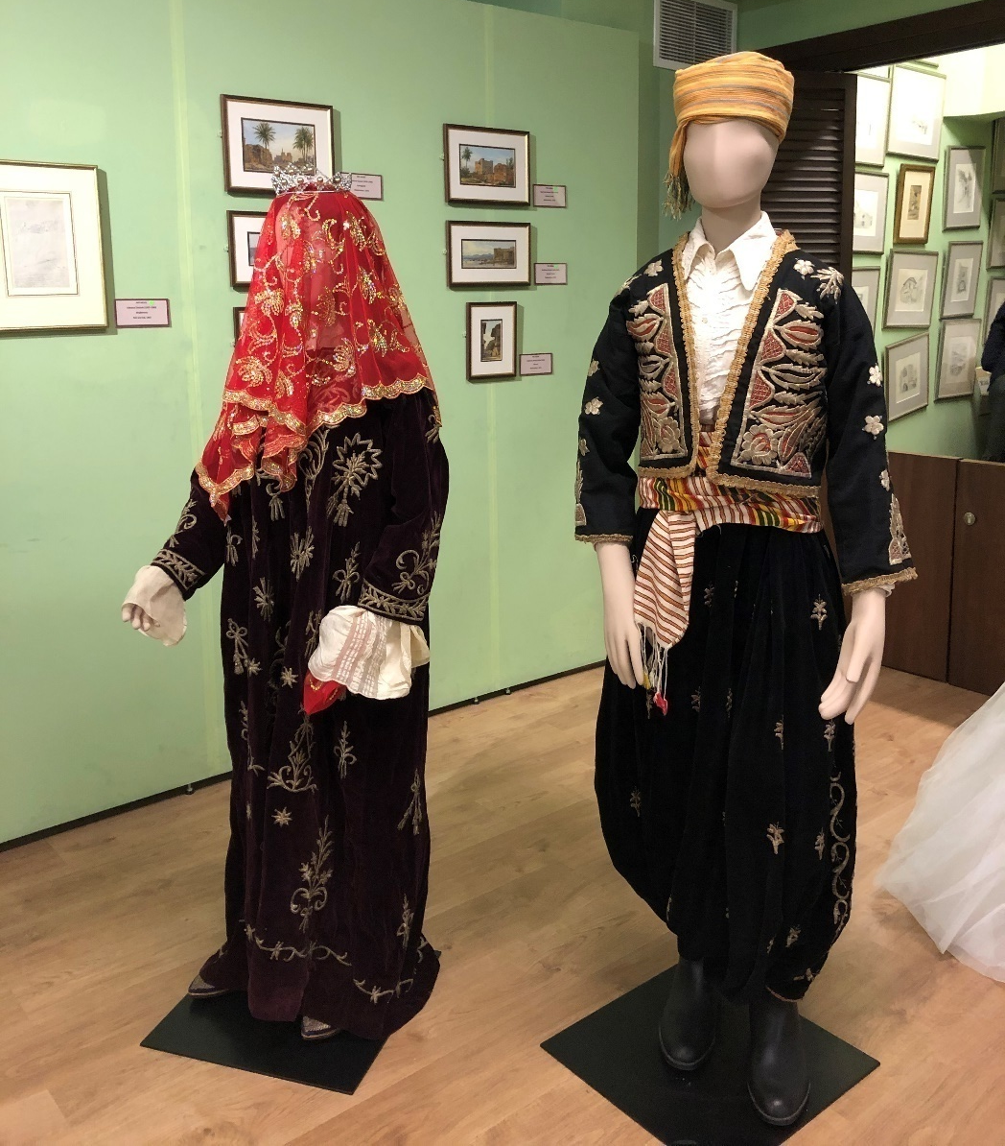
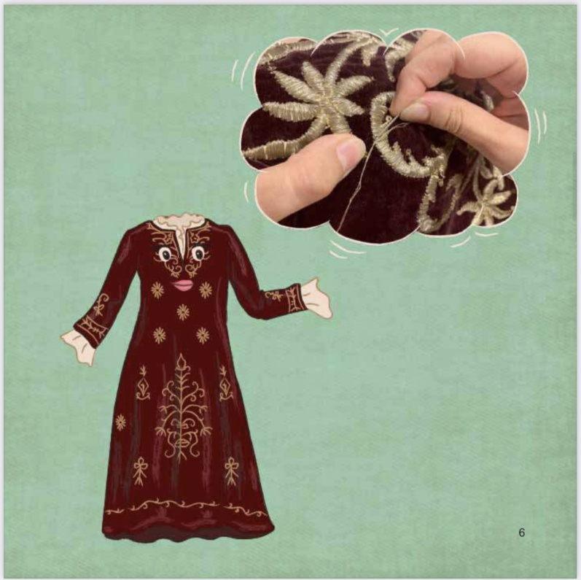
The red wedding gown (Turkish Cypriot community – Muslims)
It was made around 1800 out of velvet and was wore by Sinem from Limassol. It was embroidered by hand according to bedale technique for months using precious gold thread.
Sinen’s wedding

Slide 13
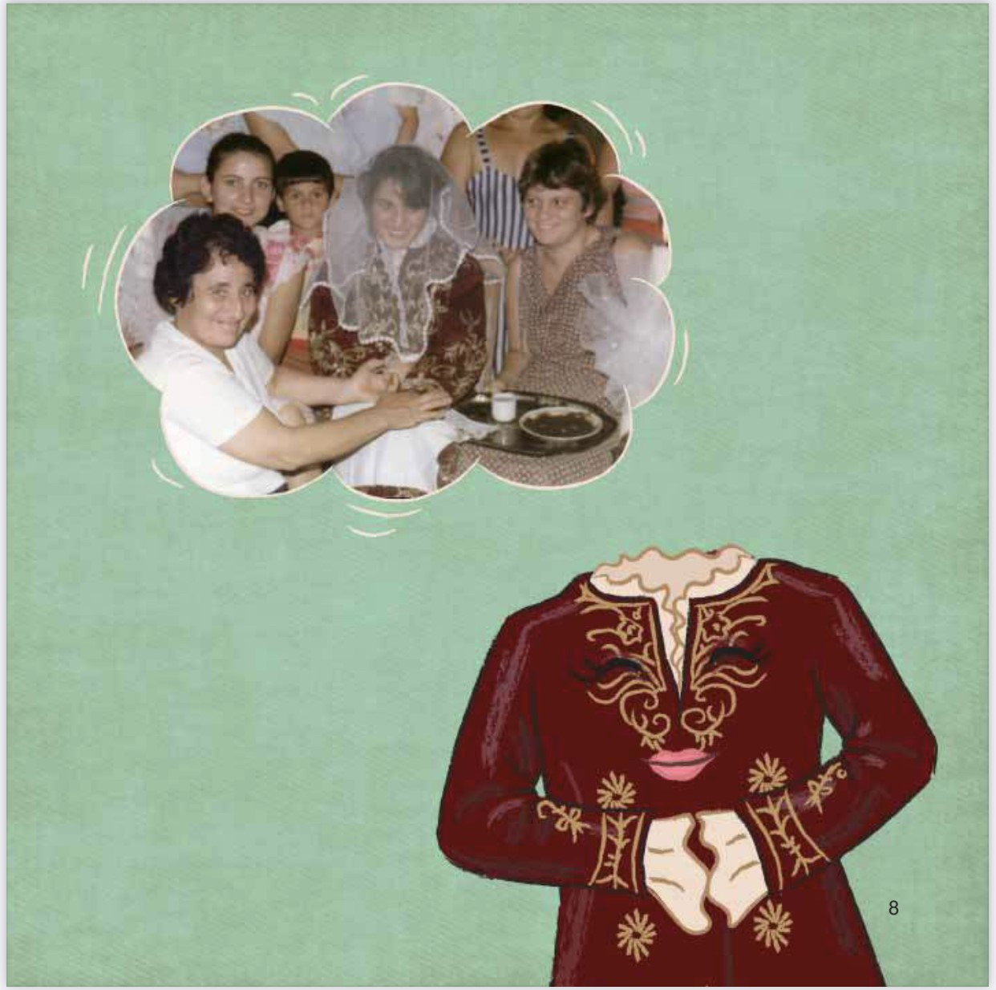
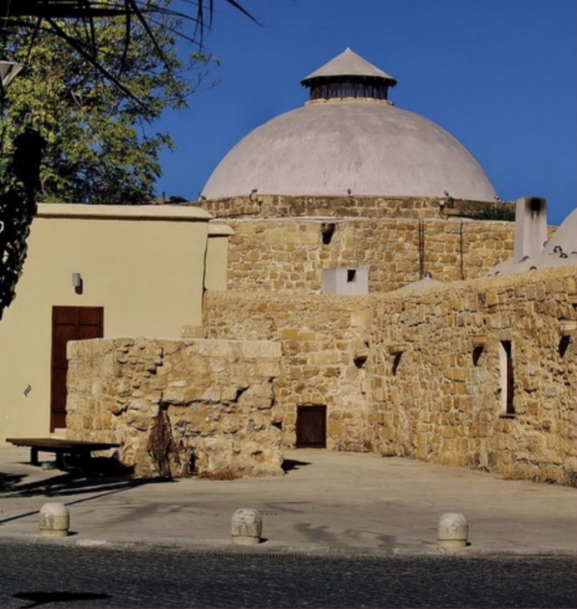
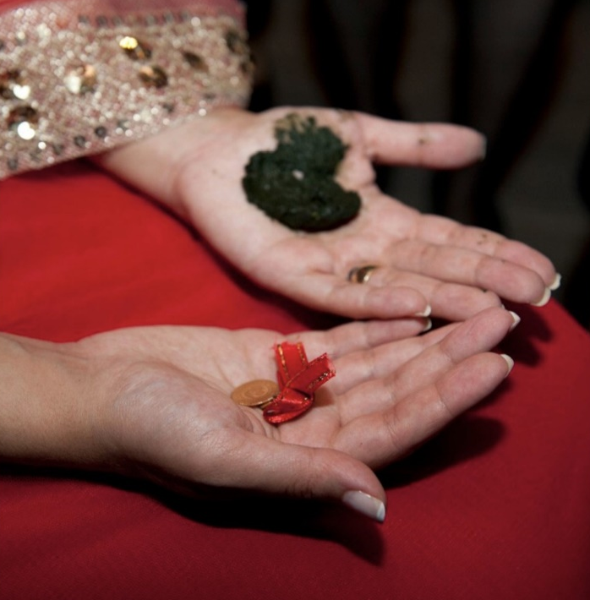
Sinen was just 14 years old on her wedding day. She went to hamam for the traditional bath before the wedding, and then she removed the scarf from her head and replaced it with a stunning crown. Her sisters painted her fingers and palm with henna.
After, she put a red glove on her hand and held a coin tight for good luck.

Slide 14
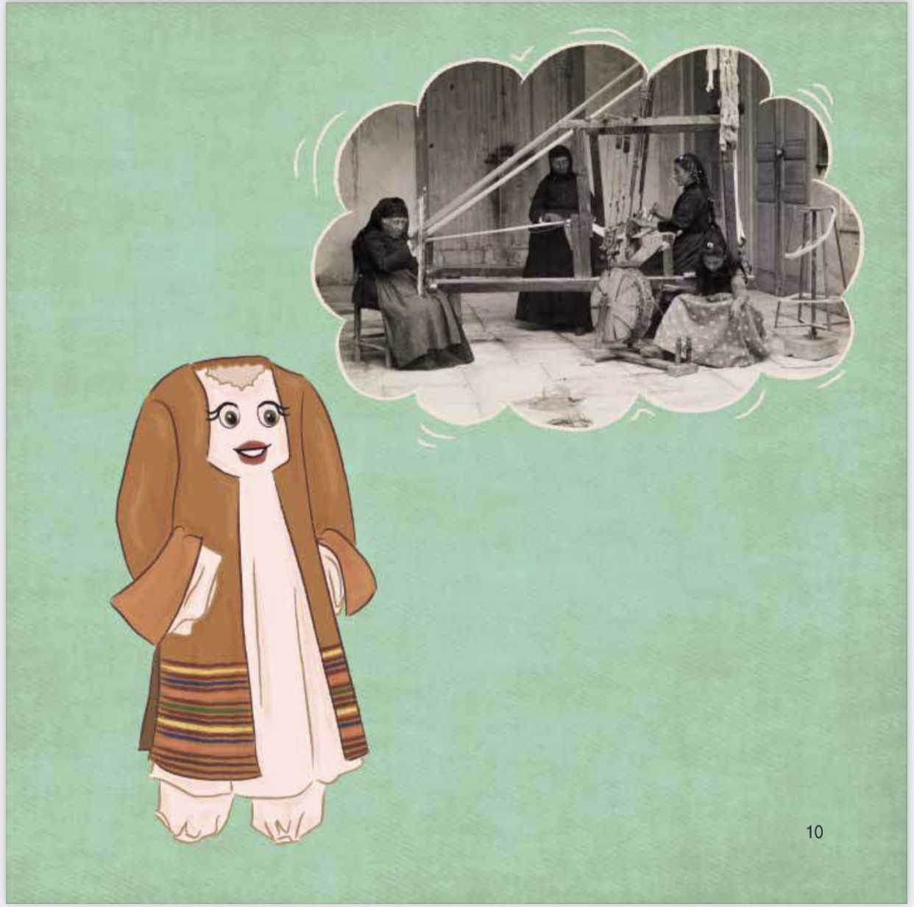
The traditional wedding dress ( Greek Cypriot community – Orthodox)
Calliope’s wedding
Calliope married Yiorgi in October of 1802. She wore a colourful sayia, a long beige shirt and a silk vrakou (panties). She lived at Ayios Andronikos, a village in Karpasia area, and was one of few villages inhabited by both Greek and Turkish Cypriots.

Slide 15
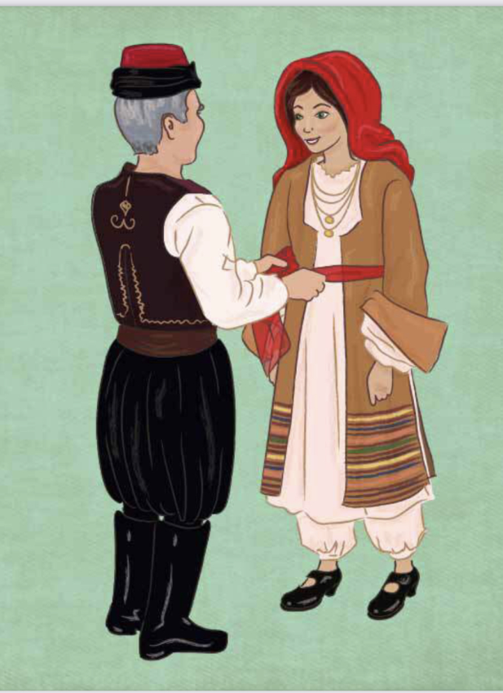
The “zosimo” custom (The red scarf blessing)
The couple is blessed with a red scarf three times by each parent and other relatives as well in some cases.
This is a special and sacred moment, as the parents are bidding their child farewell.
They use the scarf to make the sign of the crucifix on the bride and groom’s chest or head.
They then take turns to wrap the scarf around the bride and groom’s waist three times, tying it loosely.

Slide 16
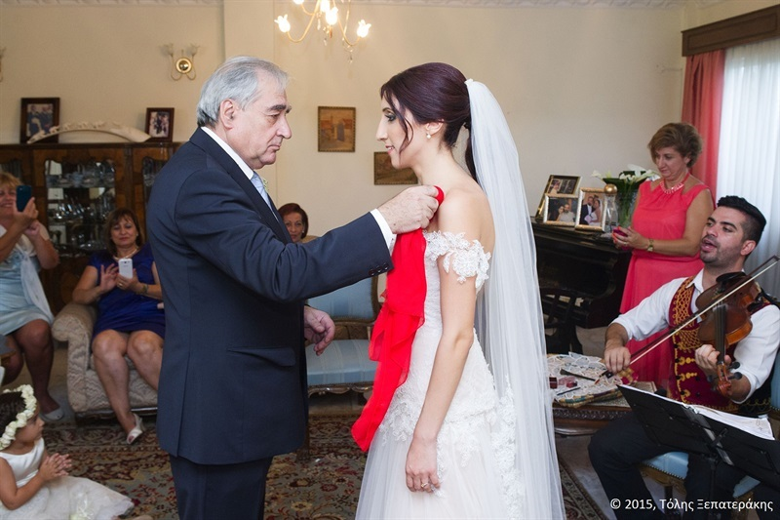
The red scarf blessing, zosimo, symbolises:
The untying of the scarf by the parents marked the couple’s transition from virgin life to married life, according to folk and byzantine sources.
Furthermore, the use of the red scarf, which is held lopsided and folded in a triangular shape, refers to the red triangular fabric that was used in the medieval era to prevent evil and protect against the evil eye.
Similarly, the wrapping of the scarf three times around the waist is to keep the evil eye away from the couple.
At the same time, the process is also a wish and aspiration for fertility.

Slide 17
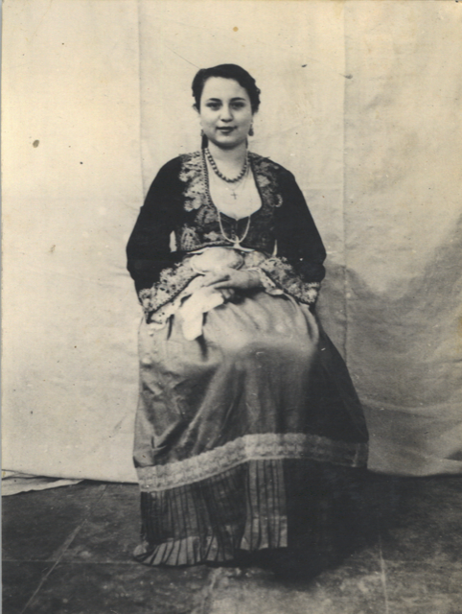
Traditional wedding gowns
Some girls wore a long red skirt called rutzetti , and an embroidered jacket in top called sarka.

Slide 18
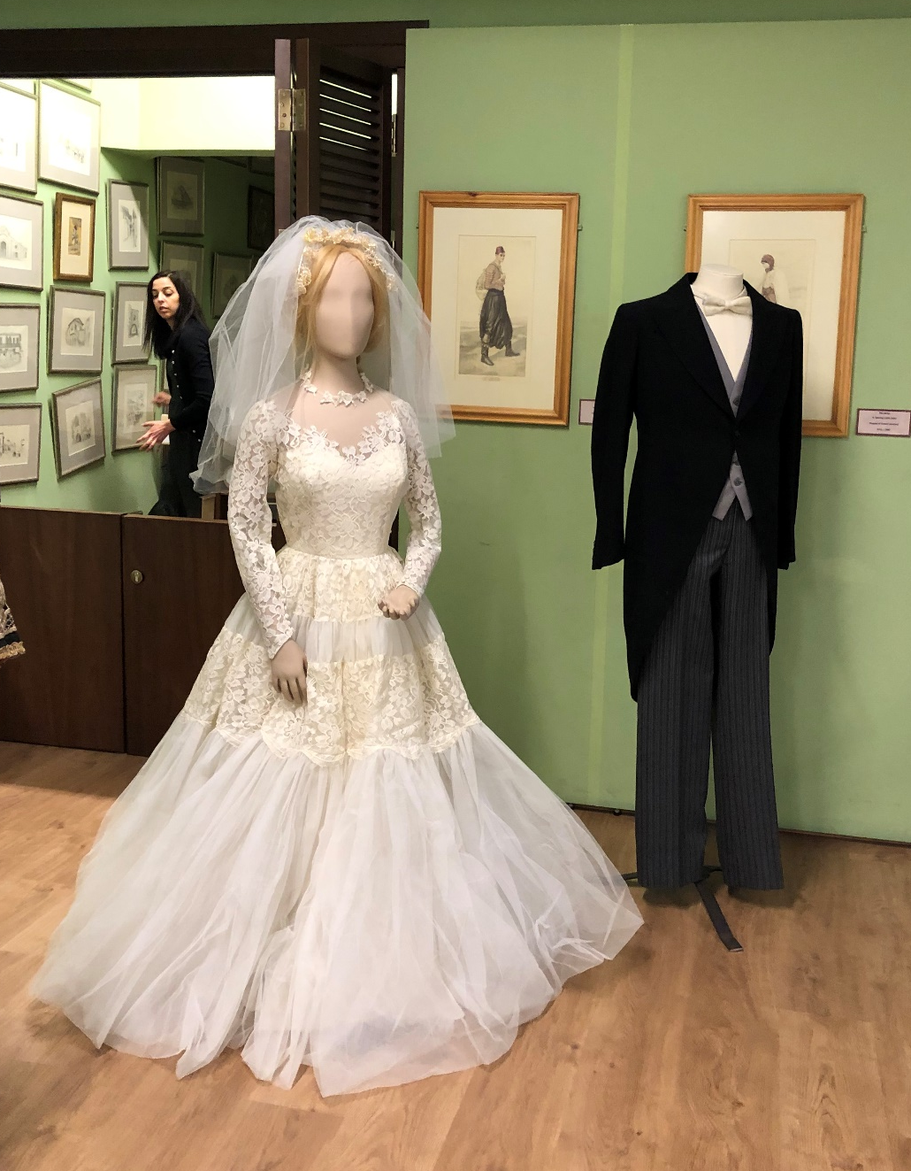
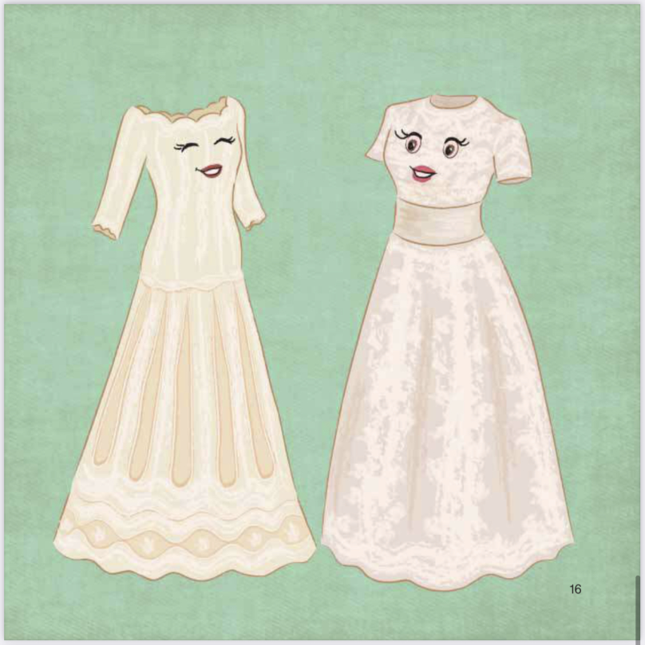
The lace wedding dress
It was wore in 1960 by Anna and was made in a contemporary dressmaker’s shop at the capital of Cyprus, Nicosia.
Anna came from an upper class family an she wanted to follow the fashion of the time. The design was brought from Europe by her aunt and it is said that it is very similar to Queen Victoria’s wedding dress.

Slide 19
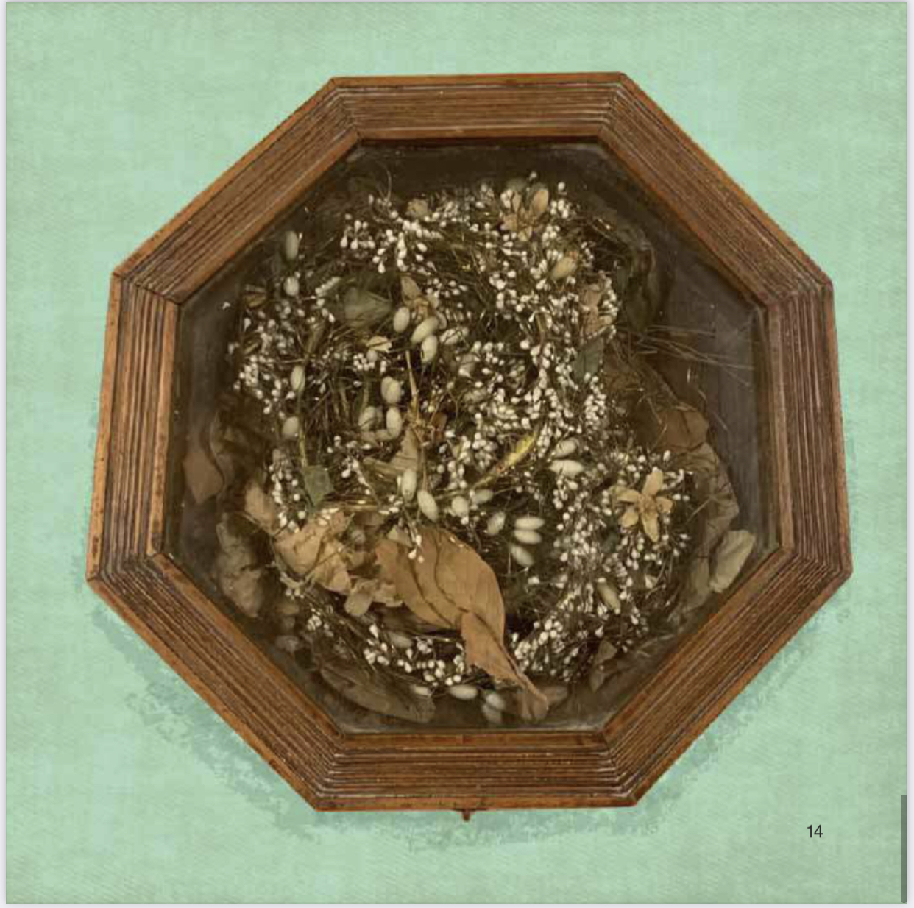
The wreathes’ box
The wreathes used in the wedding ceremony, as part of the ritual, were later placed in a wooden carved box and placed on the wall on top of the couple’s bed.

Slide 20
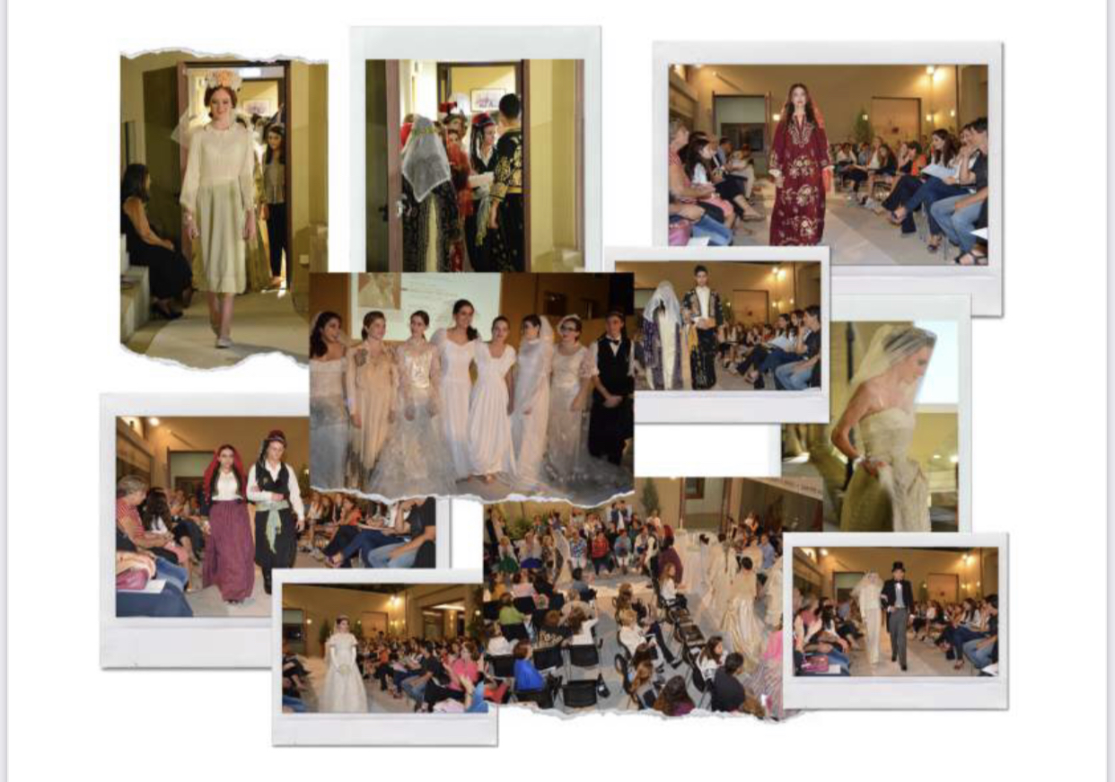
Fashion show of historical wedding gowns
“Here come the brides”, CVAR, October 2014

Slide 21
