Slide 1
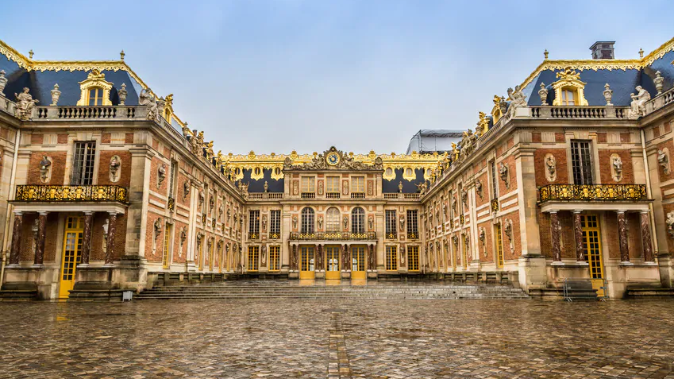
Baroque and German history
1650 -1730

Slide 2
Germany Today
Capital: Berlin
Population: 83,24 millions
Land area: 357.588km²
Population density: 232 persons per km²
Italy 206 per km²
Cyprus 130 per km²
Greece 81 per km²

Slide 3
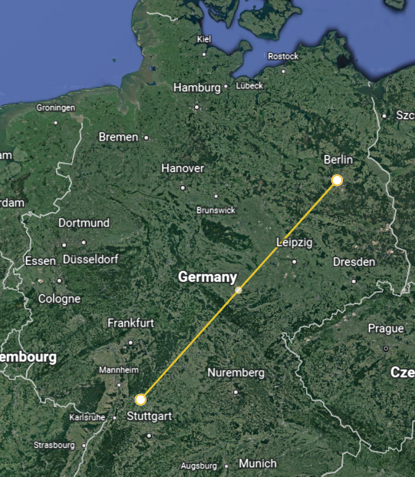
Distance to Berlin
614km by road
ca 6h 30m drive
473.79 km
Neckarbishofsheim

Slide 4
The Federal Republic of Germany
16 Länder (States)
16 Ministerpräsidenten (Chiefs of the Government of each state)
Baden-Württemberg
States part of the
legislative power
of BRD
But why do we have a federal organization like that ?

Slide 5
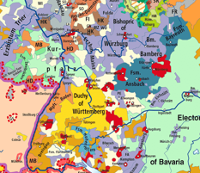
The Holy Roman Empire of the German Nation
King elected by princes
No Capital
Hundreds of tiny principalities with dukedoms +princes
Privileges for support
Old territories correspond some modern states
Baden, Württemberg,

Slide 6
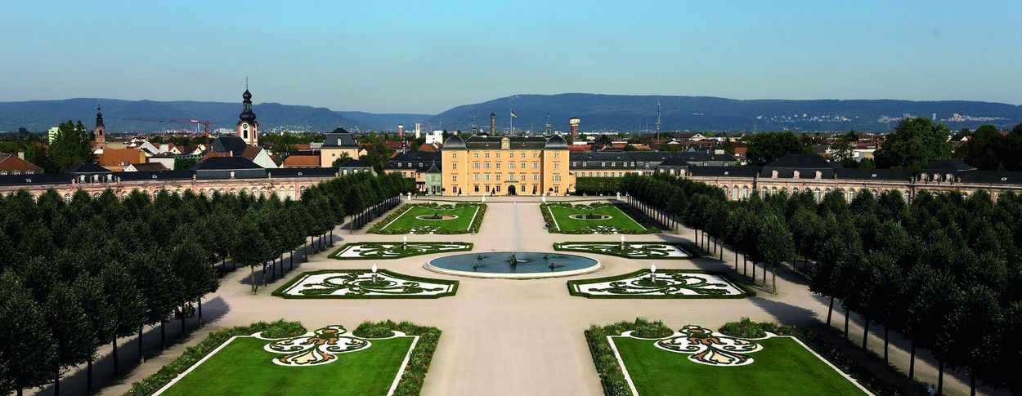
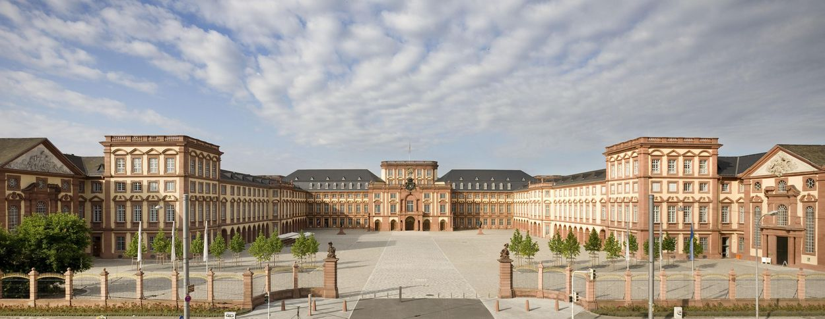
Baroque
Absolutism
Louis XIV and Versailles as Idols
Sign of Power
Competition between the Princes in germany

Slide 7
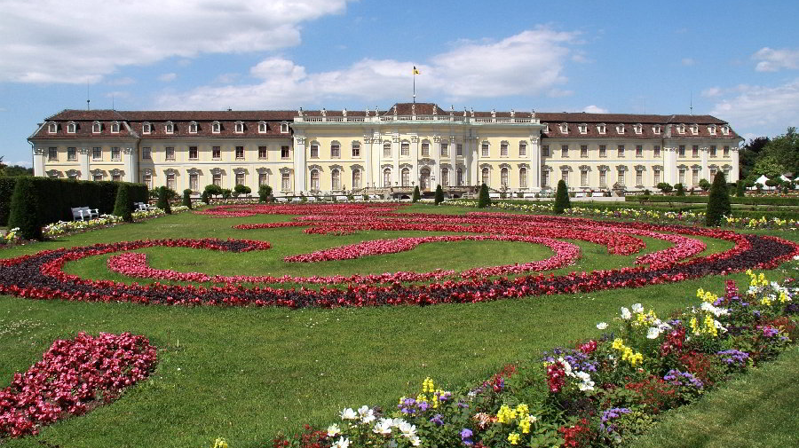

Slide 8
Thirty years war 1618 – 1648
Religious war in whole Europe
Catholics vs Protestants
Defined by atrocities, famine and widespread destruction
Total death toll: 4.500.00 – 8.000.00

Slide 9
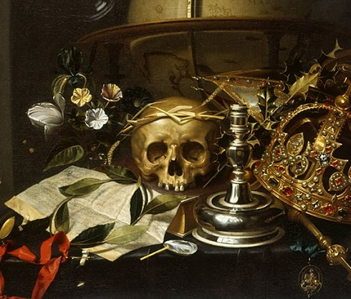
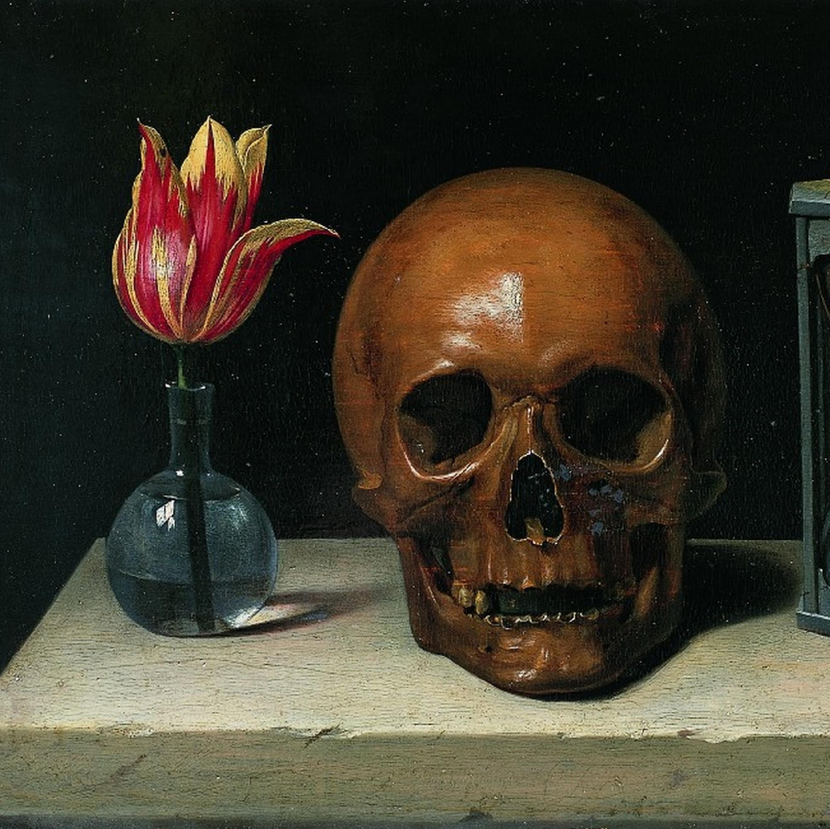
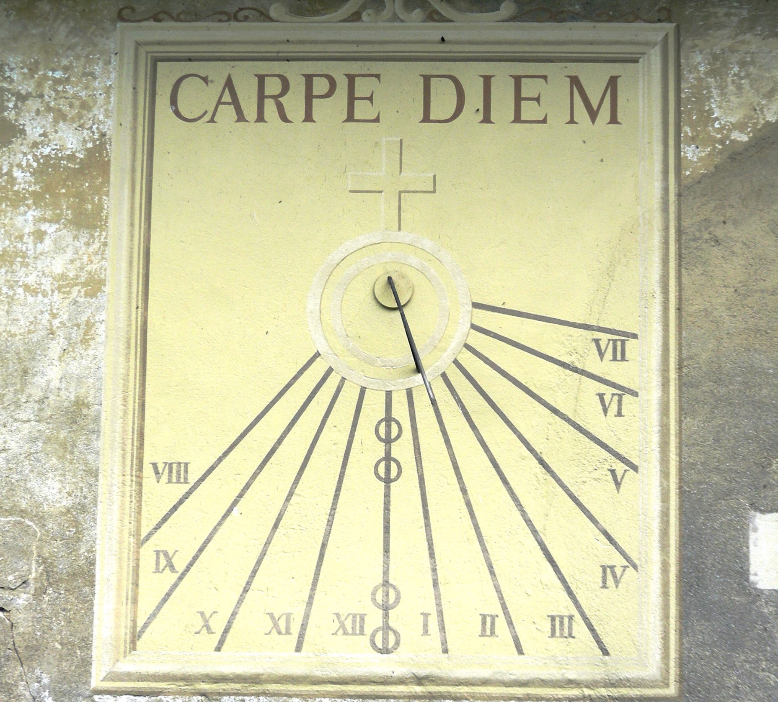
Motives of the Baroque
Vanitas
Lat. (nullity)
Memento Mori
Lat. ( “be aware of your mortality”)
Carpe diem
Lat. (“enjoy the day”)

Slide 10
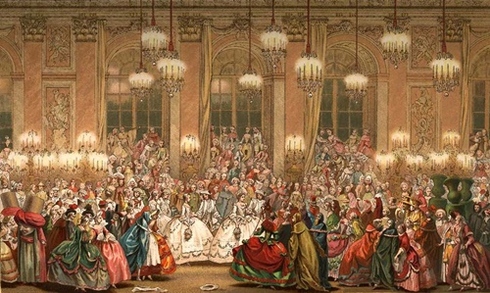
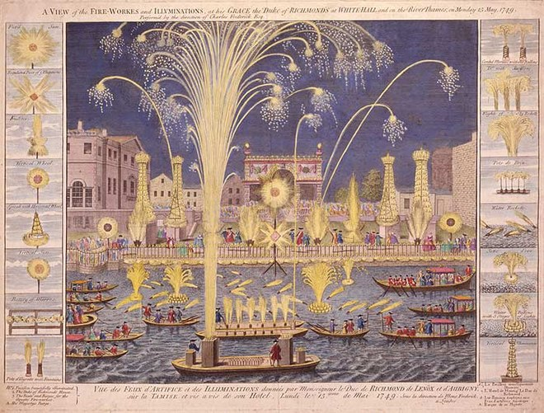
Carpe Diem

