Slide 1
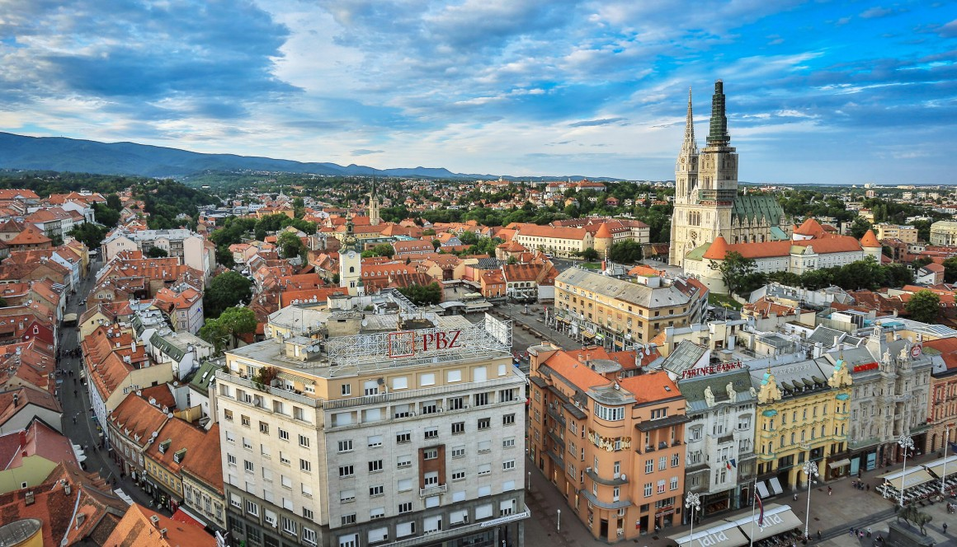
THE City of zagreb
Created by luka lajić

Slide 2

GENERAL INFORMATION
Capital city of Croatia
Population: 792, 875
Mayor: Milan Bandić
Zagreb City Day: May 31st

Slide 3
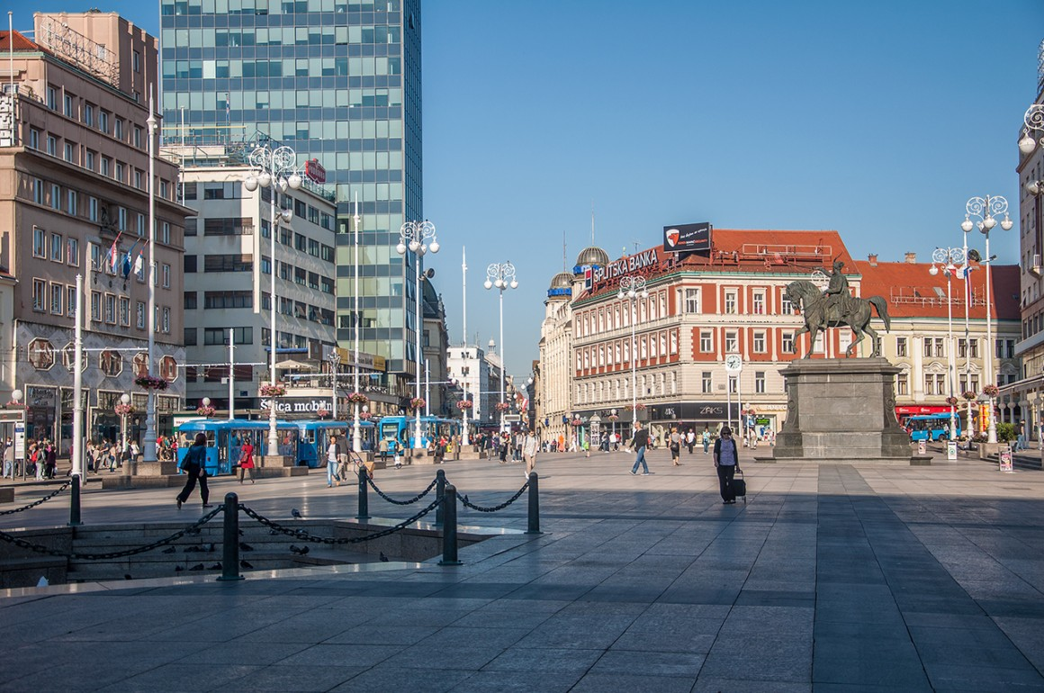
Ban jelačić square
The central square of the city
Named after Ban Josip Jelačić
The square is marked as a pedestrian zone, however it’s accessible by tram

Slide 4
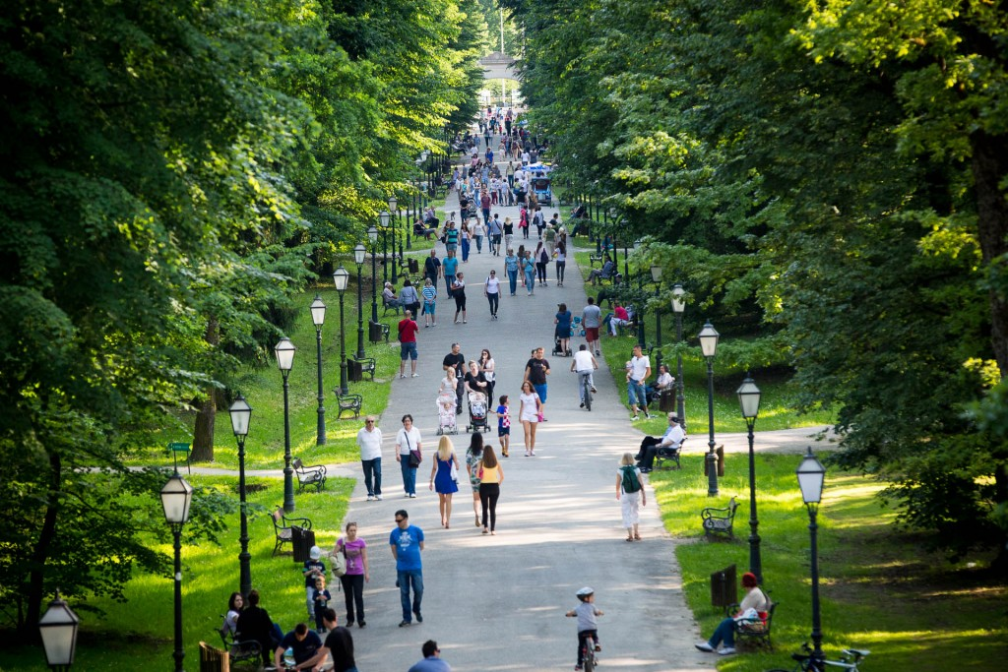
Maksimir park
The city’s biggest park
The park was opened in the late 18th century
The most visited family attraction
It encompasses five lakes and the Zagreb City Zoo

Slide 5
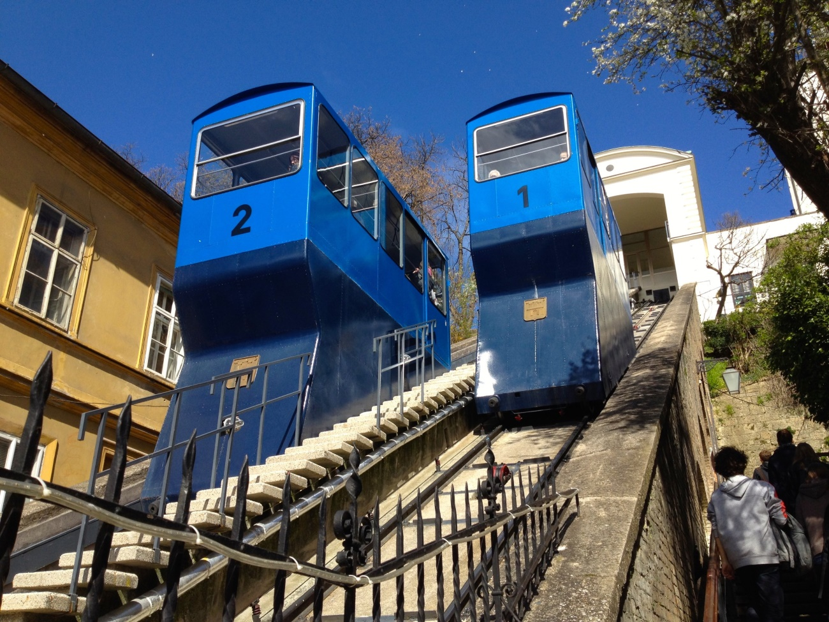
Zagreb funicular
The shortest public- transport funicular in the world
It’s situated in Tomić street, connecting Ilica Street with The Upper Town
The funicular needs 55 seconds to cross the distance

Slide 6
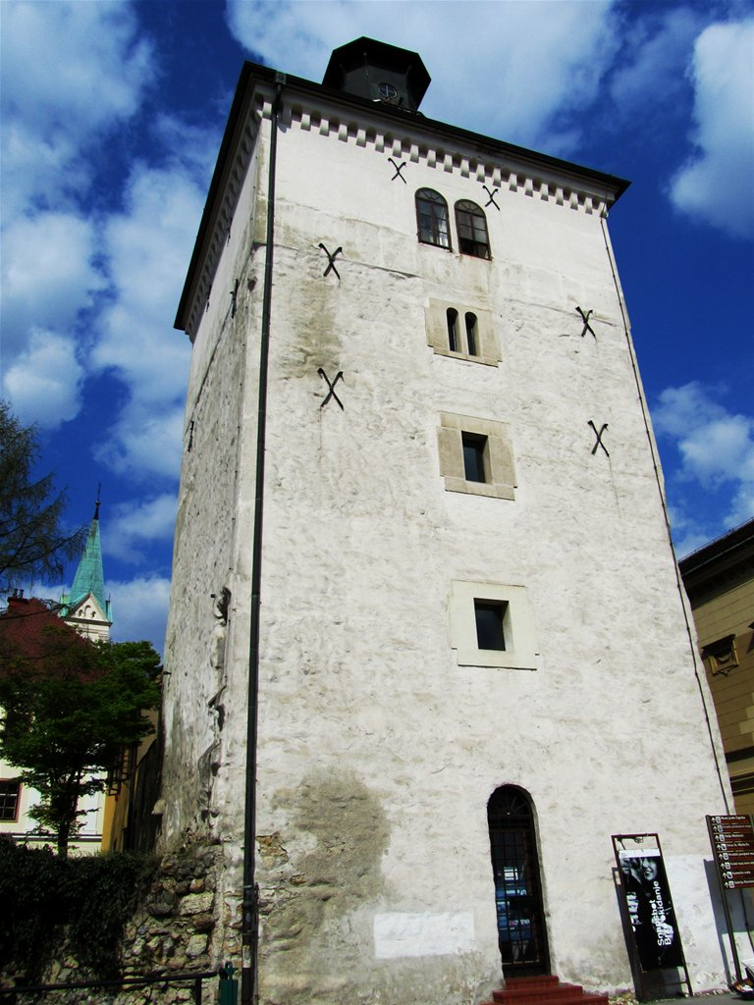
Lotrščak tower
It was built in the middle of the 13th century in order to protect the southern city gate
For the last 100 years a cannon has been fired from the tower at noon every day

Slide 7
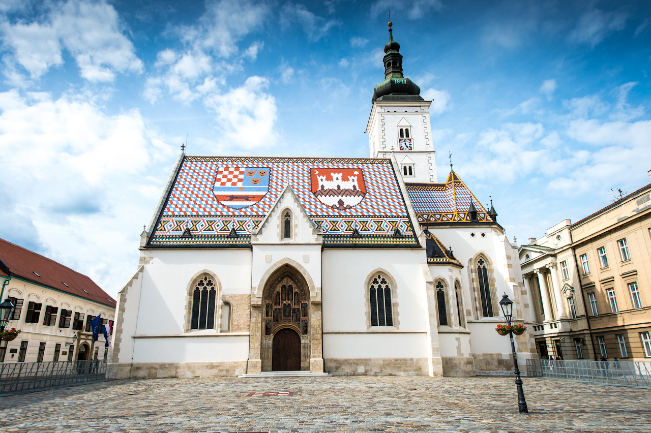
ST MARK’S CHURCH
Zagreb’s most emblematic building
Recognizable by the colourful tiled roof
The church was built in the 13th century
It is only open at mass time

Slide 8
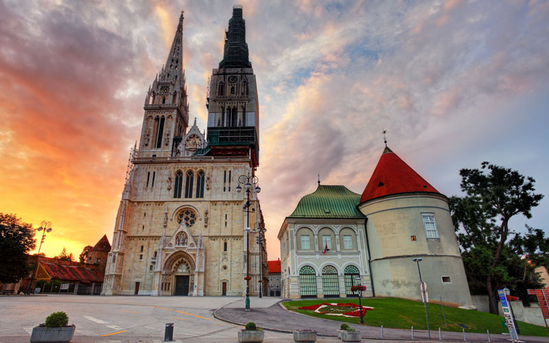
Zagreb cathedral
The tallest building in Croatia
It was designed by Hermann Bollé
The cathedral is easily visible from any part of the city because of its twin spires

Slide 9
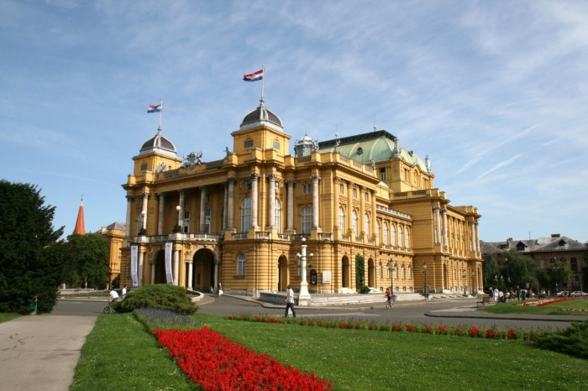
CROATIAN NATIONAL THEATRE
Commonly referred to as HNK (Hrvatsko narodno kazalište)
It was built in the late 1860’s
The theatre was designed by two Viennese architects- Hellmer and Fellner

Slide 10
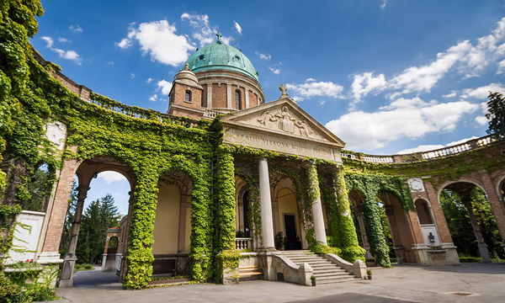
Mirogoj cemetery
Designed by Hermann Bollé in the 19th century
The cemetery is counted among the top 10 cemeteries of Europe
Ornate structures and greenery spread around 7 acres of its space

Slide 11
Photo credits
http://www.infozagreb.hr/media/places/large_bg0-55379bab576b3.jpg
https://upload.wikimedia.org/wikipedia/commons/7/70/Coat_of_arms_of_Zagreb.svg
http://wevemadeahugemistake.com/wp-content/uploads/2015/04/IMG_5097.jpg
http://justzagreb.com/wp-content/uploads/2015/06/JustZagreb-194-1024x683.jpg
http://www.tomthorpe.co.uk/wordpress/wp-content/uploads/2013/06/006-DSC_1406.jpg
http://www.thebalkanbackpacker.com/wp-content/uploads/2016/01/zagreb-view_2.jpg
http://meetzagreb.com/wp-content/uploads/Cathedral-Zagreb.jpg
http://s2.pticica.com/foto/0001105853_l_0_dryswn.jpg

