Slide 1
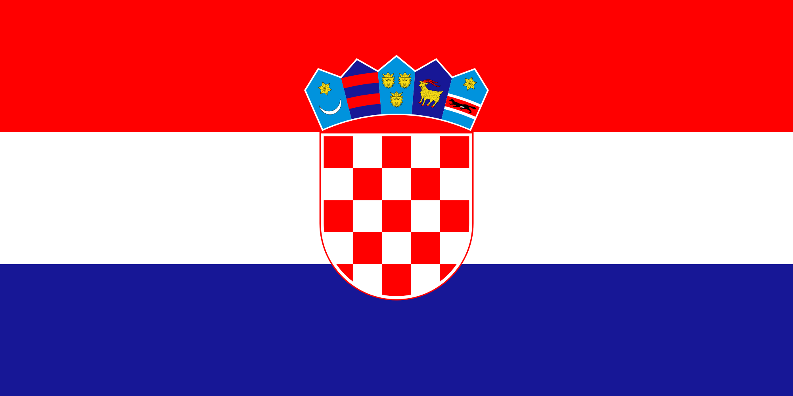
CROATIA
ALLKJA SARA

Slide 2
REPUBLIC OF CROATIA (Republika Hrvatska)
Croatia is a European state, member of the European Union since 2013.
Its capital city is Zagreb.
The country's population is 4.28 million, the most of them are Croats and 86% of the population is formed by Roman Catholics.

Slide 3
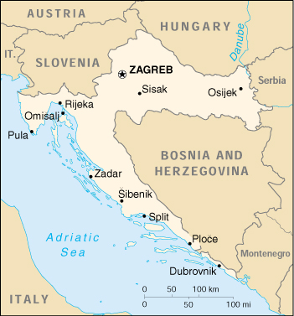
GEOGRAPHY
Croatia is located in Central and Southeast Europe,
bordering Slovenia to the northwest, Hungary to the northeast, Serbia to the east, Bosnia and Herzegovina and Montenegro to the southeast and the Adriatic Sea to the southwest.

Slide 4
CLIMATE
Most of Croatia has a moderately warm and rainy continental climate. Mean monthly temperature ranges between −3 °C (in January) and 18 °C (in July).
The coldest parts of the country are Lika and Gorski Kotar where snowy forested climate is found at elevations above 1,200 metres.
The warmest areas of Croatia are at the Adriatic coast characterised by the Mediterranean climate.

Slide 5
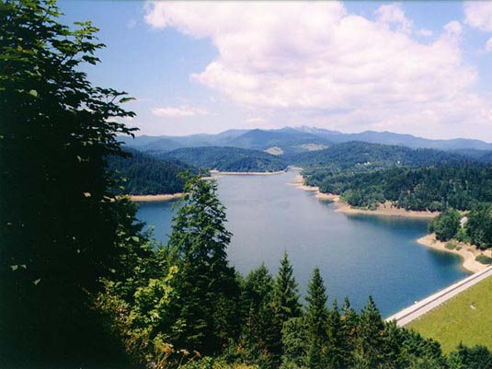
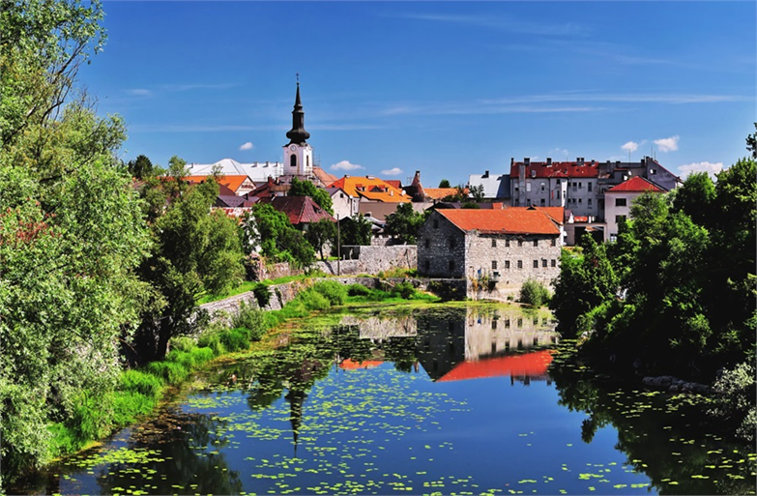
LIKA
GORSKI KOVAR

Slide 6
ADRIATIC COAST OF CROATIA

Slide 7
THE MOST IMPORTANT CITIES
City | Population
1. Zagreb | 790,017
2. Split | 178,102
3. Rijeka | 128,624

Slide 8
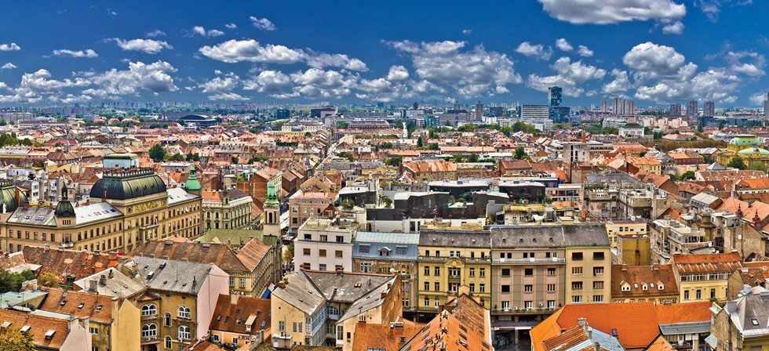
ZAGREB

Slide 9
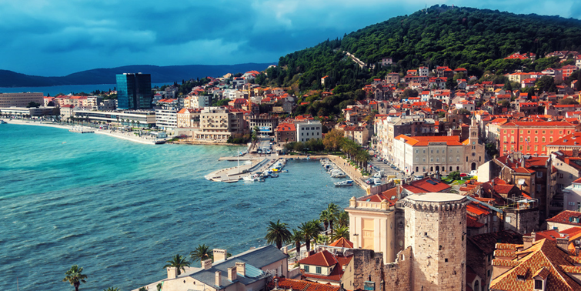
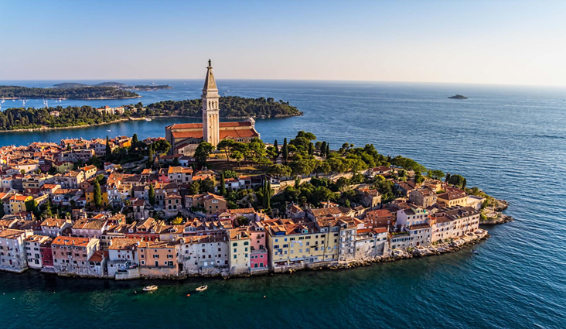
RIJEKA
SPLIT

Slide 10
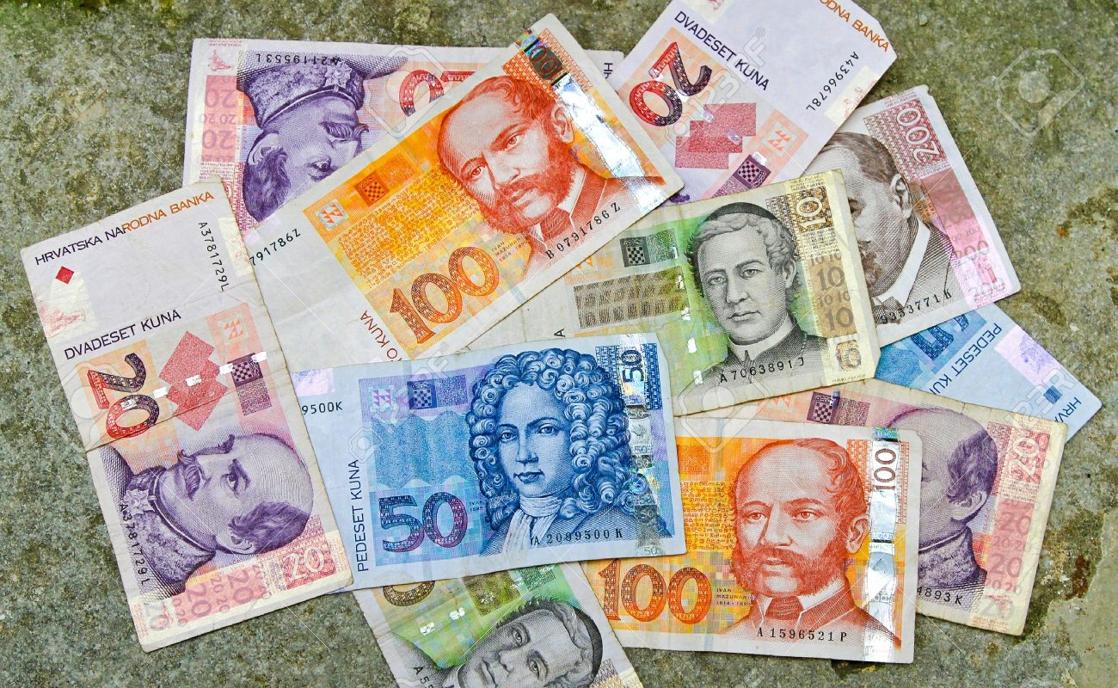
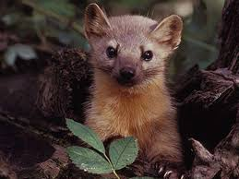
CURRENCY
The kuna is the currency of Croatia, in use since 1994.
The word "kuna" means "marten" in Croatian since it is based on the use of marten pelts as units of value in medieval trading.

Slide 11
CUISINE
Croatian traditional cuisine varies from one region to another.
Dalmatia and Istria have culinary influences of Italian and other Mediterranean cuisines.
The continental cuisine is heavily influenced by Hungarian, Austrian and Turkish culinary styles.

Slide 12
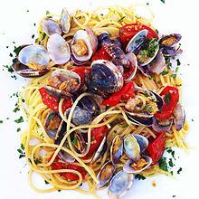
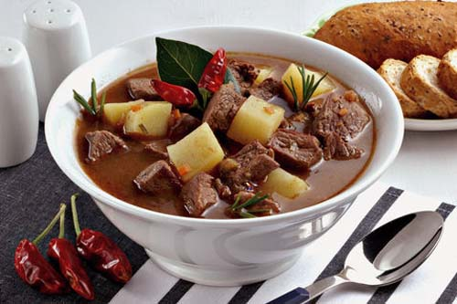
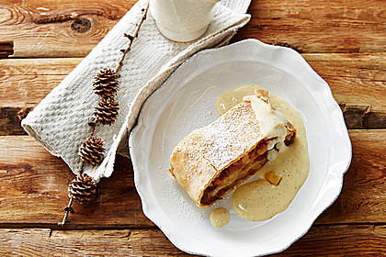
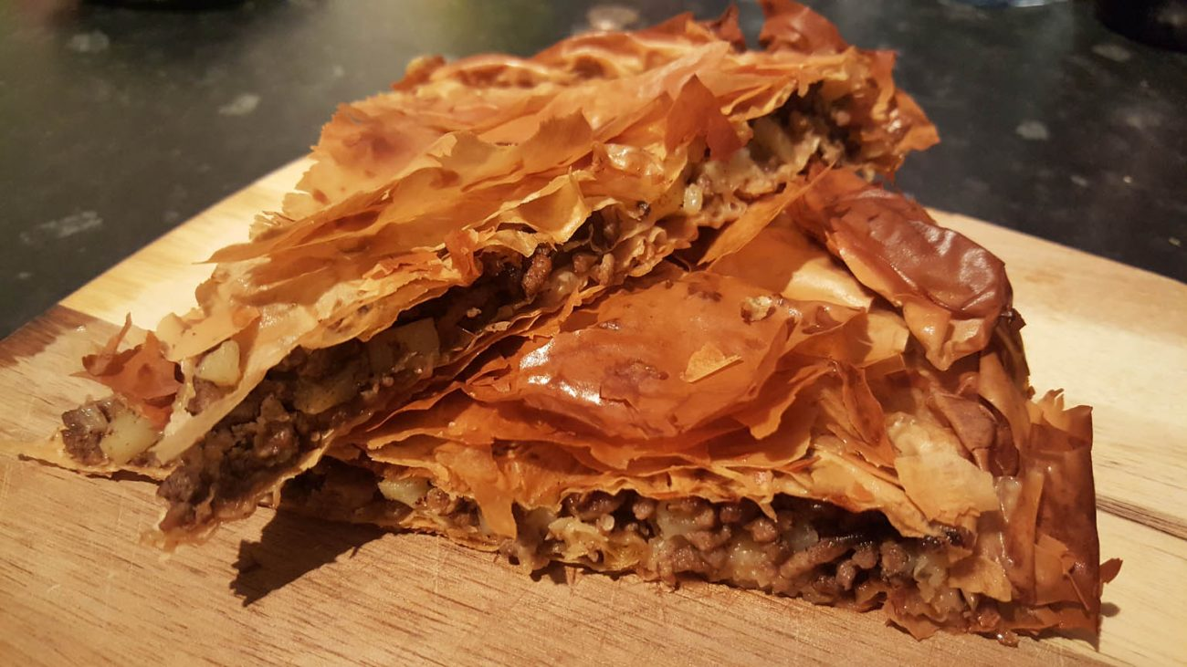
GOULASH
ITALIAN PASTA WITH CLAMS
TURKISH BÖREK
APPLE STRUDEL

