Slide 1
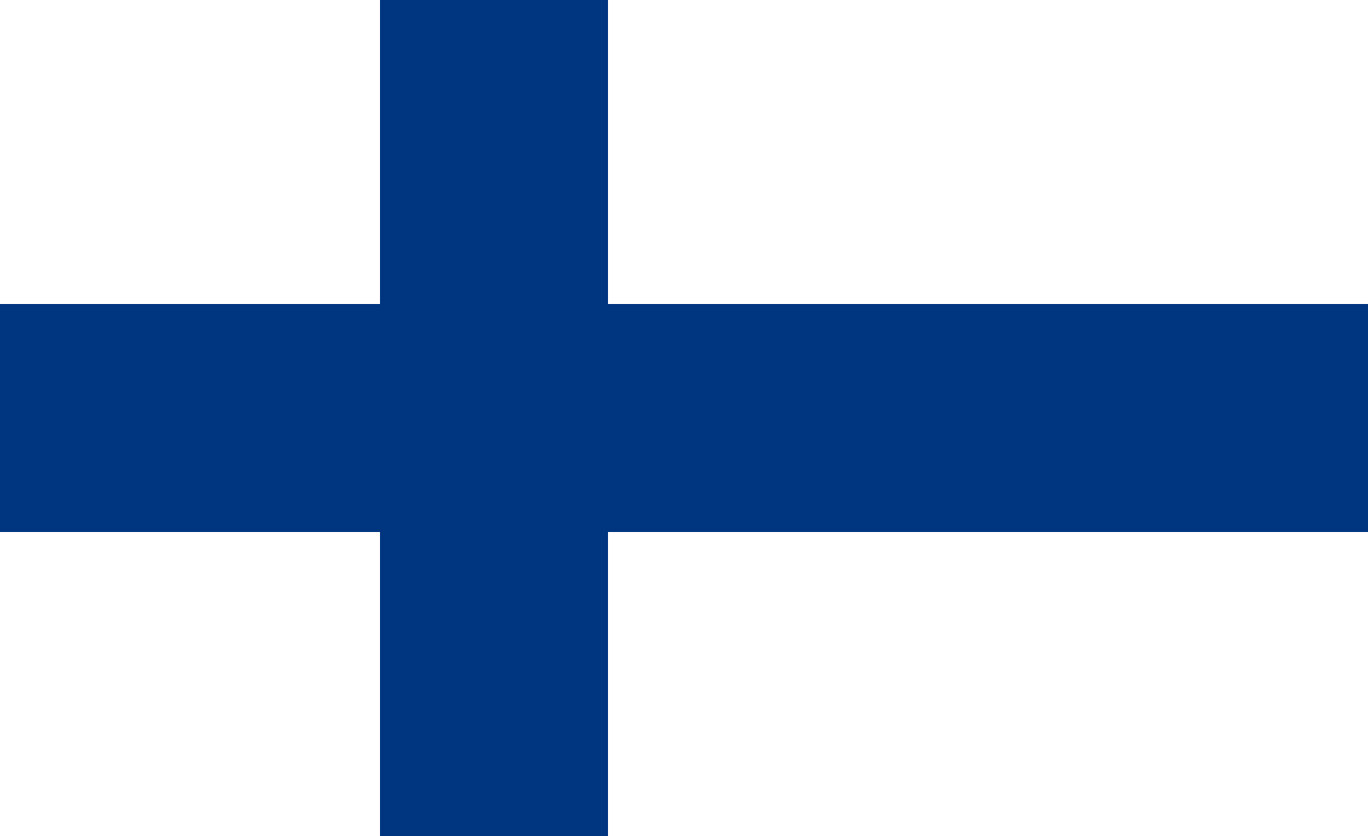
Getting to know Finland
Looking forward to our Mobility 7-13 May 2017
Bargnesi Milena
Secchiaroli Maria Livia
Valentini Aurora

Slide 2
Borders: - the Baltic Sea - Gulf of Bothnia - Gulf of Finland - Sweden - Norway - Russia.
Finland can be divided into four different regions
In archipelago Finland, rock and water are dominant.
In coastal Finland agriculture plays a leading role.
The interior Finnish lake district supports extensive forests.
Upland Finland is covered by Arctic scrub.
Bargnesi Milena
Secchiaroli Maria Livia
Valentini Aurora

Slide 3
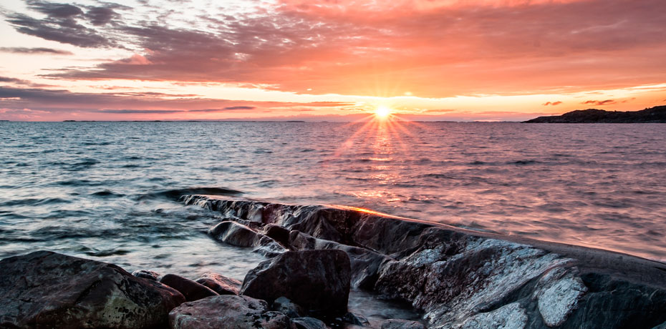
ARCHIPELAGO FINLAND
Bargnesi Milena
Secchiaroli Maria Livia
Valentini Aurora

Slide 4
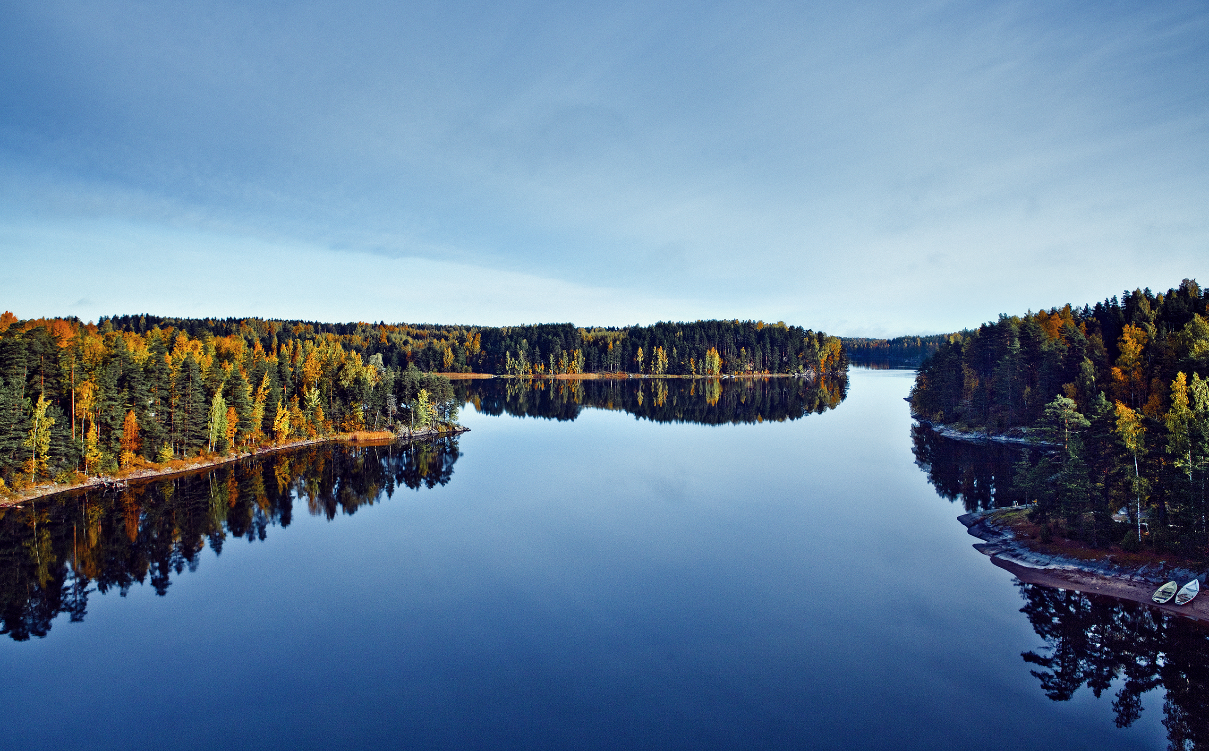
FINNISH LAKE DISTRICT
Bargnesi Milena Secchiaroli Maria Livia Valentini Aurora

Slide 5
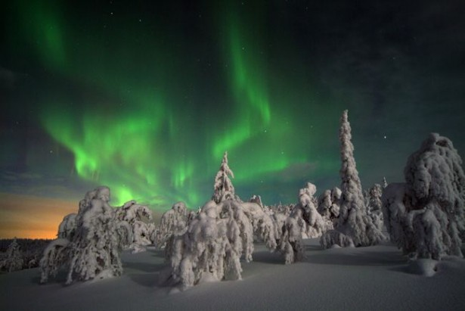
Finland has a reputation as a land of ice and snow, but summers are warm and sunny, with daytime temperatures reaching 25-30ºC, and even spring and autumn can be surprisingly mild. The sun never truly sets in midsummer and locals take full advantage of the midnight sun for late-night sports, barbecues and parties.
Bargnesi Milena
Secchiaroli Maria Livia
Valentini Aurora

Slide 6
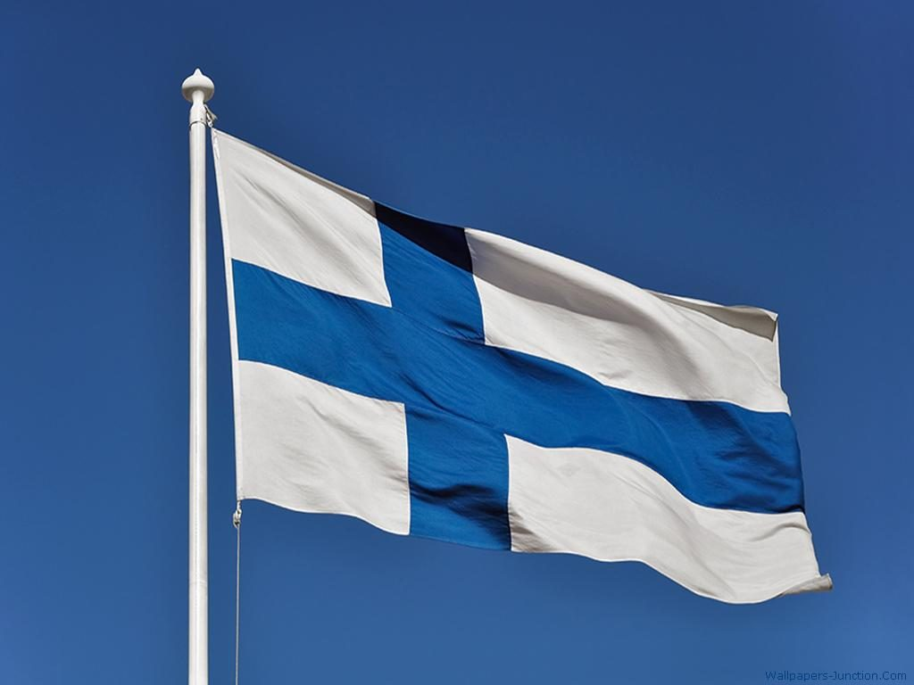
Finnish and Swedish are the official languages of Finland (Finnish predominates nationwide).
Swedish is the language of 5% of the population.
Bargnesi Milena
Secchiaroli Maria Livia
Valentini Aurora

Slide 7
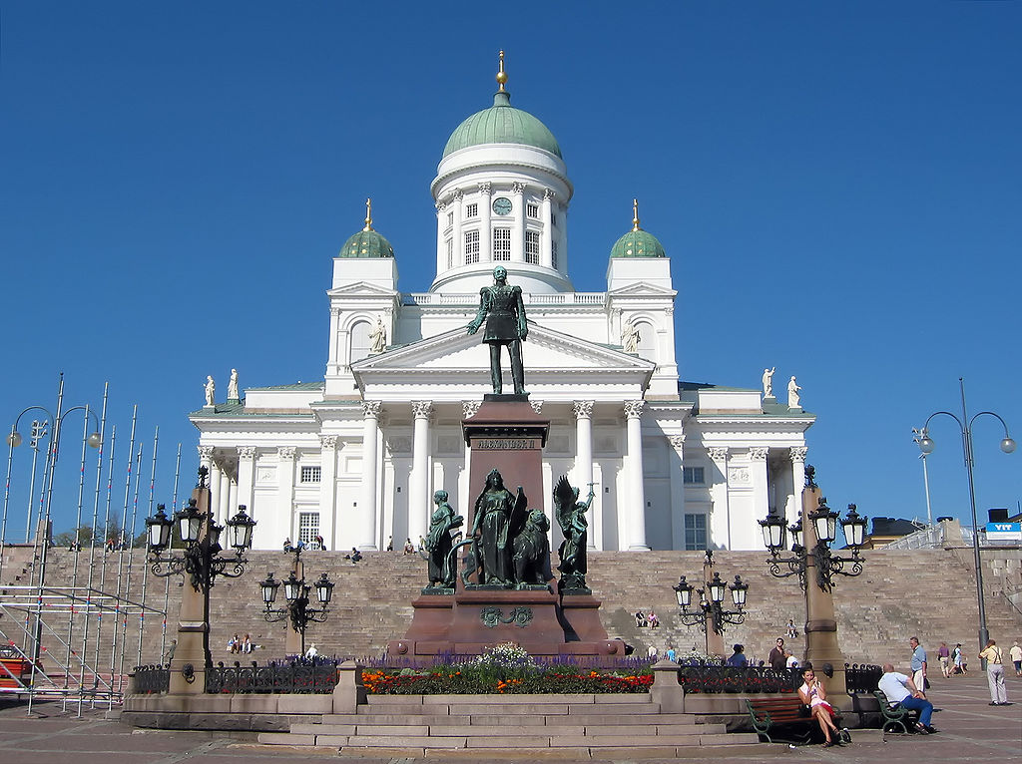
The Evangelical Lutheran Church of Finland is one of the largest Lutheran churches in the world.
Bargnesi Milena
Secchiaroli Maria Livia
Valentini Aurora

Slide 8
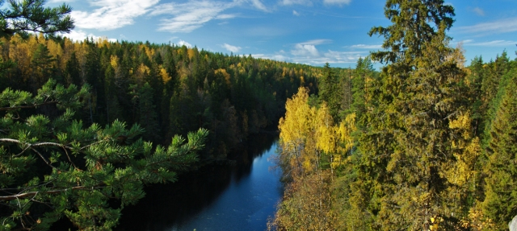
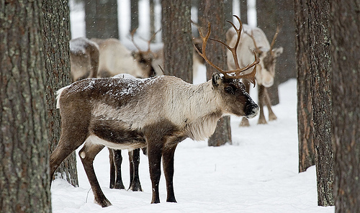
Forests play a key role in the country's economy, making it one of the world's leading wood producers.
Finnish breed cattle and swine and it’s important also the breeding of reindeers.
Bargnesi Milena
Secchiaroli Maria Livia
Valentini Aurora

Slide 9
Helsinki
Bargnesi Milena
Secchiaroli Maria Livia
Valentini Aurora

Slide 10
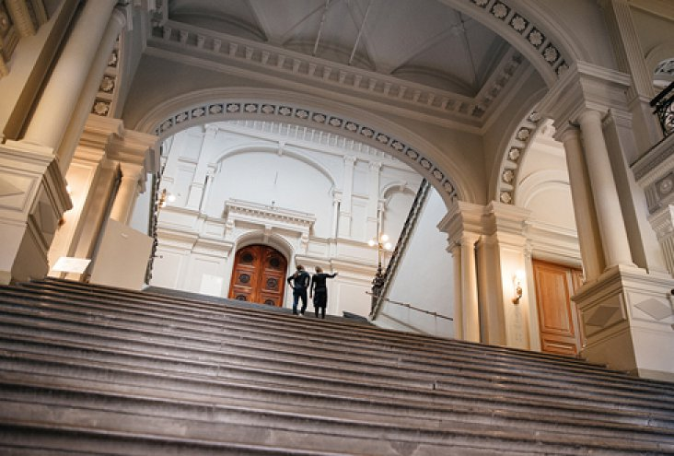
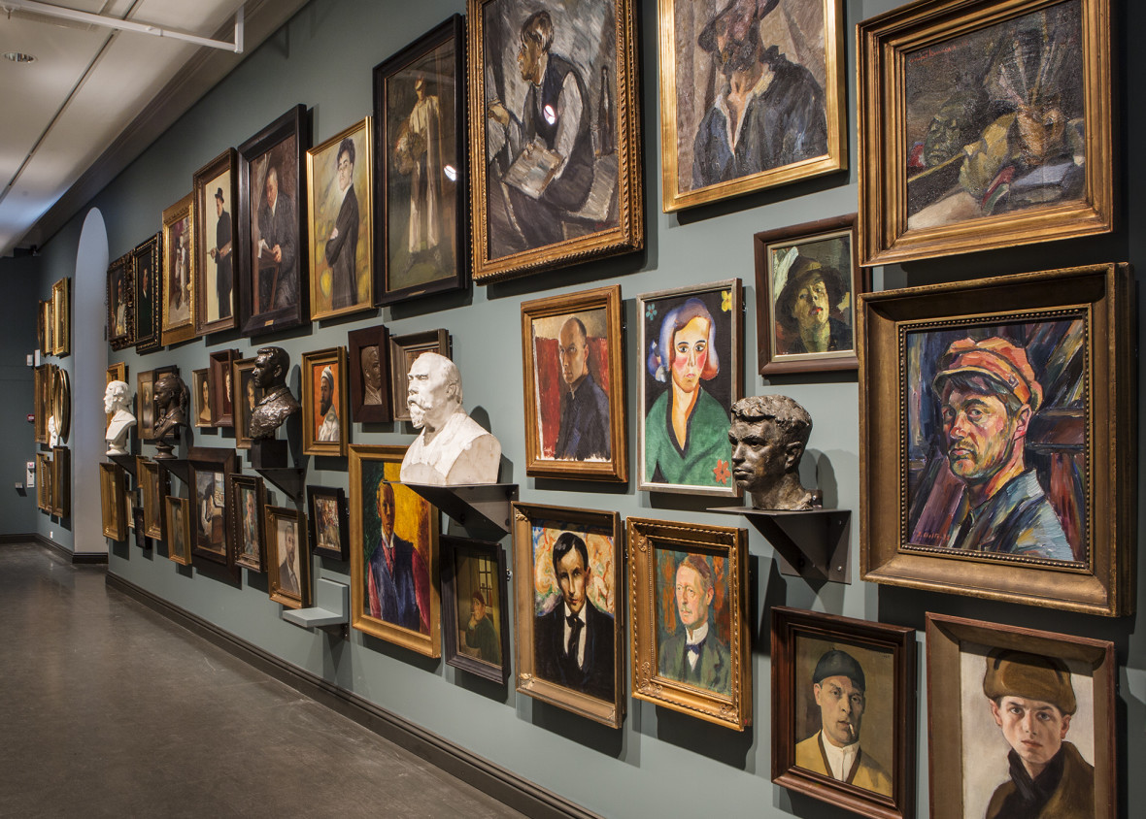
The Ateneum Art Museum is Finland’s best-known art museum and the home of Finnish art.
Bargnesi Milena
Secchiaroli Maria Livia
Valentini Aurora

Slide 11
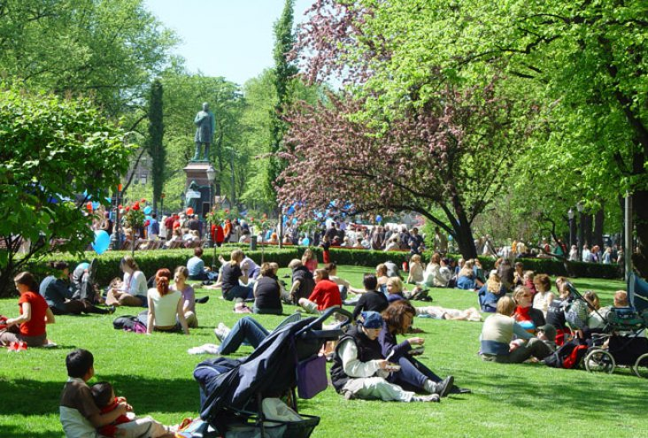
Esplanade Park
Bargnesi Milena
Secchiaroli Maria Livia
Valentini Aurora
Situated in the heart of Helsinki, the Esplanade Park serves as a promenade for visitors and a place to relax for the locals.

Slide 12
Bargnesi Milena
Secchiaroli Maria Livia
Valentini Aurora
The Cathedral has become the symbol of the whole Helsinki.

Slide 13
Senate Square is dominated by four buildings:
Helsinki Cathedral,
the Government Palace,
University of Helsinki
National Library of Finland.
Bargnesi Milena
Secchiaroli Maria Livia
Valentini Aurora

Slide 14
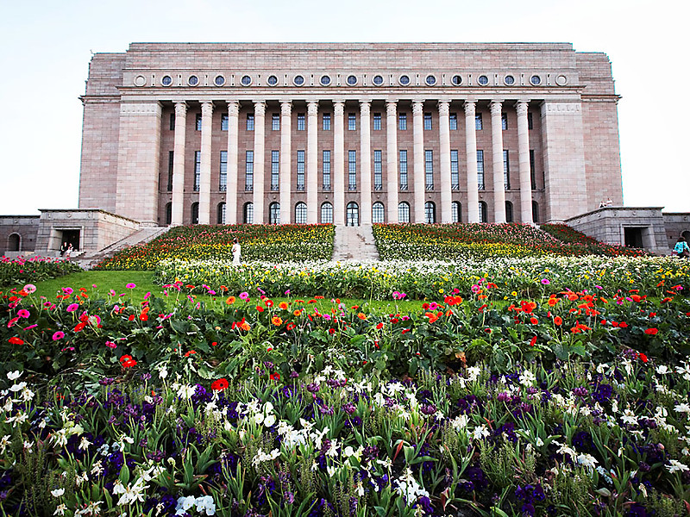
P
A
R
L
A
M
E
N
T
Bargnesi Milena
Secchiaroli Maria Livia
Valentini Aurora

Slide 15
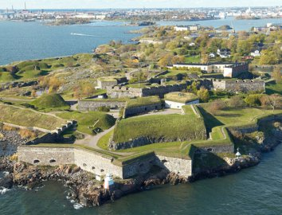
Suomenlinna Sea Fort is one of the biggest sea fortresses in the world.
Bargnesi Milena
Secchiaroli Maria Livia
Valentini Aurora

Slide 16
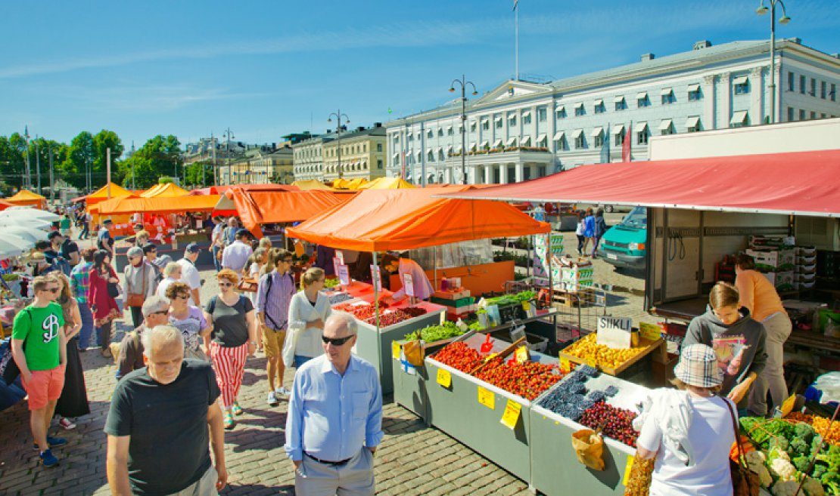
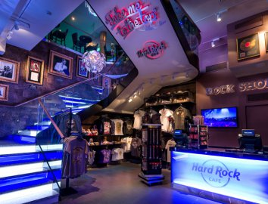
The Market Square is Helsinki's most international and famous market.
Hard Rock International has conquered the world, and now the famous brand has opened in Finland!
Bargnesi Milena
Secchiaroli Maria Livia
Valentini Aurora

Slide 17
The school where we are going to stay for a week, called KUNGSVÄGENS SKOLA.
Bargnesi Milena
Secchiaroli Maria Livia
Valentini Aurora

Slide 18
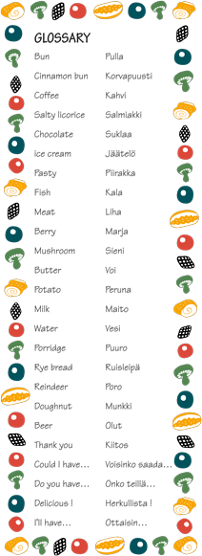
Glossary
THANK YOU! → KIITOS
WATER → VESI
CHOCOLATE → SUKLAA
MILK → MAITO
FISH → KALA
Bargnesi Milena
Secchiaroli Maria Livia
Valentini Aurora

