Slide 1
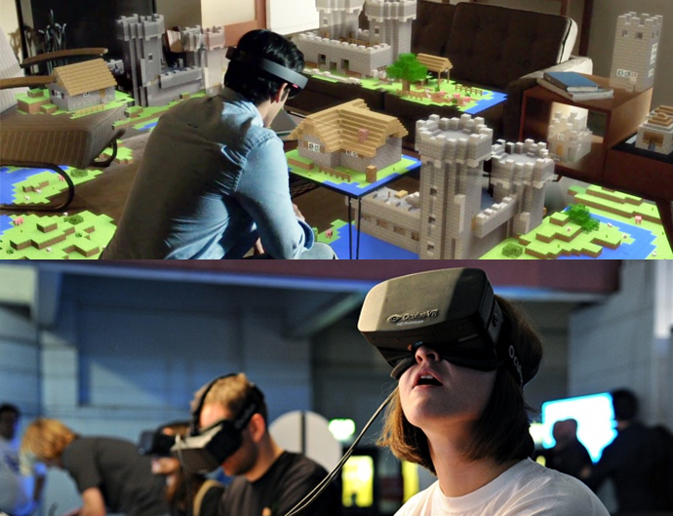
Virtual Reality & Augmented Reality

Slide 2
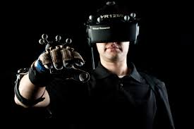
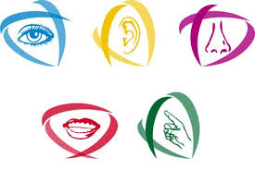
What is “VR” ?
1968
Notes:
Virtual reality allows the user to be immersed into a virtual world, unlike regular screens in front of the user which do not allow for such an experience. VR can include 3 of the 4 senses, including vision, hearing, touch and possibly even smell. With this power, VR can take people for a virtual world fairly easily. The only current problems are the availability of such hardware and the price at which it can be purchased.
The first helmet of virtual reality was create on 1968( nineteen-sixtee-height) by Ivan SUTHERLAND.

Slide 3
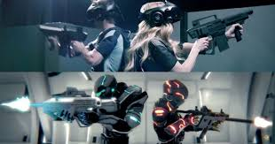
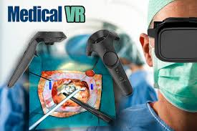
Different utilities
Virtual Reality
Notes:
You can live life experiences that you cannot do in real for example: you can fly, play games but you can also use it in medical field to treat phobias (fear of emptiness, spiders or crowds) or for the training of rescuers or soldiers

Slide 4
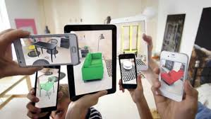
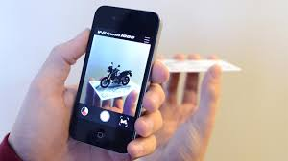
What is “AR” ?
1968
Notes:
The first helmet of augmented reality was create on 1968( nineteen-sixty-height) by Ivan SUTHERLAND.
It’s a version of reality where live direct or indirect views of physical real-world environments are augmented with superimposed computer-generated images over a user's view of the real-world

Slide 5
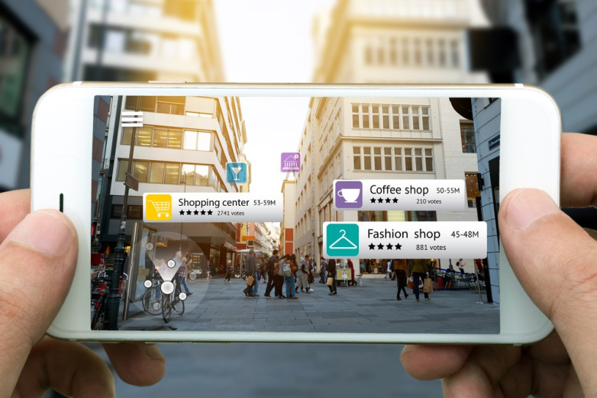
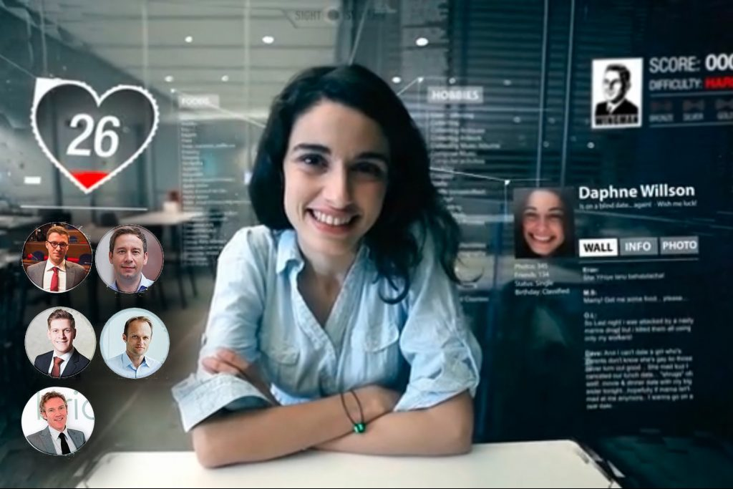
Footprints
Notes:
In the future, augmented reality could be used in digital identity to know the name and informations of people, restaurants and hotels. It could be dangerous because all the people could know everything about us ! We couldn’t have a private life ! It’s why I hope augmented reality will not be developed in digital identity.
Like any connected device that’s part of the Internet of Things. Additionally, communications between VR devices and servers might be sent unencrypted.

Slide 6
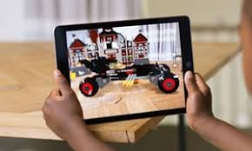
Different utilities
Augmented reality
Notes:
You can also use Augmented reality in video games and wich where you can see object in 3D. Augmented reality is more like an entertainment compared to the virtual reality. The first difference is that in augmented reality you can only have more in reality, you have more informations, more object but you are still in real life. In VR, you’ve got a whole other world, even if they represent the life as real, it’s still fake.

Slide 7
Dangers of Virtual and Augmented Reality
Virtual reality:
-Dry eye
-Troubles of head and stomach
-Cardiac risk
-Depression, violence and madness
-Confusion between the reality and the virtual
Augmented reality:
https://youtu.be/lK_cdkpazjI?t=177
We could not have private life
Notes:
The dangers of virtual reality were especially dangers for health like dry eye, troubles of head and stomach, cardiac risk or even depression, violence and madness or confusion between the reality and the virtual. Contrary augmented reality has more danger for social life because the slightest gesture can be to analyze like in video that we are going to show you (just an extract). In the video we can remark the people are examine every move

Slide 8
And you ?
What happens if someone hacks VR headsets and cause adverse real-world reactions ??
Notes:
( question aux gens de la classe )

Slide 9
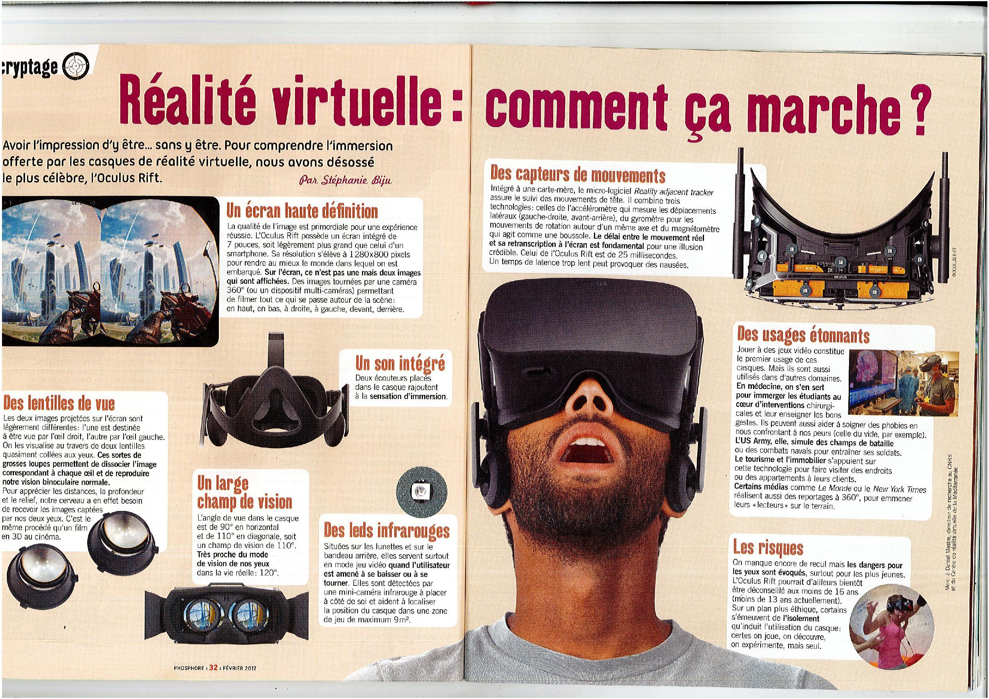
https://blog.bigmitch.io/doù-vient-la-réalité-virtuelle-575ef743a58c
BigMitch
https://www.tripwire.com/state-of-security/security-data-protection/rise-vr-impending-security-risks/
TripWire
http://www.realitytechnologies.com/augmented-reality
Reality Technologies
https://www.google.fr/
Google / Google Images
Sources

