Slide 1
WESTERN EUROPE WESTEUROPA WEST-EUROPA
2019-1-NL01-KA229-060290
Project title: Inside Out
Project Nr. 2019-1-NL01-KA229-060290
IRELAND, THE NETHERLANDS, GERMANY
IRLAND, NIEDERLANDE, DEUTSCHLAND
By Erasmus+ project team
The European Commission's support for the production of this publication does not constitute an endorsement of the contents, which reflect the views only of the authors, and the Commission cannot be held responsible for any use which may be made of the information contained therein.

Slide 2
FLAGS

Slide 3
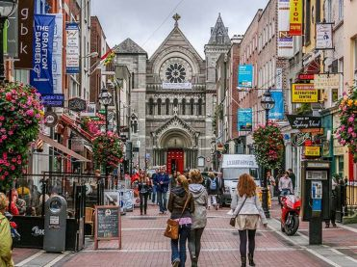
IRELAND

Slide 4
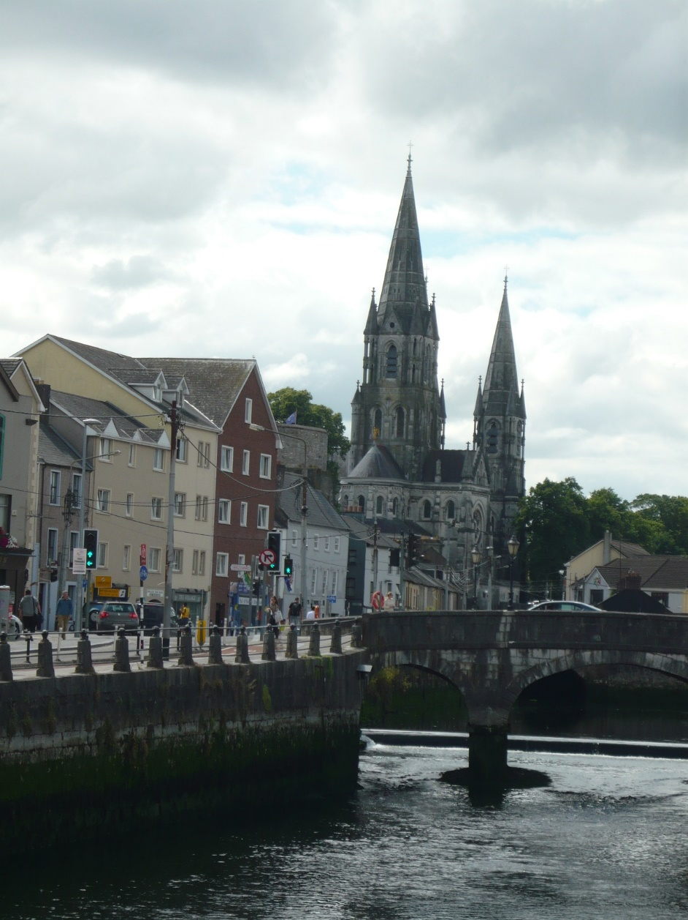
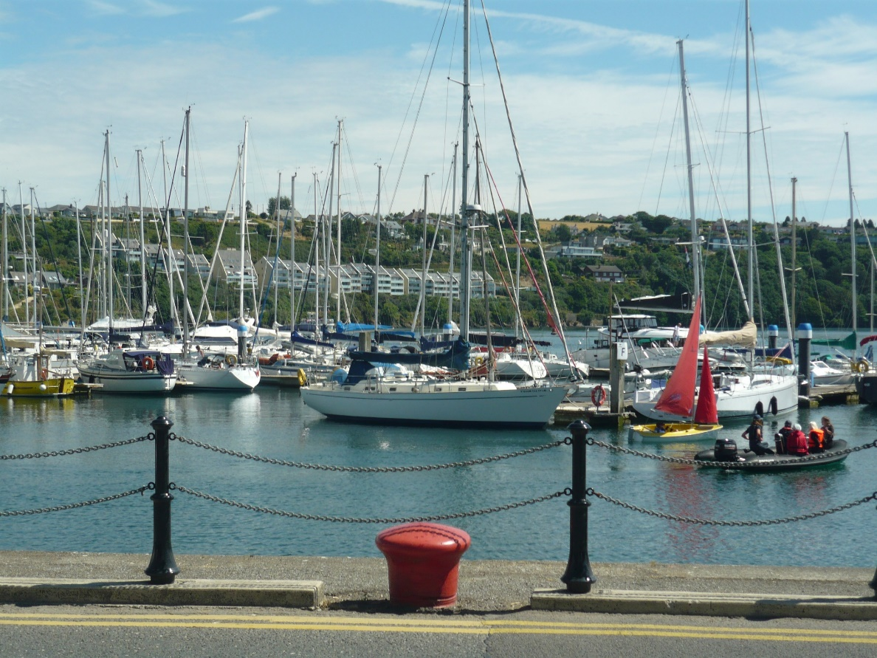
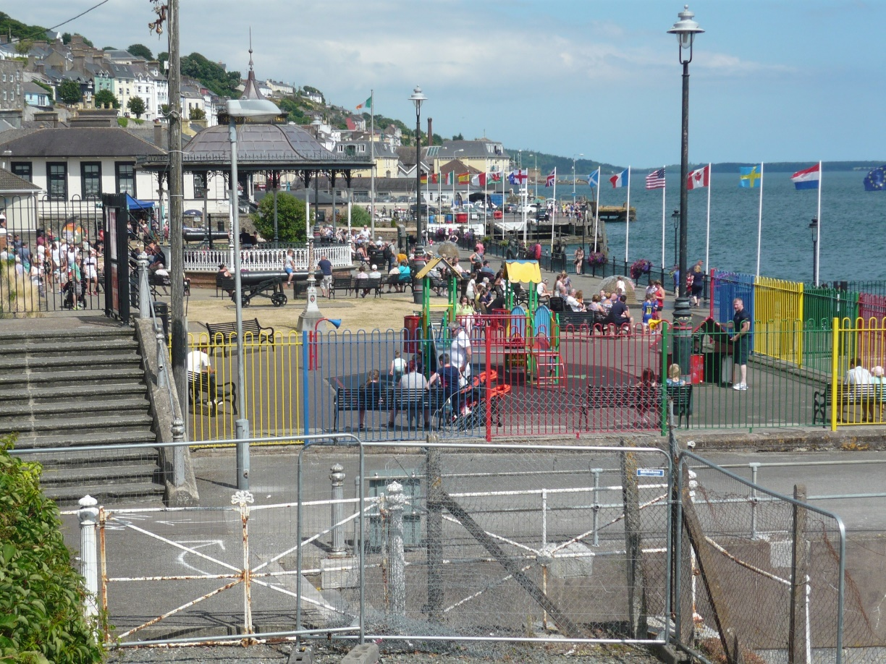

Slide 5
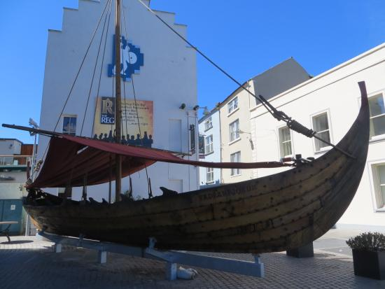
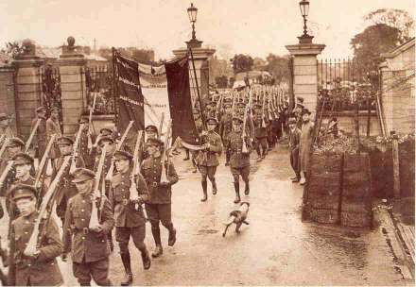
History

Slide 6
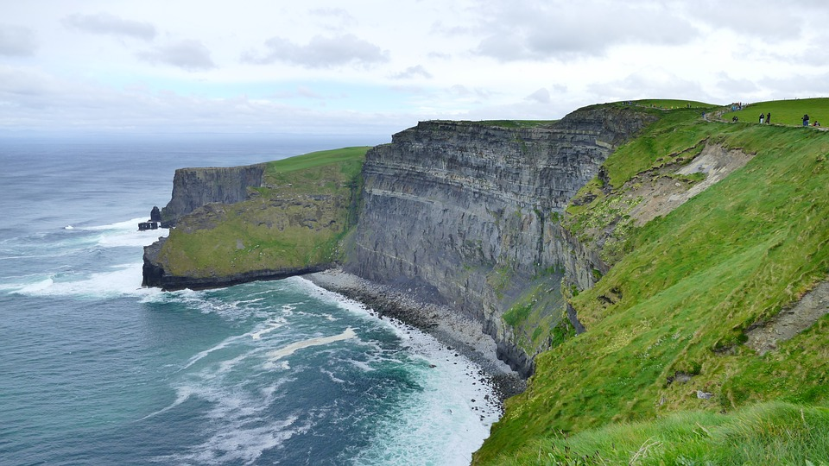
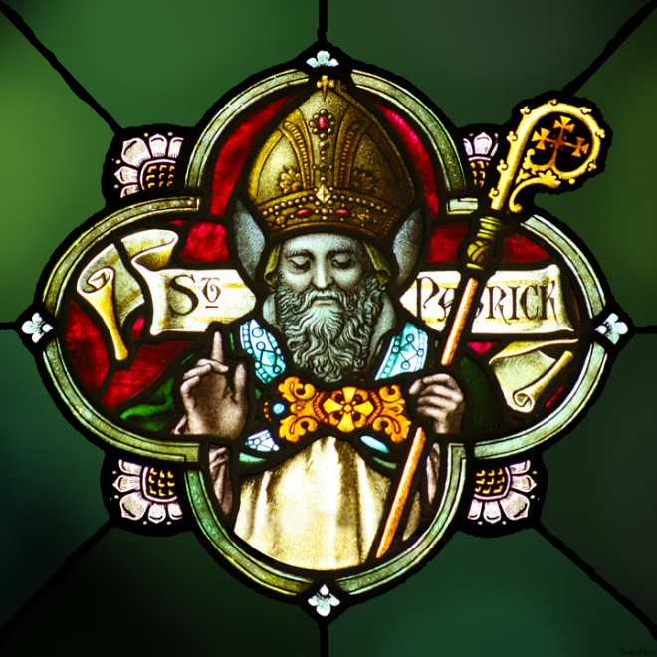
Interesting facts
The most beautiful place – the Cliffs of Moher
There are no snakes on the island
In the USA there live more people of Irish origin than in Ireland
The 17th of March is a public holiday (St Patrick’ s Day)

Slide 7
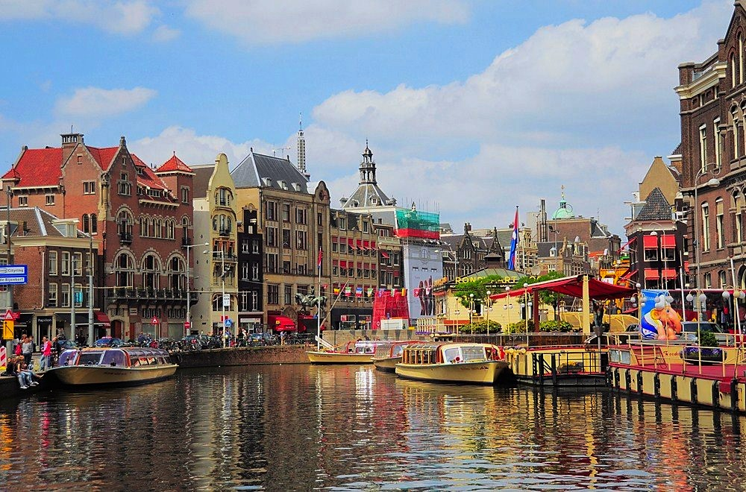
THE NETHERLANDS

Slide 8
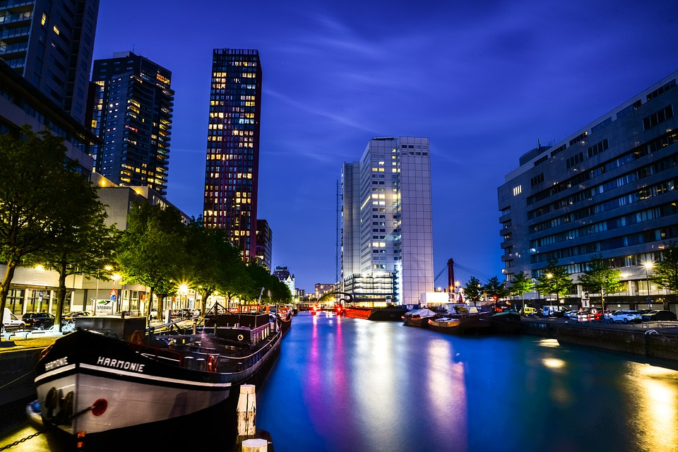
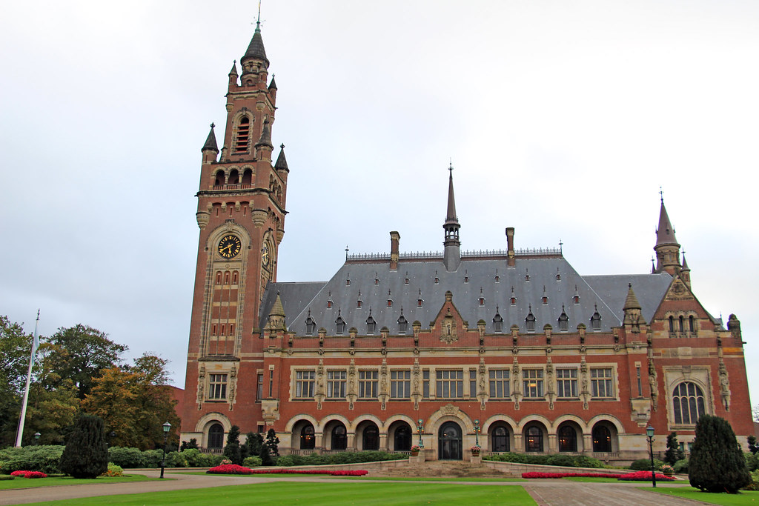
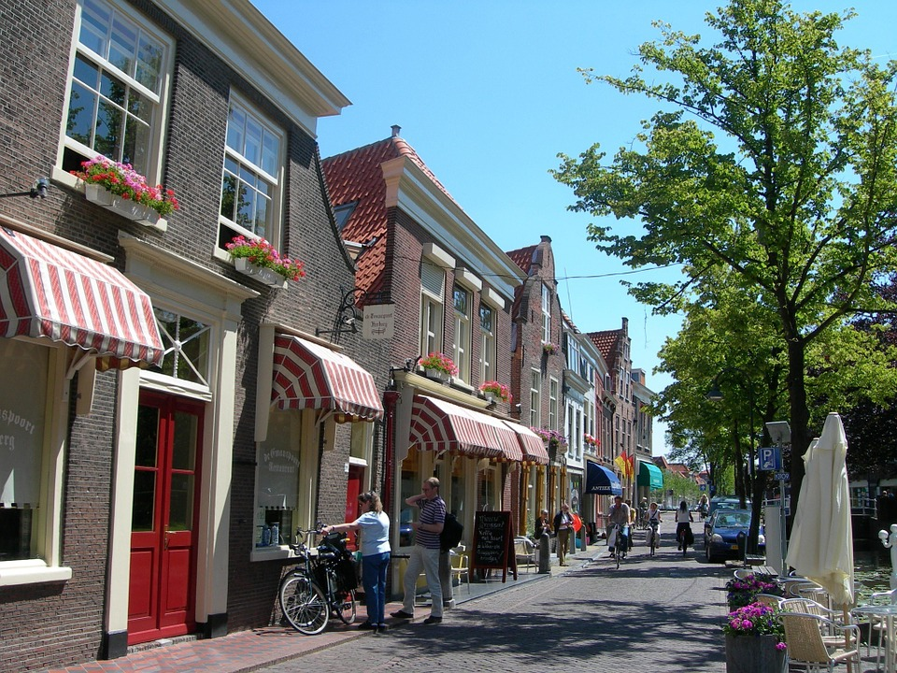

Slide 9
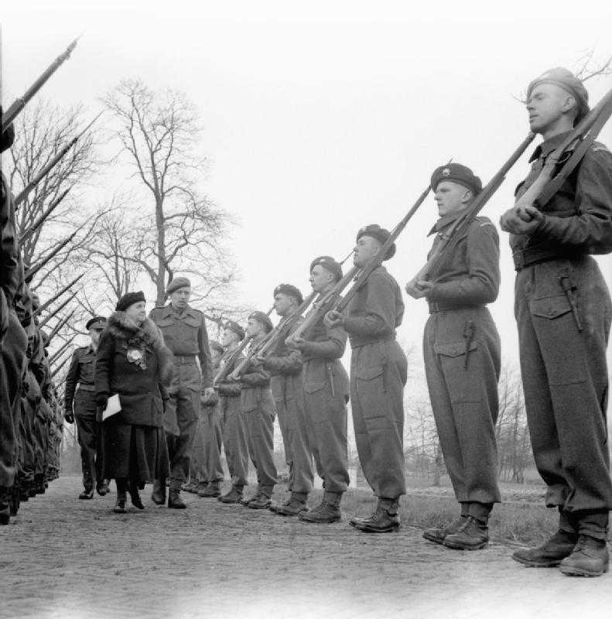
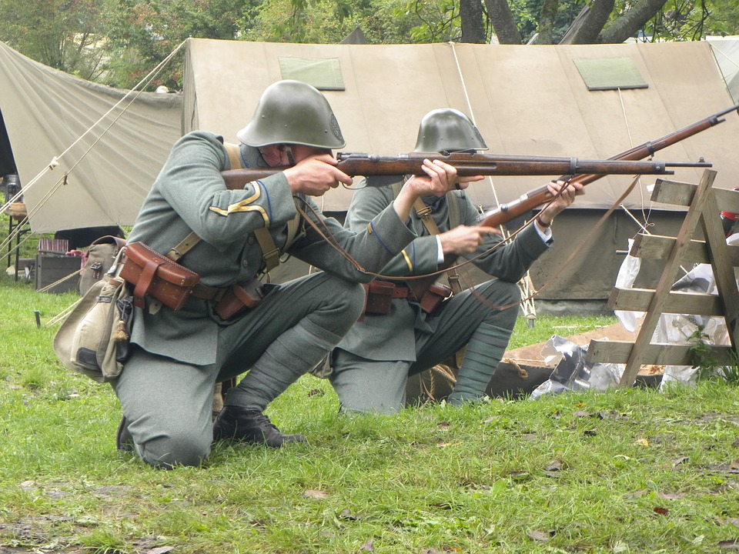
History
The first people: Germans and Celts, later Romans
They didn’t participate in the First World War
In the Second World War they were invaded by nazi Germany

Slide 10
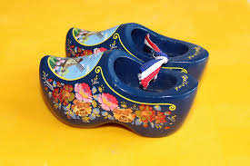
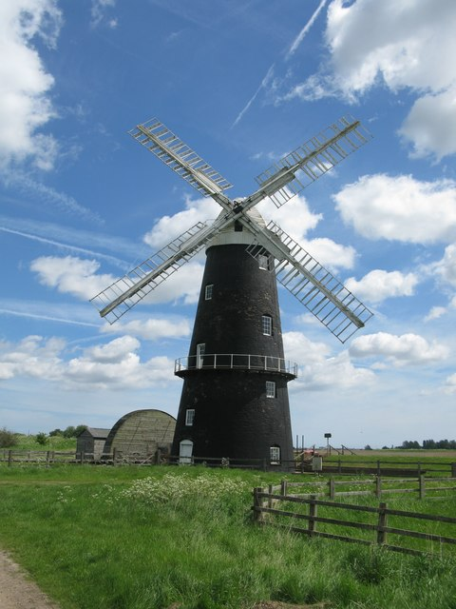
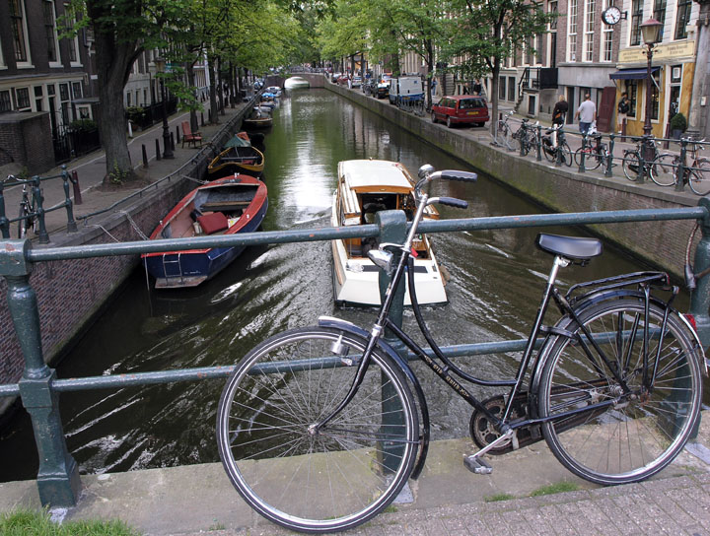
Interesting facts
The country is famous for things such as: tulips, windmills, cheese, clogs, culture (a lot of painters came from the Netherlands)...
Many people go to school, work by bike
There are many bridges in a lot of dutch towns and cities
They have many famous and good sportspeople, especially in football, cycling, speed skating, tennis and more

Slide 11
DEUTSCHLAND
Wappen von Deutschland
Flagge von Deutschland

Slide 12
Mappe von Deutschland

Slide 13
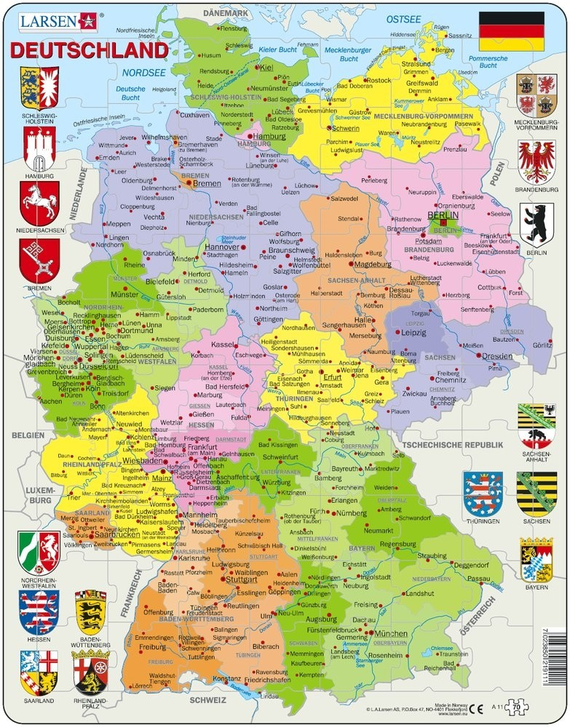
Regionen von Deutschland
Bádensko – Wúrttembersko, Bavorsko, Berlín, Brandenbursko, Brémy, Hamburg, Hesensko, Meklenbursko-Predpomoransko, Dolné Sasko, Severné Porýnie – Vestfálsko, Porýnie – Falcko, Sársko, Sasko, Sasko – Anhaltsko, Šlezvicko – Holšteajnsko, Durínsko

Slide 14
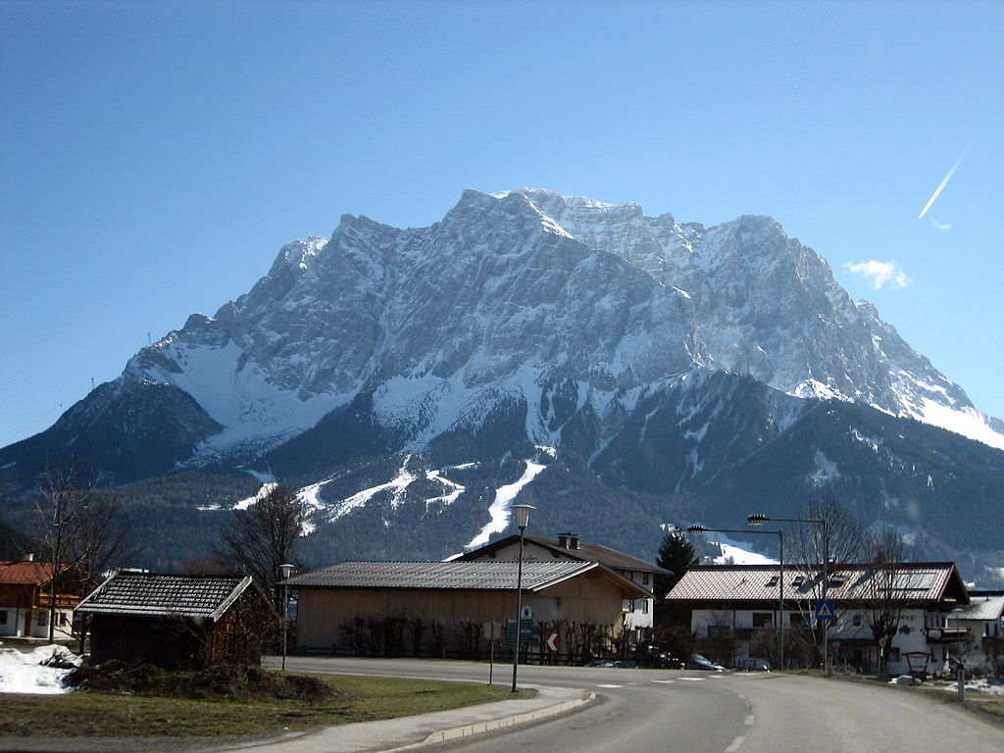
Punkte des Interesses
Zugspitze
Auschwitz – Birkenau

Slide 15
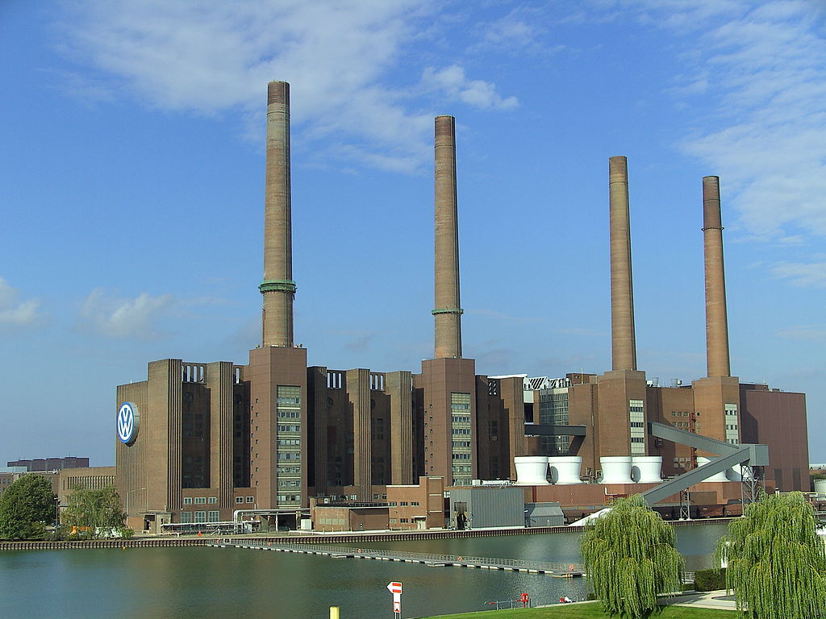
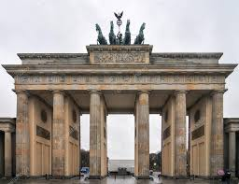
Brandenburger Tor
Fabrik Volkswagen

Slide 16
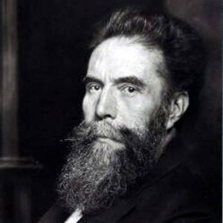
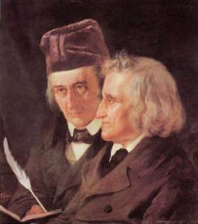
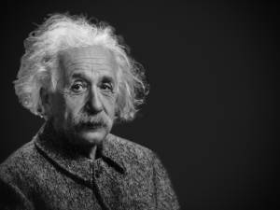
Persönlichkeiten
Ludwig van Beethoven
Wilhelm Conrad Rontgen
Jacob und Wilhelm Grimms
Albert Einstein

Slide 17
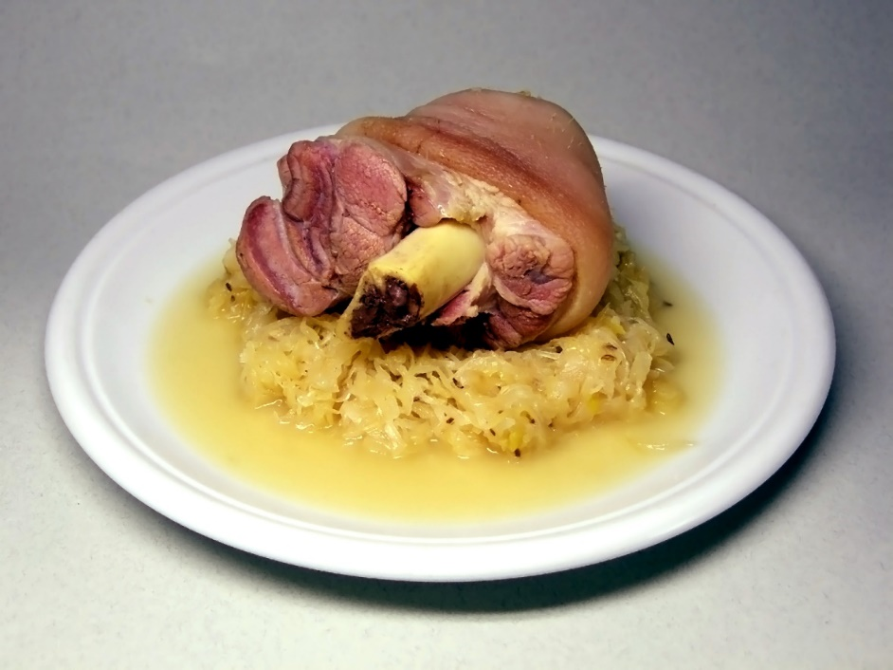
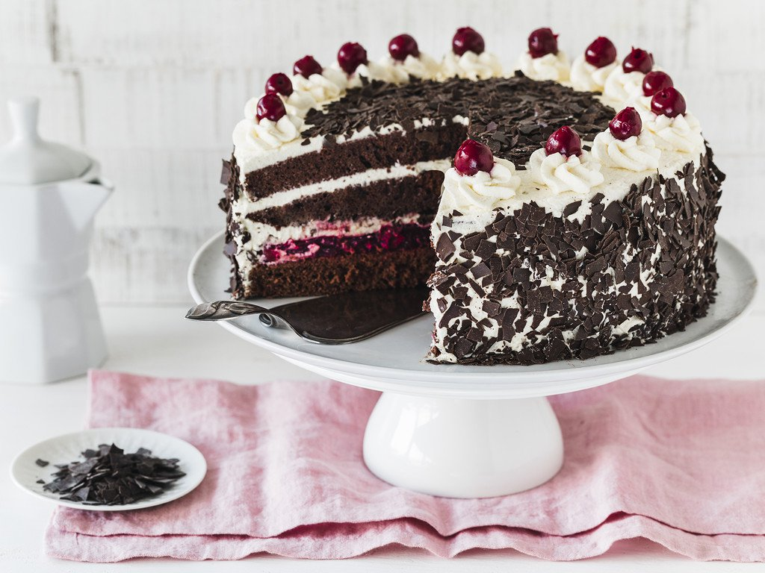
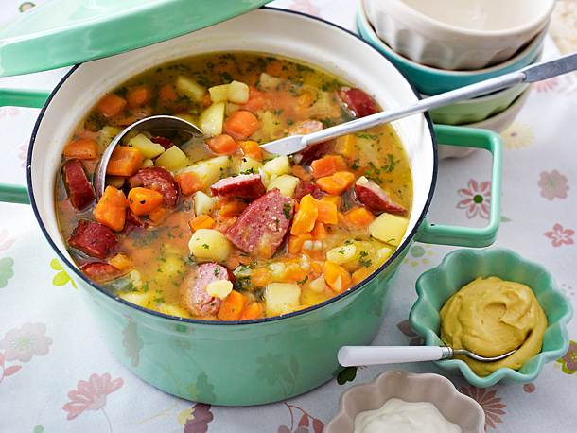
Deutsches Essen
Eisbein
Bratwurst
Schwarzwälder Kirschtorte
Eintopf

Slide 18
https://www.jigsawplanet.com/?rc=play&pid=0331a1f79f88 puzzle Kinsale
https://www.jigsawplanet.com/?rc=play&pid=3da2a012309d map of Ireland puzzle
https://www.jigsawplanet.com/?rc=play&pid=01aab1f9c729 puzzle The Netherlands

Slide 19
Resources:
https://www.publicdomainpictures.net/en/view-image.php?image=241800&picture=irish-flag
https://www.publicdomainpictures.net/en/view-image.php?image=241621&picture=german-flag
https://en.wikipedia.org/wiki/File:Flag_of_the_Netherlands.svg
http://www.proyectosalonhogar.com/Salones/Matematicas/Historia_Mat/histmat/html/dysert.html
https://www.geograph.org.uk/photo/2003670
https://www.tripadvisor.ie/Attraction_Review-g186638-d3138381-Reviews-The_Viking_Triangle-Waterford_County_Waterford.html

Slide 20
http://www.theirishstory.com/2017/09/01/the-dalkey-column-an-irish-civil-war-story/fs-troop-march-into-barracks/#.XYZhQ1UzbIU
https://pixabay.com/sk/photos/%C3%BAtesy-moher-%C3%ADrsko-na%C5%A1%C3%ADrku-2641966/
https://www.publicdomainpictures.net/en/view-image.php?image=112122&picture=shamrock-for-st-patricks-day
https://www.flickr.com/photos/donkeyhotey/13222409233
https://www.flickr.com/photos/44534236@N00/5866586357
https://www.flickr.com/photos/129231073@N06/24964152357
https://pixabay.com/sk/photos/delft-holandsko-holland-ulice-165261/
https://commons.wikimedia.org/wiki/File:The_Dutch_Royal_Family_in_Exile_during_the_Second_World_War_BU1927.jpg
https://pixabay.com/sk/photos/wwii-vojak-holandsko-vojenskej-1520621/

Slide 21
https://www.publicdomainpictures.net/en/view-image.php?image=247149&picture=tulips
https://www.geograph.org.uk/photo/5411355
https://www.maxpixel.net/Decorative-Culture-Dutch-Clogs-The-Tradition-Of-2947984
https://commons.wikimedia.org/wiki/File:BikesInAmsterdam_2004_SeanMcClean.jpg
https://www.orbistour.eu/vyznamne-osobnosti-nemecka.xhtml https://sk.wikipedia.org/wiki/Nemecko https://www.invia.sk/nemecko/miestna-kuchyna/ https://www.einfachbacken.de/rezepte/schwarzwaelder-kirschtorte-das-klassische-rezept https://en.wikipedia.org/wiki/Eisbein https://www.daskochrezept.de/rezepte/grundrezept-fuer-eintopf-jeder-art_246549.html https://tasteofartisan.com/homemade-bratwurst-recipe/

