Slide 2
SOCIAL INCLUSION

Slide 3
What is Social Inclusion
Social inclusion covers all the actions that lead to the equal participation of everyone in the society, regardless their social class,physical condition, education, gender, sexual orientation, ethnicity, among other aspects. In short, social inclusion is to offer equal opportunities of access to welfare and services to all.

Slide 4
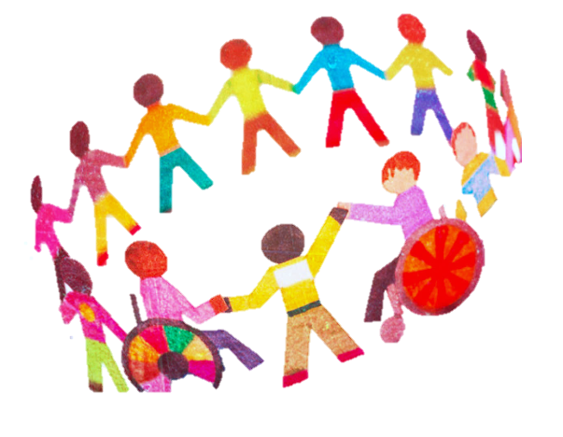
Inclusive measures/Inclusive School
Education of students with Educational Special needs;
Students of the gypsy ethnicity;
Inclusion of students who are children of immigrants from European eastern countries, from China and also from Brazil.

Slide 5
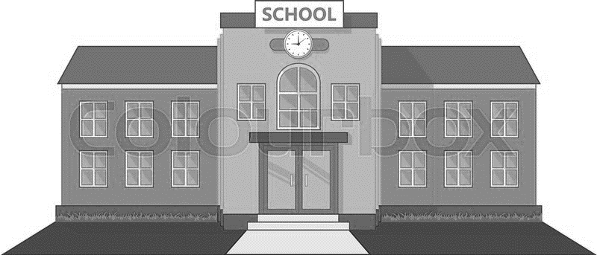
Inclusive School: education of students with Special Needs (Decree 3/2008)
State schools and the compulsory schooling were some of the best “inventions” of modern times

Slide 6
Inclusive School: education of students with Special Needs (Decree 3/2008)
Nowadays, having a state school in which attendance is compulsory is not enough though. More than ever a state school must:
be for everyone in practice and not just in the law;
grant an opportunity for all to attend it for a longer period of time than before;
be able to allow all to increase their knowledge;
be capable of granting all this without any kind of discrimination.

Slide 7
Inclusive School: education of students with Special Needs (Decree 3/2008)
Schools must have the appropriate means to answer the needs/rights of each child/youngster. If the social exclusion prevents the access to the rights of citizenship, the INCLUSION and the social participation represent the opposite.

Slide 8
Decree 3/2008 – 7th January
INCLUSIVE SCHOOL
It has the purpose of the teaching/learning process being aimed at all students’ success;
It takes for granted the practice of principles, values and fundamental tools to the equality of opportunities for all;

Slide 9
INCLUSIVE SCHOOL
Taking into account the rules and regulations of this legislation, and always taking for granted the equality of opportunities for all
OUR SCHOOL
adapts the law to the profile of functionality of each student;
tries to develop: the students’autonomy, socialization and integration in the active life as these are fundamental aspects in their personal and social upbringing.

Slide 10
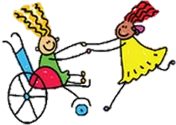
Activities that our school offers
Music;
Plastic Expression;
Swimming;
Adapted Dance;
Adapted Physical Activity;
Boccia;
Body Expression.
These activities which seem to be entertaining but which really are important for the upbringing of students with serious difficulties;

Slide 11
Last but not least,the Individual Plan of Transiction developed in a labour context aims at
integrating the students in the labour world; it occurs in the last three years of the compulsory schooling time or when they are fifteen years old.

Slide 12
Unity of support to the multi handicapping
It also exists at our school
For students with more serious mental and physical difficulties
In this kind of classroom, these students develop functionally-related competences, which, in turn, lead to a greater personal autonomy.
Apart from the previously-mentioned activities that the school offers, these students are also granted: -speech therapy; -occupational therapy; -fisiotherapy.
These therapies will help the students curb some of their specific needs.

Slide 13
Students of the gypsy ethnicity
We have been having the gypsy community in our region for some decades. However their way of life and of being part of the society have been changing along the years. They stopped being nomads and instead they started to settle down in the surroundings of a village / a small town. This change in their way of life has brought with it more children attending our school.

Slide 14
Students of the gypsy ethnicity
AT OUR SCHOOL
There is a considerable number of students of the gypsy ethnicity attending it.
CHALLENGES TO THE INTEGRITY
Lots of absences from lessons;
Lack of hygiene;

Slide 15
Students of the gypsy ethnicity
In spite of all the conditions offered by our school and of all the changes that have been happening in the core of the gypsy community itself along the past years, their complete inclusion at school still is sometimes challenging.

Slide 16
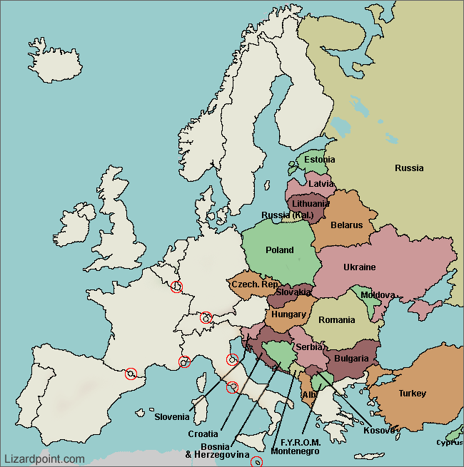
Inclusion of students who are children of immigrants from European eastern countries, from China and also from Brazil
Eastern countries
As our school is inserted in a traditionally-producing -apple region, immigrants from Eastern countries have been settling in our region. They sometimes bring along their children at their schooling-time age who then attend our school.

Slide 17
Inclusion of students who are children of immigrants from European eastern countries, from China and also from Brazil
China
As the Chinese trading / commerce activities have been increasing in some European countries, Moimenta da Beira has not been na exception to this real trend. That’s why we also have some students attending our school who come from China. Some of them were born in China, some others in Portugal, yet they try to keep their culture and language alive.

Slide 18
Inclusion of students who are children of immigrants from European eastern countries, from China and also from Brazil
Brazil
There are some Brazilian students attending our school. However, they are few in comparison to the national data.

Slide 19
MAIN BARRIERS
Tackling down this barrier by allowing these students to have individual support in this area
All the educational community works with the aim of helping these students to overcome their difficulties.

Slide 20
In short, taking into account the previously-mentioned summarized aspects, we may conclude that although our school is situated in a hinterland small town, the policy of Social Inclusion is a reality.

