Slide 1
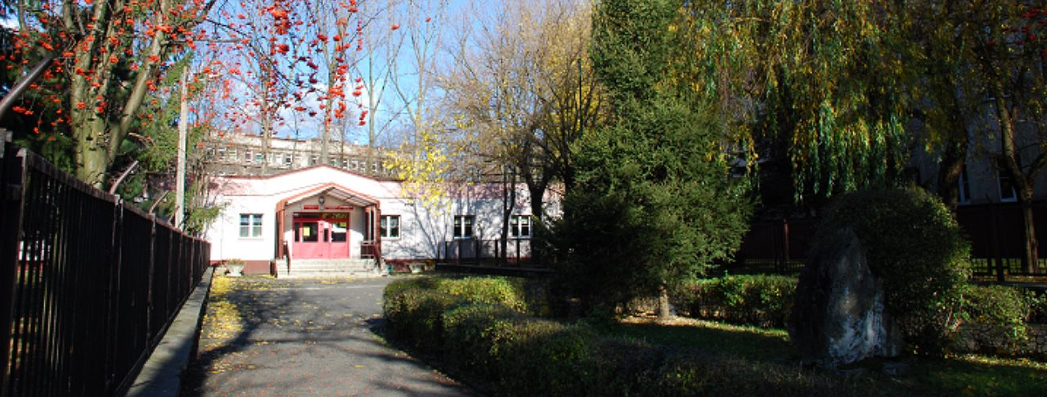
Szkoła Podstawowa nr 2 w Czeladzi

Slide 2
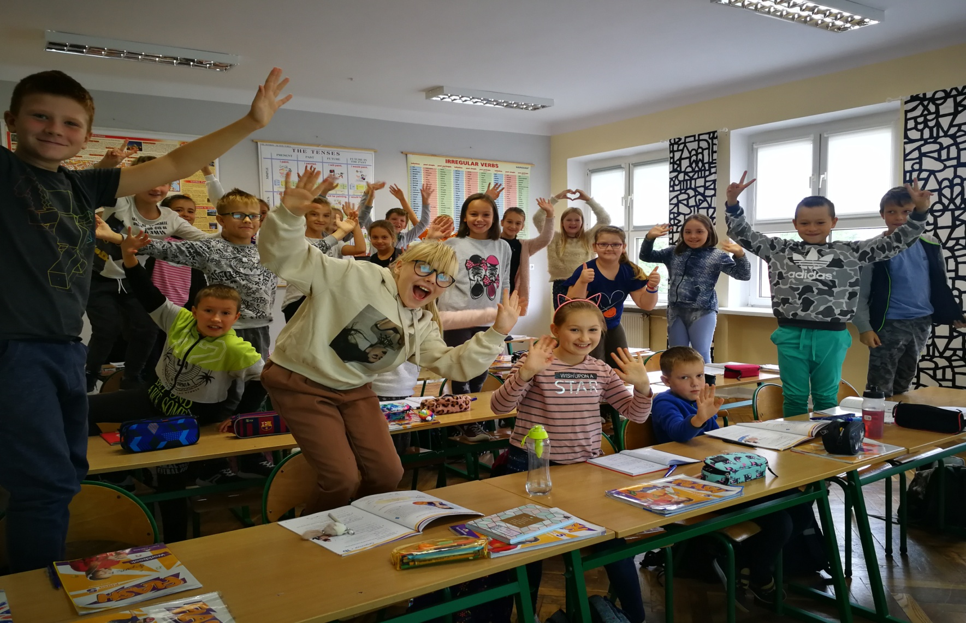
There are 566 students in our school from the age of 8 to 15

Slide 3
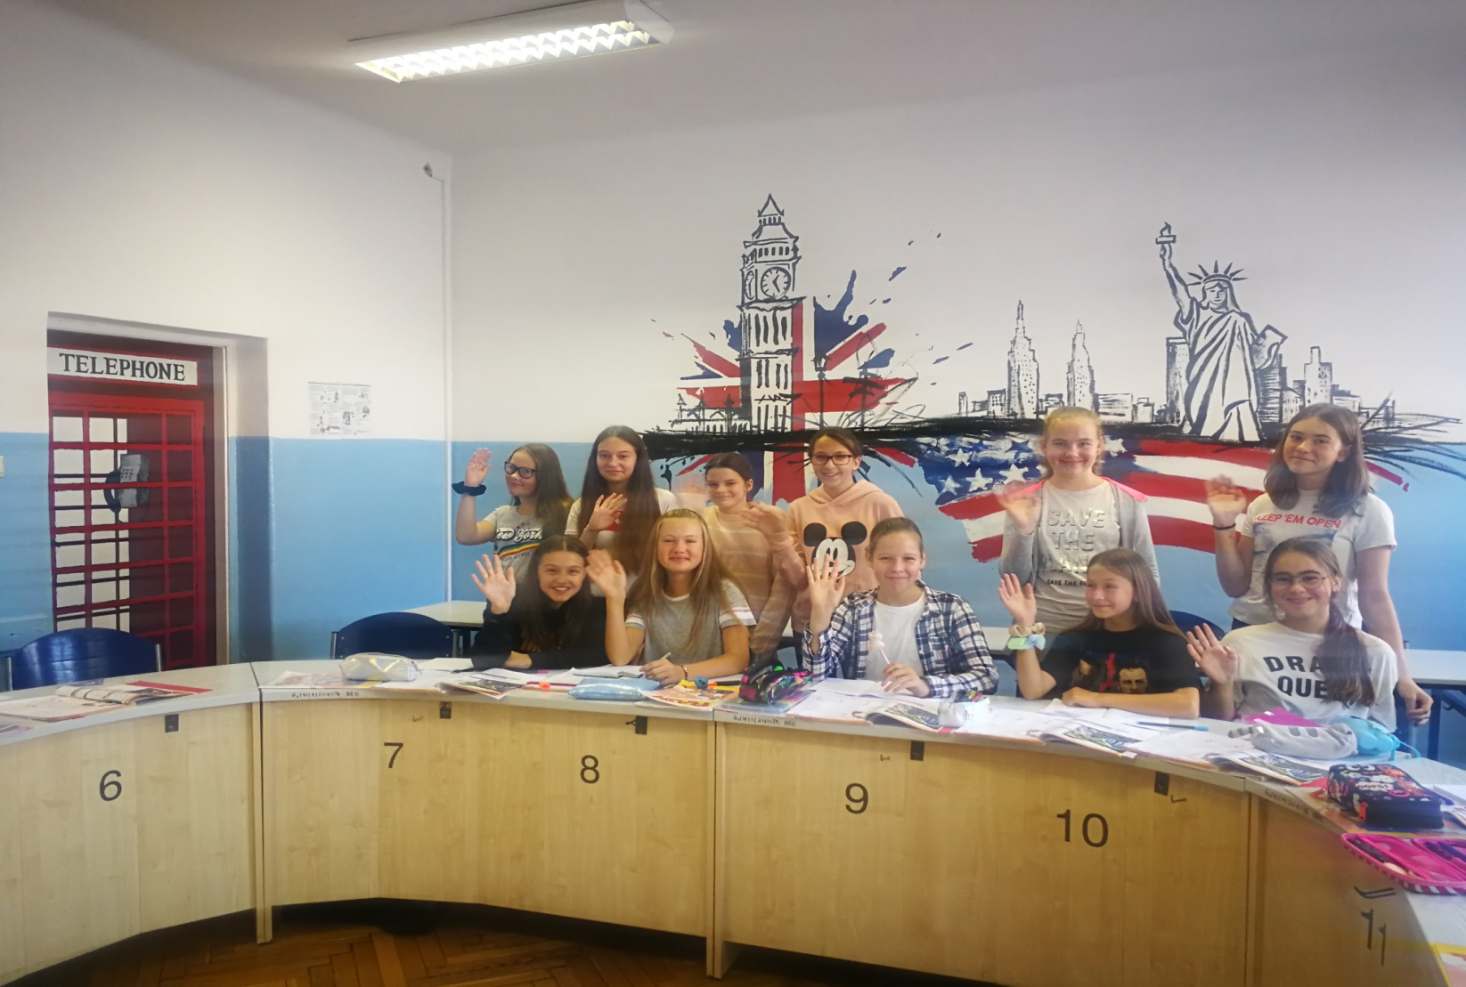
Our students learn two foreign languages: English and German

Slide 4
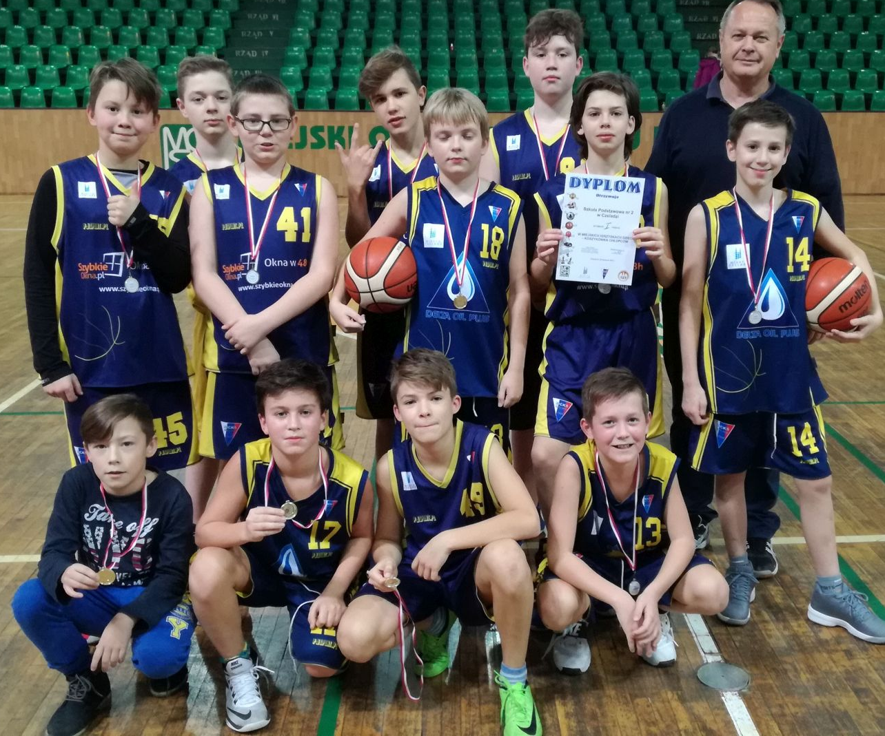
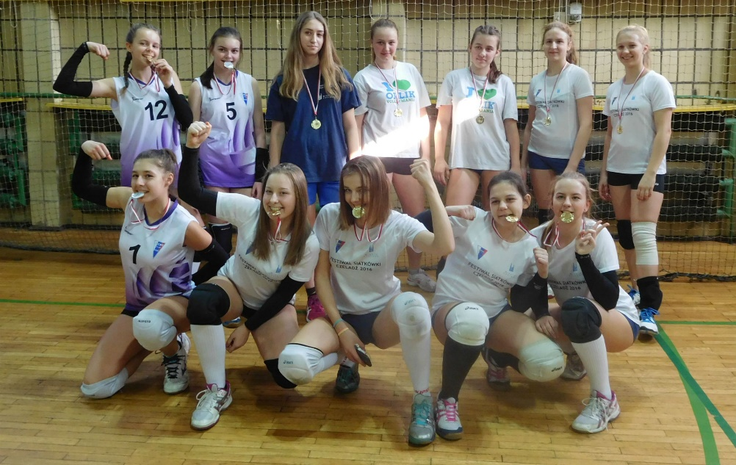
There are sports classes on each level. Girls train volleyball and boys train basketball.

Slide 5
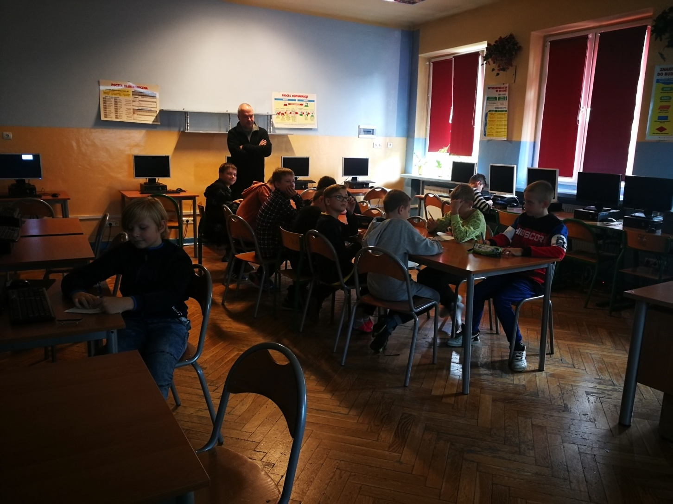
In our school students have the opportunity to learn in well-equipped labs and classrooms

Slide 6
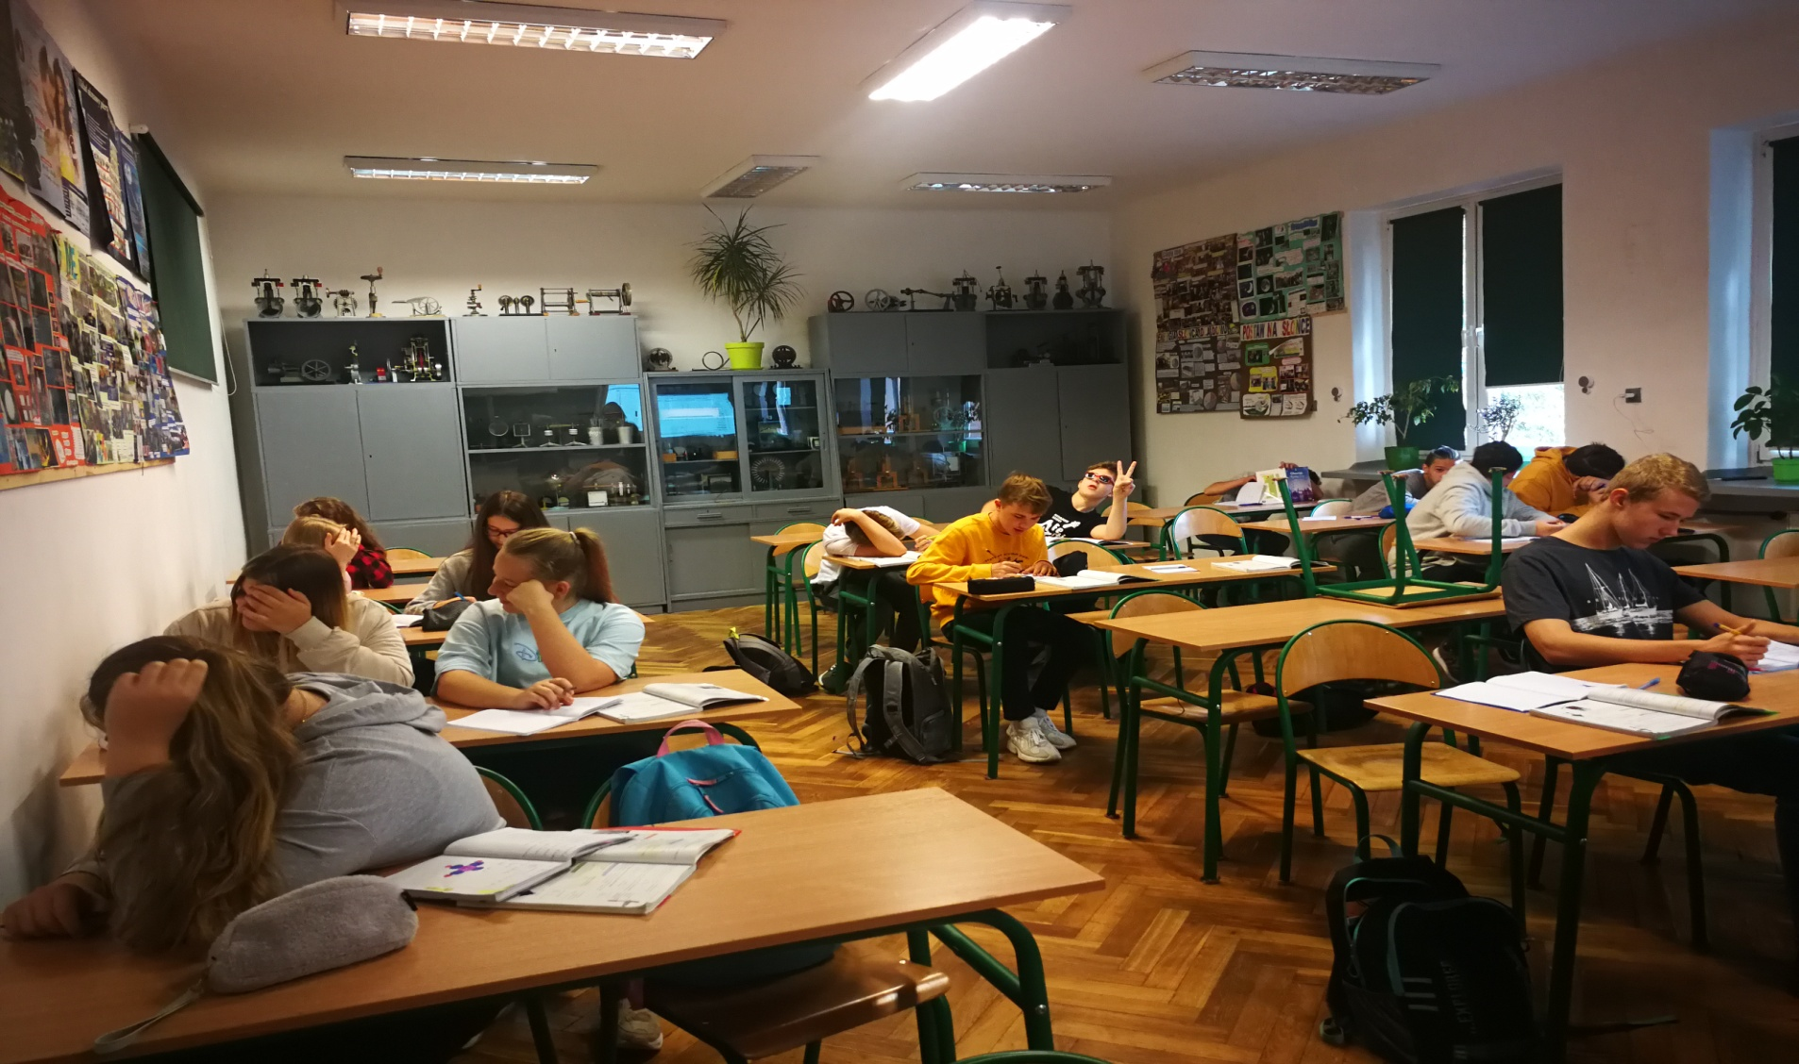
Science laboratory

Slide 7
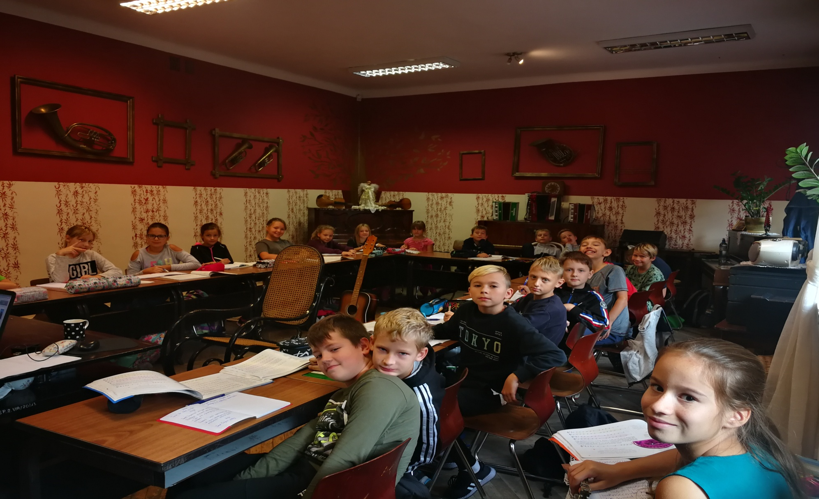
Music classroom

Slide 8
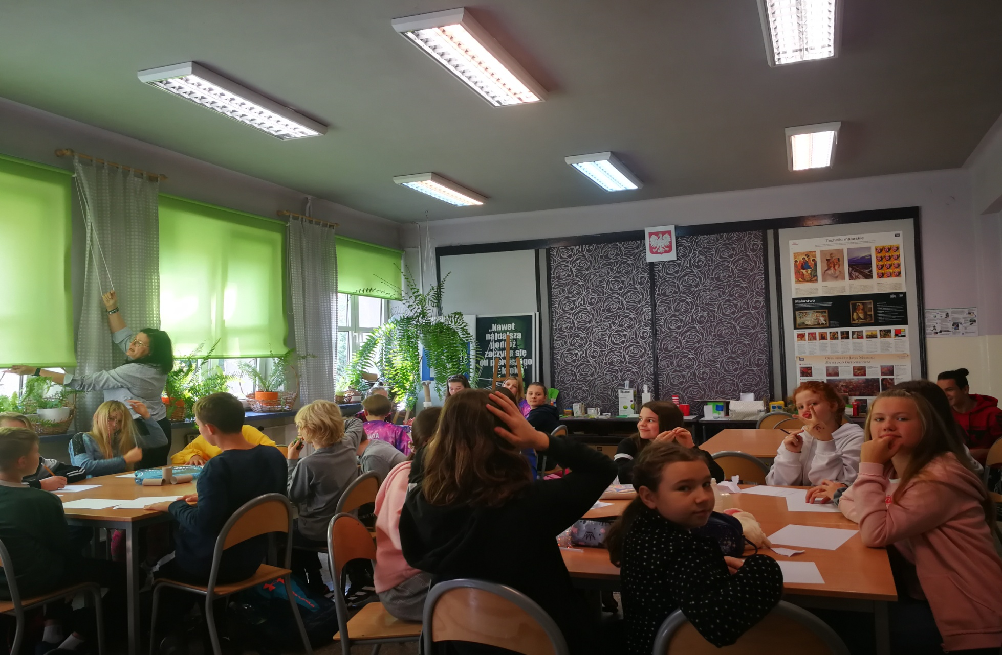
Art classroom

Slide 9
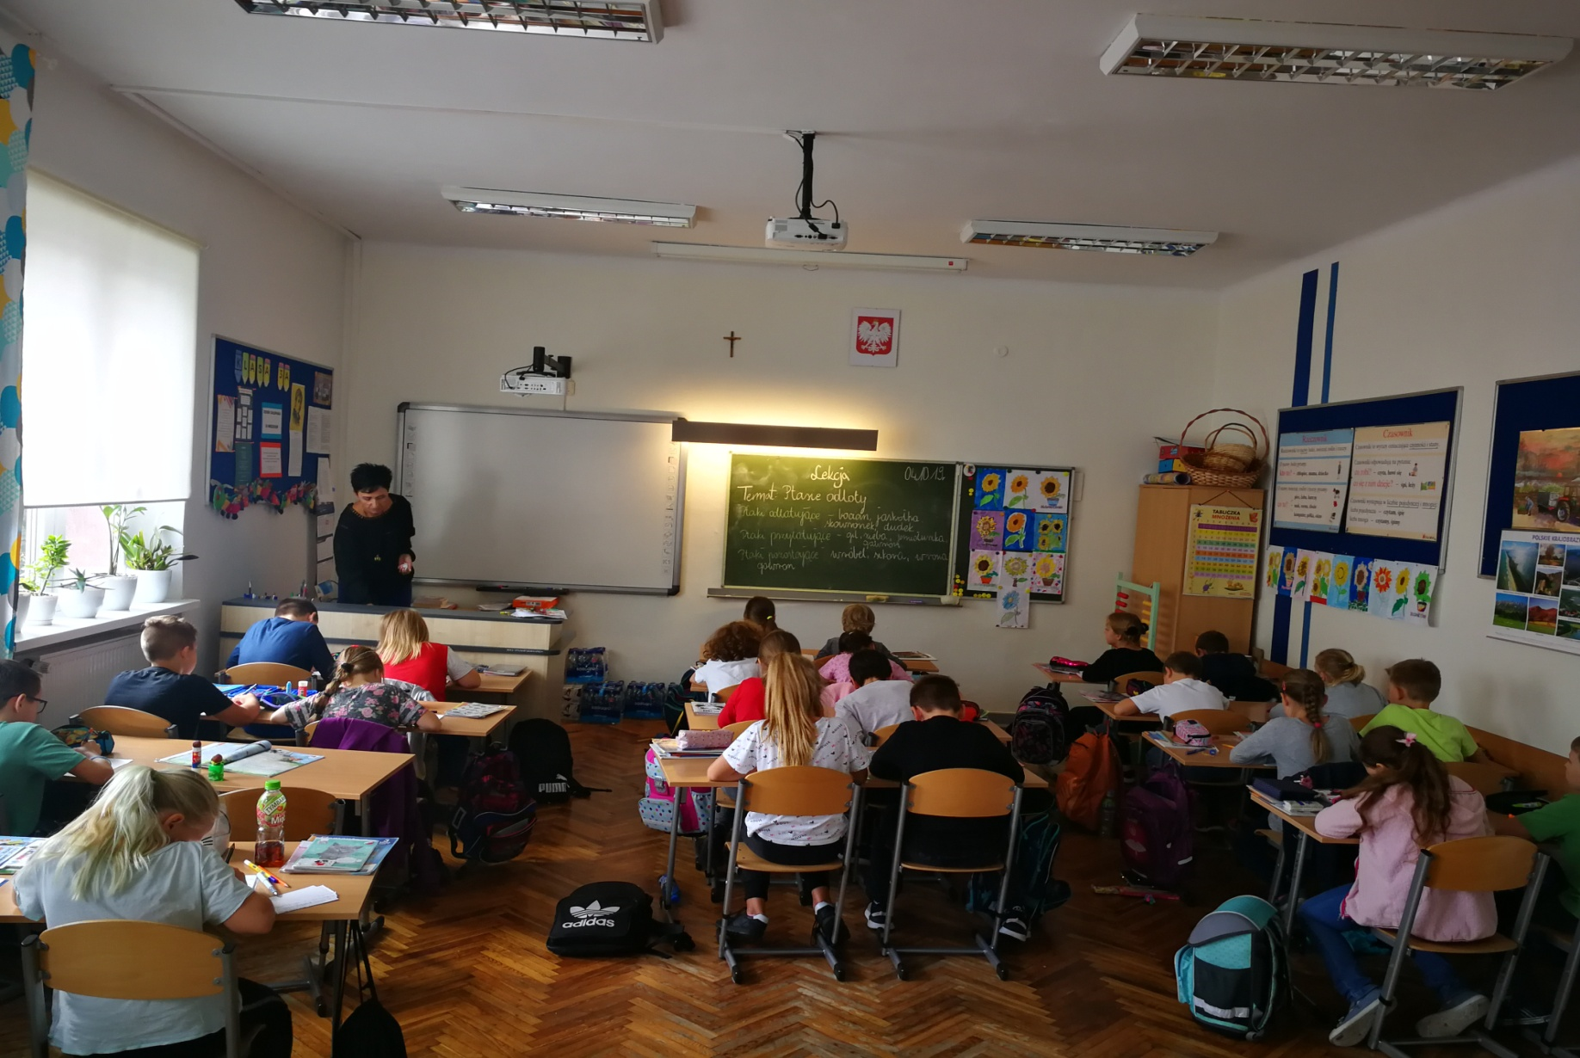
Young students’ classroom

Slide 10
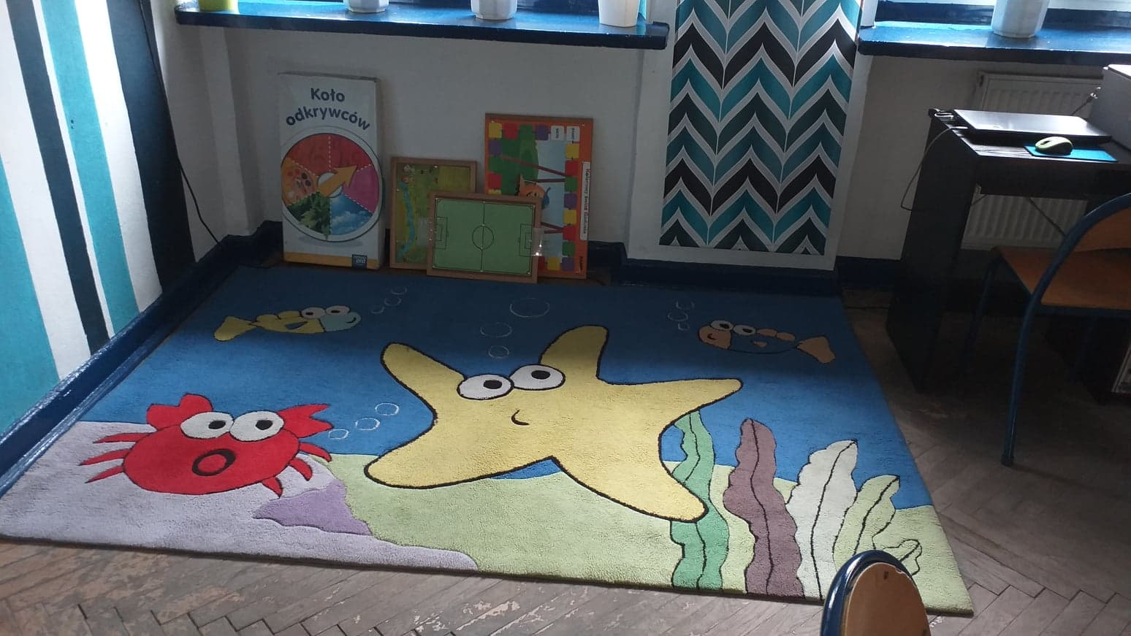
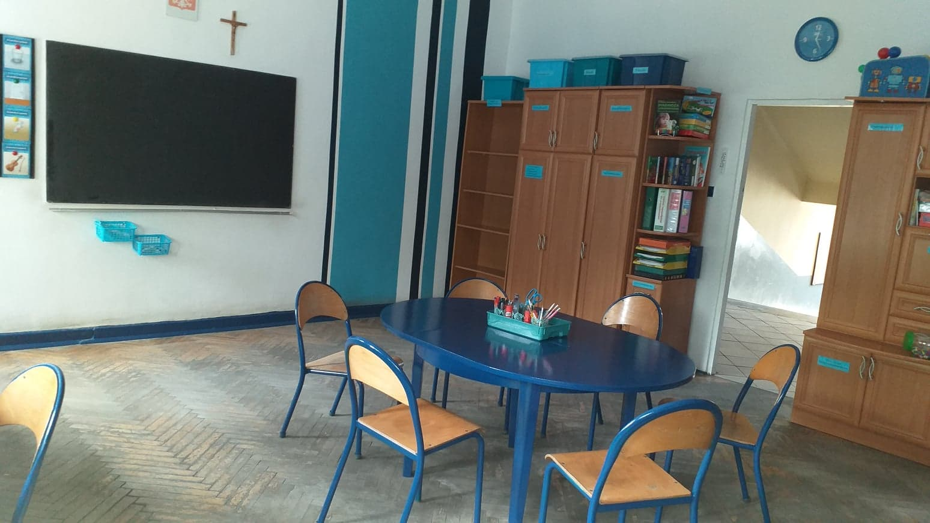
The therapeutic room for students with special needs

Slide 11
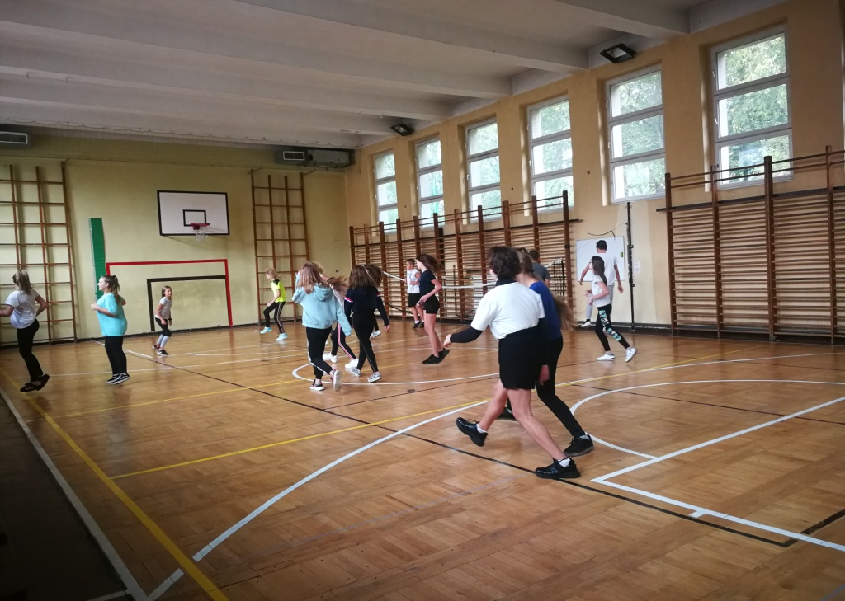
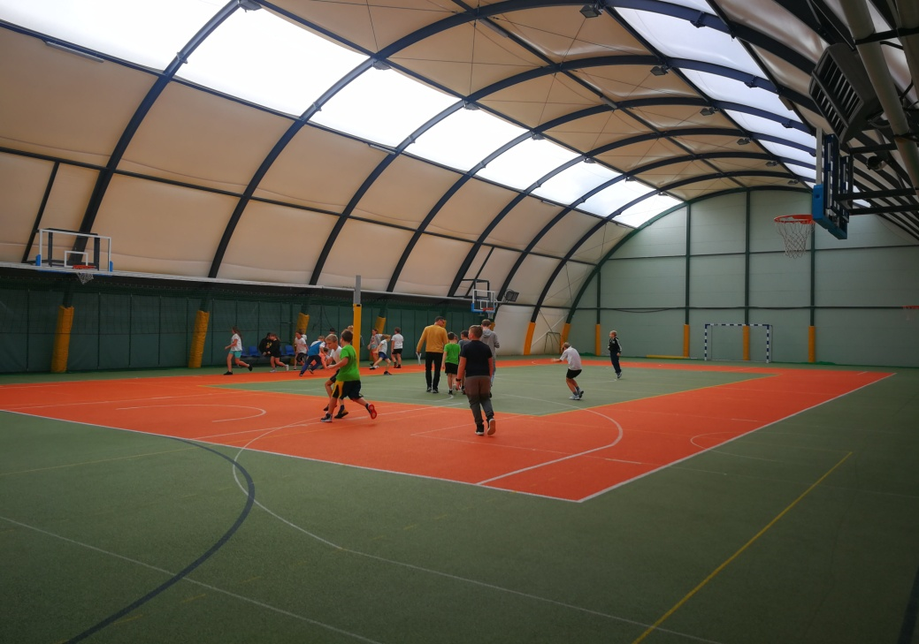
Our sport classes can train basketball and volleyball in two gyms and a new sports hall

Slide 12
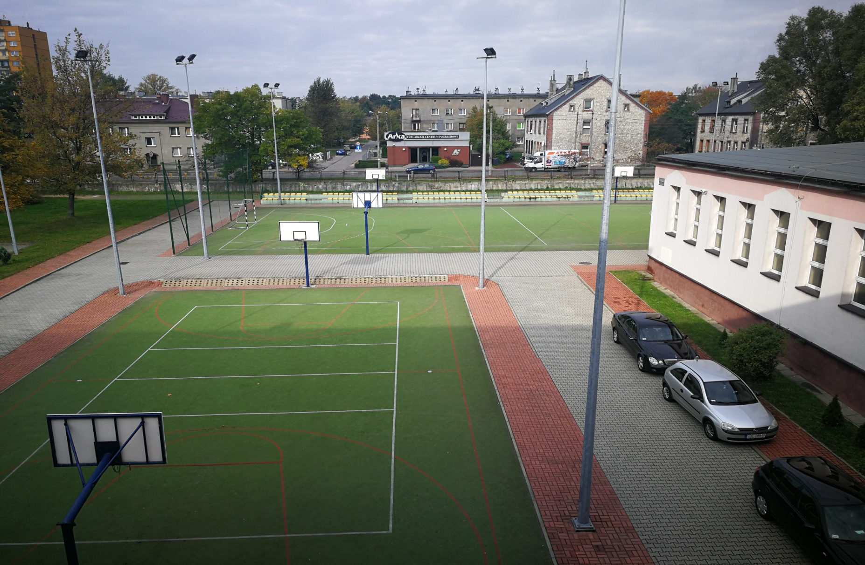
There is also a basketball court
and a football pitch outside

Slide 13
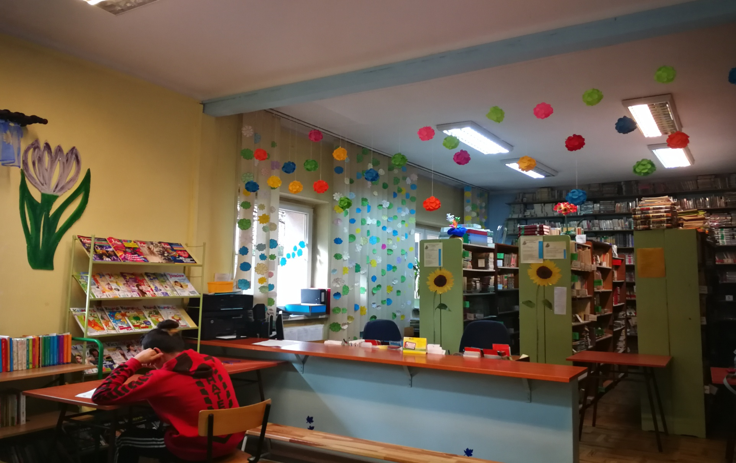
Our school library

