Slide 1
1916 The First Step..

Slide 2
Learning Outcomes
To understand the events which lead to the rising.
To recognise the people involved.
To know the results of the rising.

Slide 3
Ireland seeks Independence
Ireland had been a colony of Britain for almost 800 years.
Some rebellion had failed during that time.
In 1916 Irish rebels tried to overthrow the British in Dublin by staging a rebellion.
It failed and many rebel leaders were executed by the British forces afterwards.
Irish people were keen to support Irish politicians in the British elections that followed.
Sinn Féin, the Irish political party won many seats in the 1917-18 elections.

Slide 4
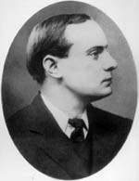
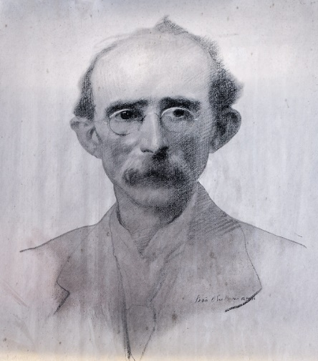
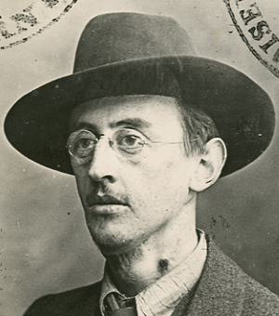
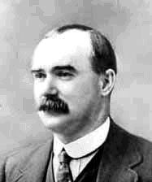
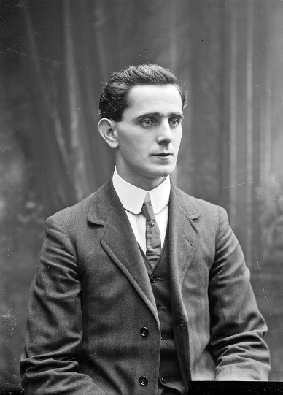
Leaders of the 1916 Rising
Padraig Pearse Tom Clarke Joseph Plunkett
Flikr.com Flikr.com Wikipedia.org
Eamonn Ceannt Séan MacDiarmada James Connolly
Flikr.com Flikr.com Flikr.com

Slide 5
1916 Rising goes ahead
At noon on Easter Monday the Irish Volunteers and the Irish Citizen Army marched from the ITGWU headquarters in Liberty Hall to the GPO, where Padraig Pearse read the Proclamation of the Irish Republic claiming that the rebels were setting up a government in Ireland. (video)
Rebels occupied the GPO, Boland’s mill and other prominent buildings in the city.
British forces were taken by surprise but only for a short while..

Slide 6
How did it go?
By Wednesday there were 1500 rebels left against over 6,500 British troops.
Rebels were heavily shelled by field guns in the streets and from the HELGA boat on the River Liffey.
The rebels were cornered in buildings and had no means of contacting each other.
The only minor victory was at Mount St. Bridge where 13 men ambushed 231 British soldiers,.
Civilians in Dublin resented the destruction of their city and looting caused some casualties.

Slide 7
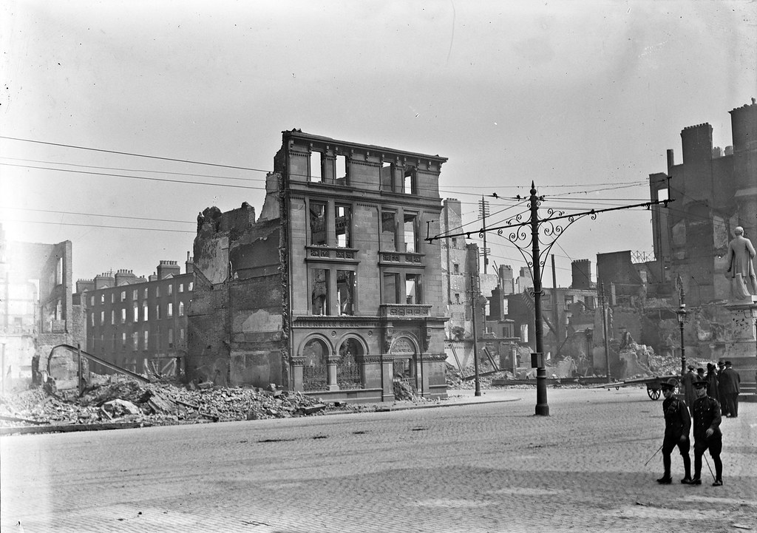
Result?
On Saturday April 29th the rebels led by Pearse, surrendered to the British General Lowe.
By Monday May 1st the rising was over.
Photo: Flikr.com

Slide 8
Results??
Deaths: 64 Rebels, 132 British soldiers and 300 civilians
£3million worth of damage to Dublin city.
Martial Law had been imposed during the rising to stop looting. This was used to Court martial the leaders after.
90 of those arrested were tried by court martial and sentenced to death.
The execution of the Rebel leaders from May 3rd to 10th turned public opinion against the British.
British reaction was to stop the executions and release 3,000 prisoners and promise to release those in British prisons.
Sinn Féin was given credit for the rising and public support grew.
In the 1917-18 elections, Sinn Féin won many seats , one of whom was Eamon de Valera.

