Slide 1
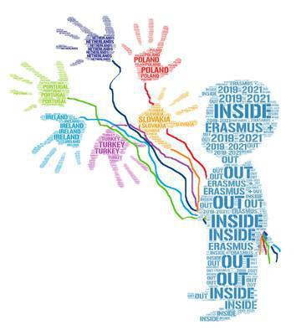
Mini CLIL Dictionary INSIDE OUT 2019-1-NL01-KA229-060290

Slide 2
Summary
Theme | PagE
Numbers | 3
School | 4
Colours | 5
Salutations | 6
Clothing | 7
Week days | 8
Months | 9
Meals | 10
Means of Transport | 11
Drinks | 12
Professions | 13
Family | 14

Slide 3
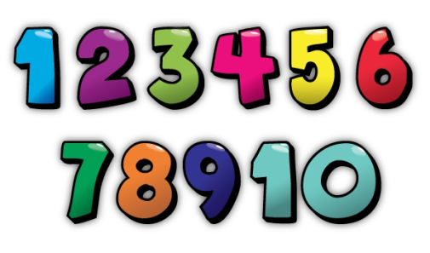
Theme: Numbers
Turkish | Polish | Dutch | Portuguese | Irish | Slovak | English
Bir | Jeden | Een | Um | Aon | Jeden | One
İki | Dwa | Twee | Dois | Dó | Dva | Two
Üç | Trzy | Drie | Três | Trí | Tri | Three
Dört | Cztery | Vier | Quatro | Ceathair | Štyri | Four
Beş | Pięć | Vijf | Cinco | Cúig | Päť | Five
Altı | Sześć | Zes | Seis | Sé | Šesť | Six
Yedi | Siedem | Zeven | Sete | Seacht | Sedem | Seven
Sekiz | Osiem | Acht | Oito | Ocht | Osem | Eight
Dokuz | Dziewięć | Negen | Nove | Naoi | Deväť | Nine
On | Dziesięć | Tien | Dez | Deich | Desať | Ten

Slide 4
Theme: School
Turkish | Polish | Dutch | Portuguese | Irish | Slovak | English
Öğrenci | Uczeń | Leerling | Aluno | Dalta | Žiak | Student
Sınıf | Klasa | Klaslokaal | Sala de aula | Seomra Ranga | Trieda | Classroom
Öğretmen | Nauczyciel | Leerkracht | Professor | Múinteoir | Učiteľ | Teacher
Sırt Çantası | Plecak | Rugzak | Mochila | Mála Scoile | Ruksak/ školská taška | Backpack
Kitap | Książka | Boek | Livro | Leabhar | Kniha | Book
Kalem | Ołówek | Potlood | Lápis | Peann Luaidhe | Ceruzka | Pencil
Kütüphane | Biblioteka | Bibliotheek | Biblioteca | Leabharlann | Knižnica | Library
Defter | Zeszyt | Schrift | Caderno | Cóipleabhar | Zošit | Notebook
Jimnastik | Sala gimnastyczna | Gym | Ginásio | Ionad Aclaíochta | Telocvičňa | Gym
Öğrenmek | Uczyć się | Leren | Aprender | Foghlaim | Učiť sa | Learn
Erasmus+ KA2

Slide 5
Theme: Colours
Turkish | Polish | Dutch | Portuguese | Irish | Slovak | English
Mavi | Niebieski | Blauw | Azul | Gorm | Modrá | Blue
Sarı | Żółty | Geel | Amarelo | Buí | Žltá | Yellow
Pembe | Różowy | Roze | Cor-de-rosa | Bándearg | Ružová | Pink
Siyah | Czarny | Zwart | Preto | Dubh | Čierna | Black
Beyaz | Biały | Wit | Branco | Bán | Biela | White
Kırmızı | Czerwony | Rood | Vermelho | Dearg | Červená | Red
Yeşil | Zielony | Groen | Verde | Glas | Zelená | Green
Turuncu | Pomarańczowy | Oranje | Cor-de-laranja | Oráiste | Oranžová | Orange
Mor | Fioletowy | Paars | Roxo | Corcra | Fialová | Purple
Gri | Szary | Grijs | Cinzento | Liath | Sivá | Gray
Erasmus+ KA2

Slide 6
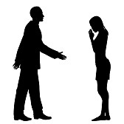
Theme: Salutations
Turkish | Polish | Dutch | Portuguese | Irish | Slovak | English
Merhaba | Cześć | Hallo/Hoi | Olá | Dia Dhuit | Ahoj | Hello
Günaydın | Dzień dobry | Goedemorgen | Bom dia | Maidin Maith | Dobré ráno Dobrý deň | Good Morning
İyi günler/ İyi akşamlar | Dobry wieczór | Goedemidddag/ Goedeavond | Boa tarde | Tráthnóna Maith | Dobré popoludnie Dobrý večer | Good Afternoon/ Evening
İyi geceler | Dobranoc | Goede nacht | Boa noite | Oíche Mhaith | Dobrú noc | Good Night
Hoşça kal | Do widzenia | Dag/Doei | Adeus | Slán | Dovidenia | Goodbye
Sonra Görüşürüz | Do zobaczenia | Tot later | Até logo | Slán go fóill | Vidíme sa neskôr | See you later
Yarın görüşürüz | Do zobaczenia jutro | Tot morgen | Até amanhã | Feicfidh mé thú amárach | Dovidenia zajtra | See you tomorrow
Erasmus+ KA2

Slide 7
Theme: Clothing
TURKish | Polish | Dutch | Portuguese | Irish | Slovak | English
Etek | Spódnica | Rok | Saia | Sciorta | Sukňa | Skirt
Pantolon | Spodnie | Broek | Calças | Bríste | Nohavice | Pants
Elbise | Sukienka | Jurk | Vestido | Gúna | Šaty | Dress
Gömlek | Koszula | T-shirt | Camisa | T-léine | Košeľa | Shirt
Spor Ayakkabısı | Buty sportowe | Sportschoenen | Sapatilhas | Bróga reatha | Tenisky | Trainers
Bot | Trzewiki | Laarzen | Botas | Buataisí | Čižmy | Boots
Şort | Szorty | Korte broek | Calções | Bríste Gearr | Kraťasy | Shorts
Tulum | Kombinezon | Trainingspak | Macacão | Culaith aonphíosa | Kombinéza | Jumpsuit
Ceket | Kurtka | Jas | Casaco | Seaicéad | Bunda, sako | Jacket
Çorap | Skarpety | Sokken | Meias | Stocaí | ponožky | Socks
Erasmus+ KA2

Slide 8
Theme: Week days
Turkish | Polish | Dutch | Portuguese | Irish | Slovak | English
Pazartesi | Poniedziałek | Maandag | Segunda | Luan | Pondelok | Monday
Salı | Wtorek | Dinsdag | Terça | Máirt | Utorok | Tuesday
Çarşamba | Środa | Woensdag | Quarta | Ceadaoin | Streda | Wednesday
Perşembe | Czwartek | Donderdag | Quinta | Deardaoin | Štvrtok | Thursday
Cuma | Piątek | Vrijdag | Sexta | Aoine | Piatok | Friday
Cumartesi | Sobota | Zaterdag | Sábado | Sathairn | Sobota | Saturday
Pazar | Niedziela | Zondag | Domingo | Domhnach | Nedeľa | Sunday
Erasmus+ KA2

Slide 9
Theme: Months
Turkish | Polish | Dutch | Portuguese | Irish | Slovak | English
Ocak | Styczeń | Januari | Janeiro | Eanáir | Január | January
Şubat | Luty | Februari | Fevereiro | Feabhra | Február | February
Mart | Marzec | Maart | Março | Márta | Marec | March
Nisan | Kwiecień | April | Abril | Aibreán | Apríl | April
Mayıs | Maj | Mei | Maio | Bealtaine | Máj | May
Haziran | Czerwiec | Juni | Junho | Meitheamh | Jún | June
Temmuz | Lipiec | Juli | Julho | Iúil | Júl | July
Ağustos | Sierpień | Augustus | Agosto | Lúghnasa | August | August
Eylül | Wrzesień | September | Setembro | Meán Fomhair | September | September
Ekim | Październik | Oktober | Outubro | Deireadh Fomhair | Október | October
Kasım | Listopad | November | Novembro | Samhain | November | November
Aralık | Grudzień | December | Dezembro | Nollaig | December | December
Erasmus+ KA2

Slide 10
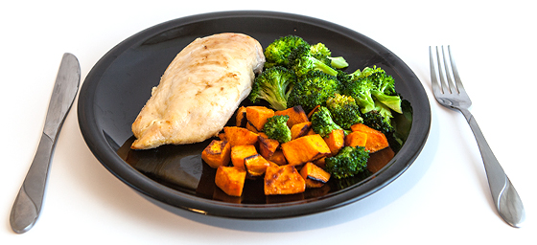
Theme: Meals
Turkish | Polish | Dutch | Portuguese | Irish | Slovak | English
Kahvaltı | Śniadanie | Ontbijt | Pequeno almoço | Bricfeasta | Raňajky | Breakfast
Atıştırmalık | Przekąska | Tussendoor-tje | Lanche da manhã | Sneaic | Desiata | Snack
Öğlen yemeği | Drugie śniadanie | Lunch | Almoço | Lón | Obed | Lunch
5 çayı | Kolacja | Avond eten | Lanche da tarde | Tae ag a cúig | Olovrant | Tea at 5
Akşam yemeği | Obiad | Avond eten/diner | Jantar | Dinnéar | Večera | Dinner
Erasmus+ KA2

Slide 11
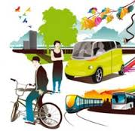
Theme: Means of transport
Turkish | Polish | Dutch | Portuguese | Irish | Slovak | English
Tren | Pociąg | Trein | Comboio | Traein | Vlak | Train
Araba | Samochód | Auto | Automóvel | Gluaisteán | Auto | Car
Uçak | Samolot | Vliegtuig | Avião | Eitleán | Lietadlo | Plain
Kamyon | Ciężarówka | Vrachtwagen | Camião | Leoraí | Kamión | Lorry
Bisiklet | Rower | Fiets | Bicicleta | Rothar | Bicykel | Bicycle
Motorsiklet | Motor | Moter | Mota | Gluaisrothar | Motorka | Motorbike
Miinibüs | Transporter | Mini busje | Carrinha | Mionbhus | Mikrobus | Minibus
Otobüs | Autobus | Bus | Autocarro | Bus | Autobus | Bus
Metro | Metro | Metro | Metro | Meitreo | Metro | Underground
Tekne | Łódź | Boot | Barco | Bád | Loď | Boat/ship
Erasmus+ KA2

Slide 12
Theme: Drinks
Turkish | Polish | Dutch | Portuguese | Irish | Slovak | English
Kahve | Kawa | Koffie | Café | Caife | Káva | Coffee
Çay | Herbata | Thee | Chá | Tae | Čaj | Tea
Şarap | Wino | Wijn | Vinho | Fíon | Víno | Wine
Meyve suyu | Sok | Sap | Sumo | Sú | Džús | Juice
Su | Woda | Water | Água | Uisce | Voda | Water
Sütlü kaahve | Kawa latte | Koffie met melk | Café com leite | Caife le bainne | Káva s mliekom | Coffee with milk
Sıcak çikolata | Gorąca czekolada | Warme chocolade melk | Chocolate Quente | Seacláid te | Horúca čokoláda | Hot chocolate
Süt | Mleko | Melk | Leite | Bainne | Mlieko | Milk
- | Koktajl | Milkshake | Batido | Creathán bainne | Kokteil | Milkshake
Bira | Piwo | Bier | Cerveja | Beoir | Pivo | Beer
Erasmus+ KA2

Slide 13
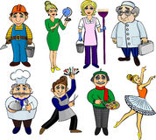
Theme: Professions
Turkish | Polish | Dutch | Portuguese | Irish | Slovak | English
Öğretmen | Nauczyciel | Leerkracht | Professor/a | Múinteoir | Učiteľ | Teacher
Mühendis | Inżynier | Ingineur | Engenheiro/a | Innealtóir | Inžinier | Engineer
Doktor | Lekarz | Dokter | Médico/a | Dochtúir | Lekár/doktor | Doctor
İtfaiyeci | Strażak | Brandweer | Bombeiro/a | Comhraiceoir Dóiteáin | Požiarnik | Firefighter
Polis | Policjant | Politie | Polícia | Garda | Policajt | Policeman
Aşçı | Kucharz | Kok | Cozinheiro/a | Cócaireacht | Kuchár | Cook
Avukat | Prawnik | Rechter | Advogado/a | Dlíodóir | Právnik/advokát | Lawyer
Şöför | Kierowca | Chauffeur | Motorista | Tiománaí | Šofér | Driver
Kuaför | Fryzjer | Kapper | Cabeleireira | Gruaiaire | Kaderník | Hairdresser
Çiftçi | Rolnik | Boer | Agricultor/a | Feirmeoir | Roľník / farmár | Farmer
Cankurtaran | Ratownik | Badmeester | Salva-vidas | Garda tarrthála | Záchranár | Lifguard
Diş hekimi | Dentysta / stomatolog | Tandarts | Dentista | Fiaclóir | zubár | Dentist
Erasmus+ KA2

Slide 14
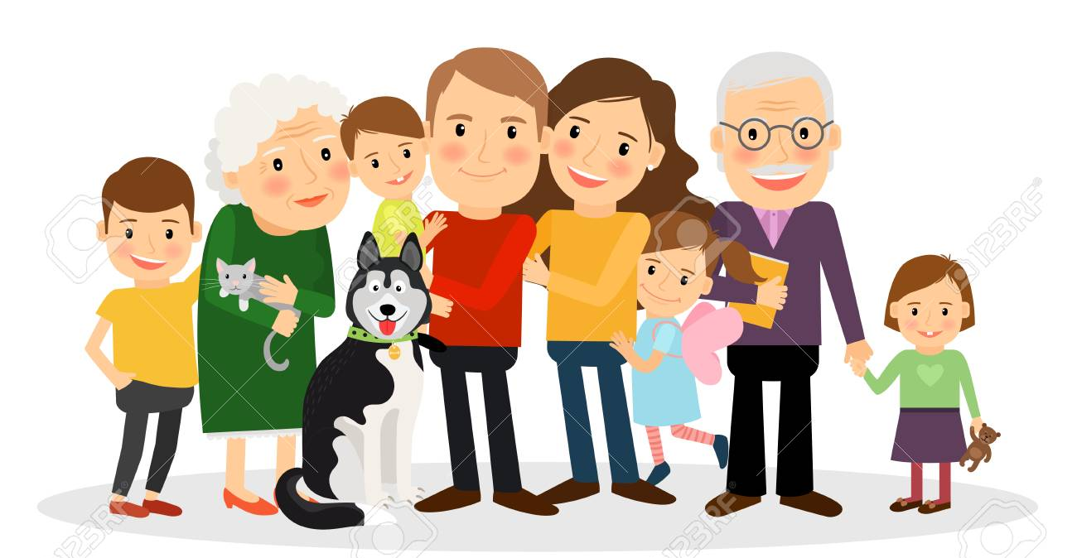
Theme: family
Turkish | Polish | Dutch | Portuguese | Irish | Slovak | English
Anne | Mama | Mama | Mãe | Máthair | Mama | Mother
Baba | Tata | Vader | Pai | Athair | Otec | Father
Erkek kardeş | Brat | Broer | Irmão | Deartháir | Brat | Brother
Kız kardeş | Siostra | Zus | Irmã | Deirfiúr | Sestra | Sister
Oğul | Syn | Zoon | Filho | Mac | Syn | Son
Kız | Córka | Dochter | Filha | Iníon | Dcéra | Daughter
Amca | Wujek | Oom | Tio | Uncail | Ujo | Uncle
Teyze | Ciocia | Tante | Tia | Aintín | Teta | Aunt
Büyükanne | Babcia | Oma | Avó | Seanmháthair | Stará mama | Grandma
Büyükbaba | Dziadek | Opa | Avô | Seanathair | Starý otec | granddad
Kuzen | Kuzyn/kuzynka | Neef | Primo/a | Col ceathar | Sesternica Bratranec | Cousin
Erasmus+ KA2

Slide 15
The disclaimer:
The European Commission's support for the production of this publication does not constitute an endorsement of the contents, which reflect the views only of the authors, and the Commission cannot be held responsible for any use which may be made of the information contained therein.

