Slide 1
Peterlee, Nov. 2015

Slide 2
Table of contents:
Build and manage an android app to administrate a Website, Blog… and centralize all the information.
Usage of Orux Maps with offline maps and GPS.

Slide 3
Download the app.
The beta version is in the website, but it is a release one.
When we decide the structure of the app, we will build a stable version and download it.

Slide 4
Download the app.
The beta version is in the website, but it is a release one.
When we decide the structure of the app, we will build a stable version and download it.

Slide 5
The app.
The android apk has been built in order to allow us to manage it without knowing programing languaje.
When the apk is running, we only have to actualize information in our website, blog, webpage…
It is very easy.

Slide 6
The app.
The app has two spaces:
In the front page, we can accede to this services:
Web,
Calendar,
Maps,
Downloads,
eTwinning,
Blogs,
Notices,
Restricted area,
Docs and help.
1

Slide 7
The app.
We can actualize this items from our laptops because everyone submit us to a web service.
1
When you change something in your pc, automatically it is changed in the app.
We´ll see examples in a moment.

Slide 8
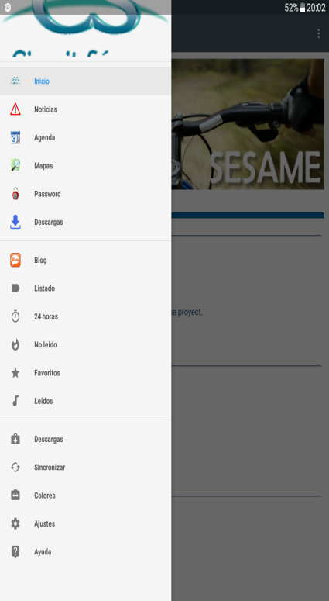
The app.
In left side, we can accede to this services:
Home,
Advices,
Calendar,
Maps,
Restricted area,
Downloads,
Blog services (4),
Settings of the app.
2

Slide 9
The app.
This is the structural design of the app and we have to decide what we want to show here.
If we want to change it, we have to actualize the app.
2

Slide 10
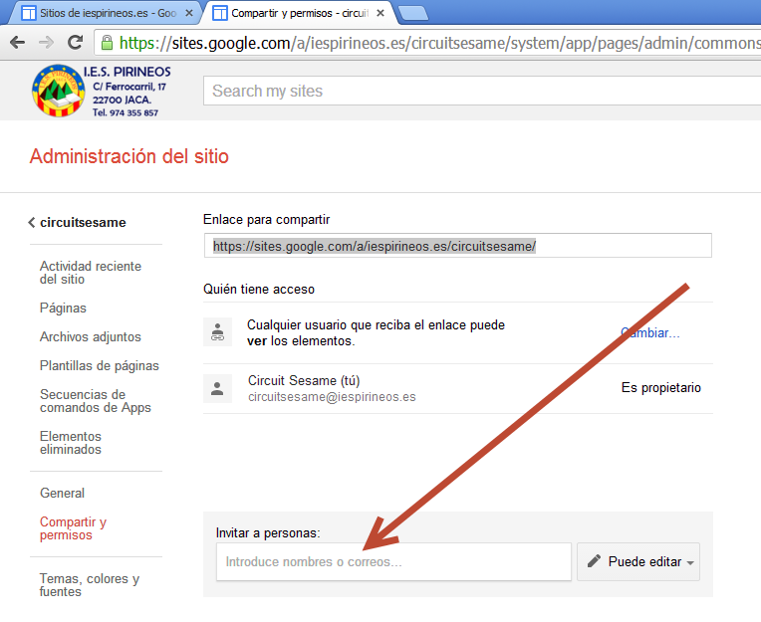
Updating from our PC.
We can allow you to accede to the edition of the site or insert more than one website.

Slide 11
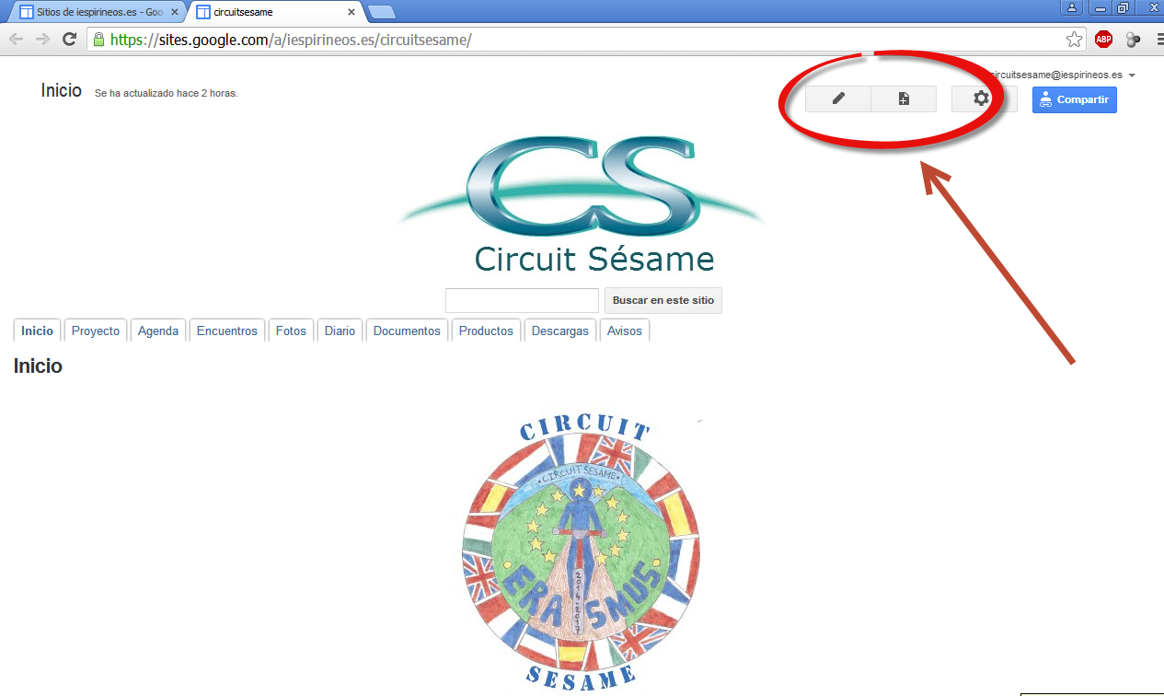
Updating from our PC.
Editing or creating a new page is very easy.

Slide 12
Updating from our PC.

Slide 13
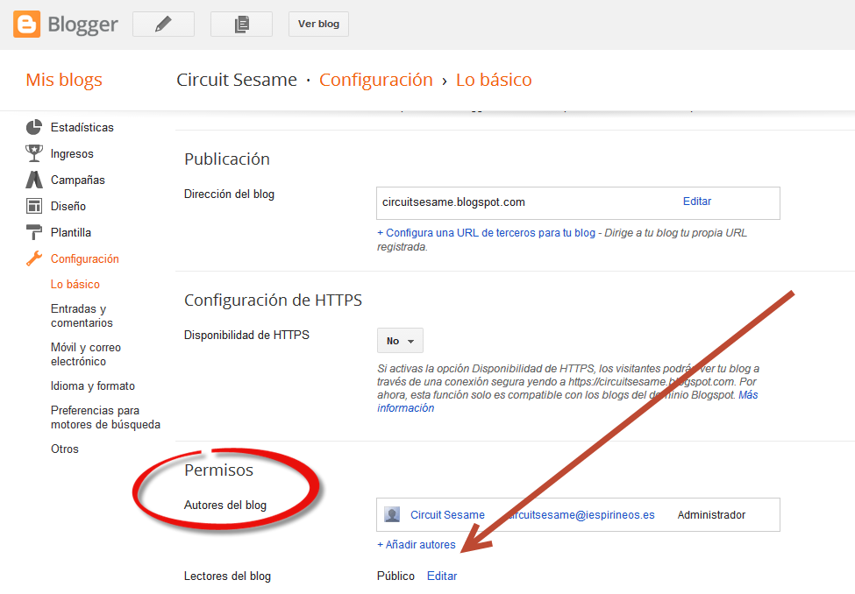
Updating from our PC.
The multi edition of the blog is possible or manage more than one blog, as you want.

Slide 14
Updating from our PC.
Changes in the web are automatically actualized in the app because the app and the website services are syncroniced.

Slide 15
Section 2.

Slide 16
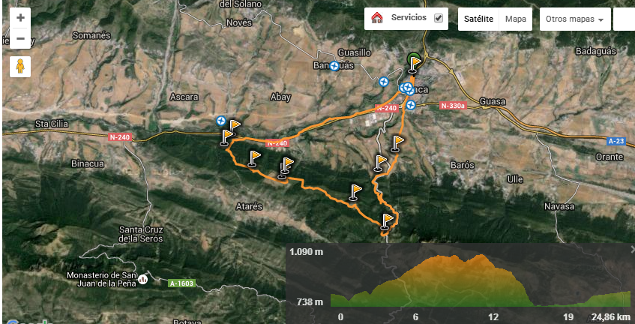
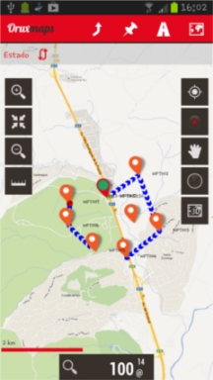
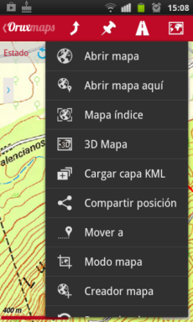
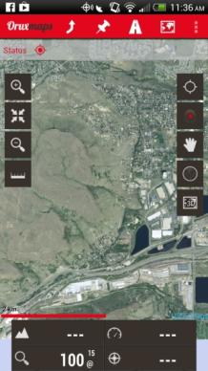
MANAGING THE BIKE ROUTES

Slide 17
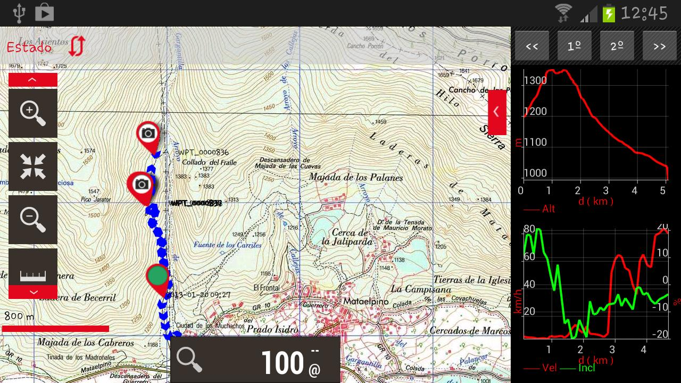
The best option: Orux Maps (creating routes with Google Maps and Wikiloc).

Slide 18
How to use Orux Maps in our project.
Complete user manuals:
French.
Italian.
English.
Spanish.

Slide 19
How to use Orux Maps in our project.
Download the app from the google play store or from our website.
Install in your android device.

Slide 20
How to use Orux Maps in our project.
Download the maps and routs from the web or from our website.
Copy them in your external SD card.

Slide 21
How to use Orux Maps in our project.
Once the software has been installed and the maps copied to the SD card, configure the device.

Slide 22
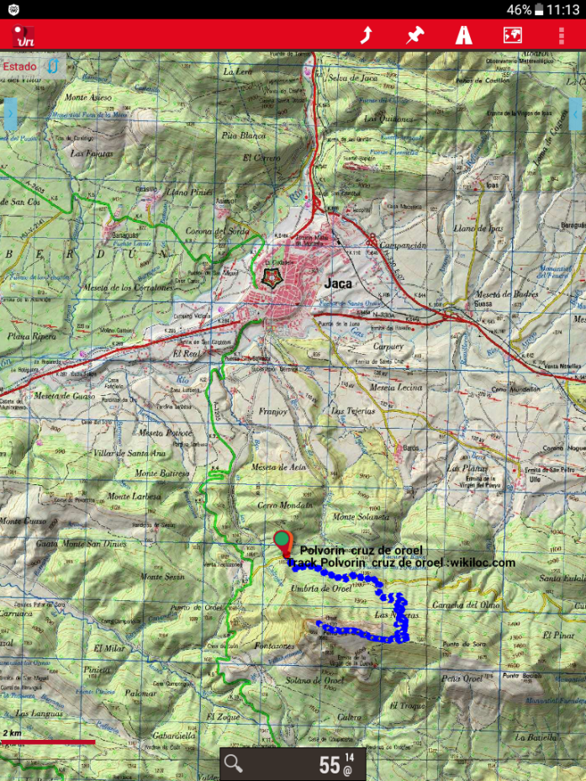
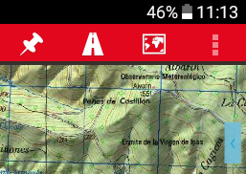
How to use Orux Maps in our project.
1. Configure paths of maps and tracks.

Slide 23
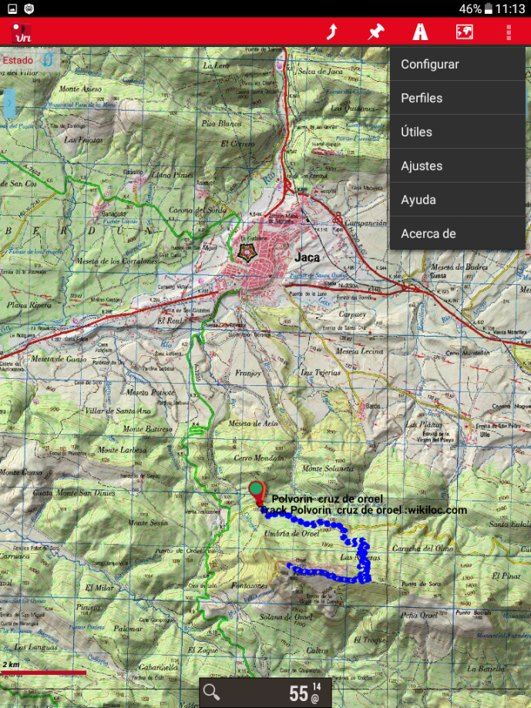
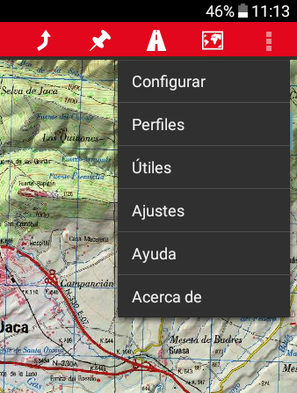
How to use Orux Maps in our project.
1. Configure paths of maps and tracks.

Slide 24
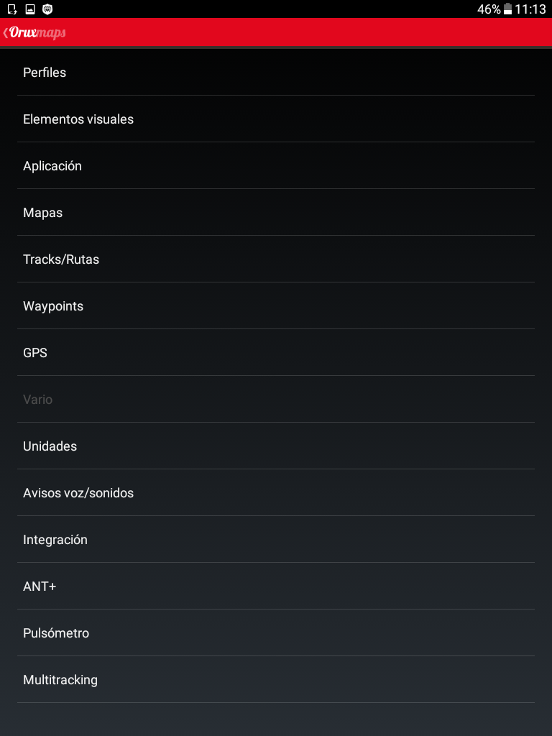
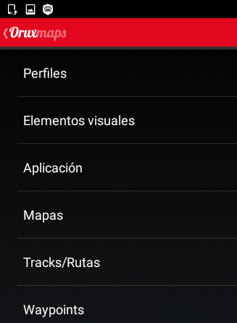
How to use Orux Maps in our project.
1. Configure paths of maps and tracks.

Slide 25
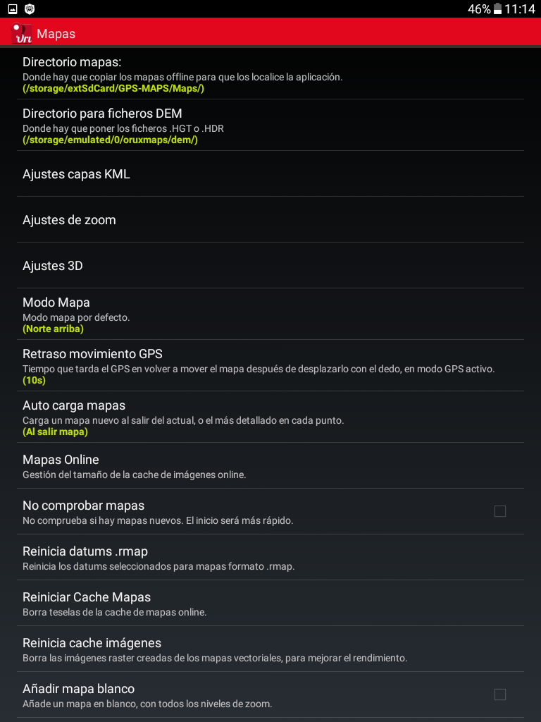
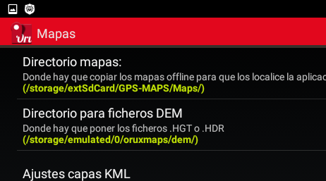
How to use Orux Maps in our project.
1. Configure paths of maps and tracks.

Slide 26
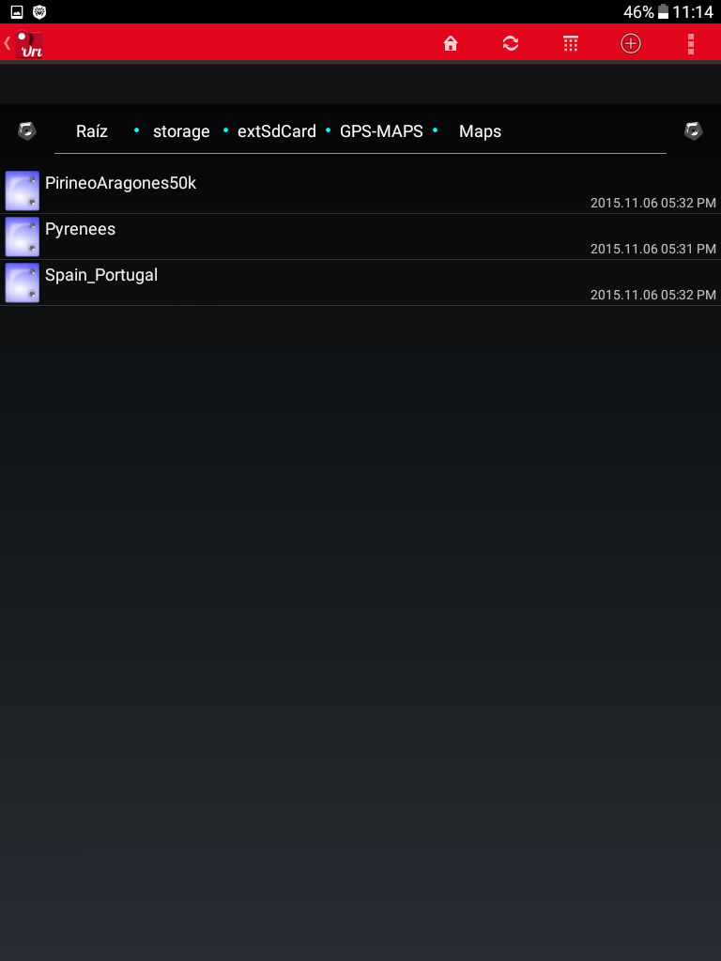
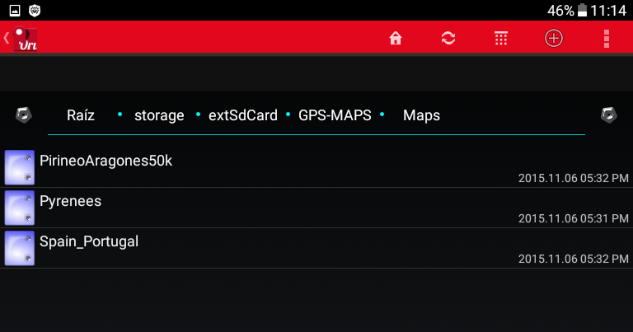
How to use Orux Maps in our project.
1. Configure paths of maps and tracks.
SELECT PLACE

Slide 27
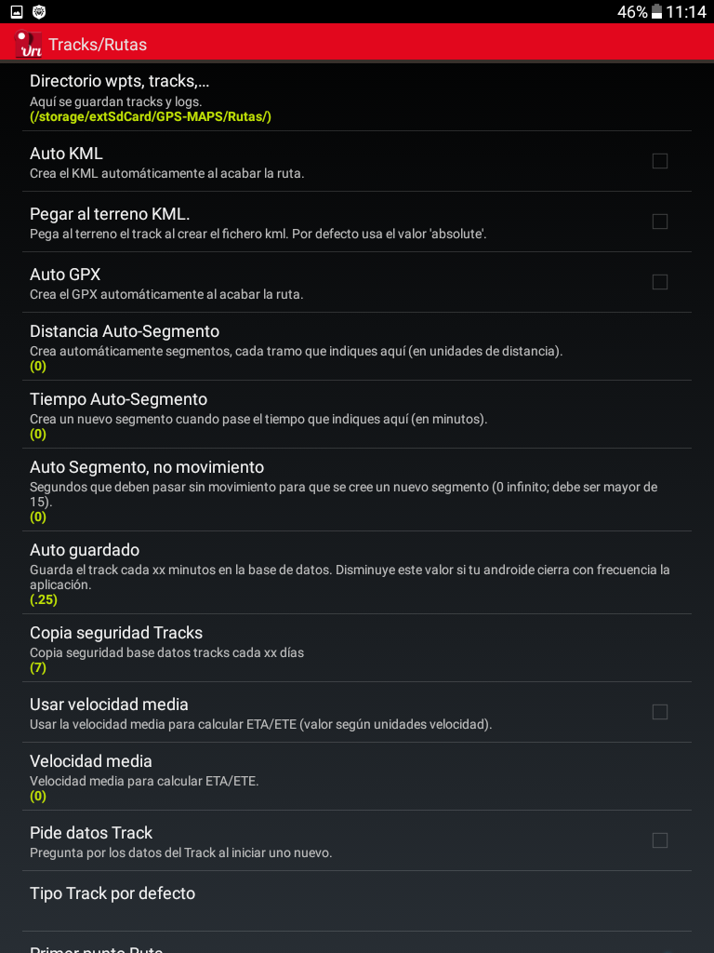
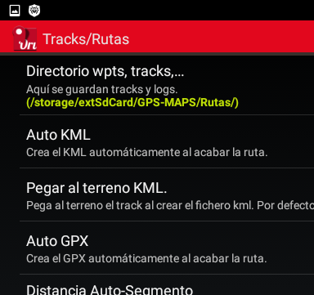
How to use Orux Maps in our project.
1. Configure paths of maps and tracks.

Slide 28
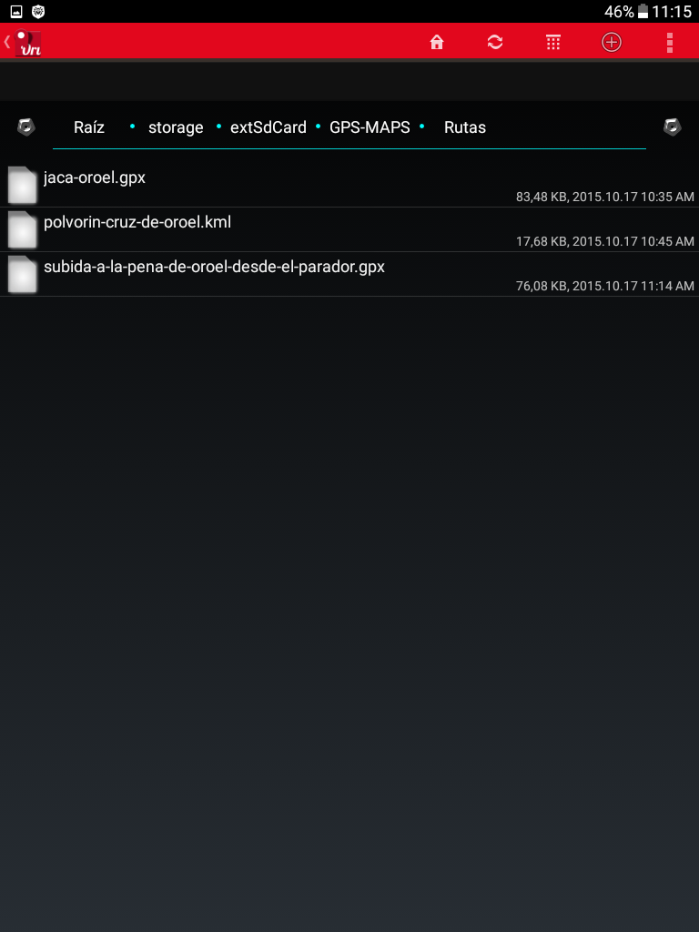
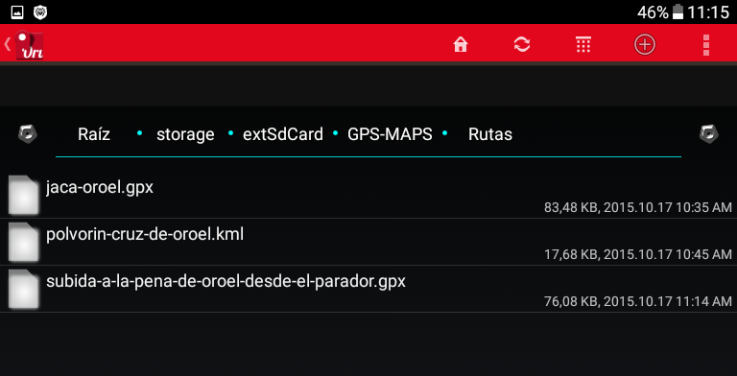
How to use Orux Maps in our project.
1. Configure paths of maps and tracks.
SELECT LOCATION

Slide 29
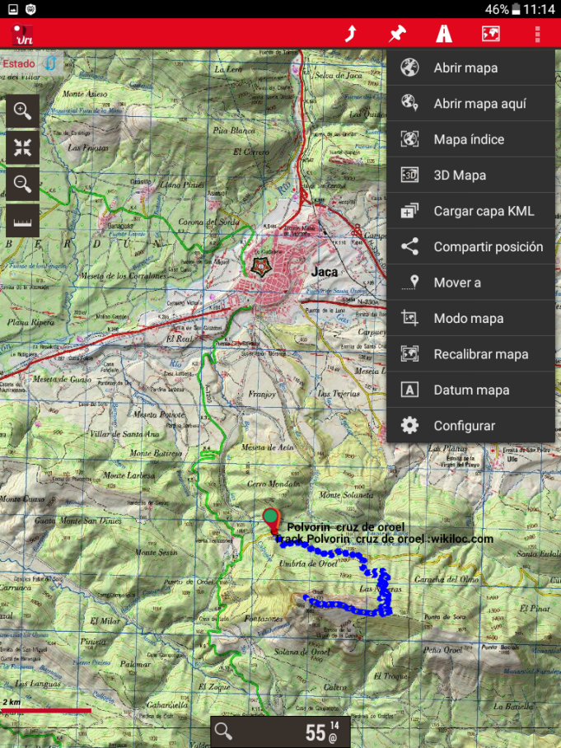
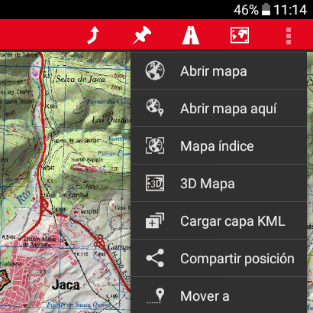
How to use Orux Maps in our project.
2. Open a map.

Slide 30
How to use Orux Maps in our project.
2. Open a map.
SELECT MAP

Slide 31
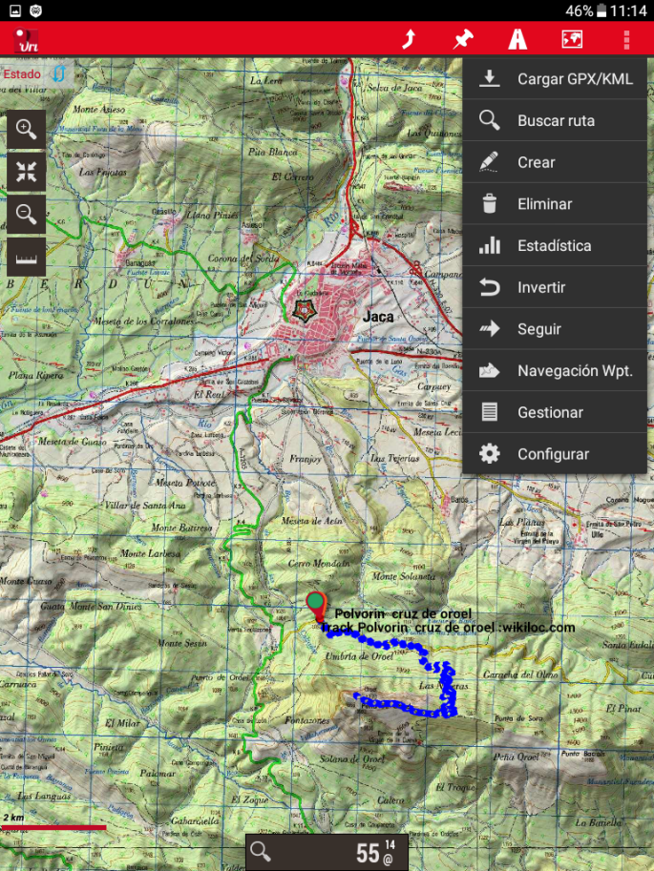
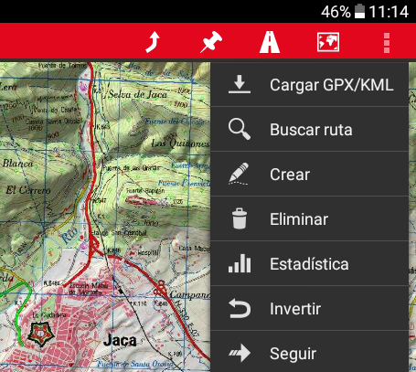
How to use Orux Maps in our project.
3. Open a route.

Slide 32
How to use Orux Maps in our project.
3. Open a route.
SELECT TRACK

Slide 33
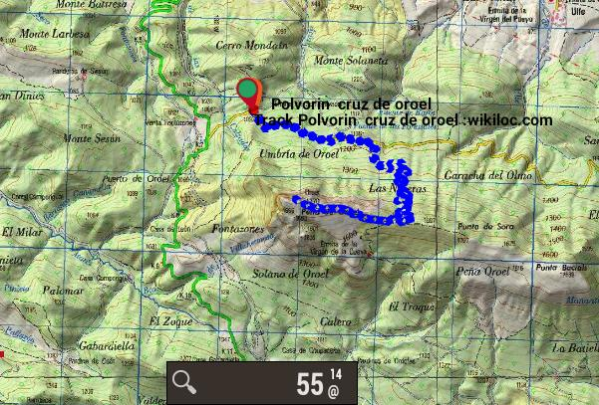
End result.

Slide 34
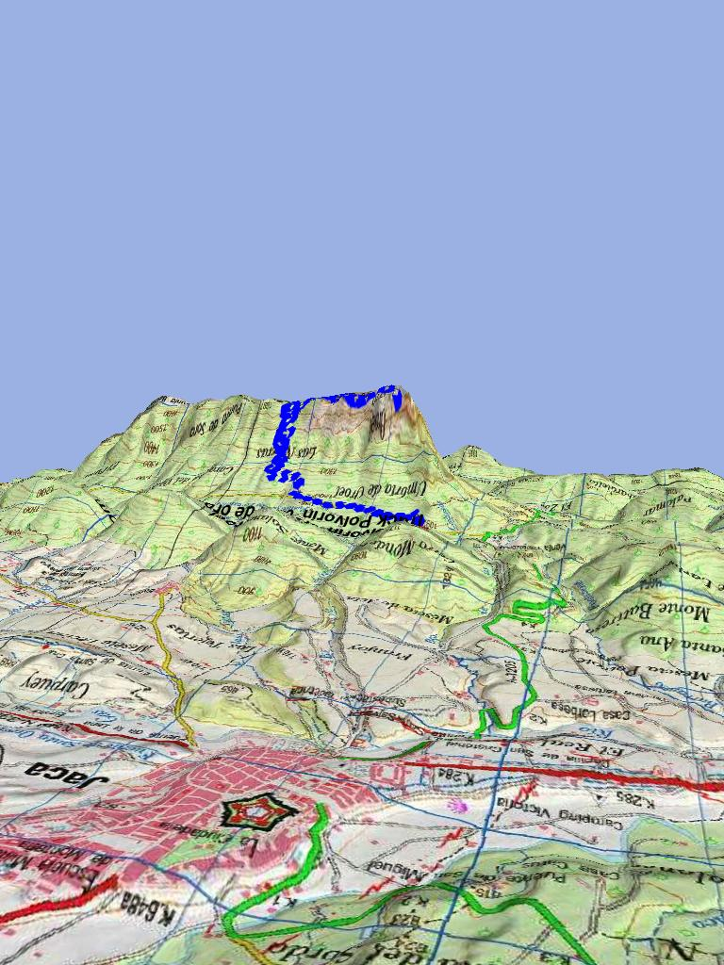
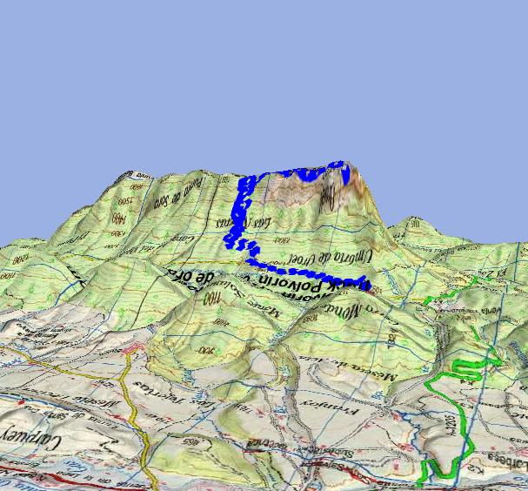
End result.
3D view

Slide 35
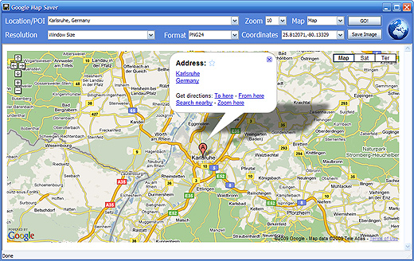
Where to download maps?

Slide 36
Where to download more maps?
We can download maps in our computer and use them offline. It´s for free.
Download the selected map.
Copy it to your SD card in your smartphone or tablet.

Slide 37
Where to download more maps?
Europe:
http://www.oruxmaps.com/cs/index.php/maps
http://www.wanderreitkarte.de/garmin_de.php
http://www.openandromaps.org/downloads/europa
Spain:
http://cosasdeandroides.com/mapas/
Aragón:
http://kunzuilh.blogspot.com.es/2012/03/mapas-ign-125000-pirineo-aragones-para.html

Slide 38
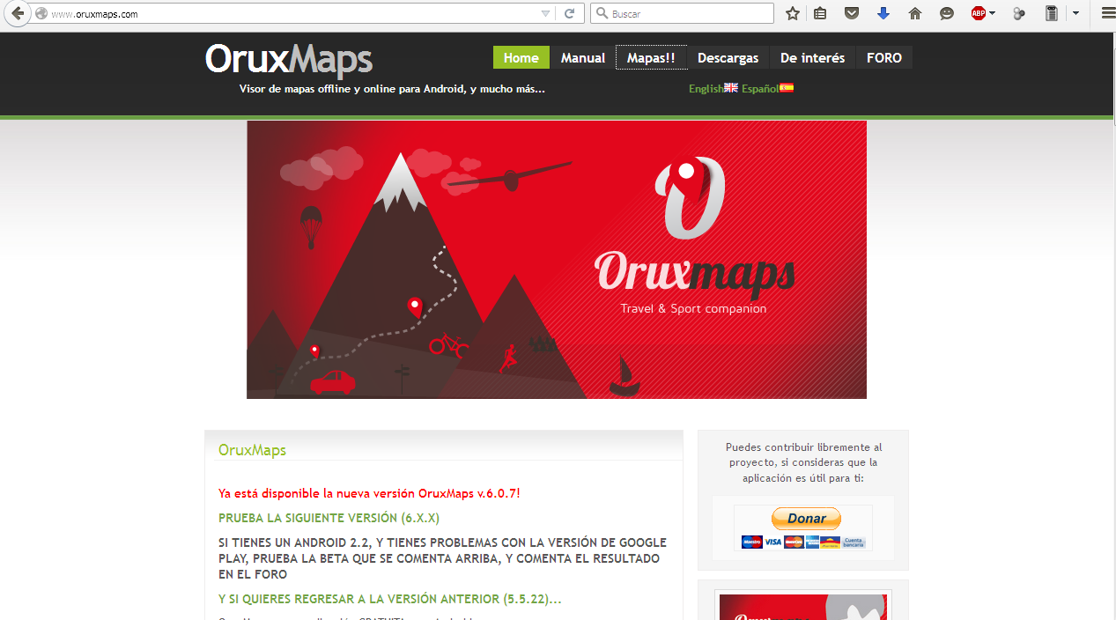
http://www.oruxmaps.com/

Slide 39
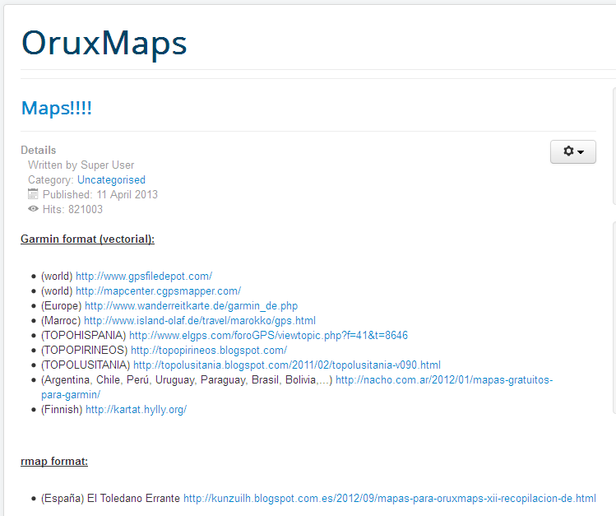

Slide 40
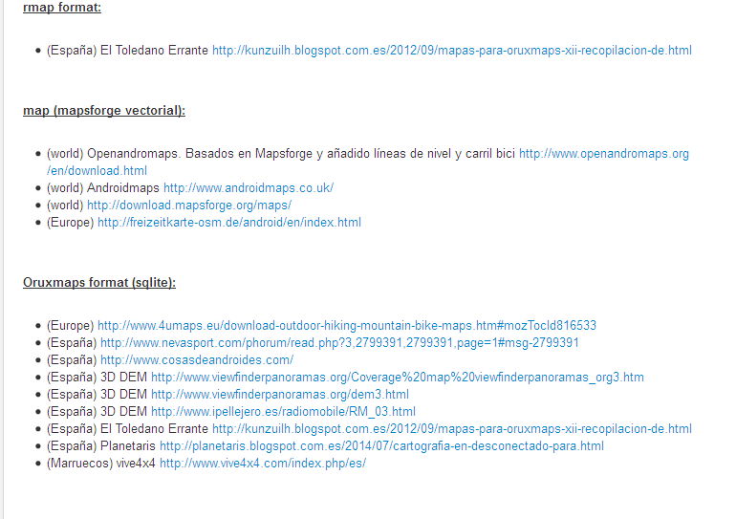

Slide 41
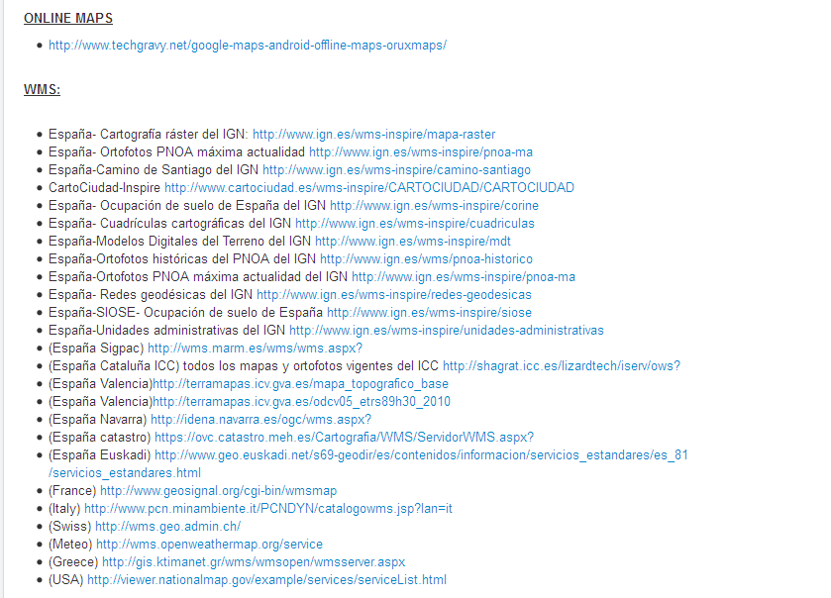

Slide 42
http://www.wanderreitkarte.de/garmin_de.php

Slide 43
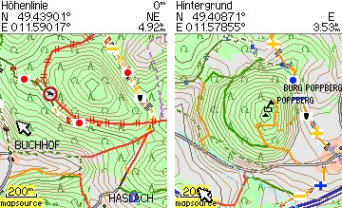
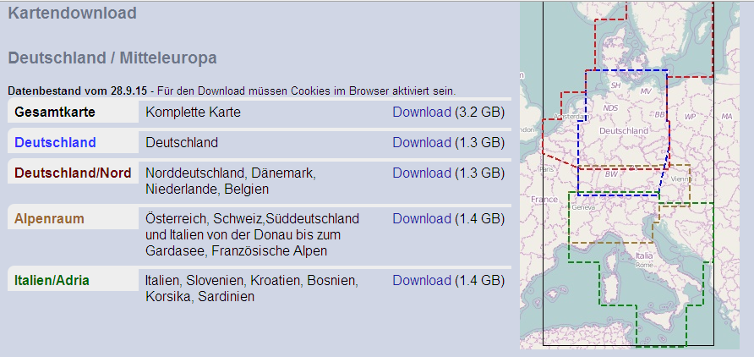
We can download Maps of Europe

Slide 44
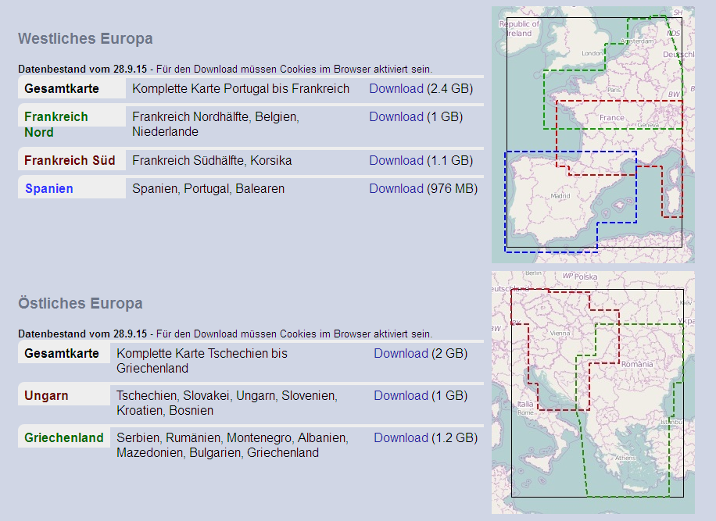

Slide 45
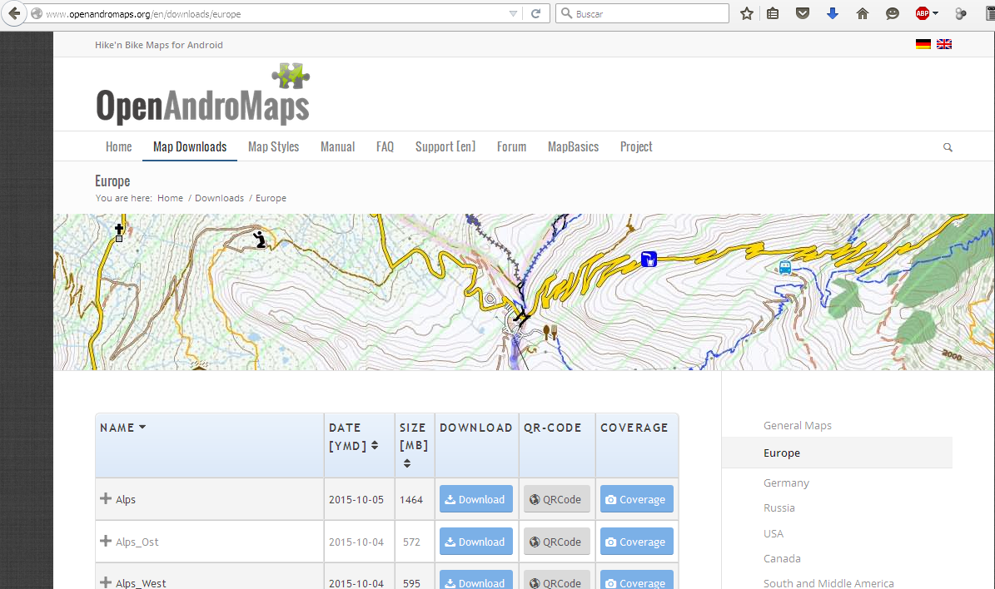
http://www.openandromaps.org/en/downloads/europe

Slide 46
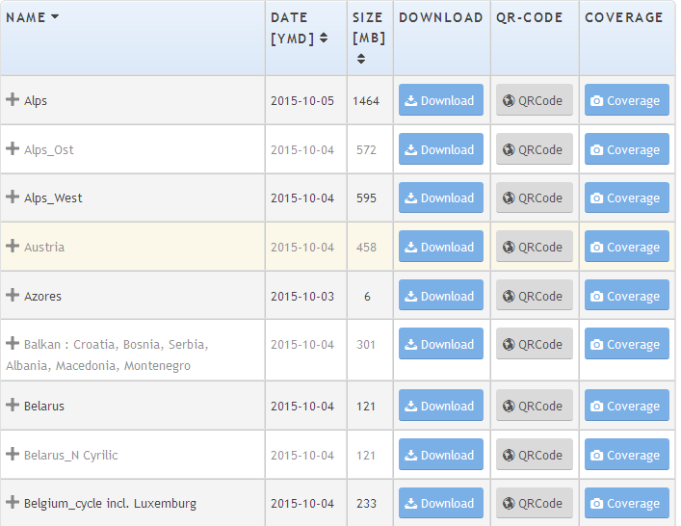

Slide 47
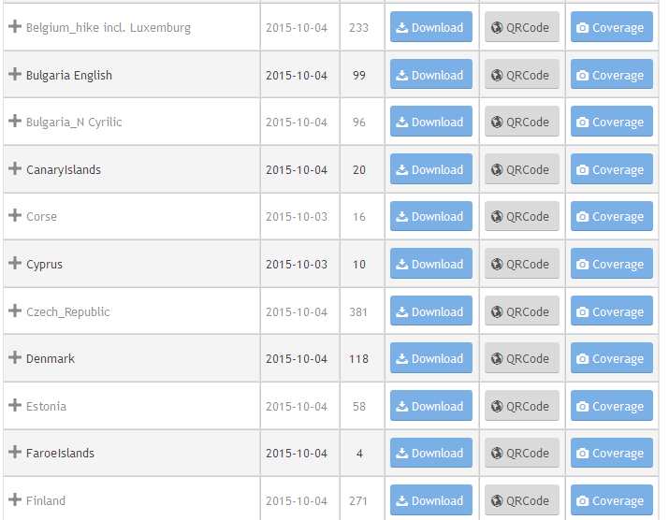

Slide 48
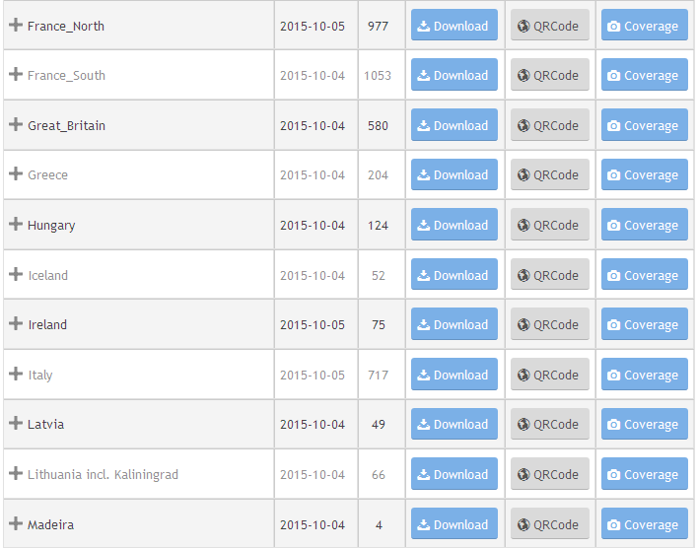

Slide 49
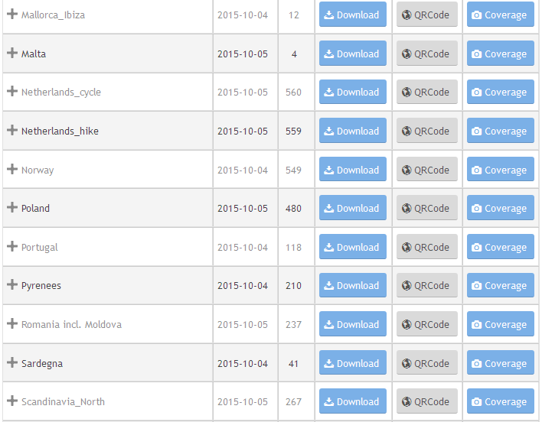

Slide 50
