Slide 1
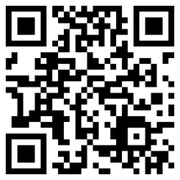
Beginning with a QR code:
How to create a qr code?
What Is a qr code?
Creating a qr with:
Apps
Web pages
programs
What information can be encoded?
Links & references
Notes:
There are many questions that can be addressed with QR codes. First, what is a QR code?. Second, how does one create a QR code? Is it easy to make them function the way that we want them too? In order to create a QR code, we can use a mobile phone, or a web page, or a computer program such as a Windows operating system. Now, that we know how to make a QR code, we can investigate a bit more. We can discuss what is encoded inside the code and how the information is contained. To conclude the discussion, here are some links that can answer some of these questions.

Slide 2
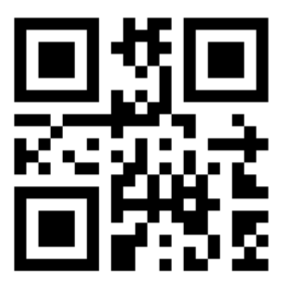
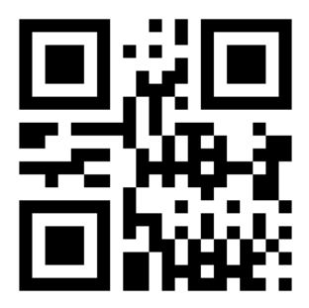
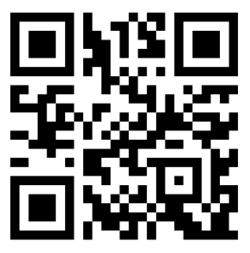
What Is A “QR” Code?
A “QR” code is a picture that contains information about the item to which it is attached. This could be a simple text message, such as a web page address, or some sentences with letters or numbers:
HELLO: =>
In order to read the message, we must use a mobile phone or tablet with a digital camera. These devices can scan the image of the code and then translate that image into a clear message. (using an APP)
1984: =>
Web page ;-) =>
Notes:
In a few words, we could understand a “QR” Code as a picture which contains a text message. These are usually things such as a web page address or some sentences with letters or numbers. For instance here we have some examples, the Word hello, one number and one web address, all of them encoded as QR code.
Apart from that, we need a device able to understand the code and decode the message, we normally use a mobile phone or a Tablet with a digital camera (using an APP)

Slide 3
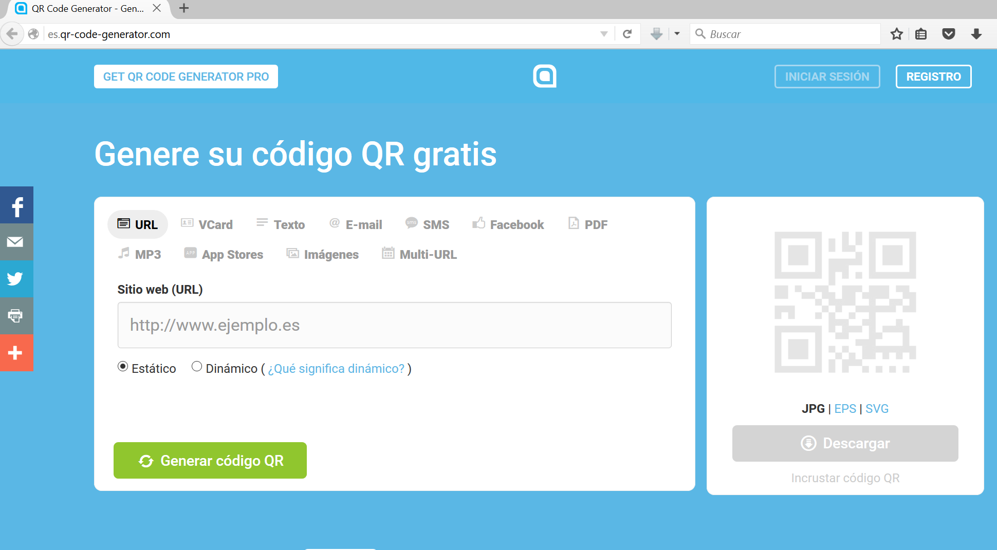
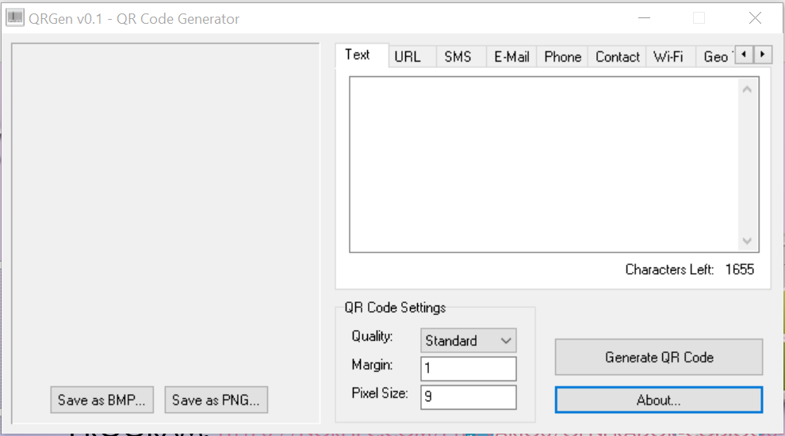
How to crEate a QR code?
Creating a qr with (for instace) :
App: with Qrdroid: https://play.google.com/store/apps/details?id=la.droid.qr
Web page: http://es.qr-code-generator.com/
Program: https://norfipc.com/ftp/varios/generador-codigos-qr-js.zip
https://www.tec-it.com/en/download/free-software/qrcode-studio/Download.aspx
http://digitalblast.com.ar/software/qrgen.rar
(or any other program, as you like)
Notes:
As previously stated, we were talking about three different methods to create a QR code: with a mobile phone, with a web page or with a computer program. For the first case, if the mobile phone is based on an Android operating system, we need to search and download an APP. In the second case, there is an example of a web page which is able to generate a QR code. And finally there are several links to use in a laptop with a Windows operating system. Depending on the type of device you are using you will need to be sure that you are using the right software. PC´s and Mac´s use different operating systems so you must be sure that you choose the right one.

Slide 4
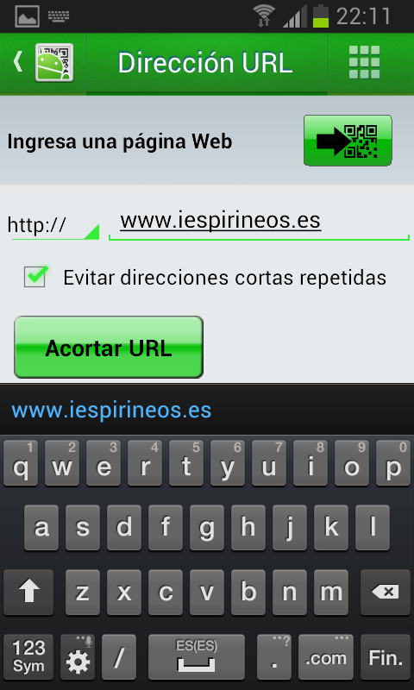
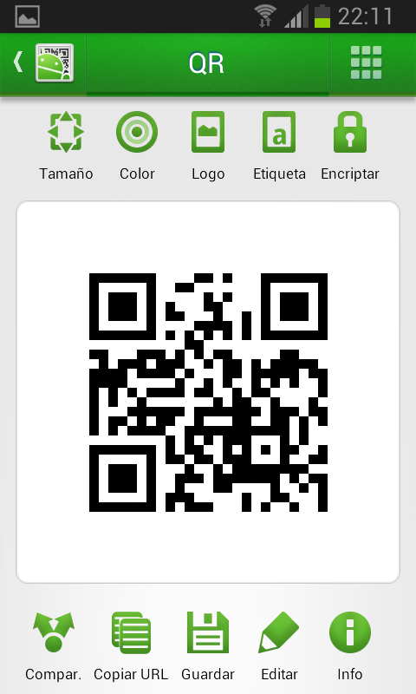
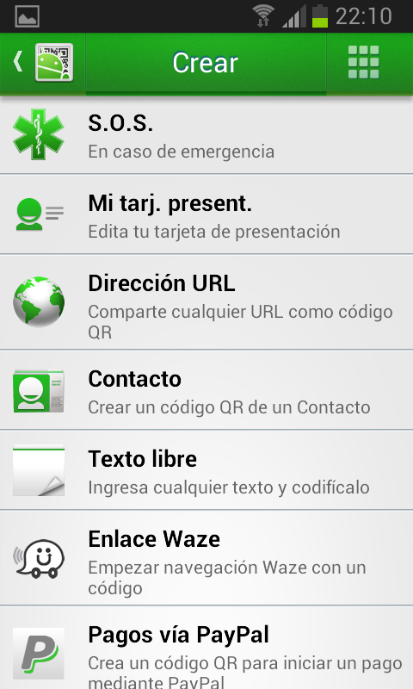
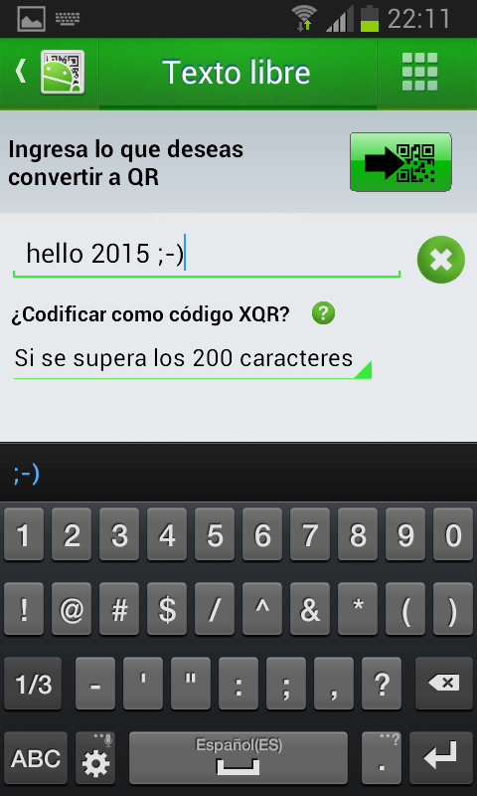
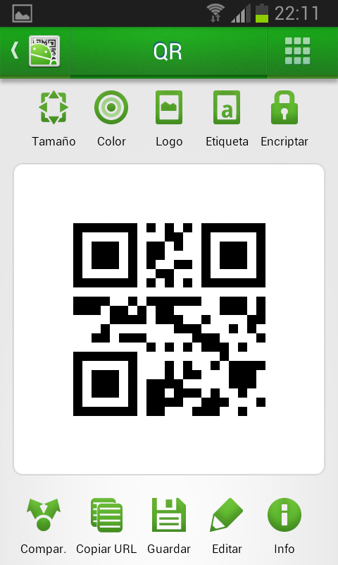
App: with Qrdroid: https://play.google.com/store/apps/details?id=la.droid.qr
Notes:
Well, here we have the screen captures of an APP for Android, one of many that we can find on the market. Many of the apps available are also free of charge. The first screen contains all diferent options that we can choose to work with the app, usually we use the options to scan, read and decode. These options allow us to see the messages that are attached to QR codes. The app can also be used to create QR codes. Many apps allow us to choose between different options to generate the code, such as choosing between text or a web page address.

Slide 5
Web page: http://es.qr-code-generator.com
You need to be connected to the net and only surfing the specific page address.
Select the type of qr, write the text, or paste it and click the green button.
Notes:
In this case You need to be connected to the net and only surfing the specific page address. Finally, Select the type of QR, write the text, or paste it and click the green button

Slide 6
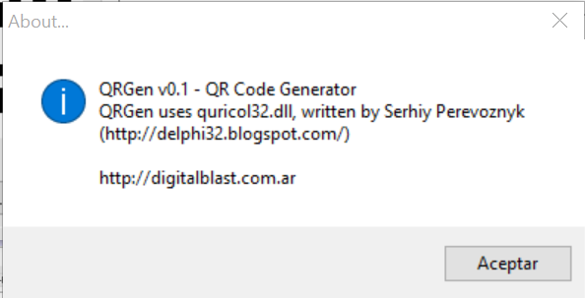
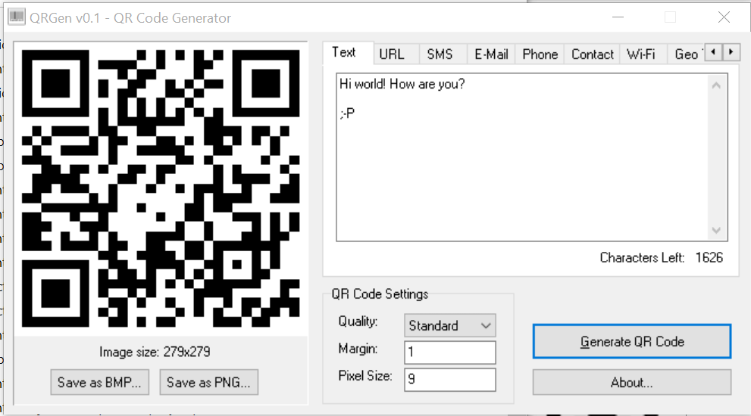
Program: https://norfipc.com/ftp/varios/generador-codigos-qr-js.zip https://www.tec-it.com/en/download/free-software/qrcode-studio/Download.aspx http://digitalblast.com.ar/software/qrgen.rar
if you chose the first link, The java-script program code is shown that can be used in a net navigator such as mozilla or any other.
But if you prefer use a traditional Windows user interface, you can choose the last link, which will allow you to download a portable program, which doesn´t need to be installed and is able to create qr codes.
Notes:
The links provided here were working when this document were being written. However, with constant changes to the net, they may not be working when you try it, so I’m really sorry if this is your case, but probably if you search something similar in google, bing, or yahoo you can find something similar. Well, talking about the links, if you chose the first link, this provides you the java-script program code to be used in a net navigator such as mozilla or any other. But if you prefer use a traditional Windows user interface, you can choose the last link, which will allow you to download a portable program, which does not need to be installed and is able to create QR codees.

Slide 7
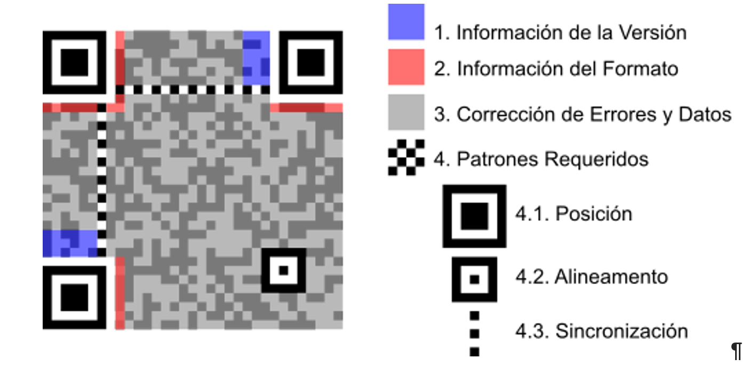
What information can be encoded inside?
We can encode a lot of information inside of a QR code picture, from text that we want to encrypt to a sequence of numbers for a bar code to identify a product or a place. But, if we want to insert more complex information, such as the movement of a chess game, we can find more additional info surfing the net with the links recommended.
Data capacity of QR code:
only numeric
Max. 7,089 characters
Alphanumeric
Max. 4,296 characters
Binary
Max. 2,953 bytes
Kanji / Kana
Max. 1,817 characters
Information about the QR type
Information about the QR format
Error correction
Pattern required
Position
Alingment
Syncronization
Notes:
We can encode a lot of information inside of a QR code picture, from text that we want to encrypt to a sequence of numbers for a bar code to identify a product or a place. But, if we want to insert more complex information, such as the movement of a chess game, we can find more additional info surfing the net with the links recommended.
The image contains the basic areas in which a QR code is divided and next to it there is some information regarding the capacity of a QR code.

Slide 8
Links & references
https://es.wikipedia.org/wiki/C%C3%B3digo_QR
Historia de los códigos QR en la página oficial de Denso Wave.
http://www.interajedrez.com/qr/index.html
https://play.google.com/store/apps/details?id=la.droid.gps&feature=more_from_developer#?t=W251bGwsMSwxLDEwMiwibGEuZHJvaWQuZ3BzIl0.
«El cementerio judío se moderniza: códigos QR y entierros on line». EL PAÍS. 24 de marzo de 2014.
«Codigos QR para ayudar a enfermos de Alzheimer». 23 de septiembre de 2014.
http://storify.com/cdperiodismo/crea-codigos-qr-desde-tu-navegador
Sitio oficial del QR Code (en inglés)
https://norfipc.com/descargas-gratis/como-usar-crear-leer-codigos-qr-generador-gratis.php
http://www.qrcode.com/en/
http://www.iso.org/iso/prods-services/ISOstore/store.html
http://www.qrcode.com/en/about/standards.html
https://norfipc.com/descargas-gratis/como-usar-crear-leer-codigos-qr-generador-gratis.php
Notes:
Finally to conclude, this topic, here we have several links in relation to the QR codes. Some of them are quite technical, others are for everyone and others contain real applications of the QR code in the industry or the storage methods for critical solutions.

