Slide 1
Interesting Facts About Water
By Group 6

Slide 2
Water
-1 liter of used motor oil poured into the river or sewage system is able to contaminate one
million liters of water.
-Loss of water from the body at the level of 10% is dangerous for your health, but 20% loss of
water causes death.
- The water content in various parts of the body:
Brain - 75%
Bone - 22%
Kidney- 83%
Muscles- 76%
Blood- 83%

Slide 3
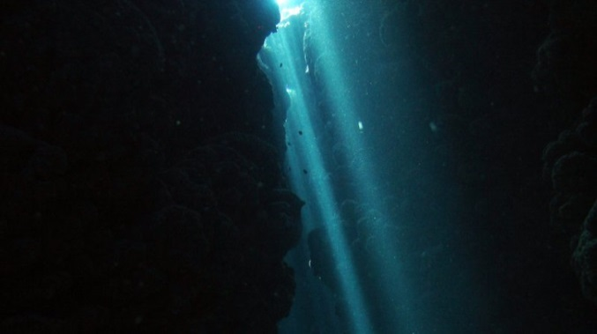
Intresting places
The Challenger Deep in the Mariana Trench is the deepest point in the Earth's seabed with a
depth of 10911 m below sea level. If we put the Mount Everest on the seabed in the
Challenger Deep, it would take 2 kilometers of diving to reach the mountain's peak.

Slide 4
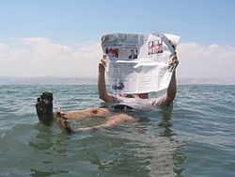
Weird Water
On the border between Jordan and Israel there is the Dead Sea which is in fact a huge lake. It
has high density so a person who cannot swim floats on its surface.

