Slide 1
Ramadan
A special celebration for the Muslims

Slide 2
Table of contents
What is the ramadan?
How is fasting done in islam?
What meals are prepared for breaking the fast during the month of Ramadan?
Isn't it unhealthy not to drink anything during fasting?
When does lent beginn?
Who is obliged to fast and who not?
How do Muslims families celebrate the sugar festival?

Slide 3
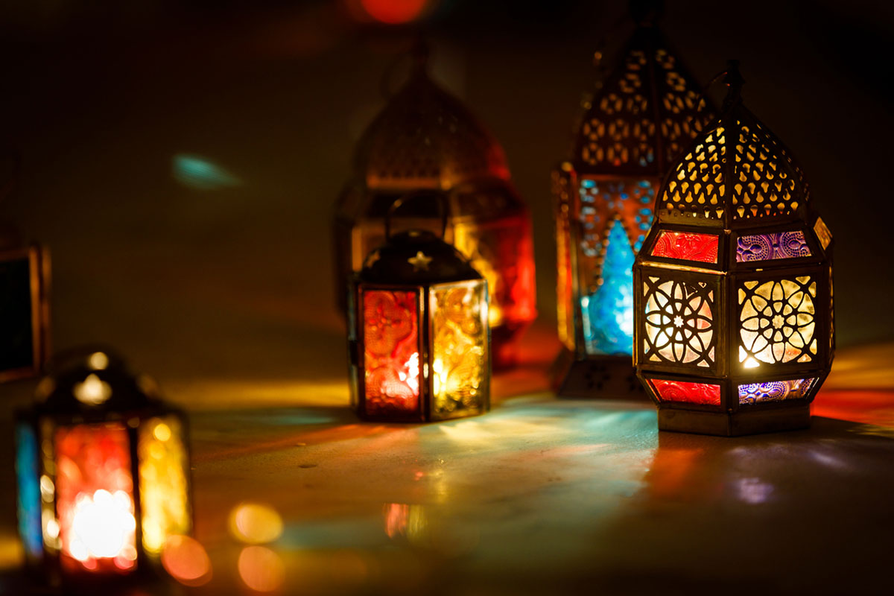
What is the Ramadan? .It is one of the five rules (Main duties) of islam .The five-time prayers a day, the pilgrimage to Mecca and the payment of the Zakat are the other rules

Slide 4
How is fasting gone im islam?
External Fasting:
inner fasting:
The muslims does not drink and eat until sunset
You should also abstain from sleeping with your partner
Muslim should also always keep himself from sins
not to look at anything reprehensible consciously
Dont speak badly
hear nothing evil and do nothing despicable

Slide 5
How is fasting im Islam?
For fasting means recognizing that one is in truth dependent solely on God.
At the same time, the fasting should become aware that he can and must renounce his supposed dependence on others.
He is a pilgrim who has set out with his fast to his Creator and leaves behind everything he is used to but not necessarily needed.
In addition, when the Muslim fasts, he deals more intensively with the remaining services such example prayers or reading the Koran.

Slide 6
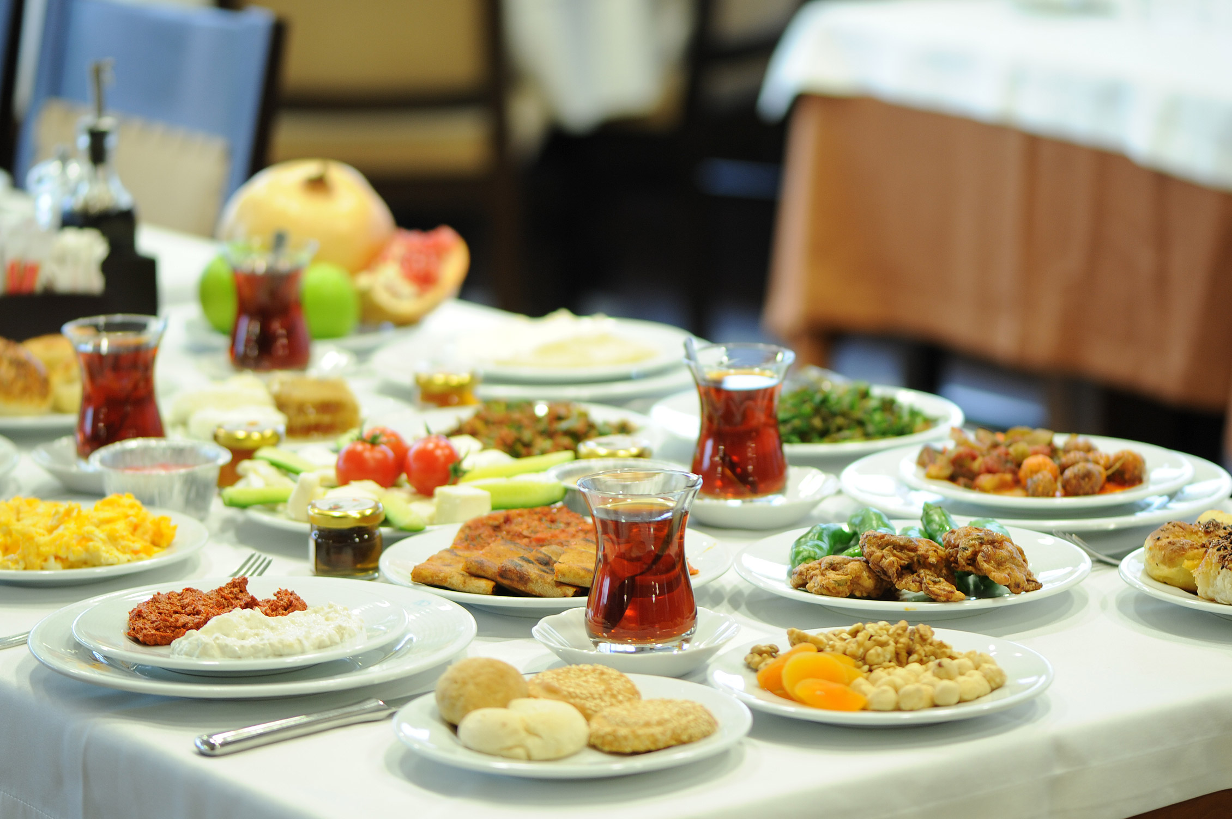
What meals are prepared for breaking the fast during the month of Ramadan?
this depends on the respective eating habits and the cultural background of the fasting Muslim.
Often a hot meal is prepared in the evening, but many enjoy the atmosphere of the fasting month and being together with family and friends and attach less importance to the food.

Slide 7
Isn't it unhealthy not to drink anything during fasting?
if you are physically fit, no damage will occur
In addition, the renunciation of food causes you to feel less thirsty

Slide 8
When does lent beginn?
Ramadan takes place in the ninth month of the Islamic lunar calendar
Thus, the month of Ramadan shifts forward 10 or 11 days a year and gradually passes through all seasons
A Muslim will therefore experience fasting days in the course of his life both in winter with shorter days, and fasting days in summer, when the days are long and fasting becomes more difficllt
If a certain fixed season were set for fasting, it would mean a permanent advantage for some of the followers of Islam in different parts of the world, for others a permanent disadvantage.

Slide 9
Who is obliged to fast and who not?
Who are
Who not
applies to every mentally accountable Muslim so for men and women
children who are in puberty
children who are not ready should fast for a few days to get used to it
sick People
Pragnant Women
Nursing mothers
Women in menstuartion

Slide 10
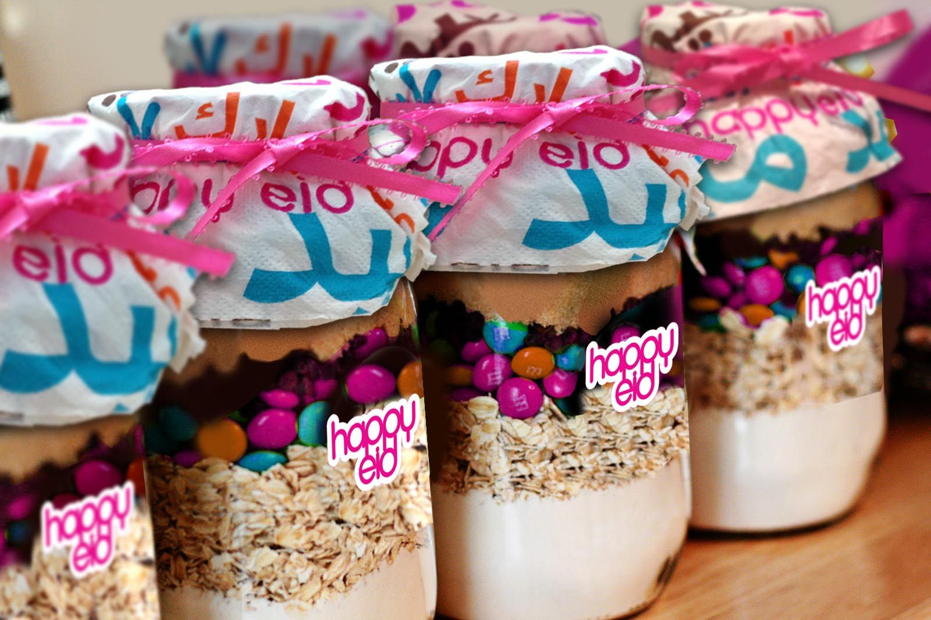
How do Muslims families celebrate the sugar festival?
The festival last for three days
is celebrated directly after the month of fasting
on the first day everyone dress smartly
you get new clothes from the family
There are many sweet
it is also donated so that families in poor countries can make themselves comfortable on the days

