Slide 1
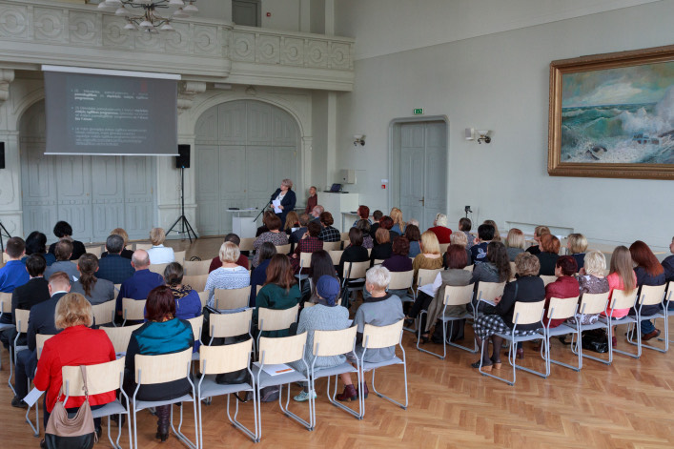
LACK OF PRIMARY EDUCATION
By Migration 2

Slide 2
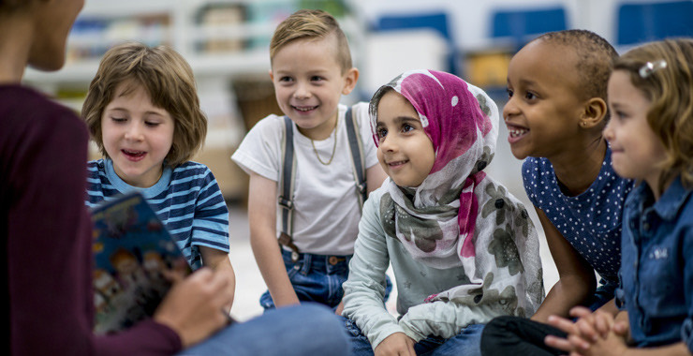
THE PROBLEMS
Many people who immigrate to new countries haven’t had any access to a public primary education in their native countries.
They don't often know the language well so they don't socialize so much with the local people.

Slide 3
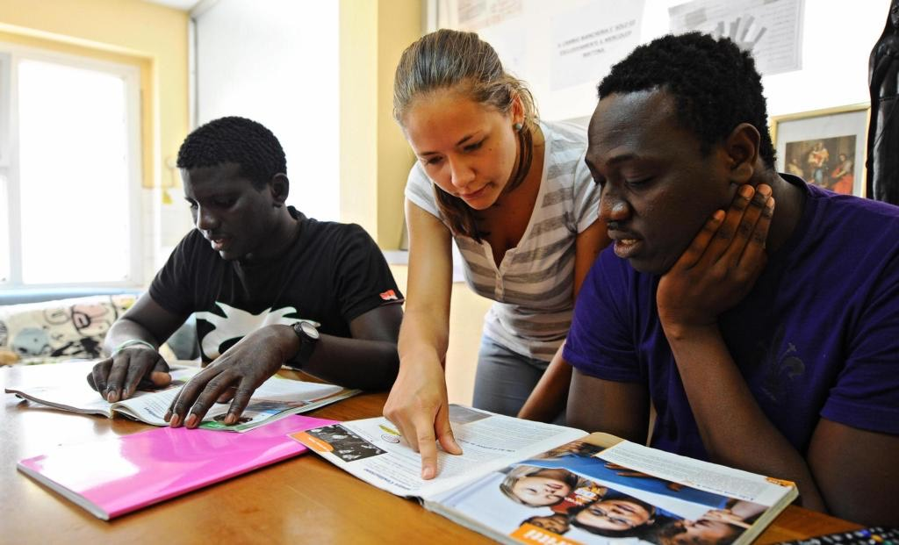
POSSIBLE SOLUTION
It could be a great idea, for us, to organize courses in libraries or schools in the afternoon or in the evening run by students, teachers and also volunteers.
Thanks to these free courses people could learn the language faster and in doing so better integrate into society and increase their employment opportunities

Slide 4
WHERE WE GET THE MONEY FROM
We don’t require a lot of money because our idea is based on volunteers that can also help us raise funds.
To acquire the necessary funds we would organize a fundraiser with the help of the city.

Slide 5
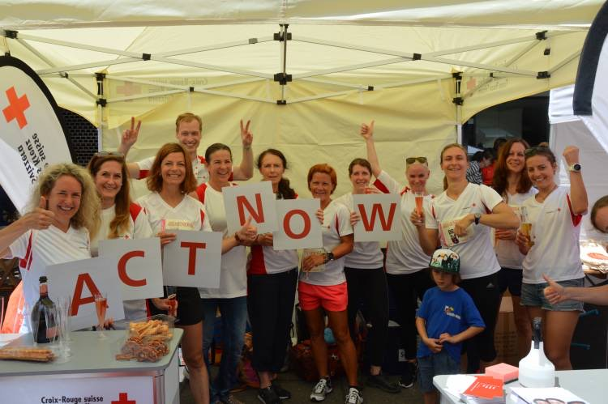
IS OUR IDEA DEMOCRATIC?
We think that our idea is democratic because it can help people to better integrate into society and therefore increasingly participate in the democratic process.
People all together should decide when there are problems.

Slide 6
WHY WE CHOSE THIS IDEA?
We have noticed that in our village/town there are a significant amount of people who come from other countries who don’t know how to speak the local language well.

Slide 7
THE END
Thank you for your attention!

