Slide 1
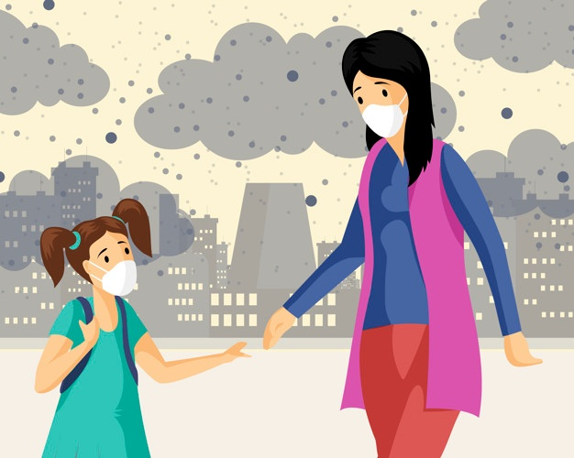
Air Pollution
POLLUTION 1 GROUP:
Alessandro, Eline, Claudia, Alise F, Alise Ķ, Pauls, Til and Lasse.

Slide 2
Index
●
AIR POLLUTION
●
CAUSES & CONSEQUENCES
●
OUR SOLUTIONS
Environmental Education
Circular economy
Promote to use public transports
Reward system
●
BUDGET

Slide 3
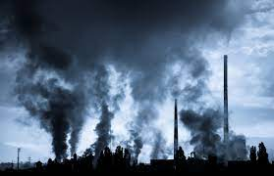
What is air pollution? Why did we choose it?
Air pollution is one of the most serious environmental problem confronting our civilization today. This problem touches a plenty of different countries , for example, Germany, Latvia, Spain , Italy and Norway.
A large number of contaminants may pollute the air in a large variety of forms.
If we do not start to solve this problem then the effects will be really tragic.

Slide 4
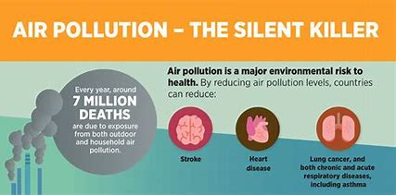
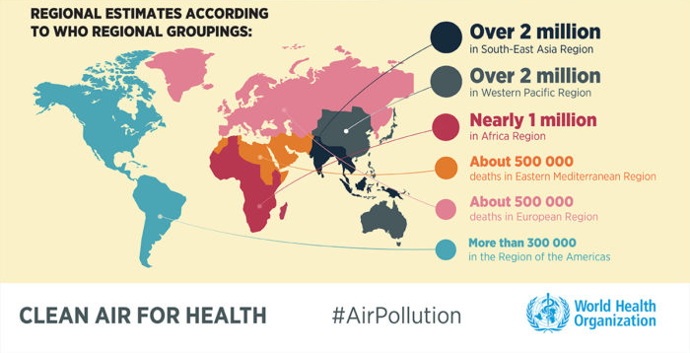
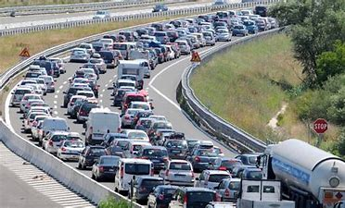
Causes and consequences
The most common causes of air pollution are transportation, wildfires and factories. It’s also caused by the use of toxic products used for cleaning or by the use of chemical pesticides and fertilizers in agriculture activities.
Air pollution accounts for an estimated 4.2 million deaths per year due to stroke, heart disease, lung cancer, lung cancer acute and chronic respiratory diseases. It also can causes acid rains, global warming, the greenhouse effect and so on.

Slide 5
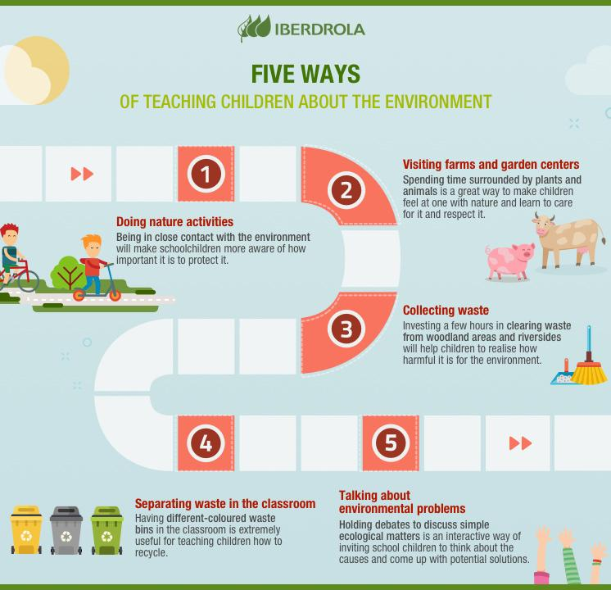
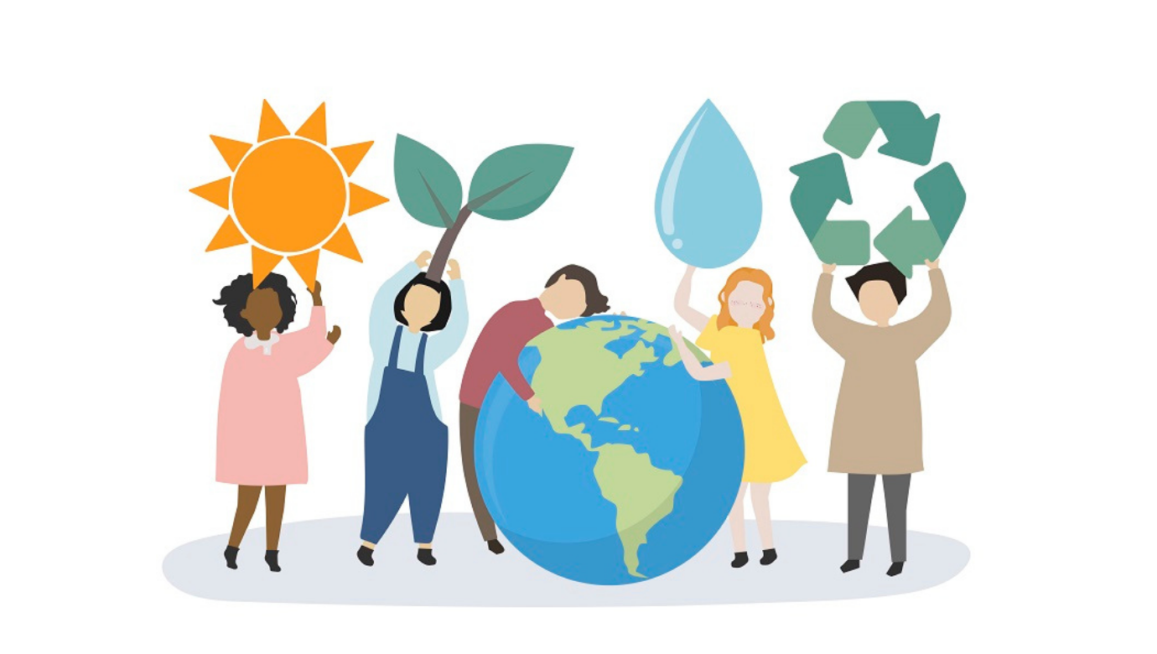
Solution 1. Environmental education:
Lessons about ecology and pollution by specialists and scientists.
Provide since childhood some lessons or courses about the Earth. This could make people concerned about our pollution problems and what do them lead to.
What’s more, promoting these information on social media can make that everybody is aware of it, and the message can arrive to all ages.

Slide 6
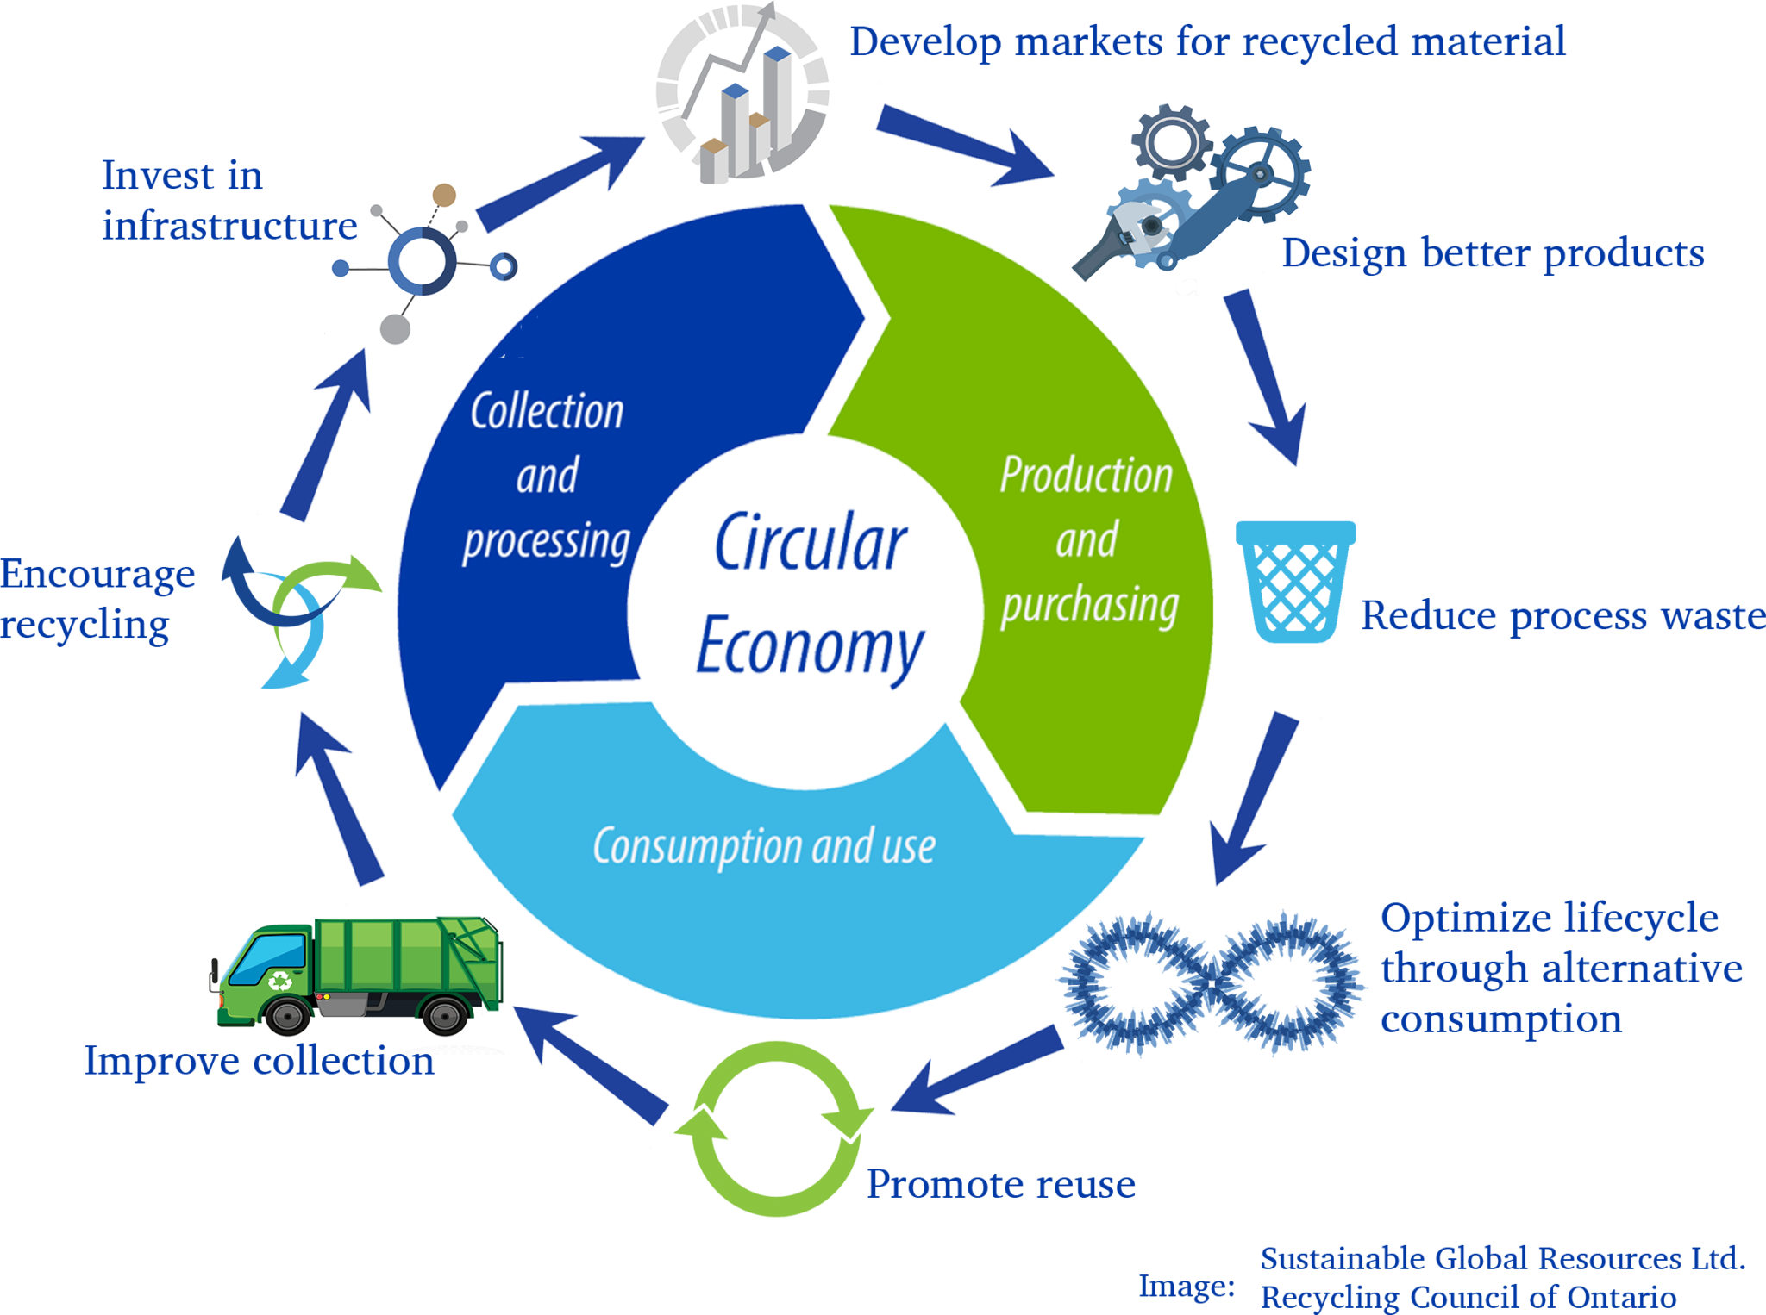
Solution 2. Circular Economy:
Circular economy is a model of production and consumption to extend the life cycle of products.
It’s divided in three major parts: production, use and recycle.
Circular economy is used by some big companies, for example Renault uses it to extends the life of vehicles, and Ikea use it for furniture’s materials. All the industries should use this system to help to defeat the air pollution.

Slide 7
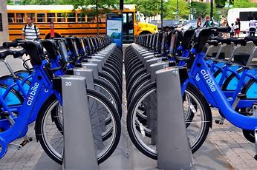
Solution 3 Promoting the use of bicycles and public transport.
An average car produces 6 tonnes of pollutants each year.
Burning fossil fuels in cars releases carbon dioxide, as these gases build up they trap heat in the atmosphere, causing climate change.
By using public transport less of the dangerous gases will be used.
Using bicycles isn't only good for the environment but it also can help people being more active and healthy.

Slide 8
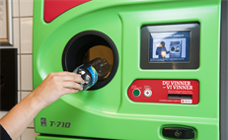
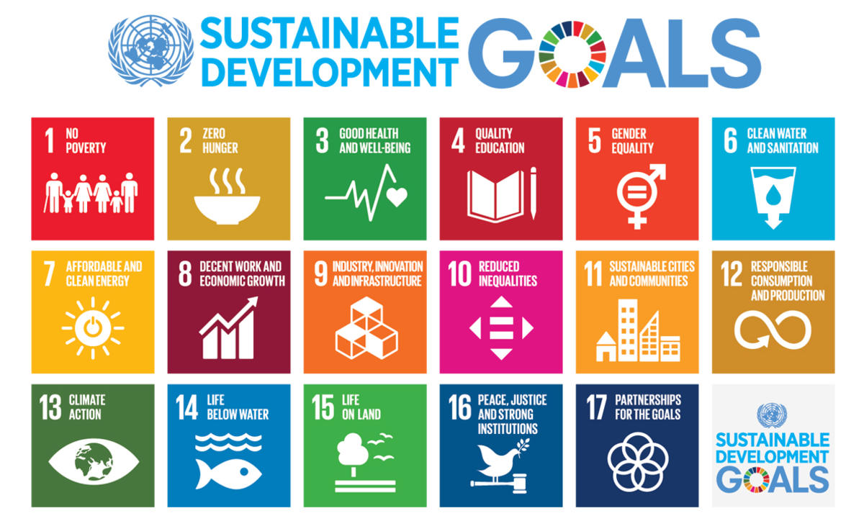
Solution 4. Reward system:
Reward those who do not pollute.
We could make apps, where you can buy used clothes and then get rewards for it. For example when buying or selling clothes on this app, you will gather “cash” for which you can buy different sustainable offers. It could be discounts, lottery for competitions and so on. By doing this we would reach sustainable goal 10, 11, 12 and 13.
In some countries this method is already used, but the pawn machines is an effective way of getting rid of plastic bottles and then getting a reward for it. This solution should be internationalised.

Slide 9
Budget
This could be an expensive project, because it includes many costs as:
Experts and teachers’ salaries.
Drivers for public transport.
Changes in the factories and their ways of production.
Rewards and pawn machines.
All this costs can be paid with government financial support, and with some volunteers.
But this project has more benefits apart from reducing the air pollution, it will create new employment opportunities and it will make improve some environmentally-friendly companies.

Slide 10
Thank you for your attention !
Do you have any questions?

