Slide 1
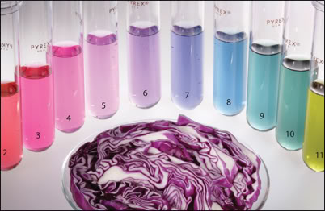
pH measurement with a homemade indicator

Slide 2
OBJETIVES
Familiarize students with the concepts of acid, base, pH and indicators.
Perform pH measurements using acid-base indicators and pH scale.
To ensure that students are able to identify the acidic or basic character of substances commonly used in everyday life.

Slide 3
THEORETICAL FOUNDATION
Acids and bases
Arrhenius`s theory
Acid: $HCl→H^{+}(aq)+{Cl}^{−}(aq)$
Base: $NaOH→{Na}^{+}(aq)+{OH}^{−}(aq)$
Brönsted-Lowry`s theory
Acid: $HClO_{4}→H^{+}+{{ClO}_{4}}^{−}$
Base: ${NH}_{3}+H^{+}↔{{NH}_{4}}^{+}$

Slide 4
CONCEPT AND pH SCALE
$$pH=−\log\left[{H_{3}O}^{+}\right]=−log\left[H^{+}\right]$$
Acid dissolution pH < 7
Neutral dissolution pH = 7
Basic dissolution pH > 7

Slide 5
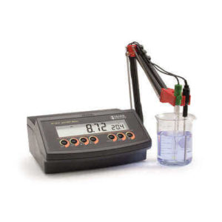
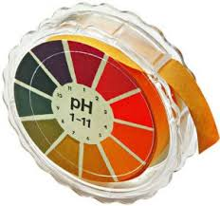
pH MEASUREMENT
Colorimetric methods
or
- Electrodes and a millivoltmeter (pH meter)

Slide 6
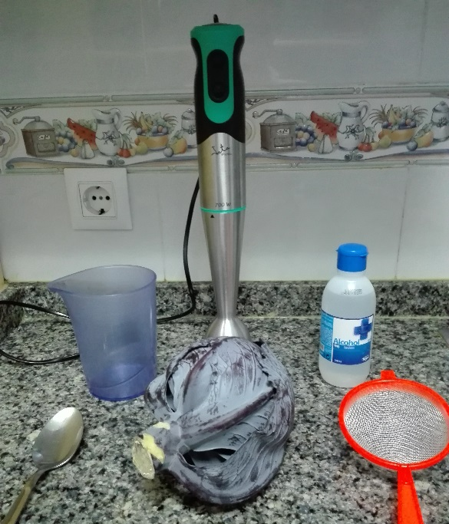
MATERIALS
Preparation of the acid-base indicator
Red cabbage.
Alcohol.
Strainer.
Glass.
Blender and glass.
Soup spoon.
PH measurement:
Plastic cups or test tube
Syringe.
PH scale
Substances to which the pH will be measured: lemon, orange, bleach, water, toothpaste, vinegar, milk and ammonia.

Slide 7
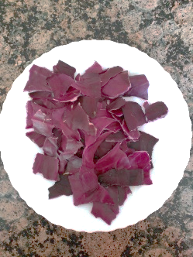
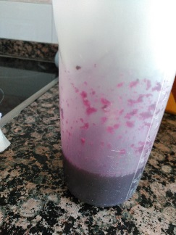
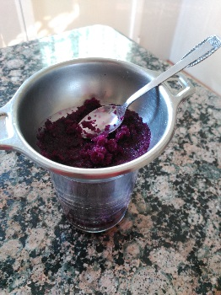
PROCESS
Split several cabbage leaves
Add alcohol
Shake
acid-base indicator
Extract the liquid
red cabbage extract

Slide 8
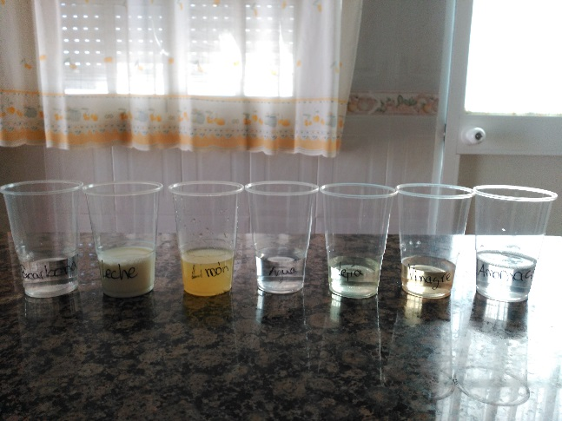
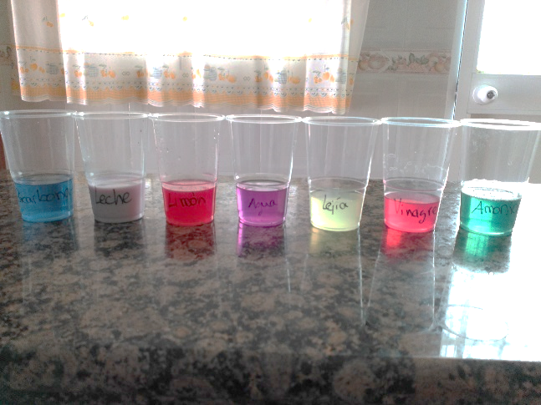
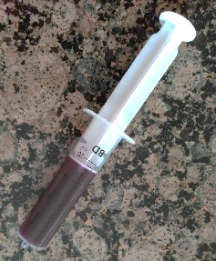
Add a few drops of cabbage extract
Add a small amount of the substance you want to measure in each glass
Shake and observe color change
pH scale

