Slide 1
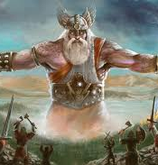
Slavic mythology
Ivana Brlić Mažuranić: Priče iz davnine

Slide 2
Introduction
The old Slavic mythological and religious system lasted for about six centuries, until the arrival of Christianity.
Most Slavic myths feature gods who have dual and opposite aspects.
A number of seasonal rituals and celebrations were held according to agricultural cycles.
It is believed that Slavic mythology can trace its roots back to the Proto-Indo European period, and perhaps as far back as the Neolithic era. The early Proto-Slav tribes split into groups, consisting of the East, West Slavs, and South Slavs. Each group created its own distinct set of localized mythologies, deities, and rituals based upon the beliefs and legends of the original Proto-Slavs.

Slide 3
Main gods
Perun - the god of justice, war and weapons, thunder and lightning (Gromovnik). Depicted as a sacred tree, usually an oak, whose branches and bark represent the living world of heaven and mortals, heaven and earth, and its roots the underworld, the world of the dead.

Slide 4
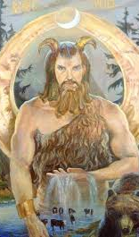
Veles
Volos or Voloh in Slavic mythology is the god of the earth, water and underground; it is associated with dragons, cattle, magic, musicians, wealth and deception. Perunov is the main opponent. Its symbol is a snake or a dragon.
He constantly challenged Perun by stealing his cattle, children (son Jaril) or wife. Perun chased Veles across the earth, attacked him with his lightning bolts from the sky, and Veles fled by turning into various animals or hiding behind trees, houses or people. In the end, Perun managed to kill Veles - he drove him into his water underground. In that ritual death, whatever Veles stole would fall from his body in the form of rain from heaven. This explained the change of seasons

Slide 5
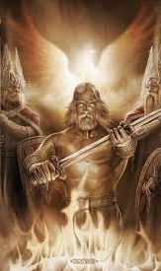
Svarog
is the god of fire and sky, the creator of everything in heaven and earth, the first deity of the Sun among the Slavs. Svarog forged the sun and placed it in the sky, so it is connected with the sky, wrought iron and fire. he has two sons: Dabog and Svarožić.

Slide 6
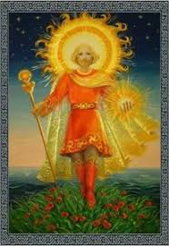
Svarožić
is the young god of the Sun, fire and the cooperative hearth. One of the two sons of the god Svarog, a child of heaven and a guardian of his father's fire. He is a benevolent god, protector of life, radiates his warmth and light, but at the same time he has his destructive power, he can turn into a catastrophe, a destroyer and a murderer. Therefore, he was respected as a god of war, but also a fighter against evil forces, and when fire burns and destroys, it is also a symbol of purification and rebirth. The victims were men and domestic animals.

Slide 7
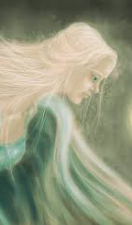
Danica
is a prominent figure in folk poetry and Slavic pre-Christian mythology. She is the bright goddess of twilight. The ancient Slavs considered her the protector of the human dream. The first light body to appear in the evening sky is the Evening Star or Evening Star, in fact the planet Venus when it appears in the morning sky.

Slide 8
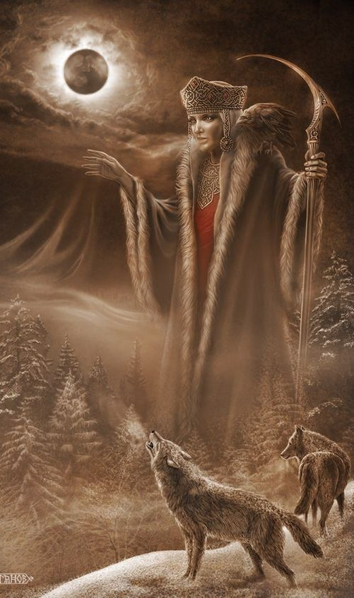
Morana
is the goddess of death and winter, rain, cold and ice. The ancient Slavs believed that all winter disasters, cold, snow, ice and death came from Morana, and called her the goddess of death of the human, animal and plant world.
It appears in various forms. The most common figure is a beautiful girl with black hair and extremely white skin wolf fangs and claws on her hands. Morana flew on a broom and sailed on an egg shell and these qualities will, later, be attributed to a new spiritual being - a witch.

Slide 9
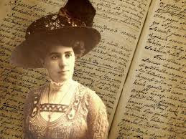
Ivana Brlić Mažuranić
famous Croatian writer, 1874-1938
4-times nominated for Nobel Prize
Croatian Andersen and Talkien
Croatian Tales of Long Ago – famous tales based on Slavic mythology, translated in many languages

Slide 10
How Quest Sought the Truth
CHARACTERS:
Vjest - old man, grandfather
Ljutiša, Marun and Potjeh (Quest) – grandchildren
Svarožić - god of light
Bjes – angry part of each human described as a character that talks to grandchildren (Fury, Rage)

Slide 11
How Quest Sought the Truth
FIRST PART:
In a very long time ago, an old man Vjest lived in a mountain with three grandchildren named Ljutiša, Marun and Potjeh. One day the grandfather sends his grandchildren for a honey to the forest, it was dark and the grandchildren start talking about the world, but then they realize that none of them were further from this forest. So they start singing a song to Svarožić to give them light. And while they were singing like that, Svarožić appeared to them and he took them around the world and told them that they must not leave their grandfather until they returned his love for him. But when Svarožić brought them back to the mountain where he took them from, they forgot all that, and they could not remember what Svarožić told them.

Slide 12
SECOND PART: There was a demon Bjesmoar in the forest who really wanted to get rid of the old man. So when the grandchildren returned to the grandfather and told him the story of Svarozic who was asked what he had said, Bjesmomar sent 3 rages, for each one, to persuade the grandchildren what they were saying. Ljutiša and Marun say that Svarožić told them that he would be the richest and strongest man in the world, but Potjeh, who loved the truth, did not allow himself to be seduced by this persuasions and simply said that he did not know what Svarožić said. So Ljutiša and Marun listened to their rages and did everything they wanted, but Potjeh was unable to persuade the rage and he decided to seek the truth.

Slide 13
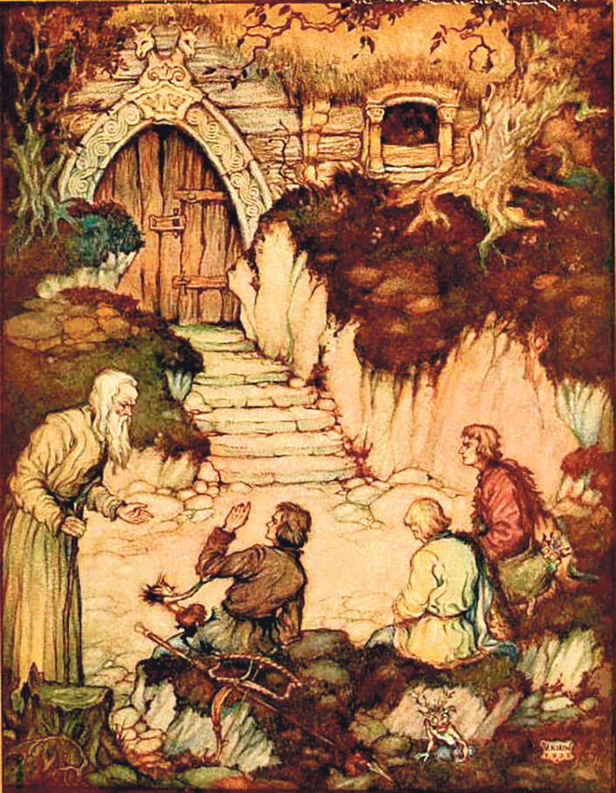
THIRD PART: So Potjeh said goodbye to his grandfather and went into the woods, sat down under a wild apple and tried to remember what Svarožić had told him. But Potjeh's anger did not give up, he constantly disturbed him, and when a thought came to Potjeh's mind, the rage would immediately distract him. In the meantime, the rages of Ljutiš and Marun did their job well. So one day they persuaded them to get rid of their grandfather. Ljutiša and Marun snuck into their grandfather's hut at night, set it on fire and went for a walk around the mountain so as not to watch their grandfather burn. Grandfather woke up and saw the house on fire, he immediately realized what had happened and began to wait calmly for the fire to take him to himself.

Slide 14
FOURT PART: At that same moment, a little further away, Potjeh wakes up and points to Svarožić and tells him what he told him the first time he saw him. All happy to have learned the truth, Potjeh goes to the well to wash himself, but accidentally falls into the well and drowns. Potjeh's rage, full of sorrow, begins to scream and roar above the well. Ljutiša and Marun happened to pass by on their way back from the walk, and when their rages heard the roar, they quickly reached him and took him to Bjesomar.

Slide 15
FIFTH PART: Then, for the first time in a year, Potjeh's two brothers were left without their rages. They see the lifeless body of Potjeh and remember that they set fire to their grandfather's house. They quickly run there and arrive at the last minute and rescue the grandfather from the fire and inform him of the death of his youngest grandson. Grandpa forgave them for everything they had done, and immediately led them through a path in the woods where they had never been before. After a while, they reached a large, white cloud on which was Svražić's castle. Potjeh was in front of the court and cried because he was not allowed into the court, because he sinned against his grandfather. His grandfather slowly approached the cloud, hugged him together and entered the yard. Ljutiša and Marin, seeing this, return home, later start a family and live in goodness long and happily.

Slide 16
Assignments – Zagreb
Make an audio story in Metaverse. The main topic is ecological disaster caused by bad Gods. The time is present (21st century). They turned a world into a place where men could not live anymore because water, air and soil are polluted. You have to continue the story so that good Gods resolve the problem and bring the world back to normal state. You have to divide your assignments among yourself and decide who will make which part of the story in Metaverse. Basically, you will create five Metaverse stories for five parts of a tale. You will present your work on Thursday.

Slide 17
Assignments – Rijeka
Make a story in Genially. The main topic is ecological disaster caused by bad Gods. The time is present (21st century). They turned a world into a place where men could not live anymore because water, air and soil are polluted. You have to continue the story so that good Gods resolve the problem and bring the world back to normal state. You will present your work on Thursday.

Slide 18
Assignments – Zadar
Make a cartoon story in Pixton. You have to recreate a tale Kako je Potjeh tražio istinu (How Quest Sought the Truth). You have to divide your assignments among yourself and decide who will make which part of the tale in Pixton. Basically, you will create five Pixton cartoons for five parts of a tale. You will do that on Thursday, when you will also present your work.

Slide 19
Assignments – Osijek
Make a cartoon story in Pixton. You have to recreate a tale Kako je Potjeh tražio istinu (How Quest Sought the Truth). You have to change something, and that is to introduce a new character which will change the story but the main line of a tale should stay as it is. Be inventive! You have to divide your assignments among yourself and decide who will make which part of the tale in Pixton. Basically, you will create five Pixton cartoons for five parts of a tale – after that you will gather this parts as one. You will do that on Thursday, when you will also present your work.

Slide 20
Assignments – Dubrovnik
Make an audio story in Metaverse. You have to recreate a tale Kako je Potjeh tražio istinu (How Quest Sought the Truth). But you have to change the end of the story. Be inventive! You have to divide your assignments among yourself and decide who will make which part of the tale in Metaverse. You will present your work on Thursday.

