Slide 1
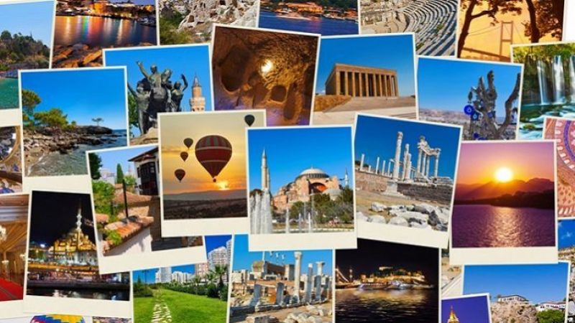
What About Us?

Slide 2
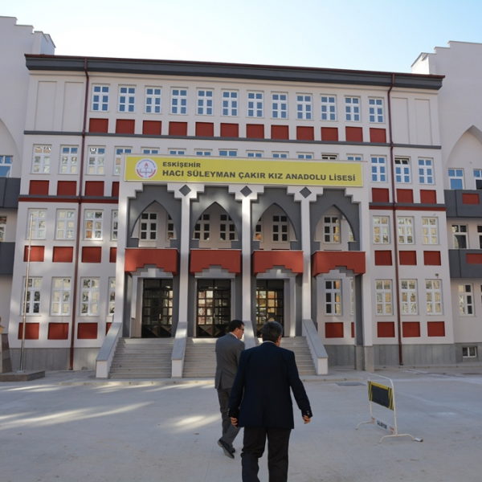
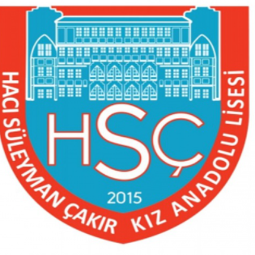
Let's begın wıth...
Hacı Süleyman Çakır Anatolian High School for Girls opened in 1960. Our school takes its name from Süleyman Çakır, who made many donations both in Eskişehir and elsewhere.
The building has 28 classrooms.
At the time being approximately 500 students study in our school.

Slide 3
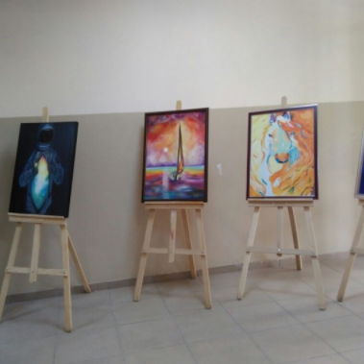
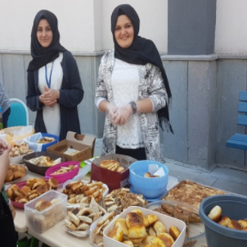
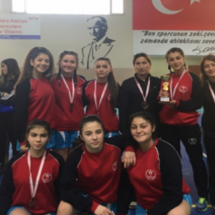
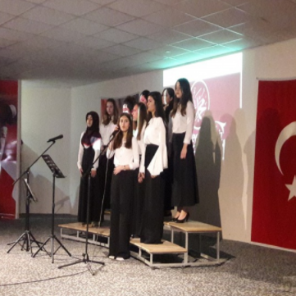
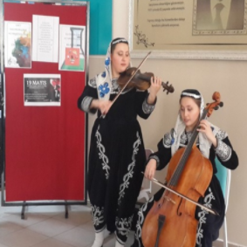
OUR SCHOOL ACTIVITIES
TÜBİTAK (The Scientific and Technological Research Council of Turkey)
Our hentbol team
Painting exhibition
Kermess activities
Our students played cello and violin in the science exhibition
Our school choir

Slide 4
let's take a look at our city.

Slide 5
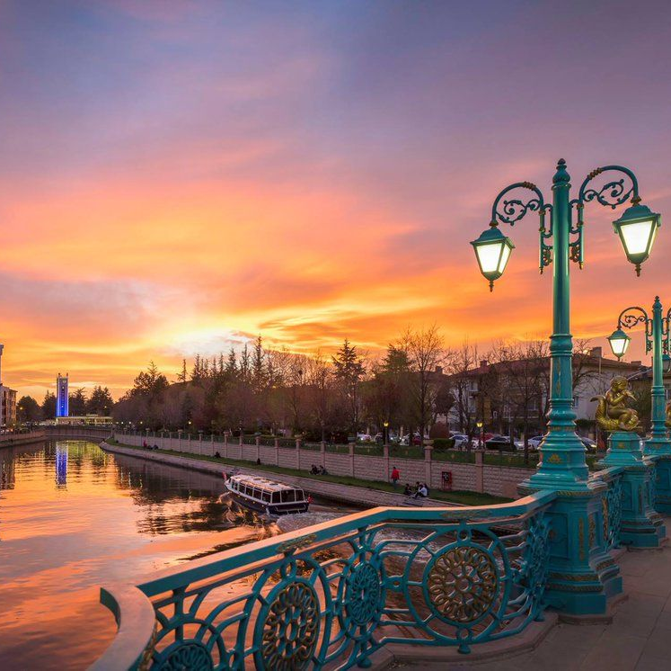
Our History
Eskişehir means old city. Eskisehir, formerly known as Dorylaion from the Phrygians, took this name because it was devastated by the wars in 1176.

Slide 6
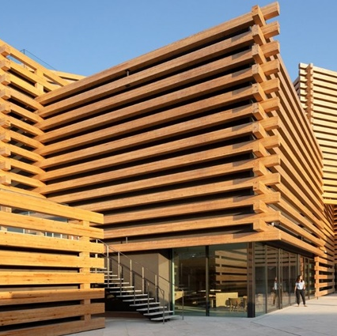
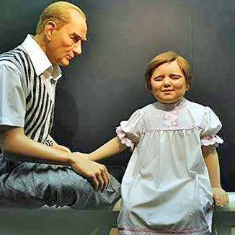
Odunpazarı with its historical houses from the ottoman empire.
Odunpazarı is a touristical place in Eskişehir.

Slide 7
It has a historical architecture that is included in the UNESCO World Heritage List.

Slide 8
Our Porsuk Stream passing through the middle of the city,

Slide 9
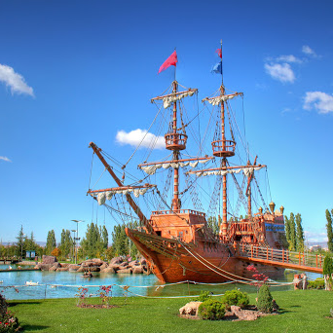
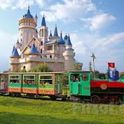
Eskişehir Sazova Science, Art and Culture Park is one of the most beautiful places to visit.

Slide 10
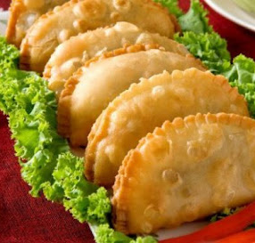
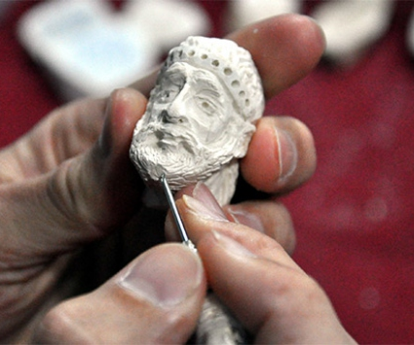
ÇIBÖREK IS ONE OF OUR SPECIFIC DISHES,
Meerschaum (Lületasi) which is also identified with Eskişehir in the same way.

Slide 11
TURKEY

Slide 12
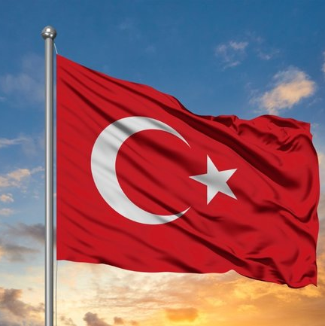
Our Flag
The red on the flag is blood red and represents the spilled blood of the martyrs. Together with the crescent moon and a star reflected on this blood at midnight, it forms the Turkish flag itself.

Slide 13
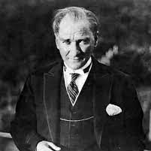
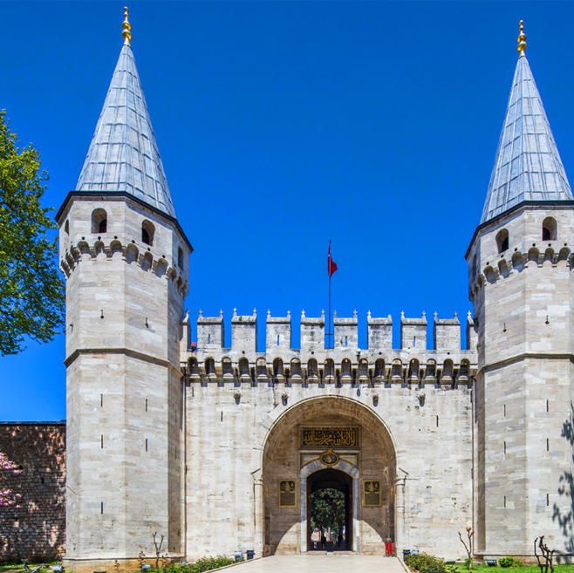
Our history, which started in the 220 BC, has hosted many cultures and nations before that.
Under the leadership of Mustafa Kemal Atatürk and thanks to the Turkish nation, our country became Turkey in 1923.

Slide 14
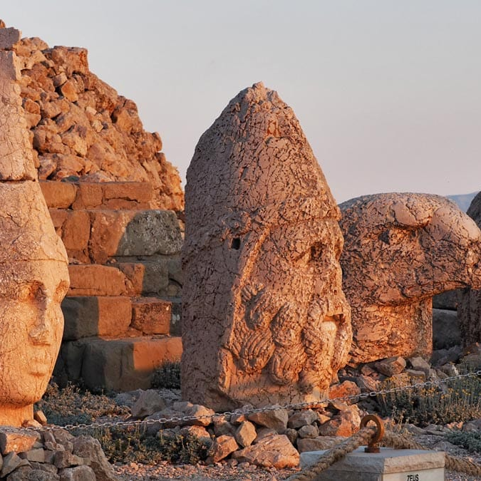
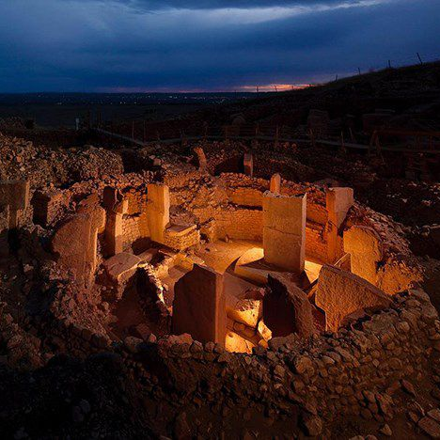
While there are many structures and cultural architecture in our mountains in our eastern region,
(Nemrut Mountains, Adıyaman)
(Göbeklitepe, Şanlıurfa)

Slide 15
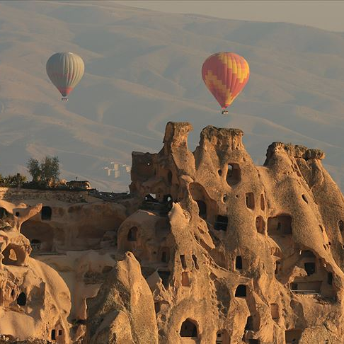
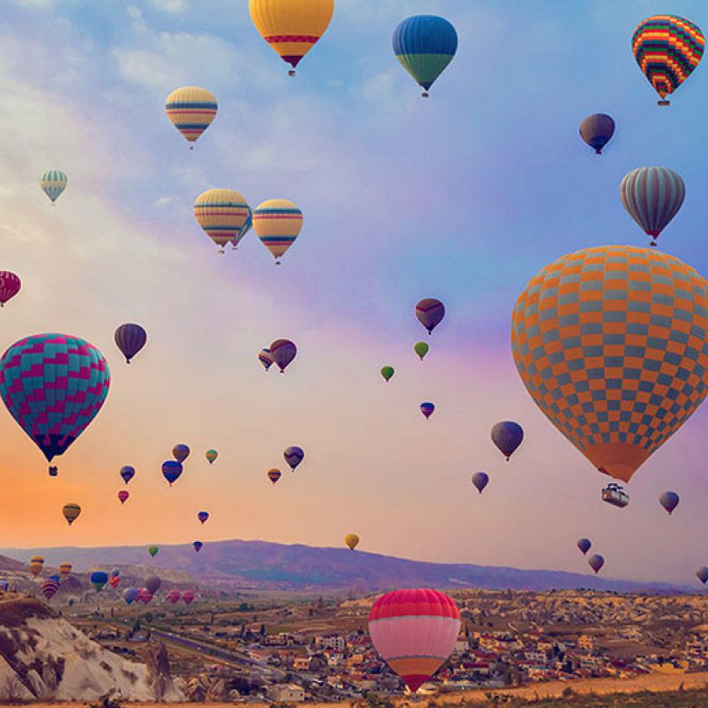
You can see the Peri bacaları (Fairy chimneys) in Cappadocia.
You can enjoy this view with air balloons integrated with Cappadocia.

Slide 16
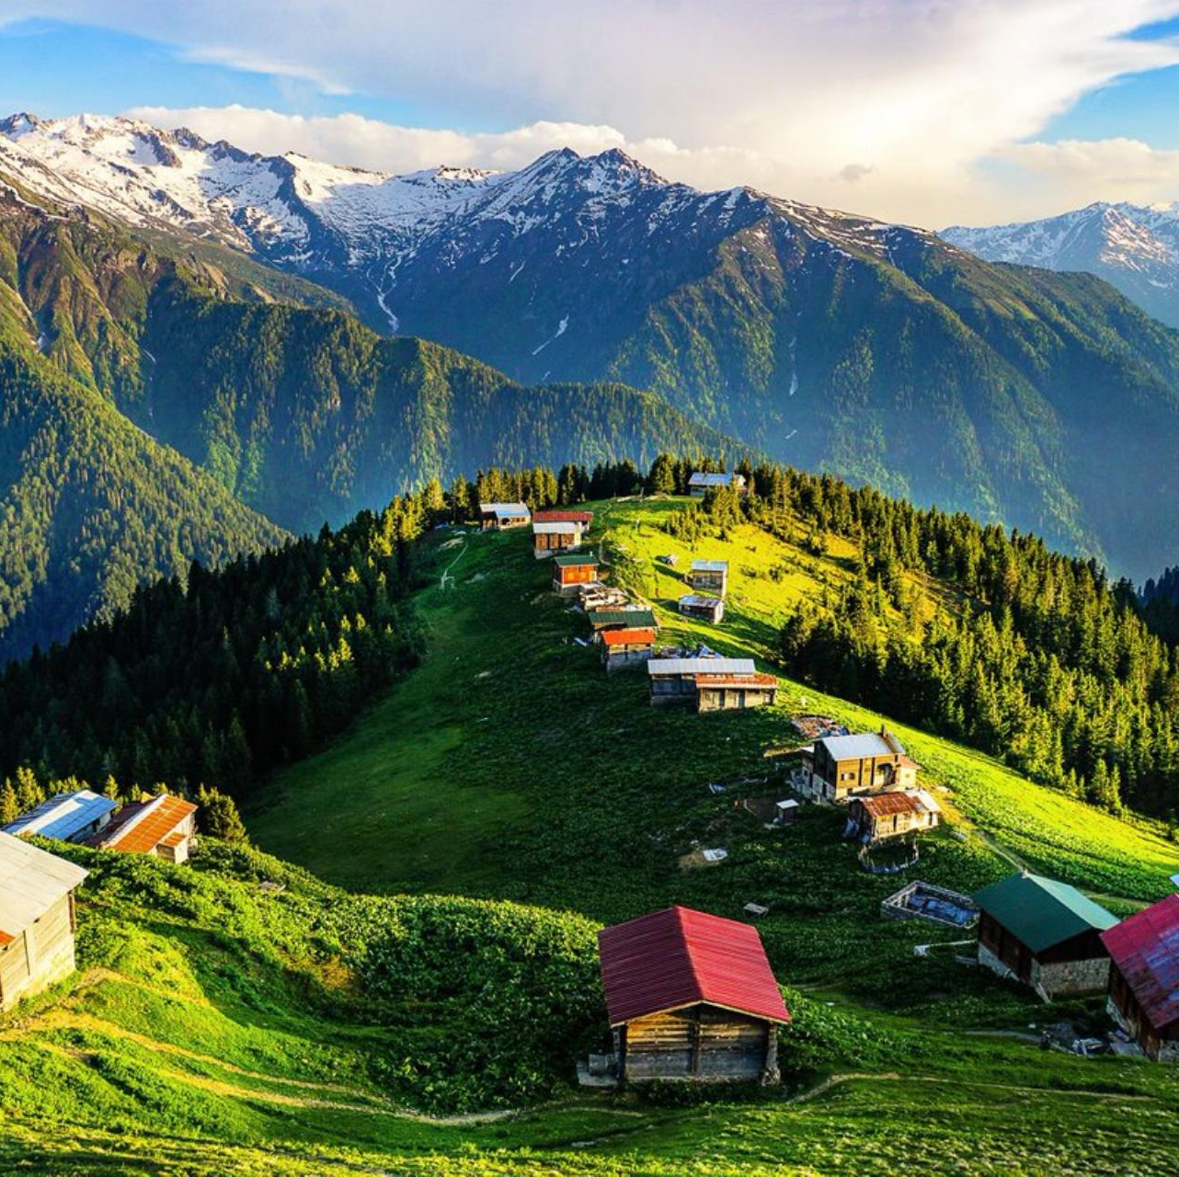
You can discover nature in the mountains where green forests and blue sea meets in the Black Sea.

Slide 17
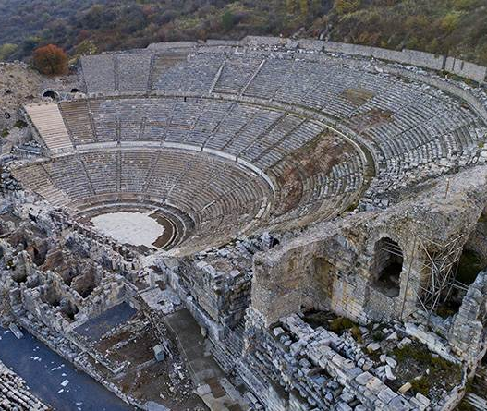
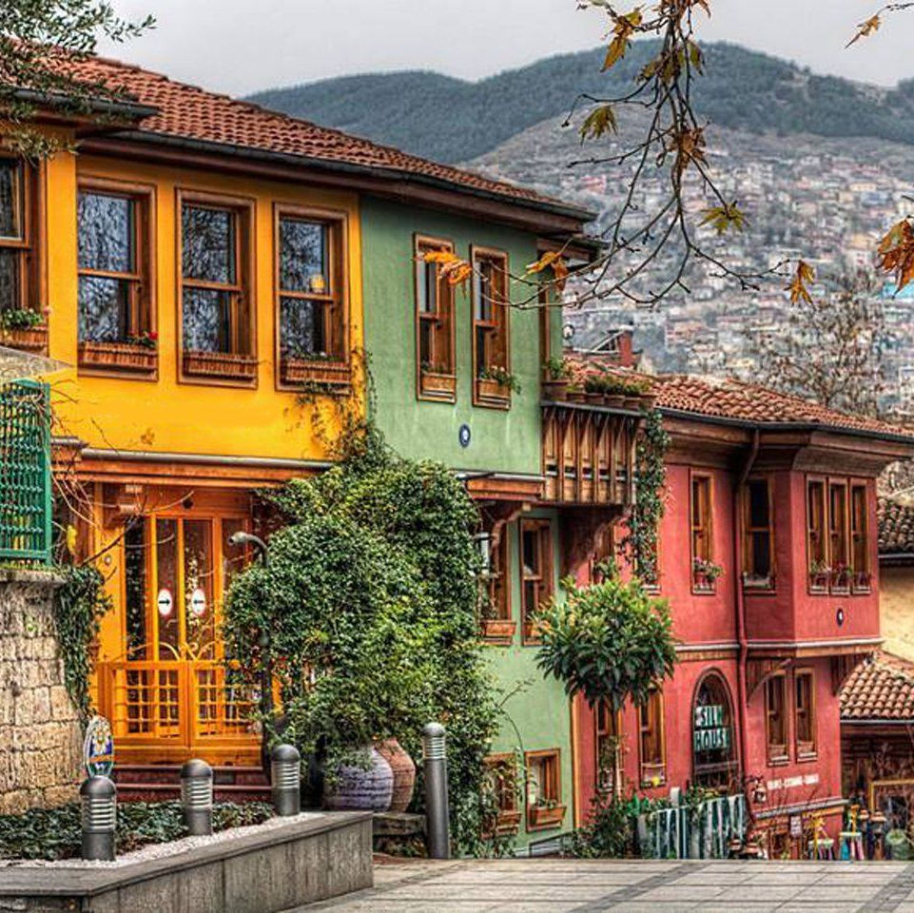
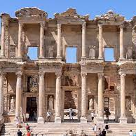
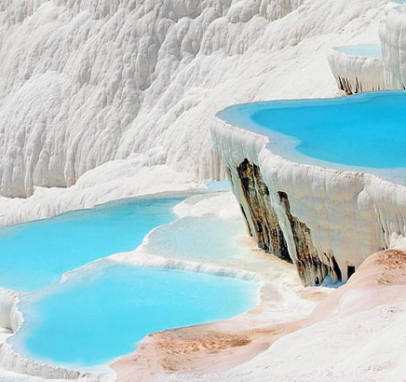
In addition to many natural beauties, we also have many historic structures from various cultures.

Slide 18
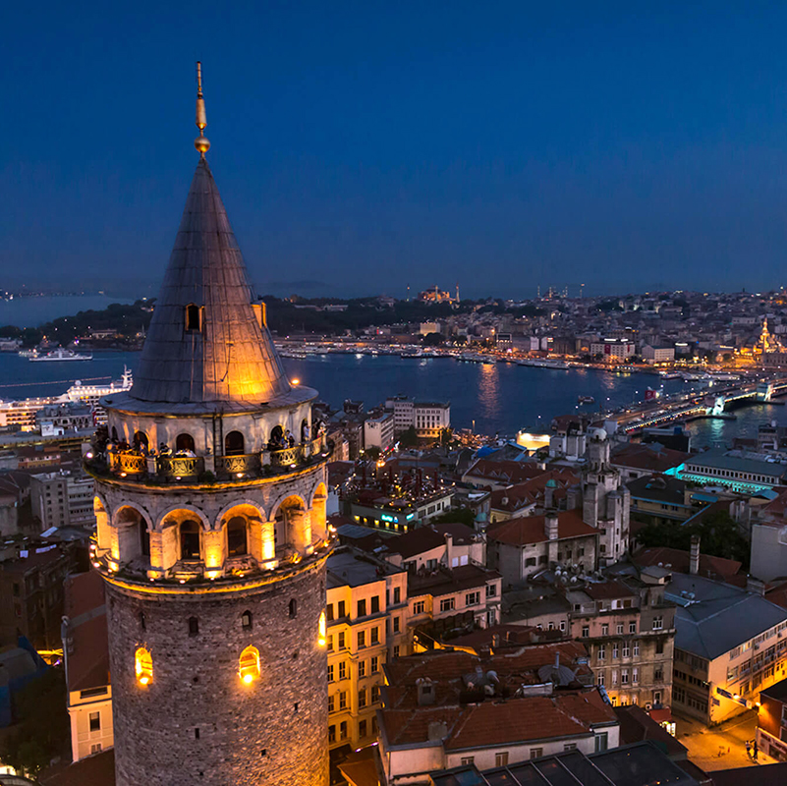
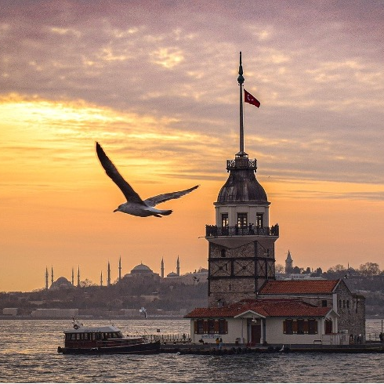
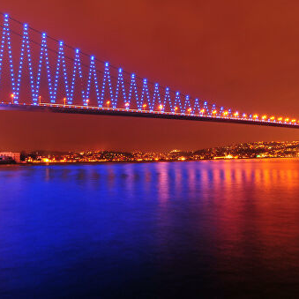
Istanbul, which is the only city in the world with land on two continents, has land in both Europe and Asia.

Slide 19
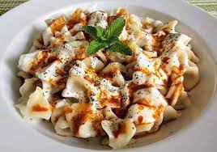
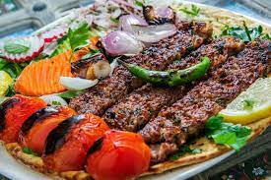
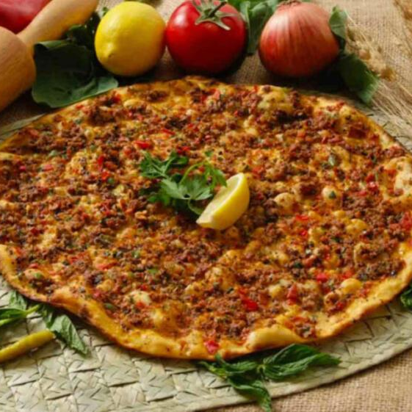
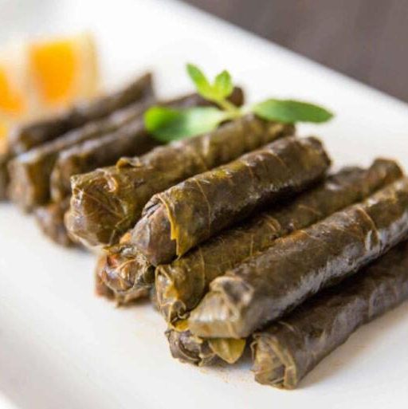
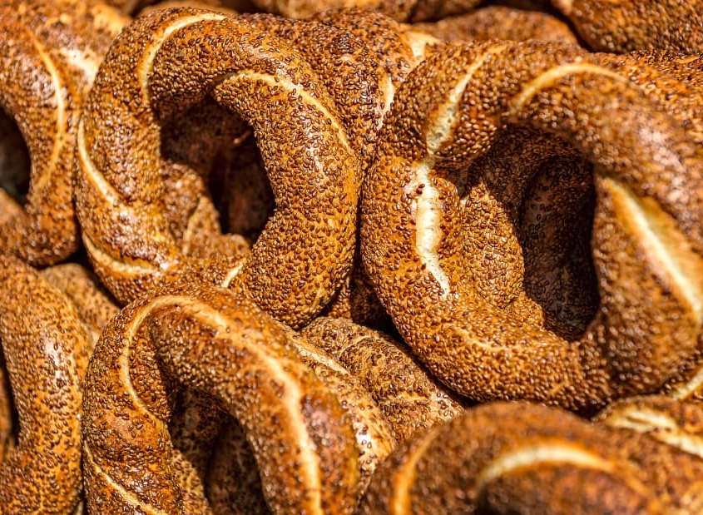
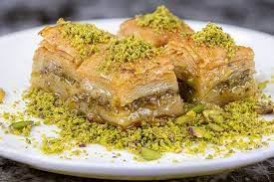
Turkish Cuisine
If we take a look at Turkish cuisine, we can see vegetable dishes depending on the season. There is almost no meat-free meal in Turkey. Likewise, pastries are also very plentiful.

Slide 20
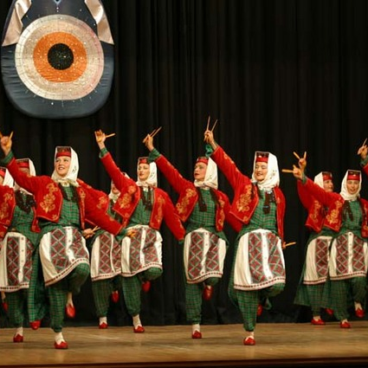
Dances
In our country, each region has different music, dress and different dance style.
We have a diverse and rich culture.

Slide 21
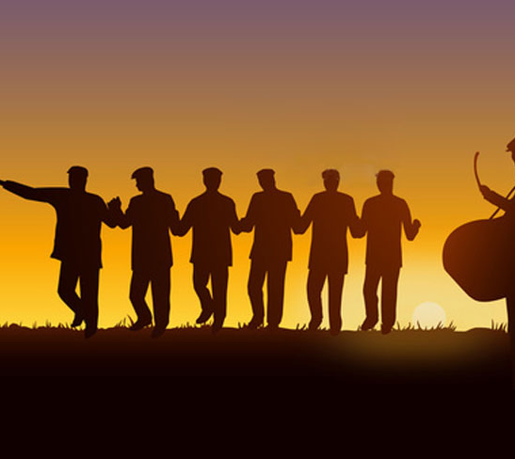
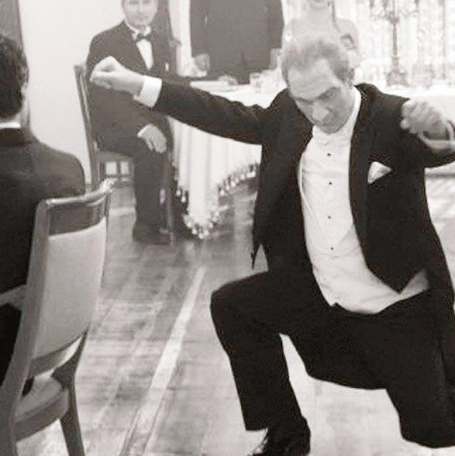
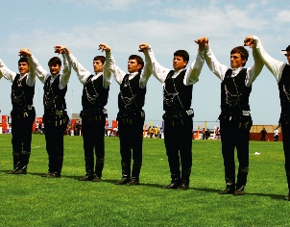
For example horon, zeybek, halay and more.

