Slide 1
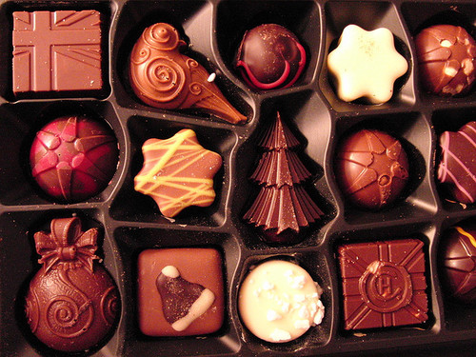
Auguri di Buon Natale e Felice Anno Nuovo
3
Pick a chocolate
and read the card!
2
6
1
5
9
4
12
8
7
11
Merry Christmas
& a Happy New Year!
10
Frohe Weihnachten
und ein glückliches Neues Jahr!

Slide 2
May the chocolate bring you joy, laughter and a lot of friends!
Vi auguro che il cioccolato vi porti gioia, sorriso e molti amici nuovi!
Möge dir Schokolade viel Freude, Lachen und neue Freunde bescheren
Merry Christmas and a Happy New Year from Luka, Toni and Tin!
click on the logo

Slide 3
Christmas, chocolate and chill
Christmas is here,
Ho, ho, ho!
Only
Chocolate will fill you with joy
On this magical holiday.
Love is in the air
All around us.
Take your friends with you and
Enjoy your favorite chocolate dessert!
Isabela Franolić, Lorena Vargek, 3.b
click on the logo

Slide 4
THE TASTE OF CHRISTMAS
As stars fill the night sky,
Our kitchen is abundant with the smell of pie.
As the fireplace heats up our house,
the hot chocolate warms our hearts.
Outside the snow starts to fall,
Santa Claus leaves the North Pole.
In this time of year,
we are waiting for his call.
Karla, Jan & Magdalena
click on the logo
Notes:
Magdalena, Karla, Jan

Slide 5
Merry Christmas
and a
Happy New Year
May peace be your gift at Christmas and your blessing all year through but chocolate will make your year even brighter
Laura Barbarić, Danijela Kraljik
click on the logo
Notes:
Danijela Kraljik, Laura Barbarić

Slide 6
Merry Christmas
It’s coming, it’s coming
the most beautiful time of the year is near
The time when everyone sings and bakes
when children leave Santa a cookie
And he gives them gifts
For every good deed you’ve done
Treat yourself with a chocolate bun
Nikolina & Katarina Mikelec
click on the logo

Slide 7
Merry Christmas
may love, peace and hot cocoa fill your heart
this Christmas!
Frohe Weihnachten
Mögen Liebe,Frieden und heiße Schokolade dein Herz dieses Weihnachten erfüllen!
Buon Natale.
Lasciate entrare nel vostro cuore l'amore,
la pace e la cioccolata calda
per la festa di Natale.
Merry Christmas and Happy New Year from Helena
click on the logo
Notes:
Helena Ilić

Slide 8
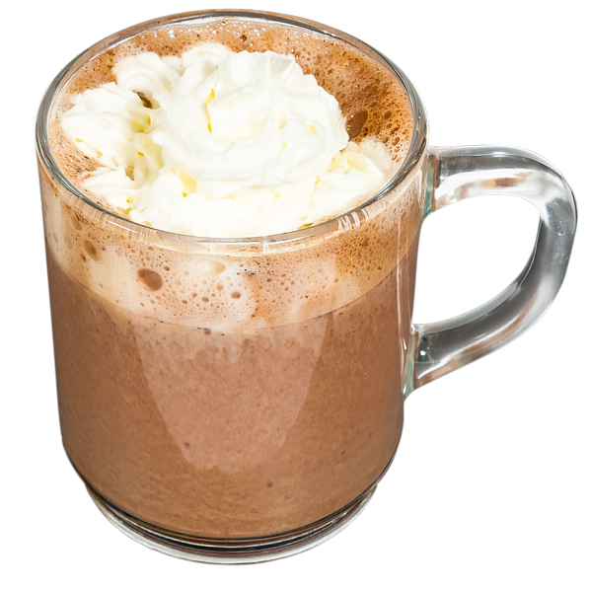
Christmas brings us joy,
And kids get their toys.
Everywhere it seems to snow,
So, don’t bother at all.
Just enjoy the time,
And live the happy life.
Even if you are feeling down,
Christmas is there to put a smile on your face.
Merry Christmas from Stipe :)
click on the logo

Slide 9
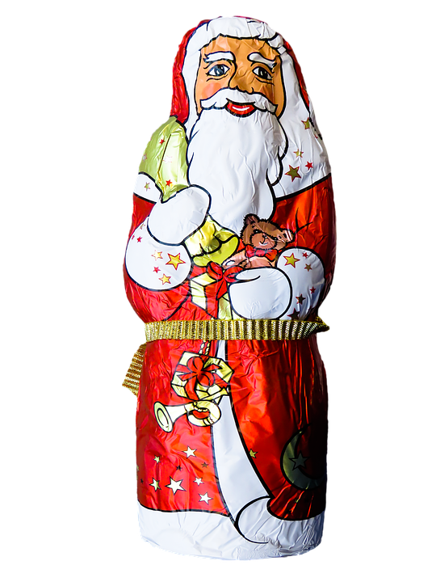
On the Christmas day,
the world is not gray
rather white from the snow
so let the holiday spirit grow.
The kids are having fun
in the weather without the sun,
while eating cookies and cakes
and watching the snowflakes.
Leonarda Lerotić and Nika Tomljenović wish you a happy Christmas
click on the logo

Slide 10
Chocolate may melt,
But my love for you never will.
It is like the everlasting ice of the North.
I feel it every time I look into
Your Aurora eyes.
Your cocoa hair makes my love for You as unbreakable as the silver ice.
Merry Christmas my beautiful Snowflake.
Merry Christmas from Marta & Eve!
click on the logo
Notes:
Marta & Eve

Slide 11
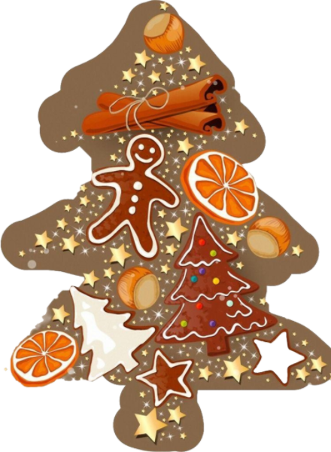
Remember that Christmas is about more than presents. There are also cookies!
Denk daran: Weihnachten ist viel mehr als nur Geschenke. Es gibt auch Weihnachtsgebäck!
Ricordate che Natale è più dei regali sotto l'albero, ci sono anche i biscotti e il panettone!
Lorena Mihok & Sandra Ždravac 3.a
click on the logo

